Slide 1
Small Particles, Big Science: The LHC and the search for the Theory of Everything
Andrew W. Rose

Slide 2
Overview
The search for the “Theory of Everything”
All about symmetry
The Standard Model of Particle Physics
The LHC and the experiments
The Future

Slide 3
The search for the “Theory of Everything”
Socrates, Antisthenes, Chrysippus, Epicurus

Slide 4
A thoroughly modern pursuit
“According to convention there is a sweet and a bitter, a hot and a cold, and according to convention there is colour. In truth there are atoms and a void.”
“That atoms and the vacuum were the beginning of the universe; and that everything else exists only in opinion.”
Democritus (c.460-370BC)
“You say there is a void; therefore the void is not nothing; therefore there is not the void.”
Parmenides (c.515-460BC)
“Moreover, it is plain that everything continuous is divisible into divisibles that are infinitely divisible: for if it were divisible into indivisibles, we should have an indivisible in contact with an indivisible, since the extremities of things that are continuous with one another are one and are in contact”
Aristotle, Physics VI, 350BC

Slide 5
Where are we now?
Planetary Motion
Gravity
Eq. of Motion
Earthly Motion
Newton, 1687

Slide 6
Where are we now?
Electricity
Faraday, 1832
Electro-magnetism
Maxwell, 1873
Magnetism
EM theory
Light
Planetary Motion
Gravity
Eq. of Motion
Earthly Motion
Newton, 1687

Slide 7
Where are we now?
Electricity
Faraday, 1832
Electro-magnetism
Maxwell, 1873
Magnetism
EM theory
Light
Wave
Quantum Theory
Quantum Mechanics
Particle
Einstein, 1905
Heisenberg, 1925
Planetary Motion
Gravity
Eq. of Motion
Earthly Motion
Newton, 1687

Slide 8
Where are we now?
Electricity
Faraday, 1832
Electro-magnetism
Maxwell, 1873
Magnetism
EM theory
Light
Wave
Quantum Theory
Quantum Mechanics
Particle
Einstein, 1905
Heisenberg, 1925
Space
Special Relativity
Time
Einstein, 1905
Planetary Motion
Gravity
Eq. of Motion
Earthly Motion
Newton, 1687

Slide 9
Where are we now?
Electricity
Faraday, 1832
Electro-magnetism
Maxwell, 1873
Magnetism
EM theory
Light
Wave
Quantum Theory
Quantum Mechanics
Particle
Einstein, 1905
Heisenberg, 1925
Space
Special Relativity
Time
Einstein, 1905
General Relativity
Planetary Motion
Gravity
Eq. of Motion
Einstein, 1916
Earthly Motion
Newton, 1687

Slide 10
Where are we now?
Electricity
Faraday, 1832
Electro-magnetism
Maxwell, 1873
Magnetism
EM theory
Light
Wave
Quantum Theory
Quantum Mechanics
Klein,
Gordon, 1926
Particle
Einstein, 1905
Heisenberg, 1925
Relativistic QM
Space
Special Relativity
Time
Einstein, 1905
General Relativity
Planetary Motion
Gravity
Eq. of Motion
Einstein, 1916
Earthly Motion
Newton, 1687

Slide 11
All about symmetry
Ceiling of the
Isfahan Lotfollah Mosque

Slide 12
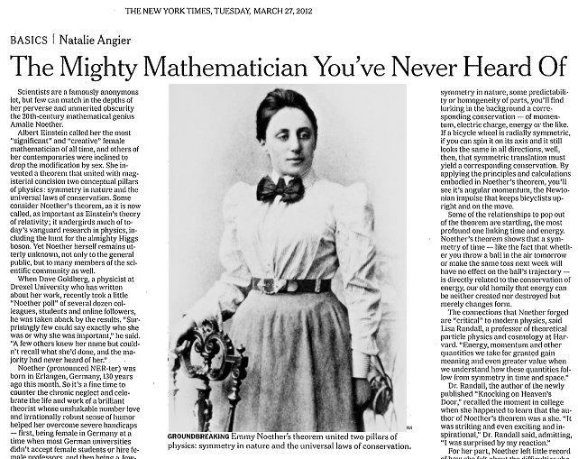
Amalie “Emmy” Noether
Notes:
In 1915

Slide 13
Amalie “Emmy” Noether
GROUNDBREAKING Emmy Noether’s theorem united two pillars of physics: symmetry in nature and the universal laws of conservation.
Notes:
In 1915

Slide 14
Noether’s Theorem
Every differentiable symmetry
of the action of a physical system
has a corresponding conservation law

Slide 15
Noether’s Theorem
Every differentiable symmetry
of the action of a physical system
has a corresponding conservation law
Symmetry
Spatial Translation
Time Translation
Rotational Symmetry
Conservation Law
Momentum
Energy
Angular Momentum

Slide 16
Noether’s Theorem
Every differentiable symmetry
of the action of a physical system
has a corresponding conservation law
Symmetry
Spatial Translation
Time Translation
Rotational Symmetry
Complex Phase
Conservation Law
Momentum
Energy
Angular Momentum
Charge

Slide 17
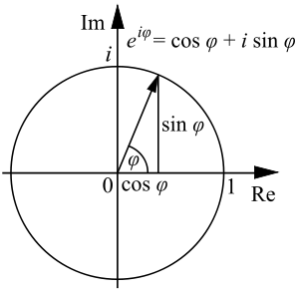
Phase (gauge) invariance
Our theory should not depend on the precise phase of the wave-function
“Where is the start of a circle?”

Slide 18
Phase (gauge) invariance
Our theory should not depend on the precise phase of the wave-function
“Where is the start of a circle?”
Trivially satisfied if our equation is of the form:
$$L∝ψ\text{†}⋯ψ$$

Slide 19
Phase (gauge) invariance
Our theory should not depend on the precise phase of the wave-function
“Where is the start of a circle?”
Trivially satisfied if our equation is of the form:
$L∝ψ\text{†}⋯ψ →ψ\text{†}e^{−iφ}⋯ψe^{+iφ}$ = $ψ\text{†}⋯ψ$

Slide 20
Phase (gauge) invariance
Our theory should not depend on the precise phase of the wave-function
“Where is the start of a circle?”
Trivially satisfied if our equation is of the form:
$L∝ψ\text{†}⋯ψ →ψ\text{†}e^{−iφ}⋯ψe^{+iφ}$ = $ψ\text{†}⋯ψ$
Dirac/Spin-½/Fermion Lagrangian
$L=iψ\text{†}γ^{0}γ^{μ}∂_{μ}ψ−$ $ψ\text{†}γ_{0}mψ$
$=i\overline{ψ}γ^{μ}∂_{μ}ψ−$ $\overline{ψ}mψ$

Slide 21
Phase (gauge) invariance
Our theory should not depend on the precise phase of the wave-function
“Where is the start of a circle?”
Trivially satisfied if our equation is of the form:
$L∝ψ\text{†}⋯ψ →ψ\text{†}e^{−iφ}⋯ψe^{+iφ}$ = $ψ\text{†}⋯ψ$
Dirac/Spin-½/Fermion Lagrangian
$L=iψ\text{†}γ^{0}γ^{μ}∂_{μ}ψ−$ $ψ\text{†}γ_{0}mψ$
$= i\overline{ψ}γ^{μ}∂_{μ}ψ−$ $\overline{ψ}mψ$
Kinetic term
Mass term

Slide 22
Local phase (gauge) invariance
Ask a different question:
Can we make the phase vary in space/time
and still have a valid theory?

Slide 23
Local phase (gauge) invariance
Ask a different question:
Can we make the phase vary in space/time
and still have a valid theory?
Mass term is obviously fine
$L=i\overline{ψ}γ^{μ}∂_{μ}ψ−$ $\overline{ψ}mψ$

Slide 24
Local phase (gauge) invariance
Ask a different question:
Can we make the phase vary in space/time
and still have a valid theory?
Mass term is obviously fine
Kinetic term contains a derivative which will obviously be broken by such a change
$L=i\overline{ψ}γ^{μ}∂_{μ}ψ−$ $\overline{ψ}mψ$

Slide 25
Local phase (gauge) invariance
Ask a different question:
Can we make the phase vary in space/time
and still have a valid theory?
Mass term is obviously fine
Kinetic term contains a derivative which will obviously be broken by such a change
Borrow a tool from relativity and introduce the covariant derivative to take into account the shifting baseline
$L=i\overline{ψ}γ^{μ}∂_{μ}ψ−$ $\overline{ψ}mψ$
$$∂_{μ}→D_{μ}=∂_{μ}−iqA_{μ}$$
Notes:
Yang-Mills, 1954

Slide 26
Local phase (gauge) invariance
Ask a different question:
Can we make the phase vary in space/time
and still have a valid theory?
Mass term is obviously fine
Kinetic term contains a derivative which will obviously be broken by such a change
Borrow a tool from relativity and introduce the covariant derivative to take into account the shifting baseline
$L=i\overline{ψ}γ^{μ}∂_{μ}ψ−$ $\overline{ψ}mψ$
$$∂_{μ}→D_{μ}=∂_{μ}−iqA_{μ}$$
$$ψ →ψe^{iφ},$$
$$A_{μ}→A_{μ}−\frac{1}{q} ∂_{μ}φ$$
Notes:
Yang-Mills, 1954

Slide 27
Local phase (gauge) invariance
$$L=i\overline{ψ}γ^{μ}D_{μ}ψ−\overline{ψ}mψ$$
$$=i\overline{ψ}γ^{μ}∂_{μ}ψ−\overline{ψ}mψ+q\overline{ψ}A_{μ}ψ$$
Kinetic term
Mass term
q

Slide 28
Local phase (gauge) invariance
$$L=i\overline{ψ}γ^{μ}D_{μ}ψ−\overline{ψ}mψ$$
$$=i\overline{ψ}γ^{μ}∂_{μ}ψ−\overline{ψ}mψ+q\overline{ψ}A_{μ}ψ$$
Kinetic term
Mass term
Incoming fermion
destroyed
Outgoing fermion
created
Boson
q

Slide 29
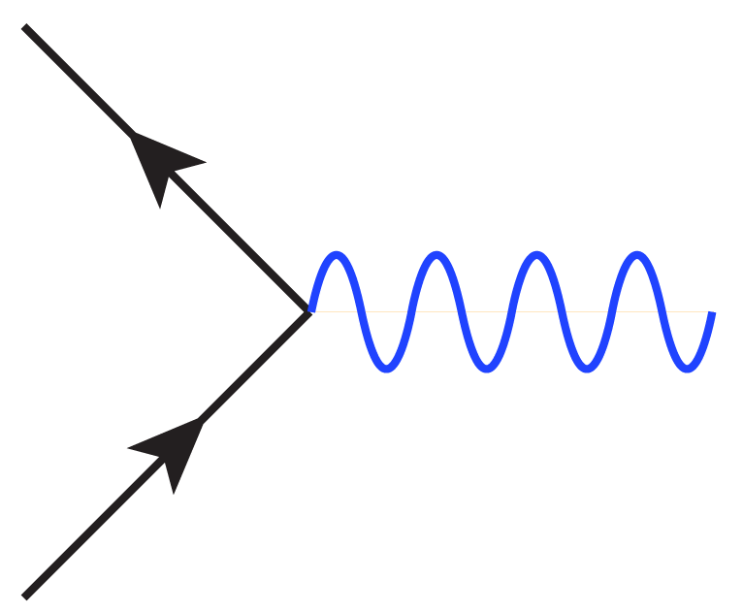
Local phase (gauge) invariance
$$L=i\overline{ψ}γ^{μ}D_{μ}ψ−\overline{ψ}mψ$$
$$=i\overline{ψ}γ^{μ}∂_{μ}ψ−\overline{ψ}mψ+q\overline{ψ}A_{μ}ψ$$
Kinetic term
Mass term
Incoming fermion
destroyed
Outgoing fermion
created
Boson
q

Slide 30
Where are we now?
Electricity
Faraday, 1832
Electro-magnetism
Maxwell, 1873
Schwinger, Feynman, 1949
Magnetism
EM theory
Light
Wave
QED
Quantum Theory
Quantum Mechanics
Klein,
Gordon, 1926
Particle
Einstein, 1905
Heisenberg, 1925
Relativistic QM
Space
Special Relativity
Time
Einstein, 1905
General Relativity
Planetary Motion
Gravity
Eq. of Motion
Einstein, 1916
Earthly Motion
Newton, 1687

Slide 31
QED
The most accurate theory ever devised:
Electron's spin g-factor: g/2 = 1.001 159 652 180 85 (76)
(better than one part in a trillion)
Coupling constant: α⁻¹ = 137.035 999 070 (98)
(better than a part in a billion)

Slide 32
Where are we now?
Electricity
Faraday, 1832
Electro-magnetism
Maxwell, 1873
Schwinger, Feynman, 1949
Gell-Mann, 1963
Magnetism
EM theory
QCD
Light
Wave
QED
Quantum Theory
Quantum Mechanics
Klein,
Gordon, 1926
Particle
Einstein, 1905
Heisenberg, 1925
Relativistic QM
Space
Special Relativity
Weak Interaction
Weak theory
Time
Fermi, 1934
Glashow, 1961
Einstein, 1905
General Relativity
Planetary Motion
Gravity
Eq. of Motion
Einstein, 1916
Earthly Motion
Newton, 1687

Slide 33
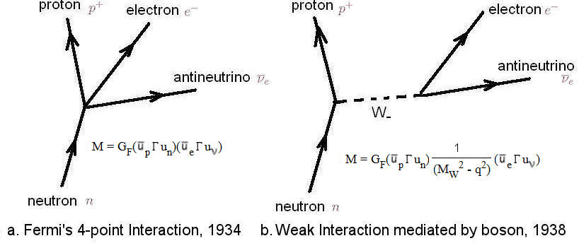
The electroweak problem
Weak force originally posited to be a point-like interaction
Quickly changed to be mediated by a heavy boson

Slide 34
The electroweak problem
Weak force originally posited to be a point-like interaction
Quickly changed to be mediated by a heavy boson
But the maths doesn’t work – the theory is not renormalizable – with the benefit of hindsight it becomes clear why

Slide 35
Massive Bosons
Mass term
$$L= \frac{1}{2}m^{2}A^{μ}A_{μ}$$

Slide 36
Massive Bosons
Mass term
$$L= \frac{1}{2}m^{2}A^{μ}A_{μ}$$
But we required: $A_{μ}→A_{μ}−\frac{1}{q} ∂_{μ}φ$
$$A^{μ}A_{μ}→\left(A^{μ}−\frac{1}{q} ∂^{μ}φ \right)\left(A_{μ}−\frac{1}{q} ∂_{μ}φ \right)≠A^{μ}A_{μ}$$

Slide 37
Massive Bosons
Mass term
$$L= \frac{1}{2}m^{2}A^{μ}A_{μ}$$
But we required: $A_{μ}→A_{μ}−\frac{1}{q} ∂_{μ}φ$
$$A^{μ}A_{μ}→\left(A^{μ}−\frac{1}{q} ∂^{μ}φ \right)\left(A_{μ}−\frac{1}{q} ∂_{μ}φ \right)≠A^{μ}A_{μ}$$
$$m^{2}=0$$

Slide 38
Massive Bosons
Mass term
$$L= \frac{1}{2}m^{2}A^{μ}A_{μ}$$
But we required: $A_{μ}→A_{μ}−\frac{1}{q} ∂_{μ}φ$
$$A^{μ}A_{μ}→\left(A^{μ}−\frac{1}{q} ∂^{μ}φ \right)\left(A_{μ}−\frac{1}{q} ∂_{μ}φ \right)≠A^{μ}A_{μ}$$
$$m^{2}=0$$
Photon seems OK: Observe $m_{γ}< {10}^{−22}m_{e}$

Slide 39
Massive Bosons
Mass term
$$L= \frac{1}{2}m^{2}A^{μ}A_{μ}$$
But we required: $A_{μ}→A_{μ}−\frac{1}{q} ∂_{μ}φ$
$$A^{μ}A_{μ}→\left(A^{μ}−\frac{1}{q} ∂^{μ}φ \right)\left(A_{μ}−\frac{1}{q} ∂_{μ}φ \right)≠A^{μ}A_{μ}$$
$$m^{2}=0$$
Not ideal for the W & Z bosons which are observed to be heavier than an entire Iron nucleus

Slide 40
Why do we care about phase (gauge) invariance?
The establishment of unitarity of a renormalizable set of Feynman rules requires Ward identities, a consequence of gauge invariance
The rules in the renormalizable gauge are equivalent to those in the unitary gauge only when the theory is gauge invariant
Veltman, ‘t Hooft, 1972

Slide 41
Why do we care about phase (gauge) invariance?
The establishment of unitarity of a renormalizable set of Feynman rules requires Ward identities, a consequence of gauge invariance
The rules in the renormalizable gauge are equivalent to those in the unitary gauge only when the theory is gauge invariant
Veltman, ‘t Hooft, 1972
No field theory can produce any meaningful or believable results unless it is renormalizable,
and to be renormalizable it must be gauge invariant

Slide 42
Why do we care about phase (gauge) invariance?
The establishment of unitarity of a renormalizable set of Feynman rules requires Ward identities, a consequence of gauge invariance
The rules in the renormalizable gauge are equivalent to those in the unitary gauge only when the theory is gauge invariant
Veltman, ‘t Hooft, 1972
No field theory can produce any meaningful or believable results unless it is renormalizable,
and to be renormalizable it must be gauge invariant
If the theory is not gauge invariant it is worth
DIDDLY SQUAT

Slide 43
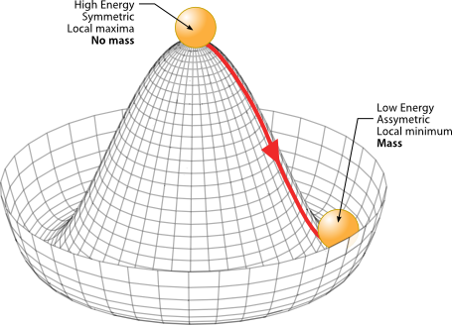
The Higgs (-Schwinger-Anderson-Kibble-Guralnik-Hagen-Englert-Brout) Mechanism
We can devise a Lagrangian which is symmetric across the origin
but which is
asymmetric about the minimum

Slide 44
The Higgs (-Schwinger-Anderson-Kibble-Guralnik-Hagen-Englert-Brout) Mechanism
We can devise a Lagrangian which is symmetric across the origin
but which is
asymmetric about the minimum
Such a field has one massive boson and a number of massless “Goldstone” bosons

Slide 45
The Higgs (-Schwinger-Anderson-Kibble-Guralnik-Hagen-Englert-Brout) Mechanism
We can devise a Lagrangian which is symmetric across the origin
but which is
asymmetric about the minimum
Such a field has one massive boson and a number of massless “Goldstone” bosons
If we require this new field to be phase (gauge) invariant,
these massless bosons get “absorbed” by our massless gauge bosons, turning them into massive gauge bosons

Slide 46
Where are we now?
Electricity
Faraday, 1832
Electro-magnetism
Maxwell, 1873
Schwinger, Feynman, 1949
Gell-Mann, 1963
Magnetism
EM theory
QCD
Light
Wave
QED
Quantum Theory
Quantum Mechanics
Weinberg, Salam, 1967
Klein,
Gordon, 1926
Particle
Einstein, 1905
Heisenberg, 1925
Relativistic QM
Standard model
Space
Special Relativity
Weak Interaction
Weak theory
Time
Fermi, 1934
Glashow, 1961
Einstein, 1905
General Relativity
Spontaneous Symmetry Breaking
Planetary Motion
Gravity
Eq. of Motion
Higgs, Kibble, Brout, Englert, 1964
Einstein, 1916
Earthly Motion
Newton, 1687

Slide 47
The Standard Model of Particle Physics

Slide 48
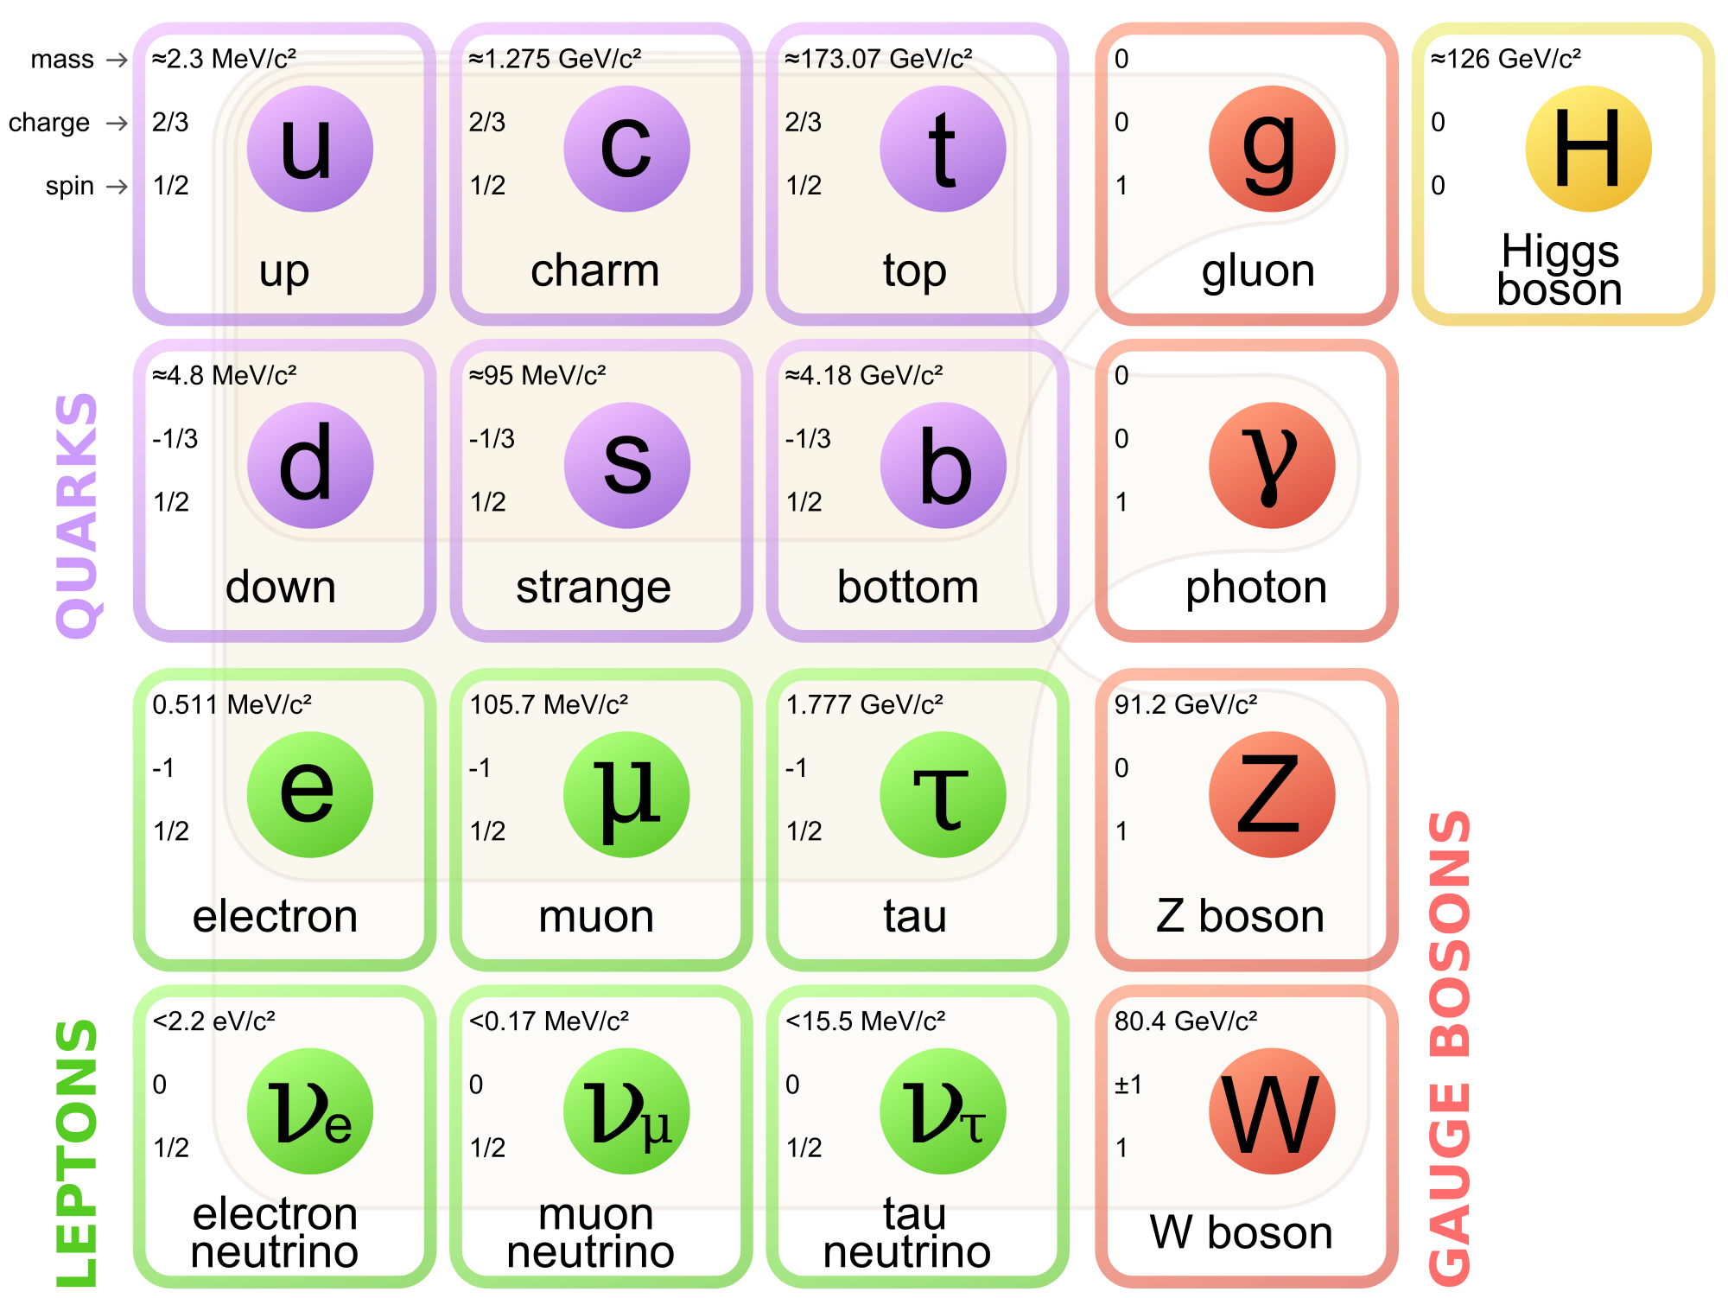
The Standard Model: 1967
The
Weinberg-Salam
model

Slide 49
The Standard Model: 1974
Burton Richter, SLAC
Sam Ting, Brookhaven

Slide 50
The Standard Model: 1976
Martin Perl, SLAC

Slide 51
The Standard Model: 1976

Slide 52
The Standard Model: 1977
Leon Lederman, Fermilab

Slide 53
The Standard Model: 1978
Charles Prescott, Richard Taylor, SLAC

Slide 54
The Standard Model: 1979
PETRA, DESY

Slide 55
The Standard Model: 1983
UA1, UA2, CERN

Slide 56
The Standard Model: 1989
LEP, CERN

Slide 57
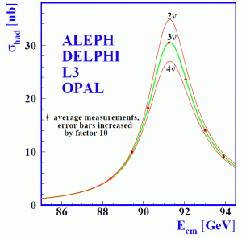
The Standard Model: 1989
LEP, CERN
Also, proved that the lifetime of the Z-boson is consistent only with there being exactly three generations of light neutrino

Slide 58
The Standard Model: 1995
D0, CDF, Fermilab

Slide 59
The Standard Model: 2012
CMS, ATLAS, CERN

Slide 60
The LHC and the experiments: Life on the cutting edge
The CMS experiment in an access configuration

Slide 61
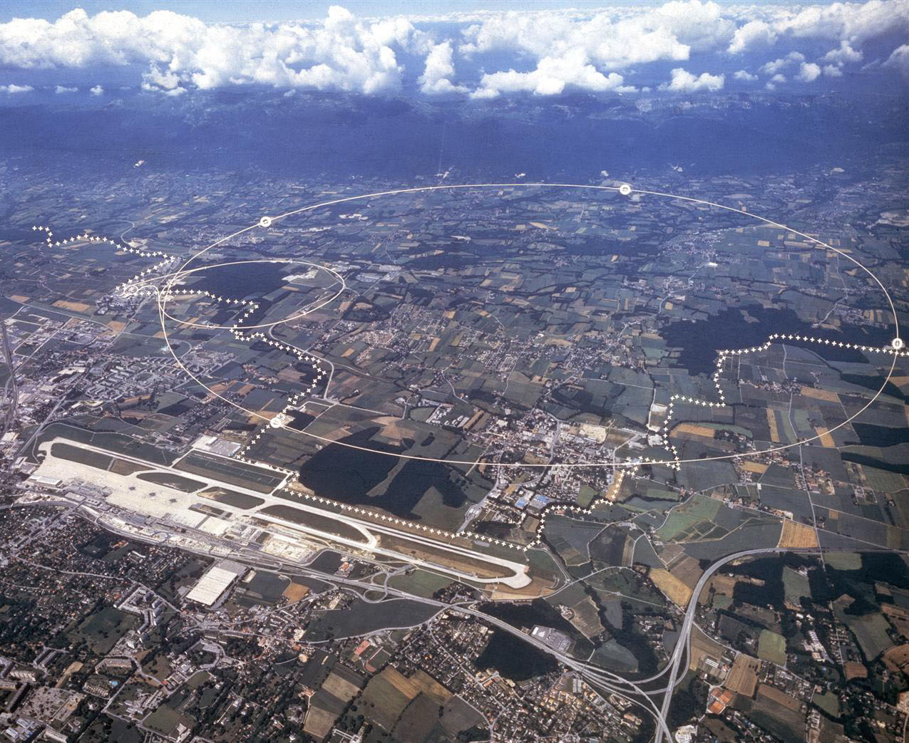
The LHC: Large Hadron Collider

Slide 62
The LHC: Large Hadron Collider
27km
8.6km
100m

Slide 63
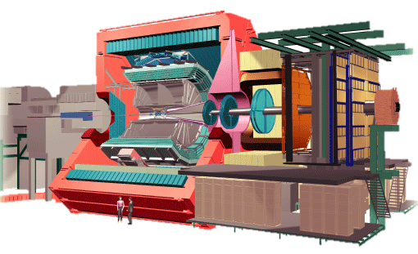
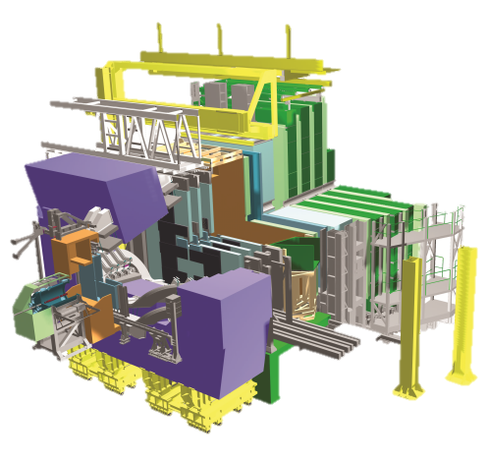
The LHC: Large Hadron Collider
27km
8.6km
100m

Slide 64
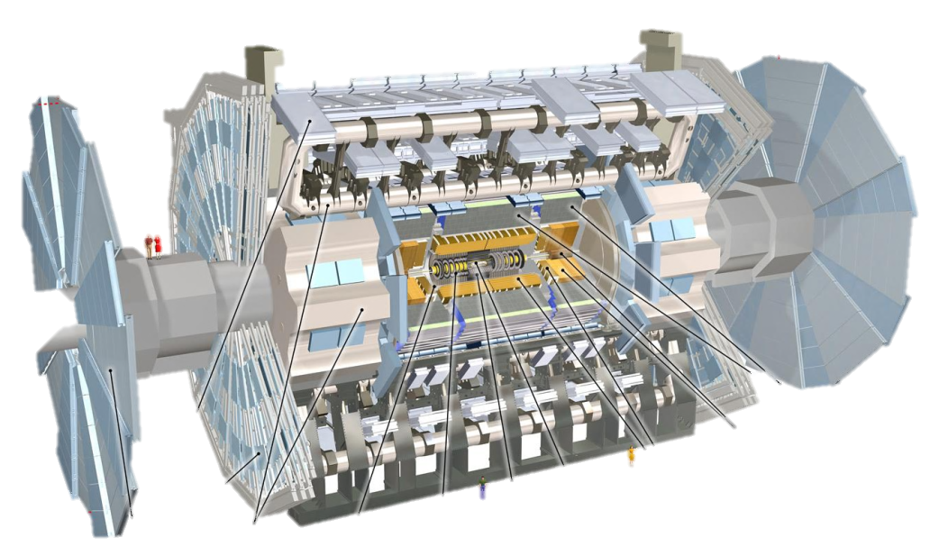
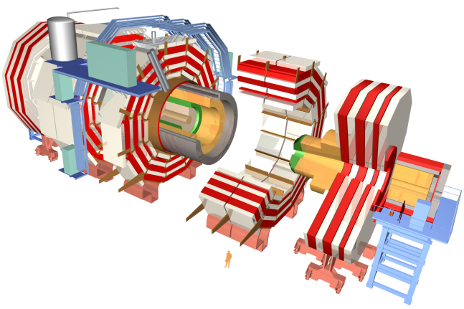
The LHC: Large Hadron Collider
27km
8.6km
100m

Slide 65
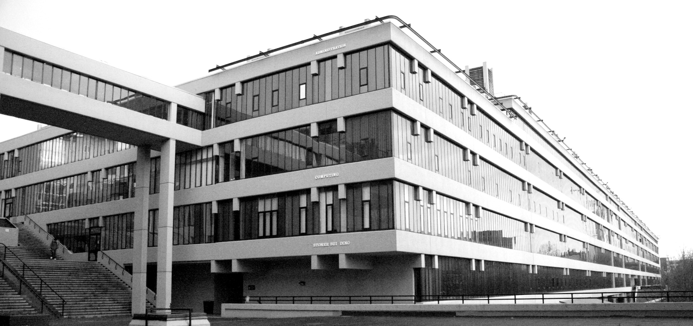
The general purpose detectors

Slide 66
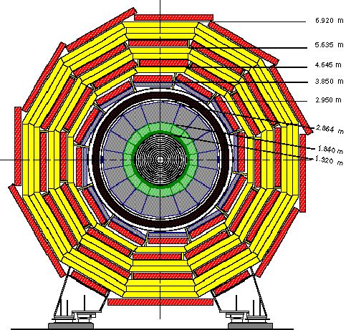
The general purpose detectors
CMS
14,000 ton
ATLAS
7,000 ton

Slide 67
The general purpose detectors
The believe-it-or-not superlatives are so extreme and Tom Swiftian they make you smile.
The LHC is not merely the world’s largest particle accelerator but the largest machine ever built. At the center of just one of the four main experimental stations installed around its circumference, and not even the biggest of the four, is a magnet that generates a magnetic field 100,000 times as strong as Earth’s. And because the super-conducting, super-colliding guts of the collider must be cooled by 120 tons of liquid helium, inside the machine it’s one degree colder than outer space, thus making the LHC the coldest place in the universe.
Kurt Andersen, Vanity Fair
CMS
14,000 ton
ATLAS
7,000 ton

Slide 68
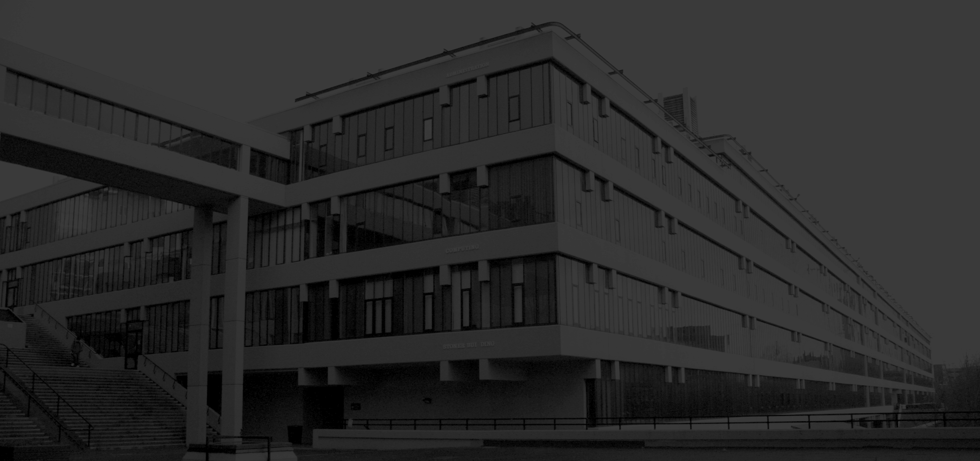
The CMS detector
CMS
14,000 ton

Slide 69
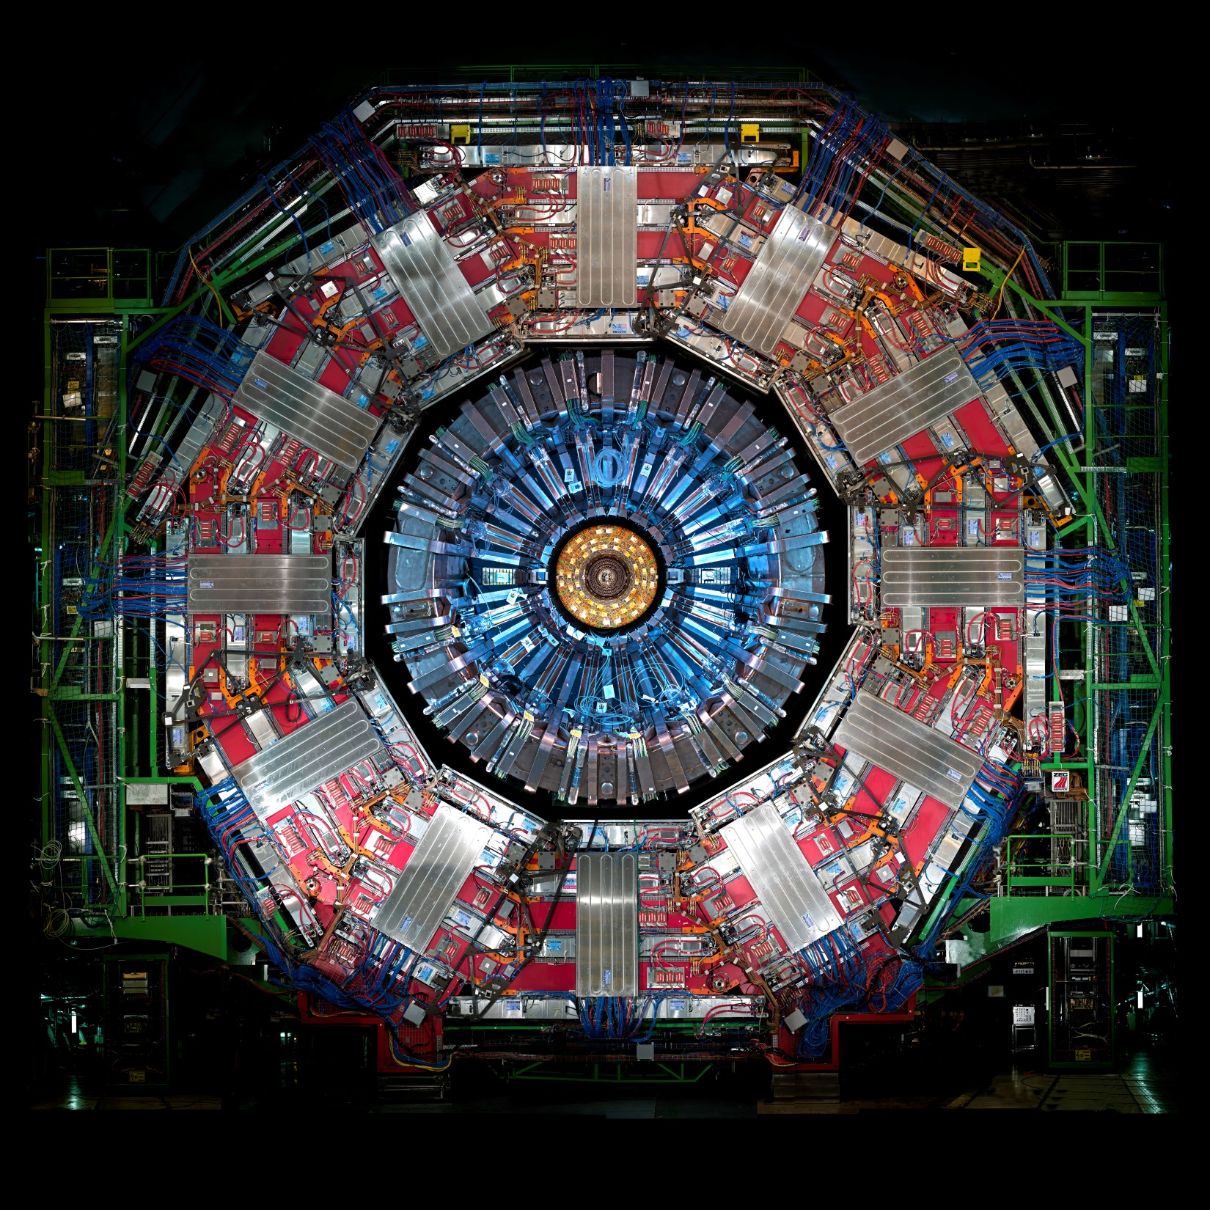
The CMS detector

Slide 70
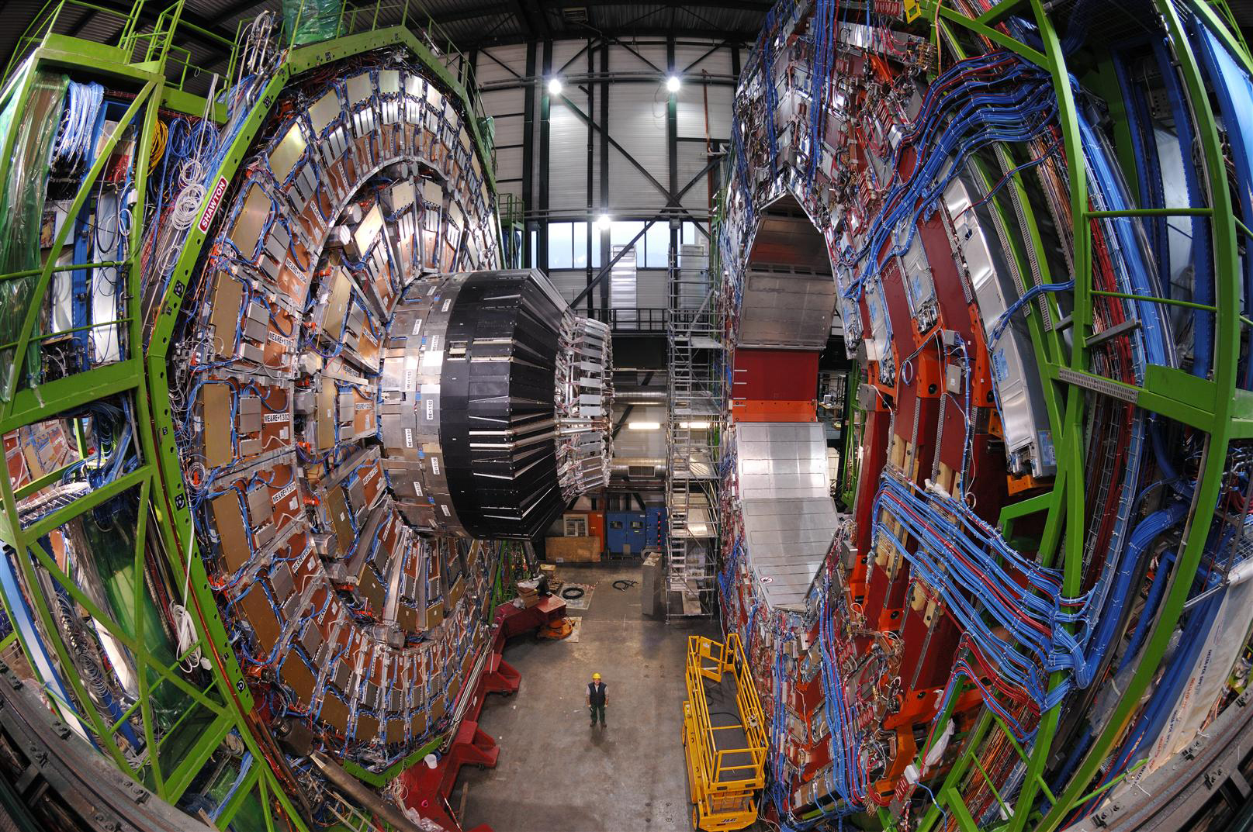
The CMS detector

Slide 71
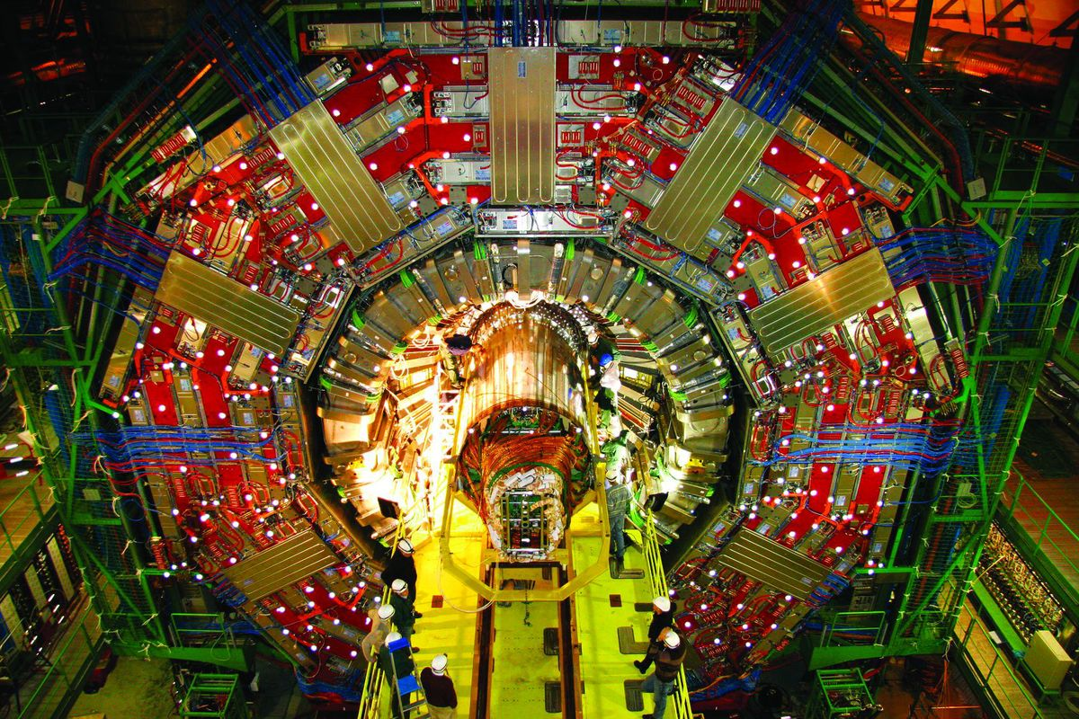
The CMS detector

Slide 72
How to detect particles

Slide 73
How to detect particles
Minimal disruption
Maximal disruption

Slide 74
How to detect particles
Minimal disruption
Tracking
Measure precise position as particles pass through
Join the dots to produce tracks
Use B-field to provide curvature with which to measure momentum of charged particles
Maximal disruption

Slide 75
CMS Silicon Strip Tracker

Slide 76
How to detect particles
Minimal disruption
Tracking
Measure precise position as particles pass through
Join the dots to produce tracks
Use B-field to provide curvature with which to measure momentum of charged particles
Maximal disruption

Slide 77
How to detect particles
Minimal disruption
Tracking
Measure precise position as particles pass through
Join the dots to produce tracks
Use B-field to provide curvature with which to measure momentum of charged particles
Maximal disruption
Calorimetry
Put a lot of material in the way
Atomic and nuclear interactions force decay down to light particles including photons
Measure the energy in the photons
Proportional to the energy of the original particle

Slide 78
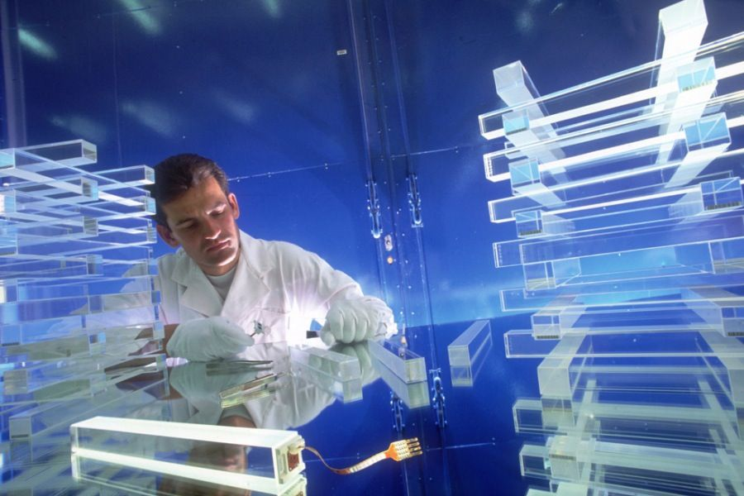
CMS Electromagnetic Calorimeter
Lead-Tungstate Crystals (PbWO₄)
86% metal by weight
Each crystal weighs 2kg

Slide 79
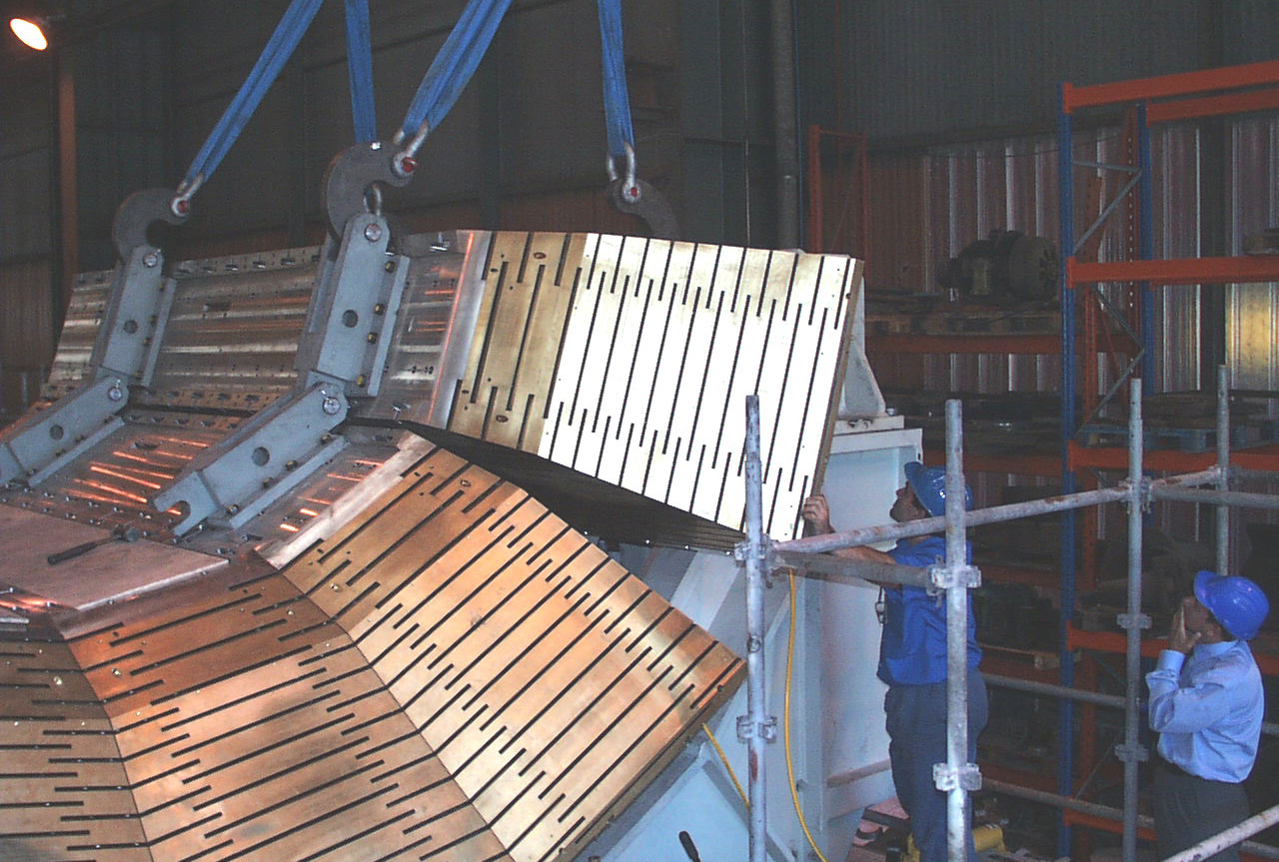
CMS Hadronic Calorimeter

Slide 80
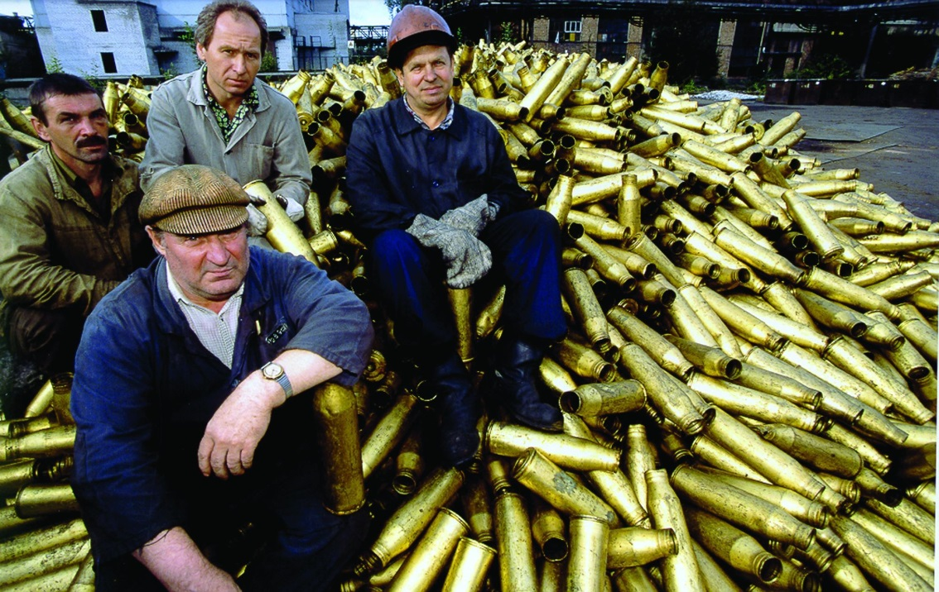
CMS Hadronic Calorimeter

Slide 81
How to detect particles
Minimal disruption
Tracking
Measure precise position as particles pass through
Join the dots to produce tracks
Use B-field to provide curvature with which to measure momentum of charged particles
Maximal disruption
Calorimetry
Put a lot of material in the way
Atomic and nuclear interactions force decay down to light particles including photons
Measure the energy in the photons
Proportional to the energy of the original particle

Slide 82
The CMS detector

Slide 83
Just to keep things interesting…
L = O(10³⁴) cm⁻²s⁻¹
~25 interactions/bx

Slide 84
Just to keep things interesting…
L = O(10³⁴) cm⁻²s⁻¹
~25 interactions/bx
× 40 million bx per second

Slide 85
Why would you do that?

Slide 86
Why would you do that?
LEP
Higgs Boson production is:
Two order of magnitude lower than the top-quark
Three orders of magnitude lower than W-boson
Ten orders of magnitude below the total interaction rate

Slide 87
Why would you do that?
LEP
Higgs Boson production is:
Two order of magnitude lower than the top-quark
Three orders of magnitude lower than W-boson
Ten orders of magnitude below the total interaction rate
That is a needle in
a haystack the same mass as the
Empire State Building

Slide 88
Just to keep things interesting…
L = O(10³⁴) cm⁻²s⁻¹
~25 interactions/bx
× 40 million bx per second
1 billion proton-proton interactions per second

Slide 89
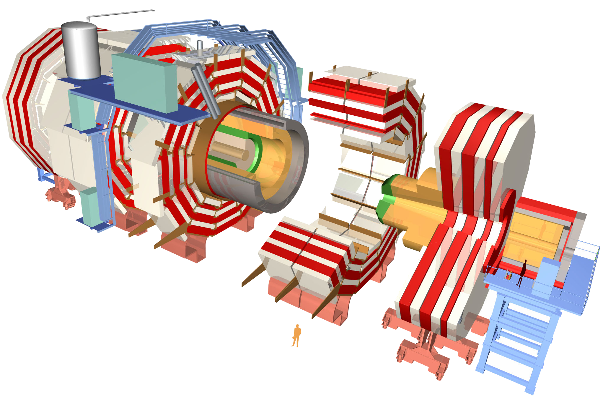
The CMS detector
~80k PbWO₄ Ecal Crystals
~15k channel Brass/Plastic sampling HCAL
~568k RPC/DT/CSC Muon channels
~65M Silicon Pixels
~10M Silicon Strips
~3500 physicists/engineers

Slide 90
The CMS detector
~80k PbWO₄ Ecal Crystals
≡ 40 TBit per second
Data rates before zero-suppression
~15k channel Brass/Plastic sampling HCAL
≡ 10 TBit per second
~568k RPC/DT/CSC Muon channels
≡ 23 TBit per second
~65M Silicon Pixels
~10M Silicon Strips
~3500 physicists/engineers

Slide 91
The CMS detector
~80k PbWO₄ Ecal Crystals
≡ 40 TBit per second
Data rates before zero-suppression
~15k channel Brass/Plastic sampling HCAL
≡ 10 TBit per second
~568k RPC/DT/CSC Muon channels
≡ 23 TBit per second
~65M Silicon Pixels
≡ 21 PBit per second
~10M Silicon Strips
≡ 4 PBit per second
~3500 physicists/engineers

Slide 92
The Internet: Visualizing big numbers
1 Eb/s
4 YB/yr
1 Pb/s
4 ZB/yr
1 Tb/s
4 EB/yr
1 Gb/s
4 PB/yr
1 Mb/s
4 TB/yr

Slide 93
CMS: Visualizing the big numbers
1 Eb/s
4 YB/yr
CMS Raw
1 Pb/s
4 ZB/yr
1 Tb/s
4 EB/yr
1 Gb/s
4 PB/yr
1 Mb/s
4 TB/yr

Slide 94
How do you store O(Pb/s) data?

Slide 95
How do you store O(Pb/s) data?
Answer: You don’t! You have to throw most of it away!
Hardware processing
PC farm
Tape storage

Slide 96
How do you store O(Pb/s) data?
Answer: You don’t! You have to throw most of it away!
Store raw data on detector for 3.2μs
Hardware processing
10 Tb/s
PC farm
Tape storage

Slide 97
Muon Candidates: Join the dots

Slide 98
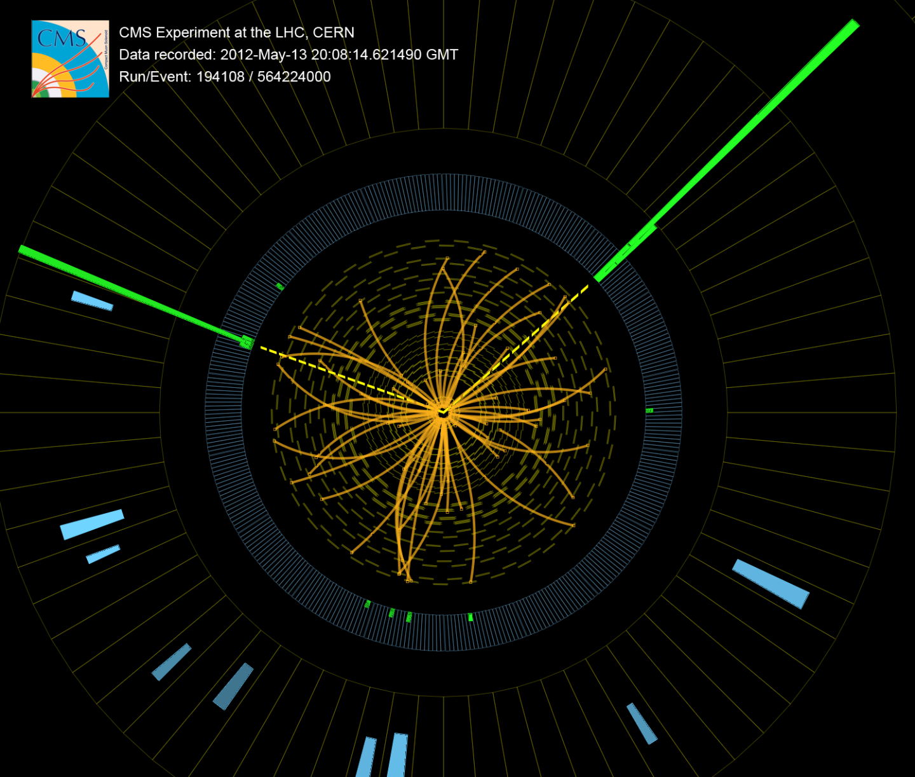
Electron/Photon Candidates: Spikes

Slide 99
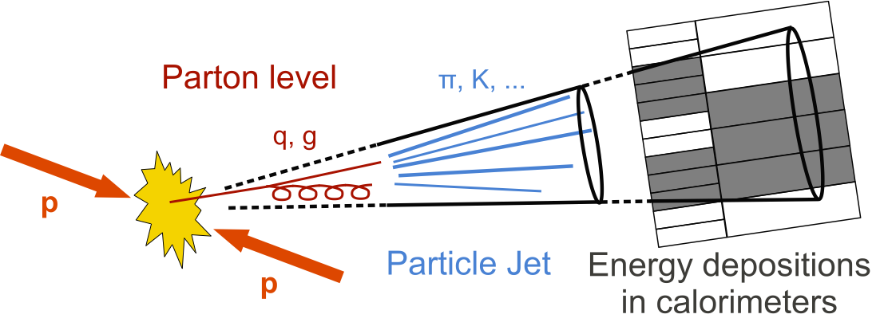
Jet Candidates: A mess

Slide 100
How do you store O(Pb/s) data?
Answer: You don’t! You have to throw most of it away!
Store raw data on detector for 3.2μs
Hardware processing
10 Tb/s
Throw away 399/400
PC farm
Tape storage

Slide 101
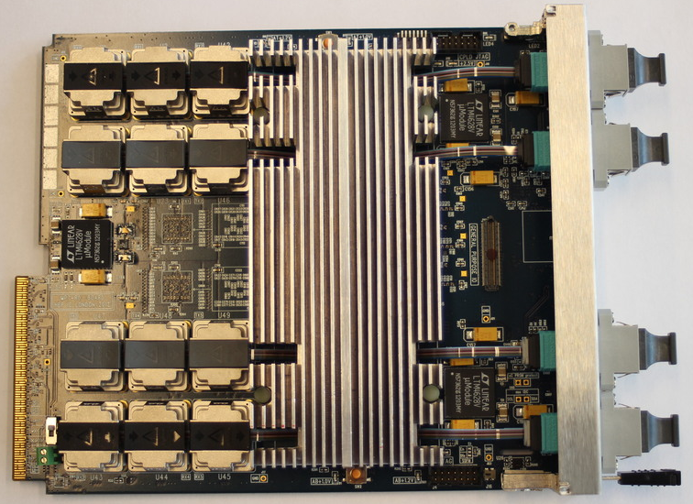
The Master-Processor, Virtex-7 (MP7)
Andrew Rose, Greg Iles
72Tx+72Rx optical links @ 13Gbps = 0.9 + 0.9Tb/s signal processor

Slide 102
How do you store O(Pb/s) data?
Answer: You don’t! You have to throw most of it away!
Store raw data on detector for 3.2μs
Hardware processing
10 Tb/s
Throw away 399/400
100kHz
PC farm
Tape storage

Slide 103
How do you store O(Pb/s) data?
Answer: You don’t! You have to throw most of it away!
Store raw data on detector for 3.2μs
Hardware processing
10 Tb/s
Throw away 399/400
100kHz
100 Gb/s
PC farm
Tape storage

Slide 104
How do you store O(Pb/s) data?
Answer: You don’t! You have to throw most of it away!
Store raw data on detector for 3.2μs
Hardware processing
10 Tb/s
Throw away 399/400
100kHz
100 Gb/s
Throw away 997/1000
PC farm
300Hz
0.5GB/s
Tape storage

Slide 105
How do you store O(Pb/s) data?
Answer: You don’t! You have to throw most of it away!
Store raw data on detector for 3.2μs
Hardware processing
10 Tb/s
Throw away 399/400
100kHz
100 Gb/s
Worldwide LHC computing grid
“Physicists analysing data”
Throw away 997/1000
PC farm
300Hz
0.5GB/s
Tape storage

Slide 106
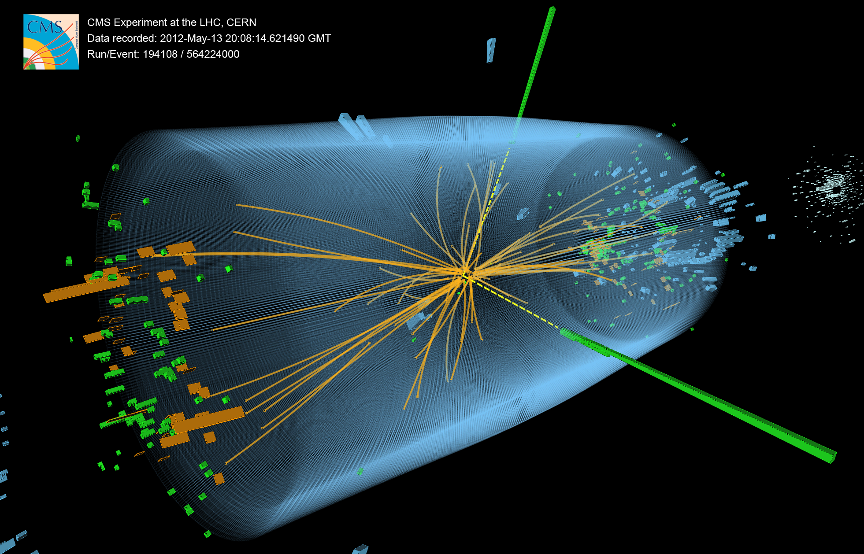
First observation of a 125GeV particle decaying to two photons

Slide 107
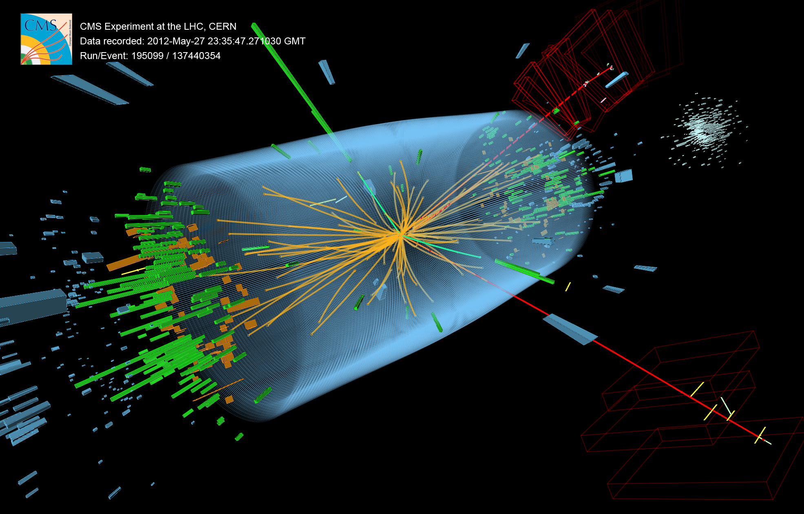
First observation of a 125GeV particle decaying to two Z-bosons

Slide 108
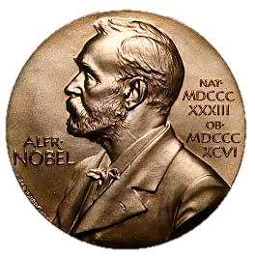
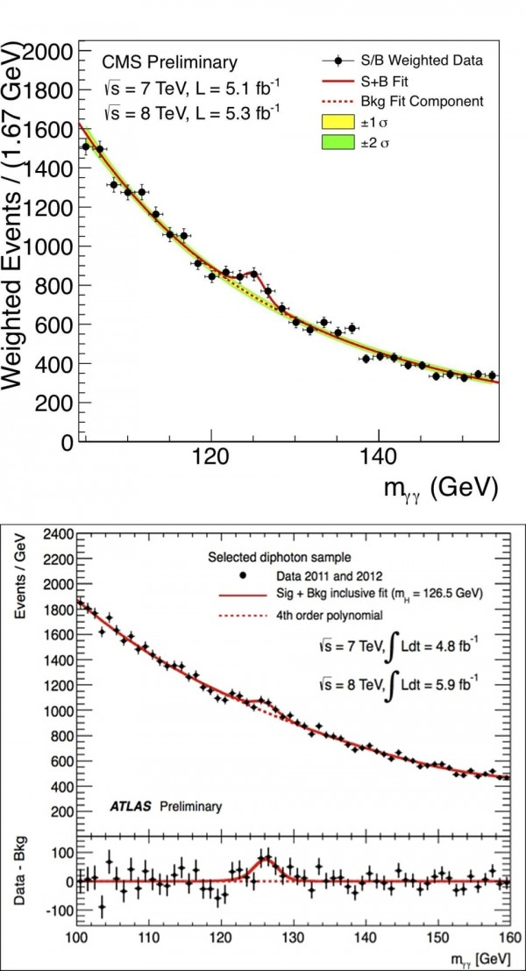
Congratulations – it’s a boson

Slide 109
Congratulations – it’s a boson

Slide 110
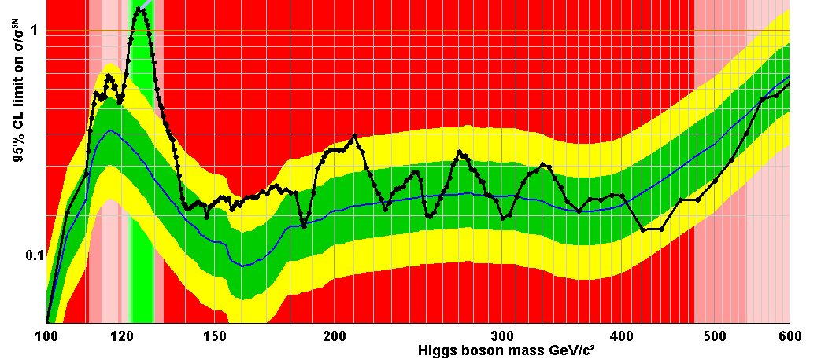
Congratulations – it’s a boson

Slide 111
Collaboration publications (2008-2015)
ATLAS: 3,321
CMS: 3,070
ALICE: 1,022
LHCb: 992
TOTEM: 52
LHCf: 29
TOTAL: 8,486
… and counting…

Slide 112
The future
Metropolis, Fritz Lang, 1927
Set in the 2020’s

Slide 113
The HL-LHC
LHC Run-2
L = O(10³⁴) cm⁻²s⁻¹
O(10) interactions/bx

Slide 114
The HL-LHC
LHC Run-2
L = O(10³⁴) cm⁻²s⁻¹
O(10) interactions/bx
LHC Run-3
L = O(10³⁵) cm⁻²s⁻¹
O(100) interactions/bx

Slide 115
The CMS detector
~80k PbWO₄ Ecal Crystals
≡ 40 TBit per second
Damage after Run-2
~15k channel Brass/Plastic sampling HCAL
≡ 10 TBit per second
~568k RPC/DT/CSC Muon channels
≡ 23 TBit per second
Endcap Ecal & Hcal will be completely fried
~65M Silicon Pixels
≡ 21 PBit per second
Pixel and strip trackers will be completely fried
~10M Silicon Strips
≡ 4 PBit per second
~3500 physicists/engineers

Slide 116
The CMS detector
Full granularity Ecal included in trigger
~80k PbWO₄ Ecal Crystals
≡ 40 TBit per second
Upgrades relevant to triggering
~15k channel Brass/Plastic sampling HCAL
≡ 10 TBit per second
~568k RPC/DT/CSC Muon channels
≡ 23 TBit per second
Complete replacement of endcap Ecal & Hcal
~65M Silicon Pixels
≡ 21 PBit per second
Tracking included in trigger
~10M Silicon Strips
≡ 4 PBit per second
~3500 physicists/engineers

Slide 117
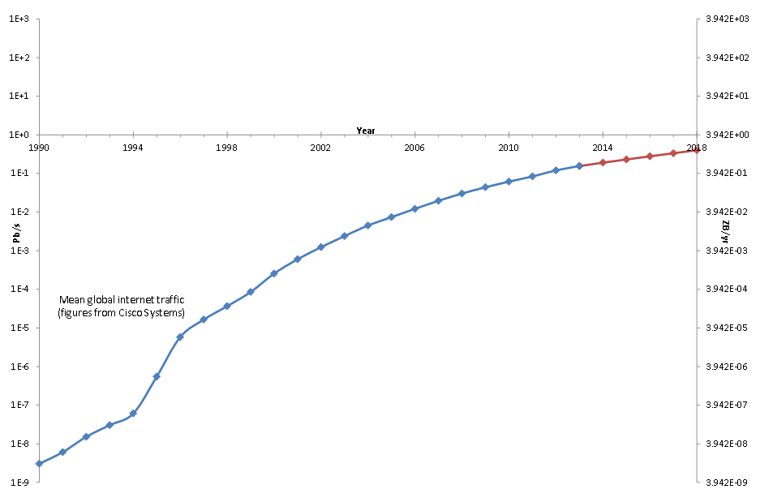
Big Data: Tracking trigger
1 Eb/s
4 YB/yr
15,000 modules @ 5Gb/s = 75Tb/s = 296 EB/yr
1 Pb/s
4 ZB/yr
Tracking Trigger
1 Tb/s
4 EB/yr
1 Gb/s
4 PB/yr
4 TB/yr

Slide 118
Big Data: Full granularity Ecal
1 Eb/s
4 YB/yr
61,200 crystals @ 1.6Gb/s = 97.92Tb/s = 386 EB/yr
1 Pb/s
4 ZB/yr
Full Granularity Ecal
1 Tb/s
4 EB/yr
1 Gb/s
4 PB/yr
4 TB/yr

Slide 119
Big Data: High-granularity endcap calorimeters
1 Eb/s
4 YB/yr
30,000 modules @ 10Gb/s = 300Tb/s = 1.2 ZB/yr
1 Pb/s
4 ZB/yr
HGcal
1 Tb/s
4 EB/yr
1 Gb/s
4 PB/yr
4 TB/yr

Slide 120
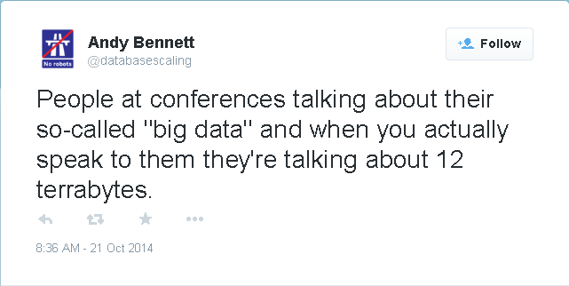
Big Data: Tech buzz-word of the moment
1 Eb/s
4 YB/yr
1 Pb/s
4 ZB/yr
Run-3 L1T Input
8 seconds of data for the CMS Level-1 trigger in Run-1
0.2 seconds of data for the CMS Level-1 trigger in Run-3
4 EB/yr
1 Tb/s
1 Gb/s
4 PB/yr
4 TB/yr

Slide 121
Again: Why would you do that?

Slide 122
Again: Why would you do that?
We are after an elegant, unified description of how the constituents of the universe interact (a “Theory-of-Everything” if you like…)

Slide 123
Again: Why would you do that?
Electricity
Faraday, 1832
Electro-magnetism
Maxwell, 1873
Schwinger, Feynman, 1949
Gell-Mann, 1963
Magnetism
EM theory
QCD
Light
Wave
QED
Quantum Theory
Quantum Mechanics
Weinberg, Salam, 1967
Klein,
Gordon, 1926
Particle
Einstein, 1905
Heisenberg, 1925
Relativistic QM
Standard model
Space
Special Relativity
Weak Interaction
Weak theory
Time
Fermi, 1934
Glashow, 1961
Einstein, 1905
General Relativity
Spontaneous Symmetry Breaking
Planetary Motion
Gravity
Eq. of Motion
Higgs, Kibble, Brout, Englert, 1964
Einstein, 1916
Earthly Motion
Newton, 1687

Slide 124
Again: Why would you do that?
Electricity
Faraday, 1832
Electro-magnetism
Maxwell, 1873
Schwinger, Feynman, 1949
Gell-Mann, 1963
Magnetism
EM theory
QCD
Light
Wave
QED
Two fundamentally different interpretations of what a force is!
One mechanism for inertial mass, one for gravitational mass.
How is this reconciled with the equivalence principle?
Quantum Theory
Quantum Mechanics
Weinberg, Salam, 1967
Klein,
Gordon, 1926
Particle
Einstein, 1905
Heisenberg, 1925
Relativistic QM
Standard model
Space
Special Relativity
Weak Interaction
Weak theory
Time
Fermi, 1934
Glashow, 1961
Einstein, 1905
General Relativity
Spontaneous Symmetry Breaking
Planetary Motion
Gravity
Eq. of Motion
Higgs, Kibble, Brout, Englert, 1964
Einstein, 1916
Earthly Motion
Newton, 1687

Slide 125
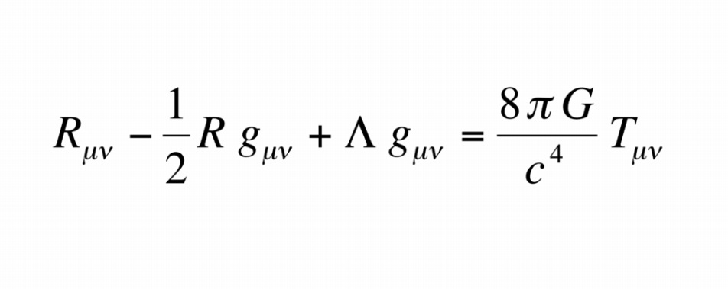
Again: Why would you do that?
General Relativity

Slide 126
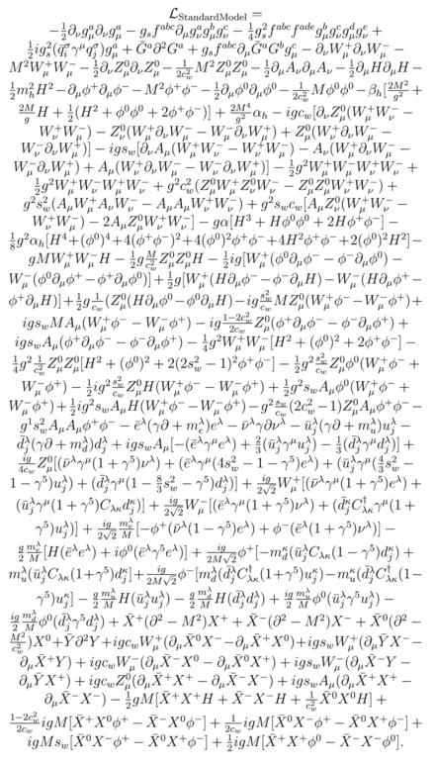
Again: Why would you do that?
Standard Model of
Particle Physics
General Relativity

Slide 127
Back to the Greeks…
“Wisest is he who thinks he knows what he knows and never thinks he knows what he does not know”
(Often misquoted as “Wisest is he who knows what he does not know”)
Socrates (470-399BC)

Slide 128
Again: Why would you do that?
What is the agent that hides the electroweak symmetry? Specifically, is there a Higgs boson? Might there be several?
Is the Higgs boson elementary or composite? How does the Higgs boson interact with itself?
Does the Higgs boson give mass to fermions, or only to the weak bosons? What sets the masses and mixings of the quarks and leptons?
What stabilizes the Higgs boson mass below 1 TeV?
Do the different behaviours of left-handed and right-handed fermions with respect to charged-current weak interactions reflect a fundamental asymmetry in the laws of nature?
What will be the next symmetry recognized in nature? Is nature supersymmetric? Is the electroweak theory part of some larger edifice?
Are there additional generations of quarks and leptons?

Slide 129
Again: Why would you do that?
✓
What is the agent that hides the electroweak symmetry? Specifically, is there a Higgs boson? Might there be several?
Is the Higgs boson elementary or composite? How does the Higgs boson interact with itself?
Does the Higgs boson give mass to fermions, or only to the weak bosons? What sets the masses and mixings of the quarks and leptons?
What stabilizes the Higgs boson mass below 1 TeV?
Do the different behaviours of left-handed and right-handed fermions with respect to charged-current weak interactions reflect a fundamental asymmetry in the laws of nature?
What will be the next symmetry recognized in nature? Is nature supersymmetric? Is the electroweak theory part of some larger edifice?
Are there additional generations of quarks and leptons?
✓

Slide 130
Again: Why would you do that?
Why is gravity such a weak force? Why are the Planck scale and electroweak scale so different from each other? What prevents quantities at the electroweak scale, such as the Higgs boson mass, from getting quantum corrections on the order of the Planck scale? Is the solution supersymmetry, extra dimensions, or just anthropic fine-tuning?
Did particles that carry "magnetic charge" exist in some past, higher-energy epoch? If so, do any remain today?
Is the proton fundamentally stable or does it decay with a finite lifetime?
Is supersymmetry realized at TeV scale? If so, what is the mechanism of supersymmetry breaking? Does supersymmetry stabilize the electroweak scale, preventing high quantum corrections? Does the lightest supersymmetric particle (LSP or Lightest Supersymmetric Particle) comprise dark matter?
What is the mass of neutrinos? Are they Dirac or Majorana particles? Is mass hierarchy normal or inverted? Is the CP violating phase non-zero?

Slide 131
Again: Why would you do that?
Why has there never been measured a free quark or gluon, but only objects that are built out of them, like mesons and baryons? How does this phenomenon emerge from QCD?
Why is the strong nuclear interaction invariant to parity and charge conjugation?
Why is the experimentally measured value of the muon's anomalous magnetic dipole moment ("muon g-2") significantly different from the theoretically predicted value of that physical constant?
What resolves the vacuum energy problem? Why does the zero-point energy of the vacuum not cause a large cosmological constant? What cancels it out?
Is electroweak symmetry breaking an emergent phenomenon connected with strong dynamics? Is electroweak symmetry breaking related to gravity through extra space-time dimensions?

Slide 132
Again: Why would you do that?
What lessons does electroweak symmetry breaking hold for unified theories of the strong, weak, and electromagnetic interactions?
Does nature have more than four space-time dimensions? If so, what is their size? Are dimensions a fundamental property of the universe or an emergent result of other physical laws? Can we experimentally observe evidence of higher spatial dimensions?
Can quantum mechanics and general relativity be realized as a fully consistent theory? Does a consistent theory involve a force mediated by a hypothetical graviton, or a product of a discrete structure of space-time itself?
Is space-time fundamentally continuous or discrete? Is the space-time continuum a smoothing-over of quantum effects or is quantum mechanics emergent from continuum mechanics?

Slide 133
Conclusion
There are still a lot of unanswered questions before we have a theory of everything!

Slide 134
Conclusion
There are still a lot of unanswered questions before we have a theory of everything!
So… I should probably get back to work

Slide 135
Conclusion
There are still a lot of unanswered questions before we have a theory of everything!
So… I should probably get back to work
Thanks for listening!

Slide 136
Spares

Slide 137
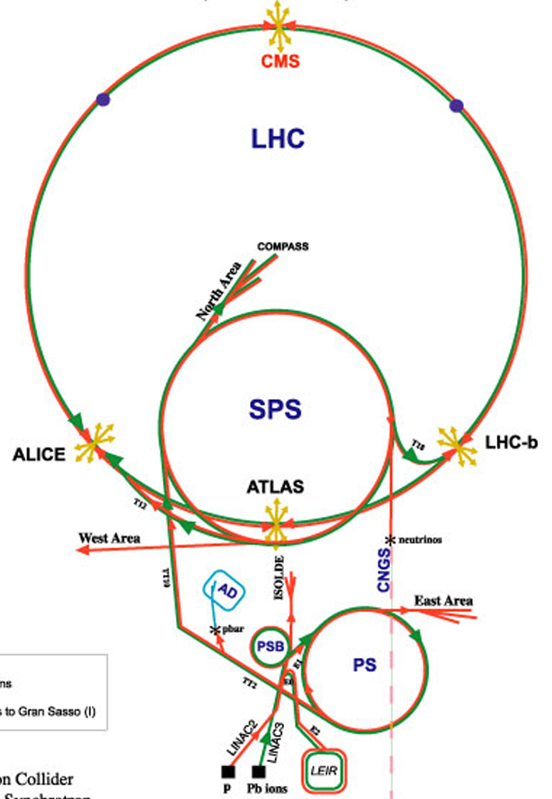
The LHC

Slide 138
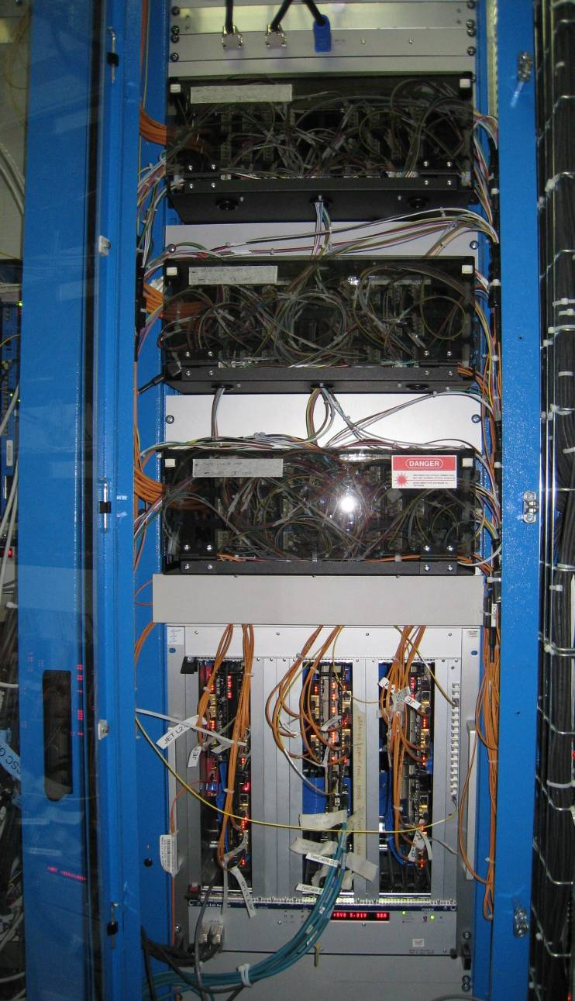
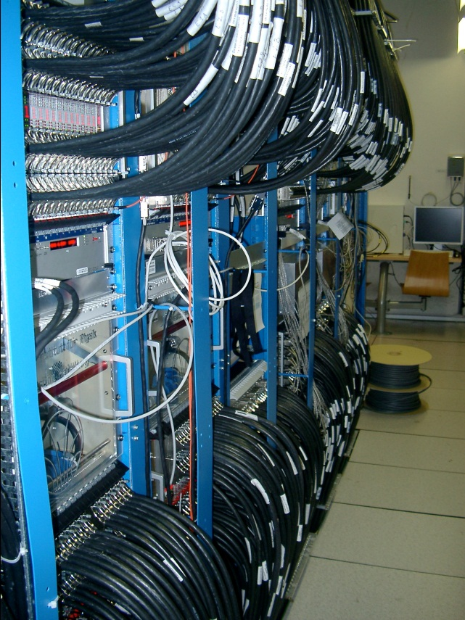
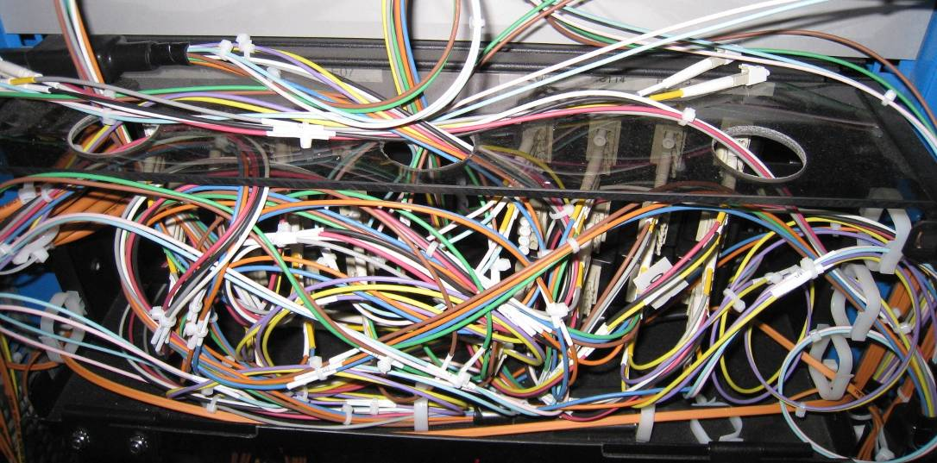
The tyranny of the links: Calorimeter trigger
RCT
GCT

Slide 139
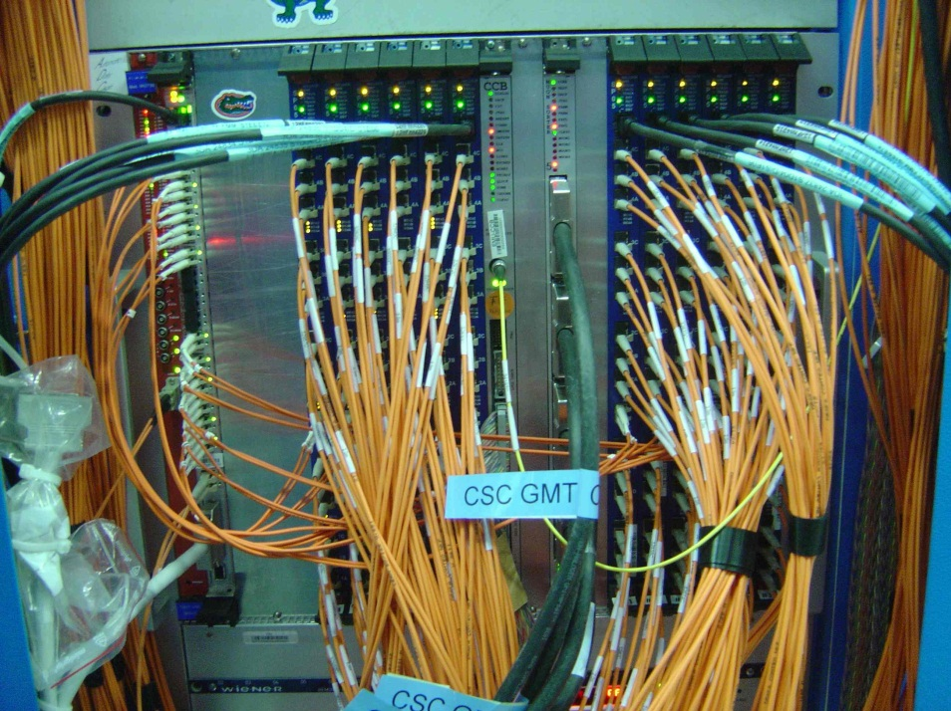
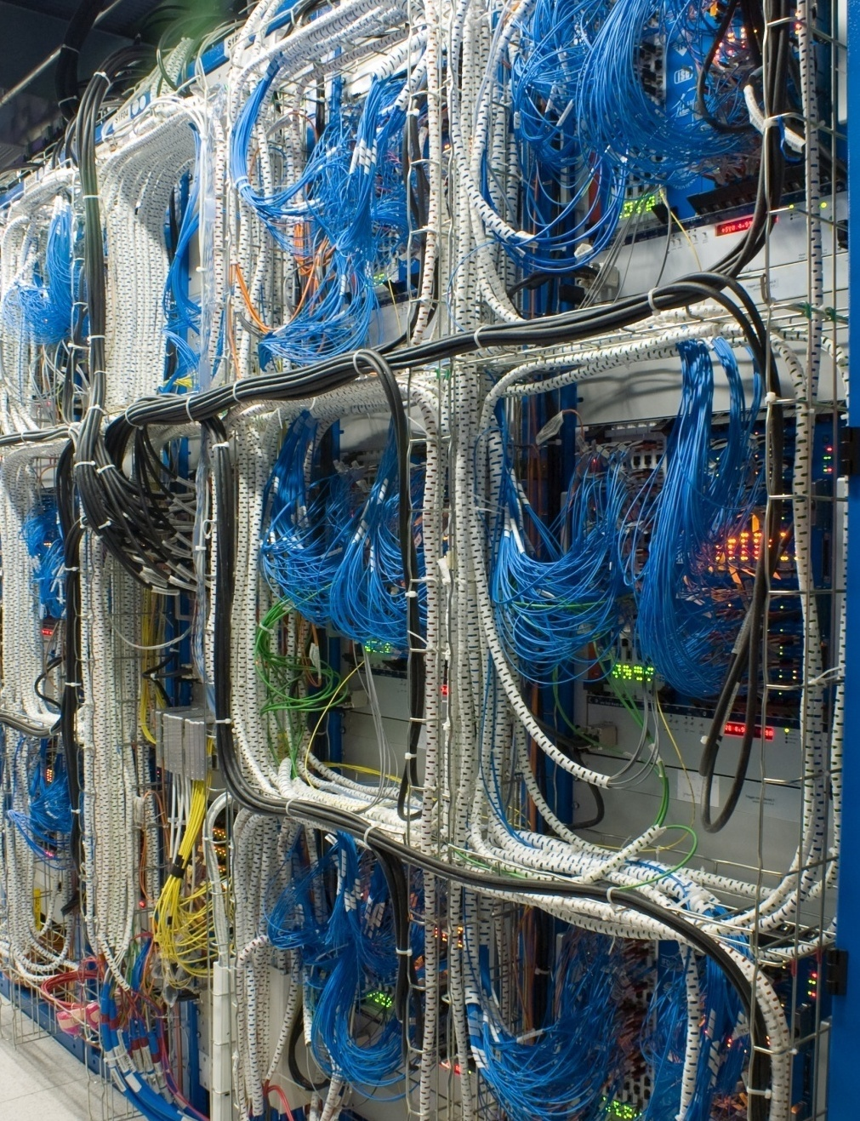
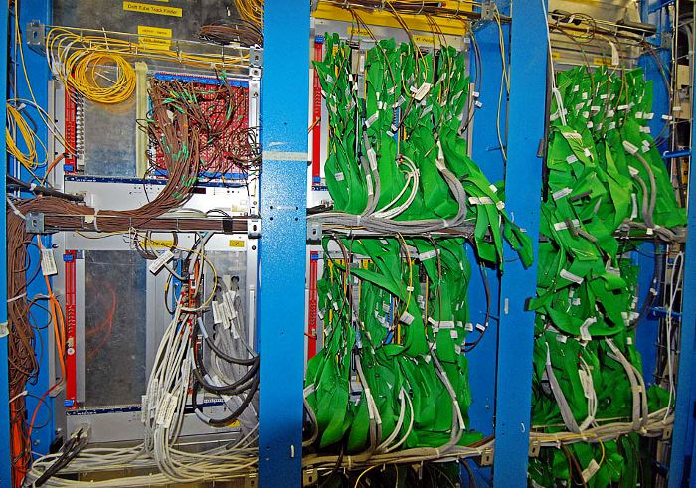
The tyranny of the links: Muon trigger
CSC Track-finder
DT Track-finder
(aka the green salad or the green spaghetti forests)
RPC Pattern Comparator

Slide 140
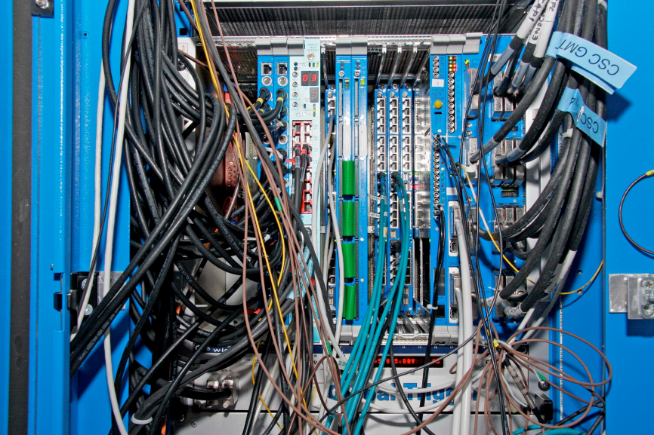
The tyranny of the links: Global trigger

Slide 141
Abstract
The Standard Model of particle physics was finalized in the mid-1970s and is phenomenally successful at describing the world we see. The subsequent discoveries of the top quark, the tau neutrino, and most recently, the Higgs boson means that all the particles within the model have now been observed, crowning the earlier successes of the model. Despite this success, the Standard Model is lacking in several respects; some of which might be resolved trivially pending more data, and others which are far more profound.
The experiments at the LHC are at the energy-frontier in the ongoing quest to understand the universe we inhabit, but the task of finding and measuring the smallest and rarest objects in the universe poses its own unique challenges.
In this talk, I will give an overview of the standard model, some of the detectors and technology being used at the LHC, and finish with a discussion on what the future might hold for each.

