Slide 1
Trigger Happy
The ongoing evolution of the CMS detector and its hardware trigger
Andy Rose, Imperial College, London
awr01@imperial.ac.uk
www.hep.ph.ic.ac.uk/~awr01

Slide 2
Overview
The CMS detector
What is triggering and how is it done at CMS?
What are the complicating factors in a hardware trigger and can we get around them?
The CMS phase-II upgrades and the challenges they pose
Mainly for the benefit of students for whom these may be new concepts – hopefully a useful recap for everyone else!

Slide 3
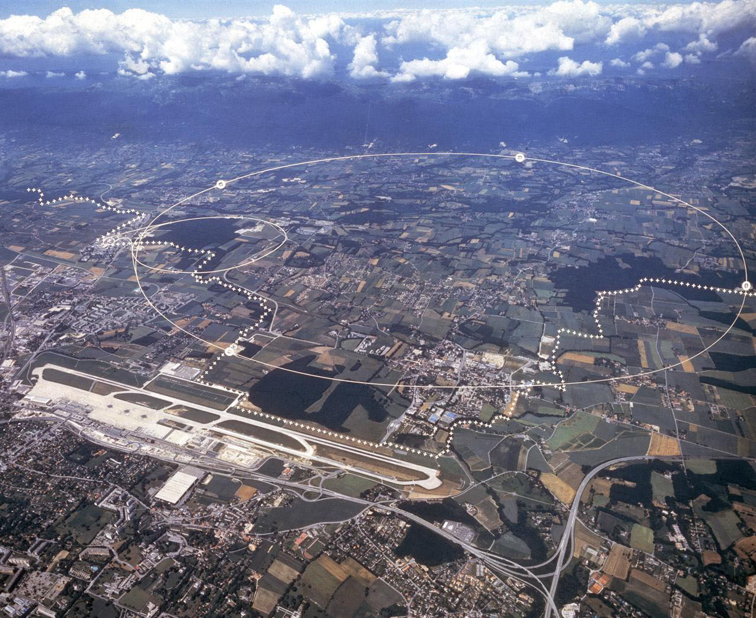
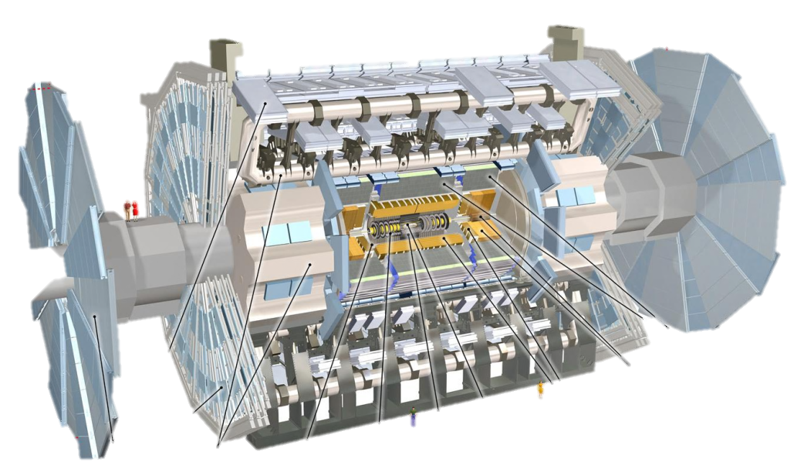
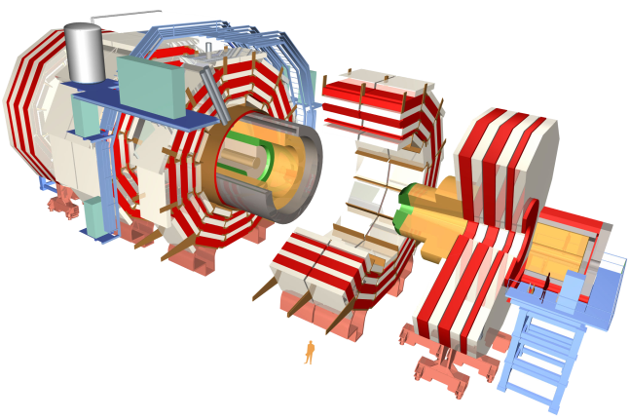
The LHC: Large Hadron Collider
27km
8.6km
100m

Slide 4
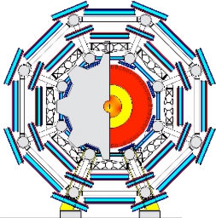
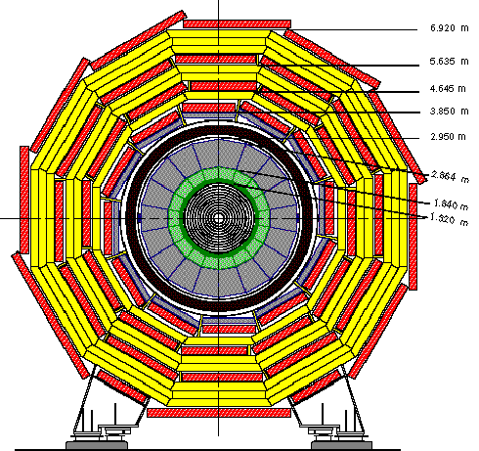
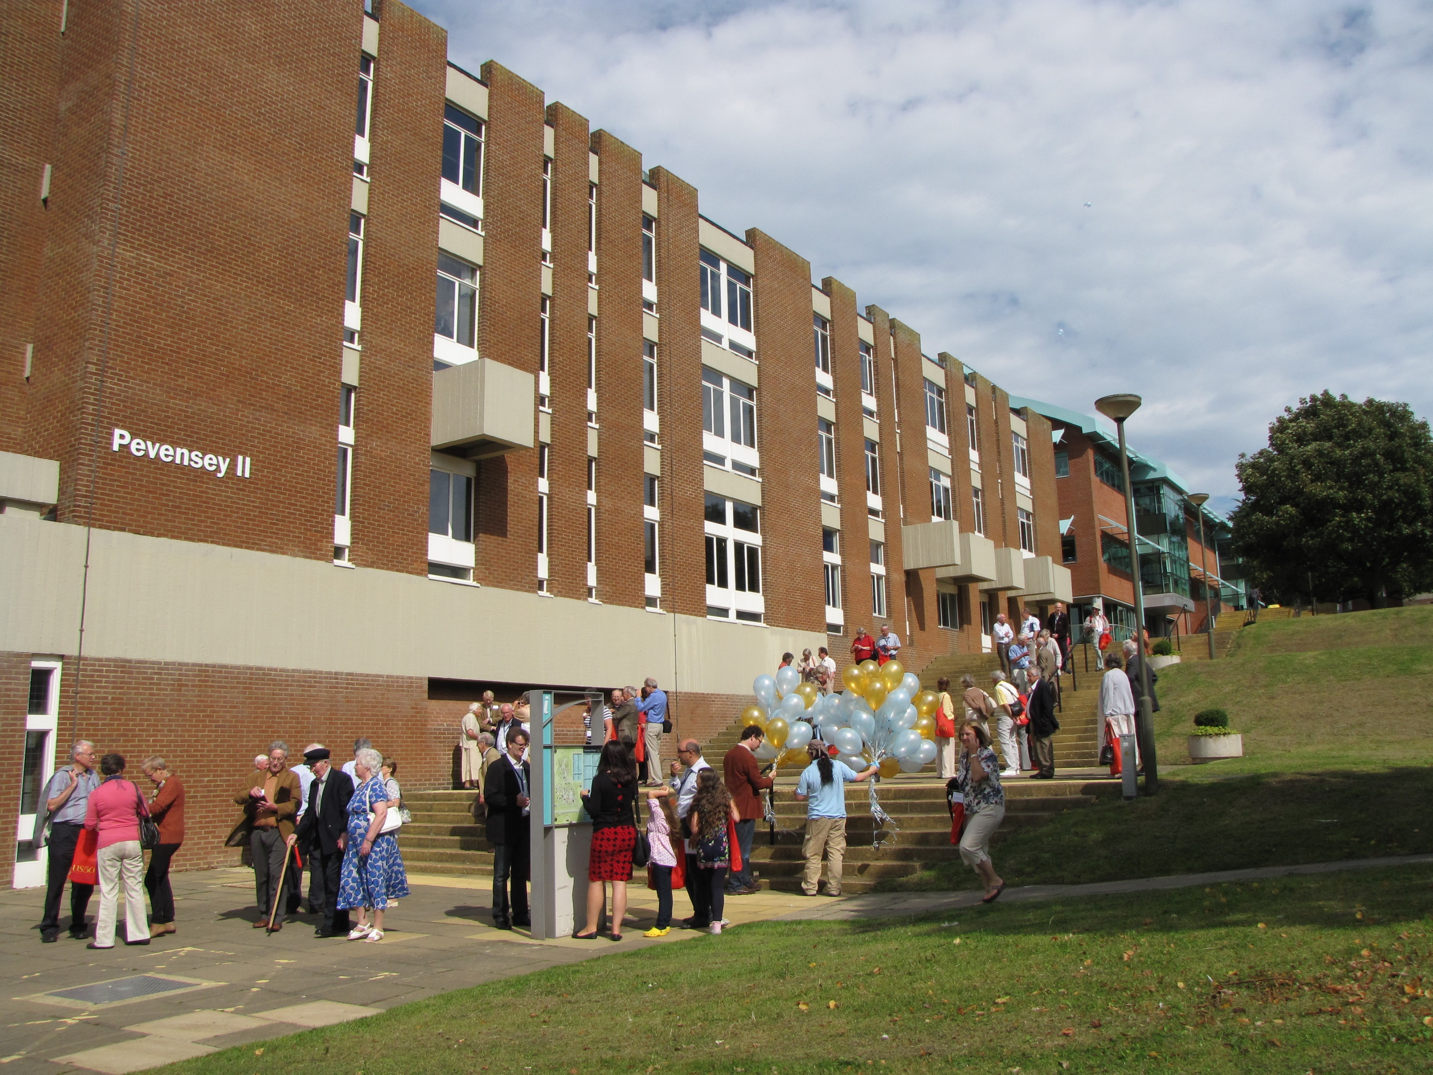
CMS vs. Atlas vs. Pevensey II
CMS
14,000 ton
ATLAS
7,000 ton

Slide 5
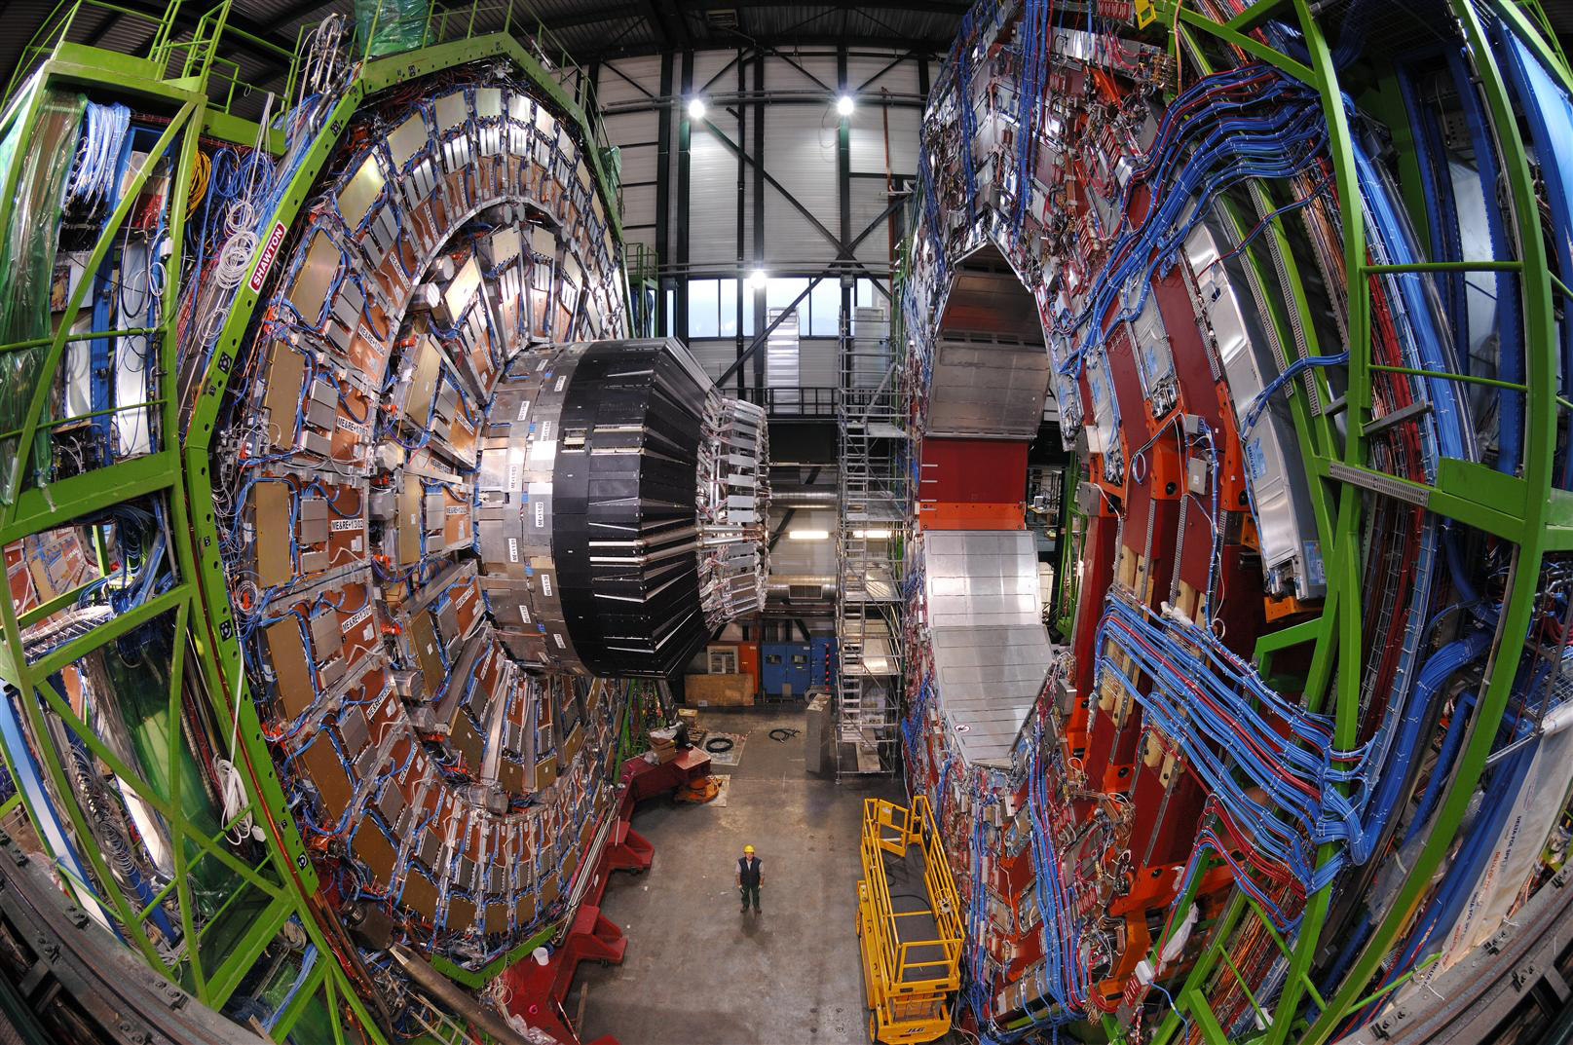
The CMS detector

Slide 6
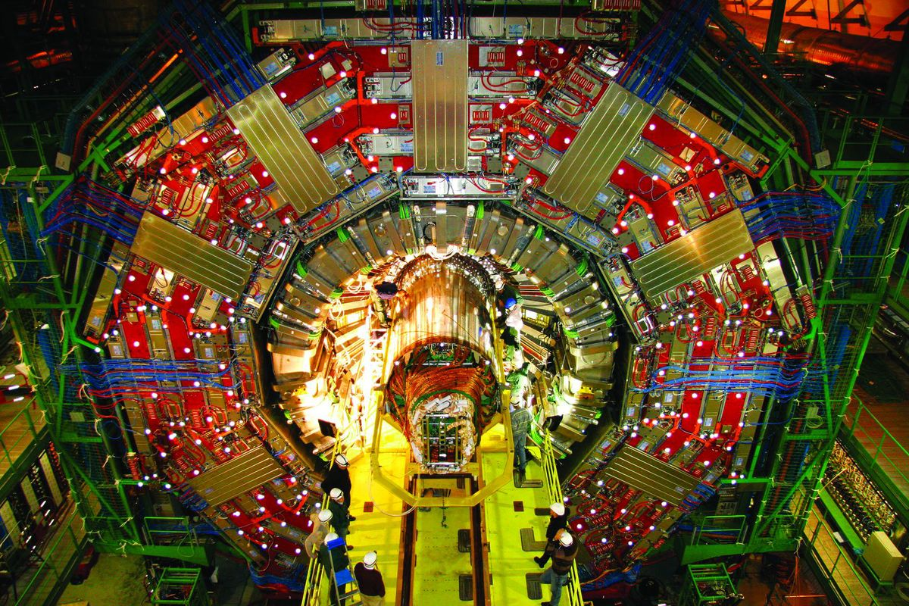
The CMS detector

Slide 7
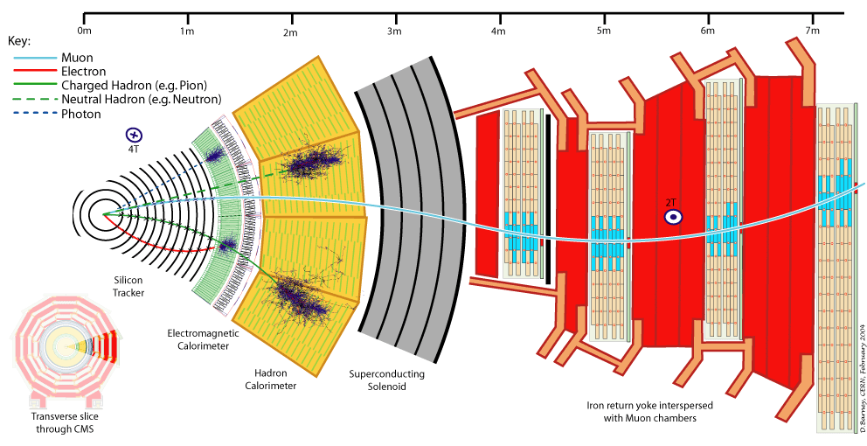
The CMS detector

Slide 8
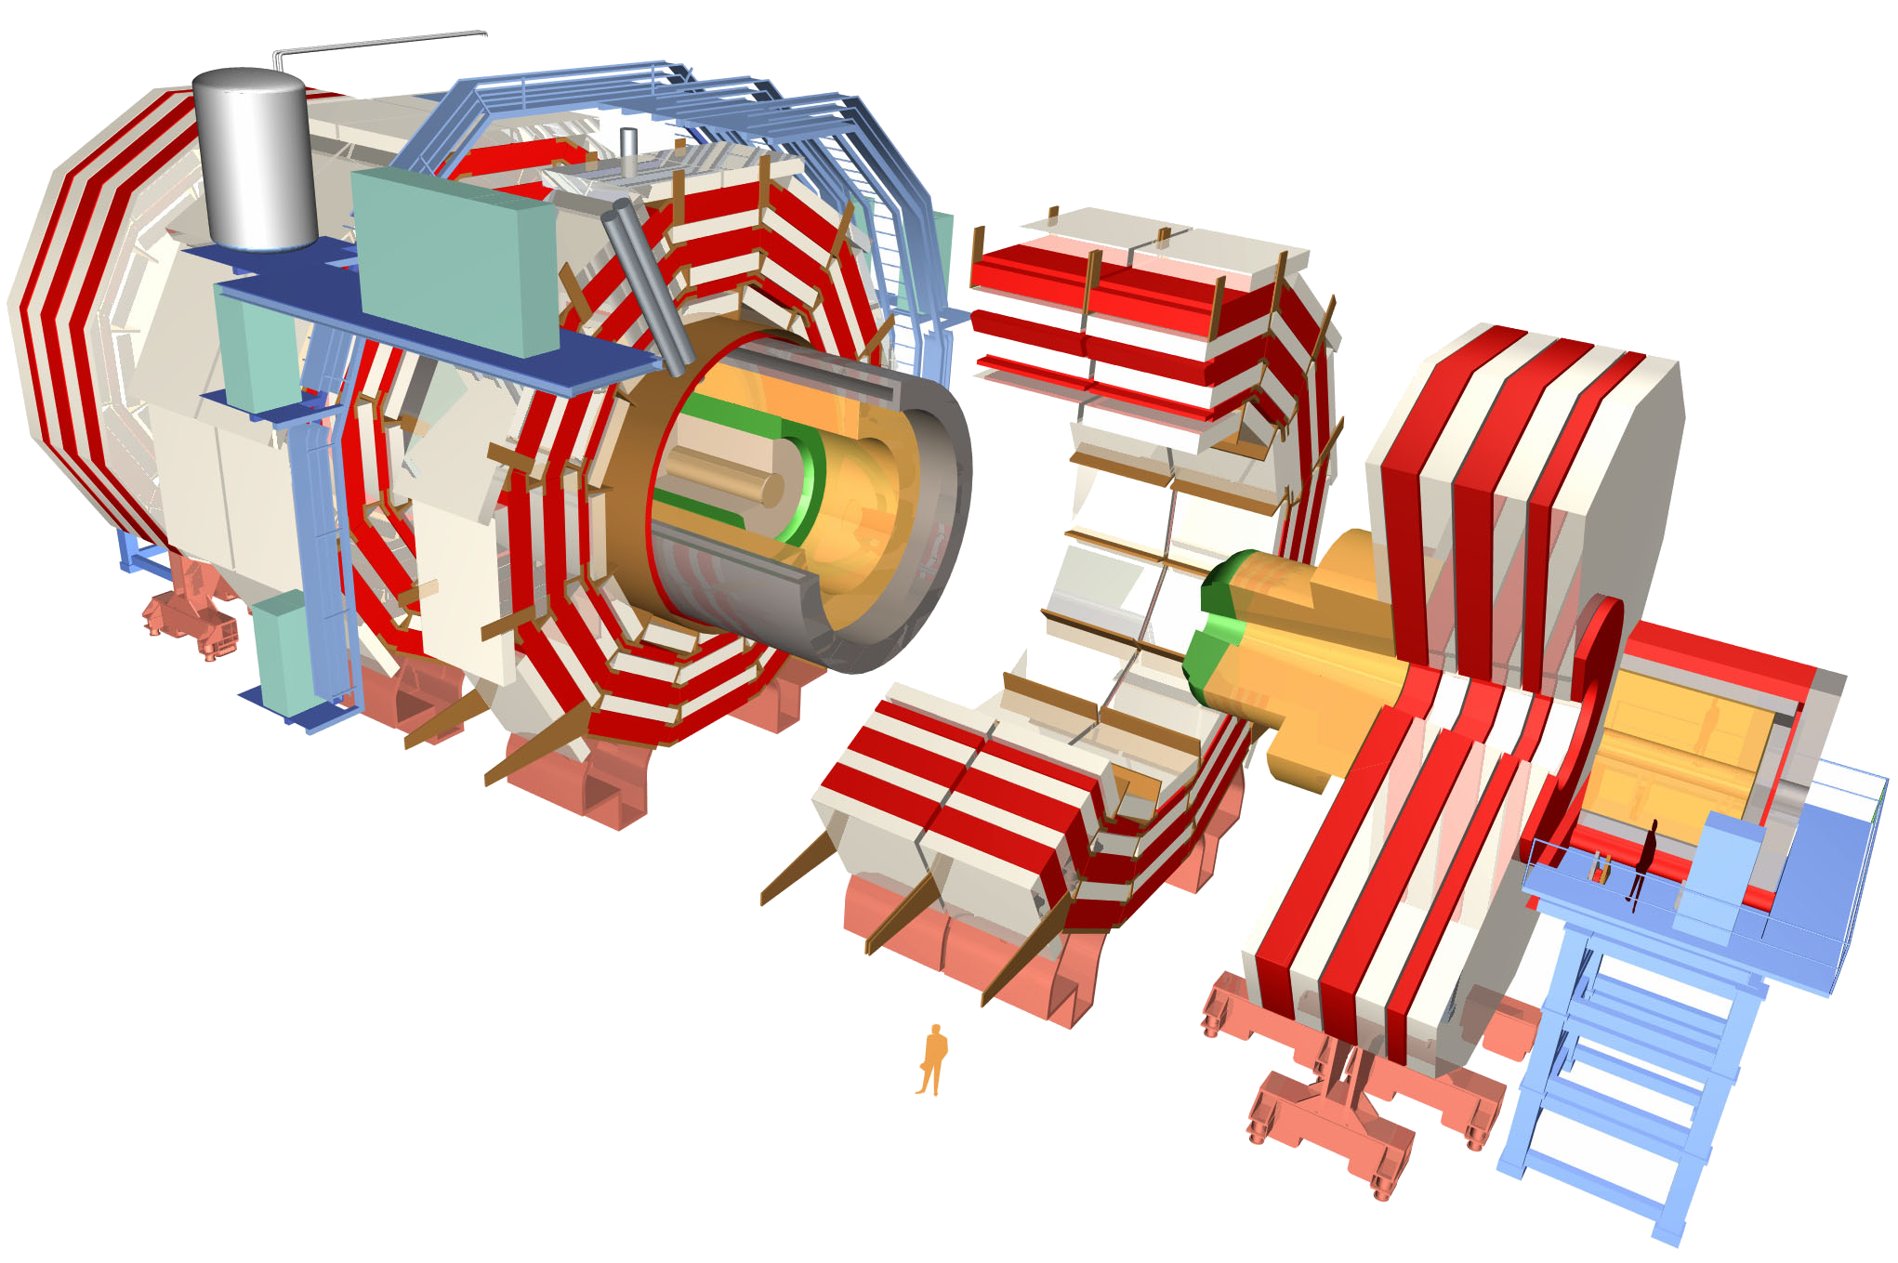
The CMS detector
~80k PbWO₄ Ecal Crystals
~15k channel Brass/Plastic sampling HCAL
~568k RPC/DT/CSC Muon channels
~65M Silicon Pixels
~10M Silicon Strips
~3500 physicists/engineers

Slide 9
The CMS detector
~80k PbWO₄ Ecal Crystals
≡ 40 TBit per second
Data rates before zero-suppression
~15k channel Brass/Plastic sampling HCAL
≡ 10 TBit per second
~568k RPC/DT/CSC Muon channels
≡ 23 TBit per second
~65M Silicon Pixels
~10M Silicon Strips
~3500 physicists/engineers

Slide 10
The CMS detector
~80k PbWO₄ Ecal Crystals
≡ 40 TBit per second
Data rates before zero-suppression
~15k channel Brass/Plastic sampling HCAL
≡ 10 TBit per second
~568k RPC/DT/CSC Muon channels
≡ 23 TBit per second
~65M Silicon Pixels
≡ 21 PBit per second
~10M Silicon Strips
≡ 4 PBit per second
~3500 physicists/engineers

Slide 11
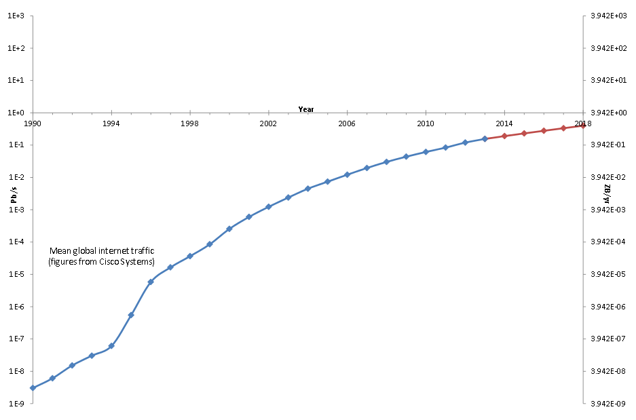
CMS: Visualizing the big numbers
1 Eb/s
4 YB/yr
CMS Raw
1 Pb/s
4 ZB/yr
CMS Zero-suppressed
1 Tb/s
4 EB/yr
1 Gb/s
4 PB/yr
1 Mb/s
4 TB/yr

Slide 12
How do you store O(Pb/s) data?
For a very short time…
  3.2μs in CMS

Slide 13
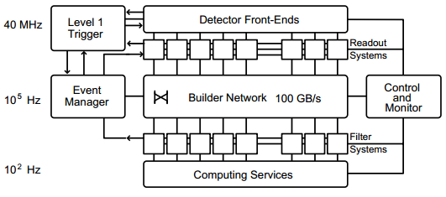
How do you store O(Pb/s) data?
Store raw data on detector for 3.2μs
Hardware processing
10 Tb/s
PC farm
Tape storage

Slide 14
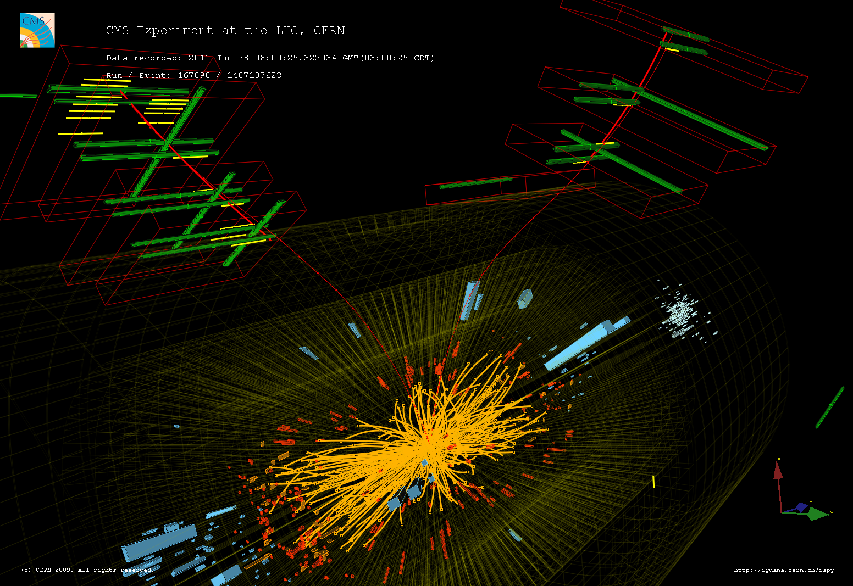
Muon Candidates:
Join the dots

Slide 15
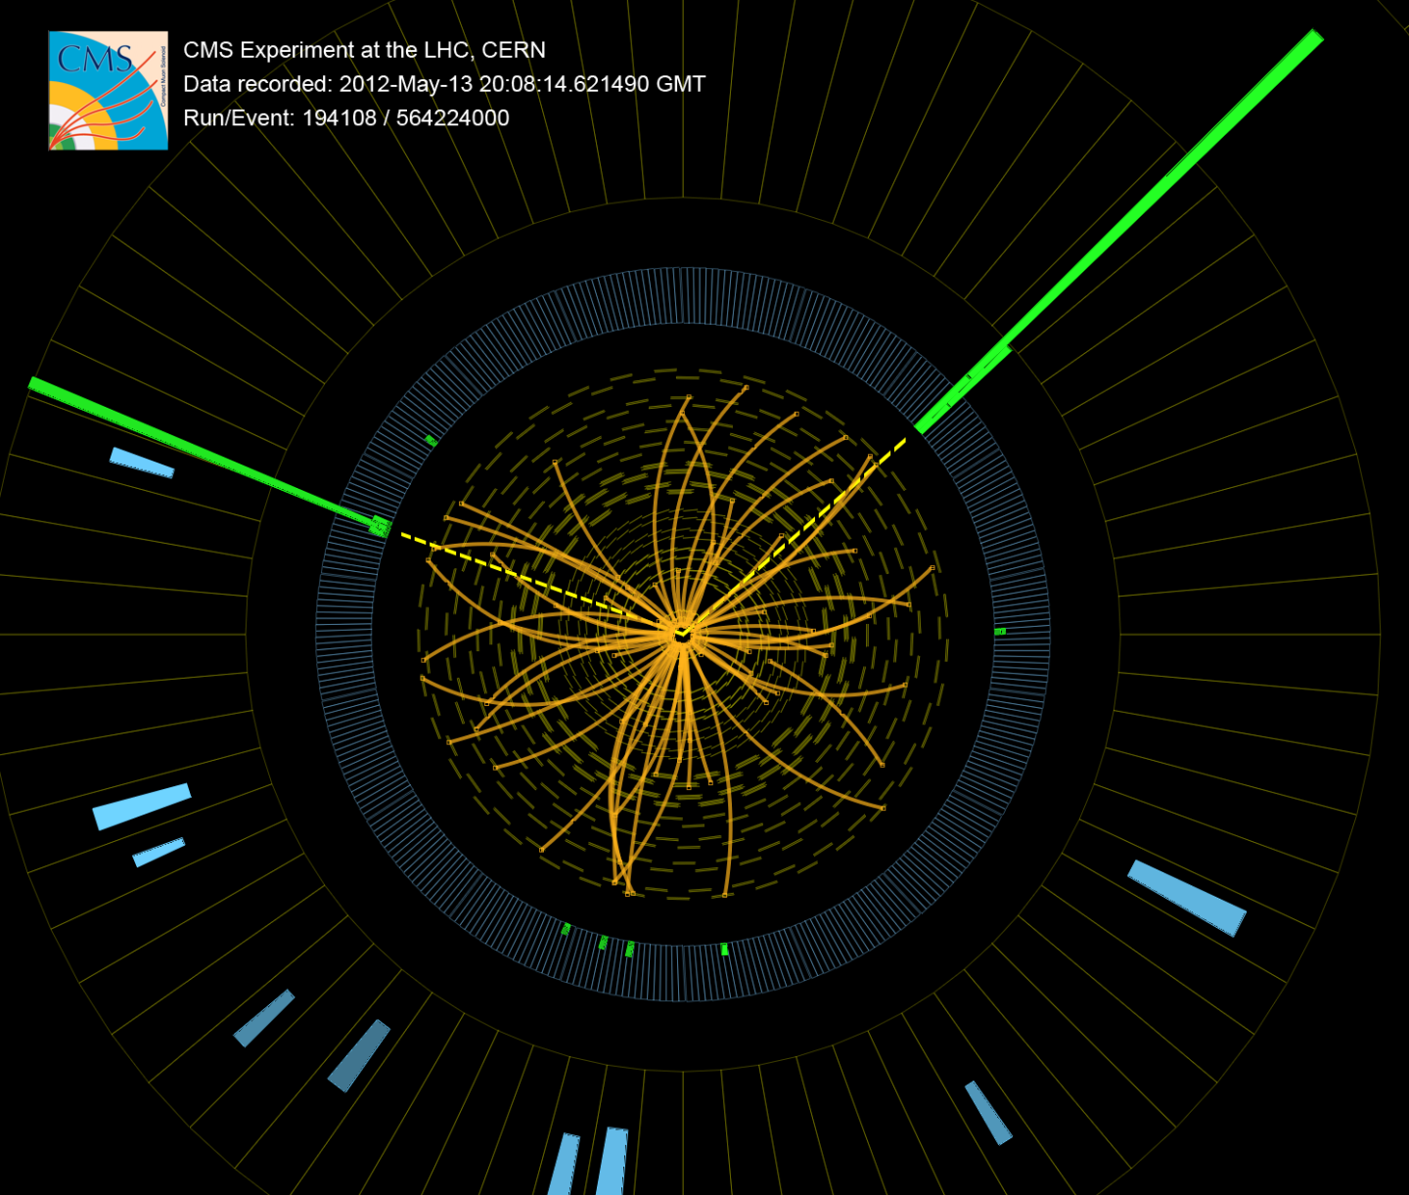
Electron/Photon Candidates:
Spikes

Slide 16
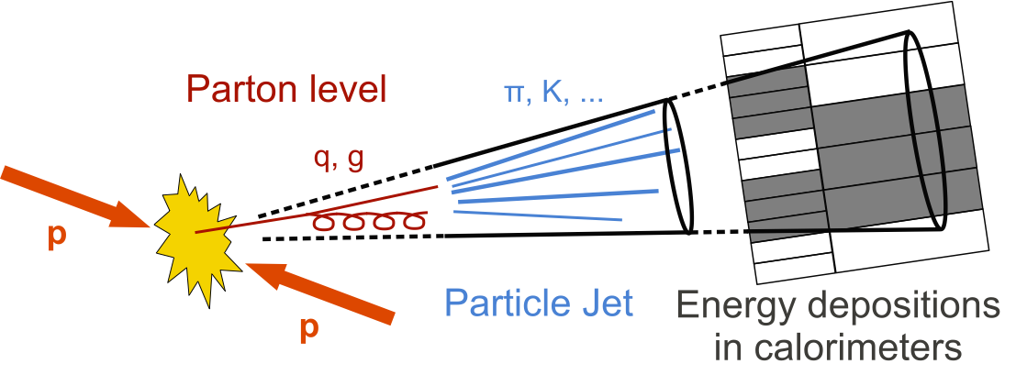
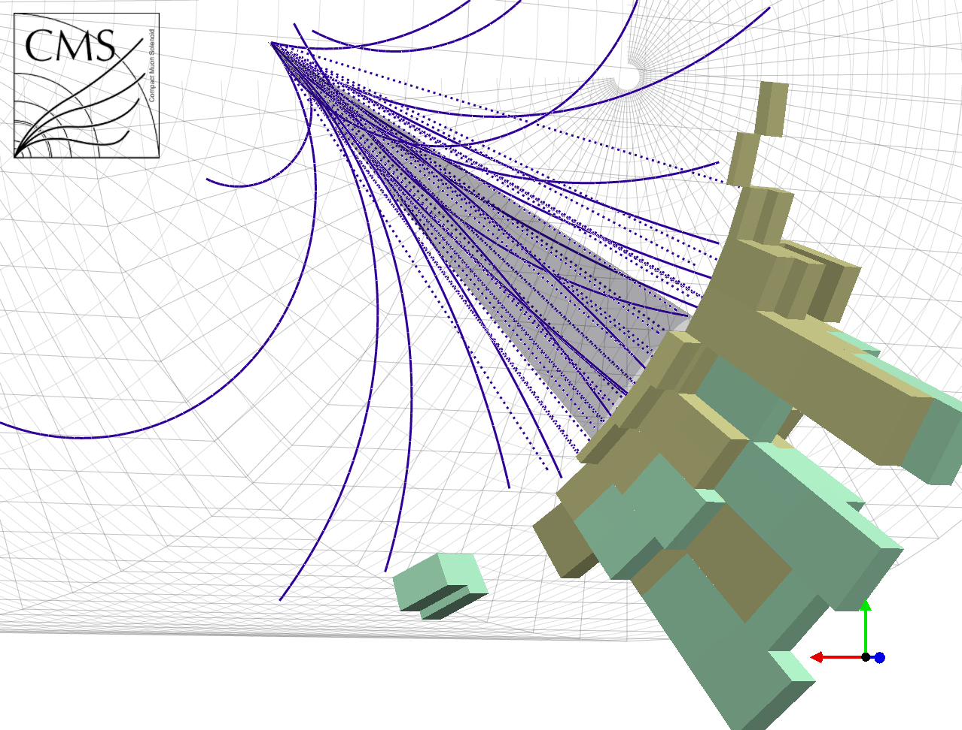
Jet Candidates: A mess

Slide 17
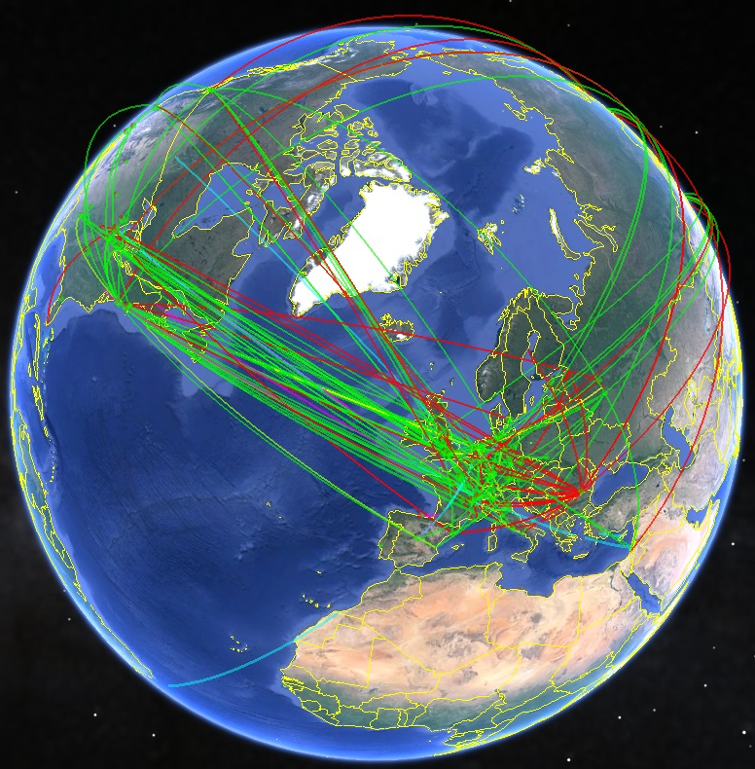

How do you store O(Pb/s) data?
Answer: You don’t! You have to throw most of it away!
Store raw data on detector for 3.2μs
Hardware processing
10 Tb/s
Throw away 399/400
100kHz
100 GB/s
Worldwide LHC computing grid
“Physicists analysing data”
Throw away 997/1000
PC farm
300Hz
0.5GB/s
Tape storage

Slide 18
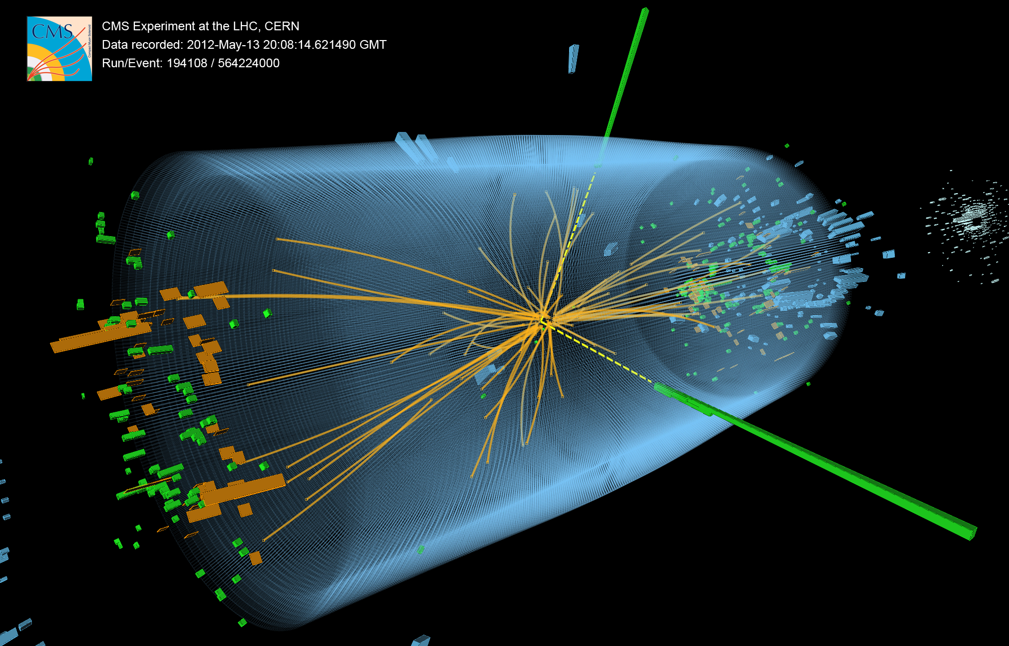
First observation of a 125GeV particle decaying to two photons

Slide 19
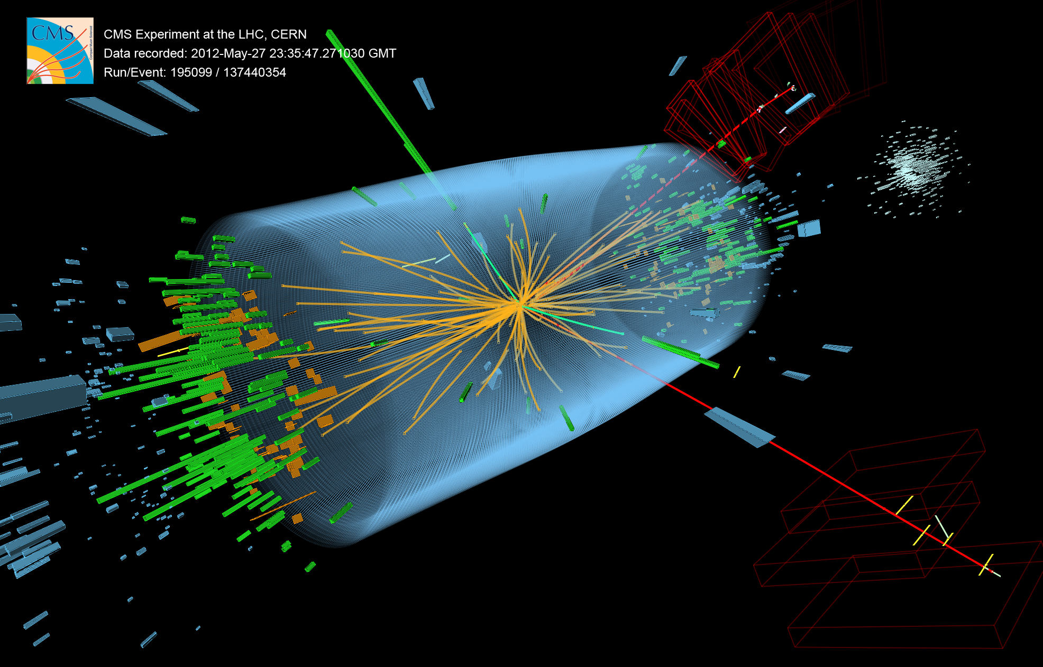
First observation of a 125GeV particle decaying to two Z-bosons

Slide 20
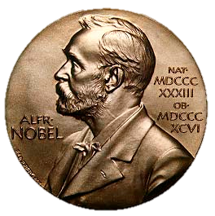
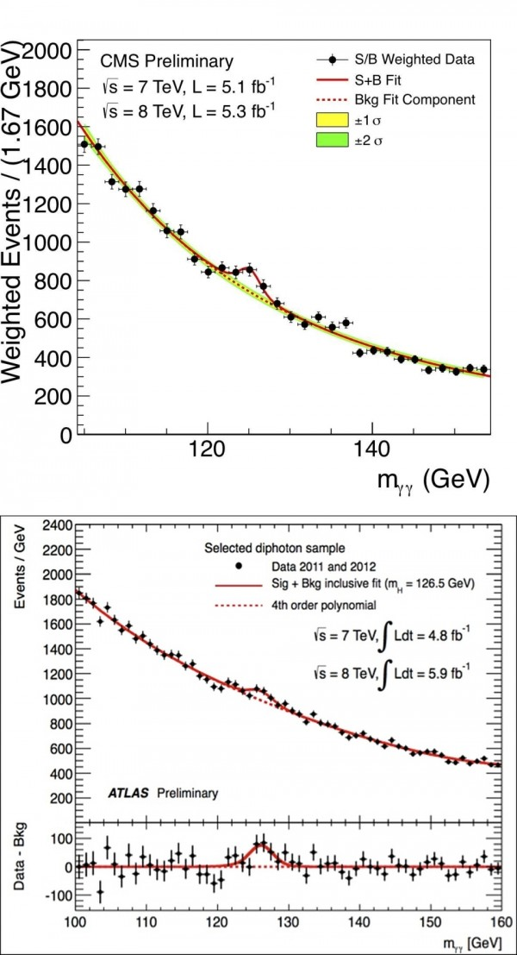
Congratulations – it’s a boson

Slide 21
The CMS Level-1 trigger
Where the real fun is to be had :)
Hardware processing
PC farm
Tape storage

Slide 22
A divergence of the CMS and Atlas triggers?
Up to 2015, the Atlas and CMS triggers were similar
  With the caveat that Atlas has three levels compared to CMS’s two levels
Both hardware triggers used the same architecture and were forced into similar design choices
In the Phase-1 shutdown, CMS – pushed by the UK – made changes to its trigger which started pushing the two experiments down different paths…

Slide 23
The tyranny of the links

Slide 24
The job of the trigger
The job of the trigger is to receive a vast amount of data from a diverse set of subsystems
Analyse it
  in a very short amount of time (~1μs)
Give a yes-no answer on whether an event should be discarded

Slide 25
How much data can a board receive?
$$N_{bits}= N_{cables}×N_{channels/cable}×Linespeed×ε_{encoding}×τ_{transmission}$$
1 for serial links
12/24/48 for parallel optics
≤160 for parallel
1 for parallel
8/10 for any serial
64/66 for “fast” serial
Only “free” parameter
For LHC, every board is synchronous and everything is processed “in-time”. This is fixed at 25ns.
<200Mbit/s for parallel
Up to 25Gbit/s for serial (but limited by cost)

Slide 26
The tyranny of the links
But remember…
  Parallel links need big connectors so bandwidth limited by space available on circuit board
  Serial links have a serialization/deserialization latency of 75ns
    And we only have ~1000ns for the level-1 trigger in total
Running at non-multiples of LHC clock adds realignment latency
But really, the killer problem is caused by the sheer volume of data…

Slide 27
The tyranny of the links
Say that you have too much data and that you can’t receive enough bits to fit all data onto a single board
You can split processing across multiple boards
Except that you need to handle the boundaries!
Which means either
  Duplicating the data before it reaches your processing cards
  Sharing data between your processing cards
Both of which mean increasing the volume of data going to each board
So you need more links
So you need more boards
Which means more boundaries
Which means more sharing/duplicating
…

Slide 28
The tyranny of the links
$$N_{bits}= N_{links}×N_{channels/link}×Linespeed×ε_{encoding}×τ_{transmission}$$
Restricted by available space
Restricted by technology available
Restricted by only feasible architecture
Question:
So, what can you do?
Answer:
Chose the best available technology you can and then throw out as
much data as you can get away with until you satisfy your bit-limit
Imagine a “card” with 4 input links and up to 4 output links…

Slide 29
The conventional architecture
3
4
3
1
4
2
1
2
Thrown away enough data now!
3
4
3
1
4
2
1
2
3
4
3
1
4
2
1
2
3
4
3
1
4
2
1
2
4
4
1
2
1
2
3
3
3
4
4
1
2
1
2
3
3
4
3
1
4
2
1
2
BX:1
BX:2
BX:3
BX:4
3
4
4
1
2
1
2
3

Slide 30

Can the tyranny be broken?
$$N_{bits}= N_{cables}×N_{channels/cable}×Linespeed×ε_{encoding}×τ_{transmission}$$
Restricted by available space
Restricted by technology available
Restricted by only feasible architecture
Maybe it’s time to start questioning the received wisdom…
Can we increase $τ_{transmission}$?
This requires a completely new architecture
In order that every BX is processed, we require as many processing “nodes” as the number of bunch-crossings the data is transmitted over
Imagine a “card” with 4 input links and up to 4 output links…

Slide 31
The time-multiplexed architecture
Well… this doesn’t look like a great start – but we’ll come back to it in a minute…

Slide 32
The time-multiplexed architecture
1
5
1
5
1
5
1
5
All data for 1bx from all regions in a single card!
Everything you need!
1
6
6
6
6
2
2
2
2
7
7
7
7
3
3
3
3
4
4
4
4
1
5
1
5
1
5
1
5
2
All data for 1bx from all regions in a single card!
Everything you need!
6
2
6
6
6
2
2
2
7
3
7
3
7
7
3
3
4
4
4
4
1
5
1
5
1
5
1
5
All data for 1bx from all regions in a single card!
Everything you need!
6
6
2
2
6
6
2
2
7
7
3
3
7
7
3
3
4
4
4
4
1
5
1
5
1
1
5
5
6
6
6
6
2
2
2
2
BX:6
BX:1
BX:2
BX:3
BX:4
BX:5
BX:7
7
7
7
7
3
3
3
3
4
4
4
4
32

Slide 33
Can the tyranny be broken?
YES!
  Time-multiplexing means that your trigger systems are no-longer limited by the number of links into a board!
  No need to throw away data before processing (although if you can, why not…)
  Fewer boundaries means less data and fewer fibre for a given resolution
NO!
  Time-multiplexing means that you CAN (but don’t have to) have the raw data-rate throughout your system – this means more links than if you throw data away!

Slide 34
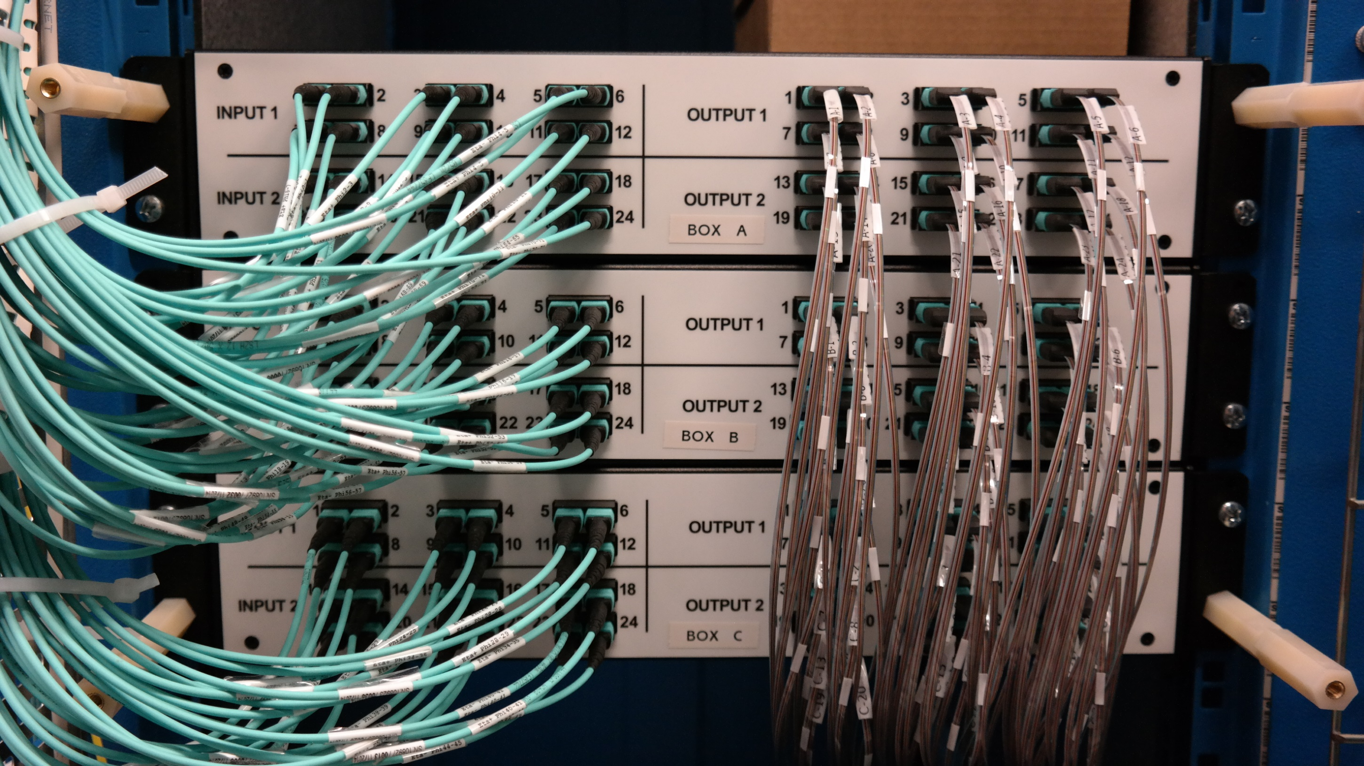
What about that horrible patch panel?
Pay Molex to have a robot build it for you and pack it into a 2U rackmount box

Slide 35
The advantages of time-multiplexing
Minimizes (or even eliminates) boundaries
  Most different board “species” in CMS can be traced back to the need to handle a particular choice of geometric division
  TMT means no specialization of hardware for a particular boundary handling situation
    “One-board-fits-all” design
    All specialization is in firmware – complete flexibility
Advantages claimed in 2011

Slide 36
The advantages of time-multiplexing
No duplication of data needed
  Less hardware and fewer links for a given resolution
Data need only be thrown away by choice, not necessity
  Should allow better physics
Equality of data
  Without duplication, all data is equal
  Can easily add new input sources
    Scalability
Advantages claimed in 2011

Slide 37
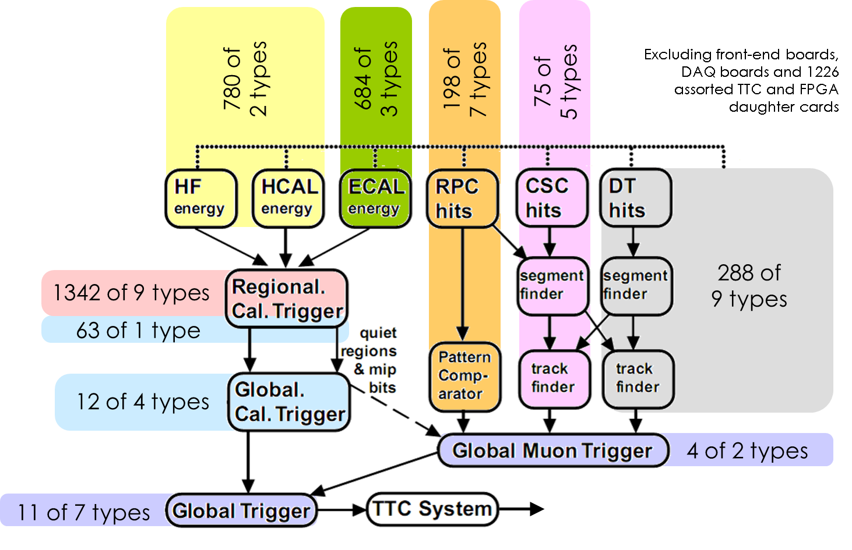
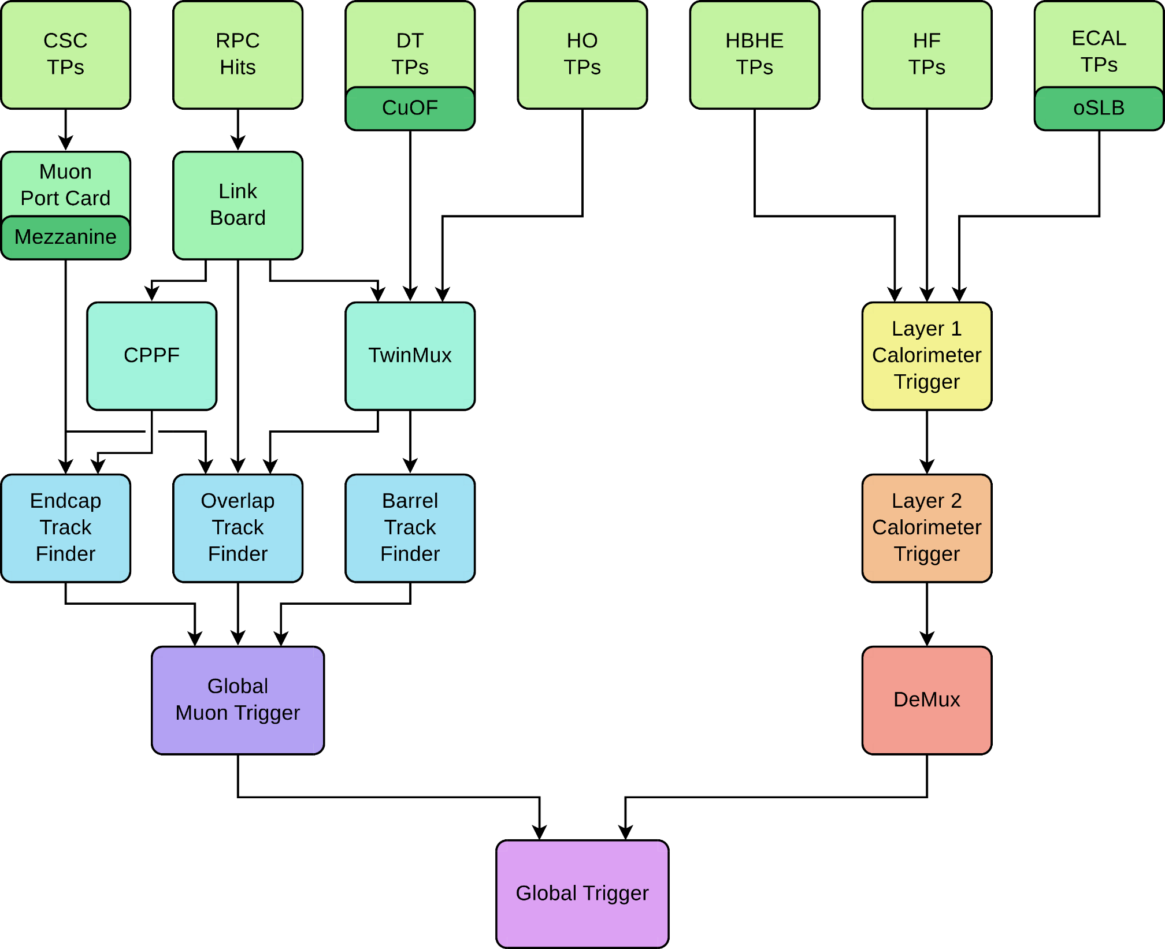
Is this really the case?
Run 0
Run 1
The proof of the pudding is in the eating:
CMS has been running with a TM calo trigger since 2015
18 of 1 type
9 of 1 type

Slide 38
Is this really the case?
Run 0
Run 1
Conventional
Time-multiplexed
18 of 1 type
9 of 1 type

Slide 39
Is this really the case?
Run 0
Run 1
Conventional
Conventional

Slide 40
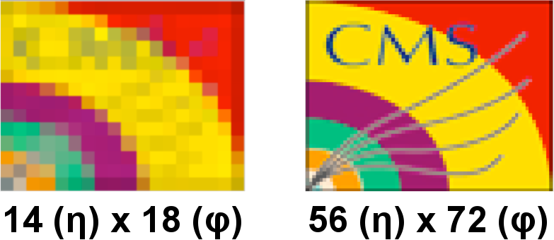
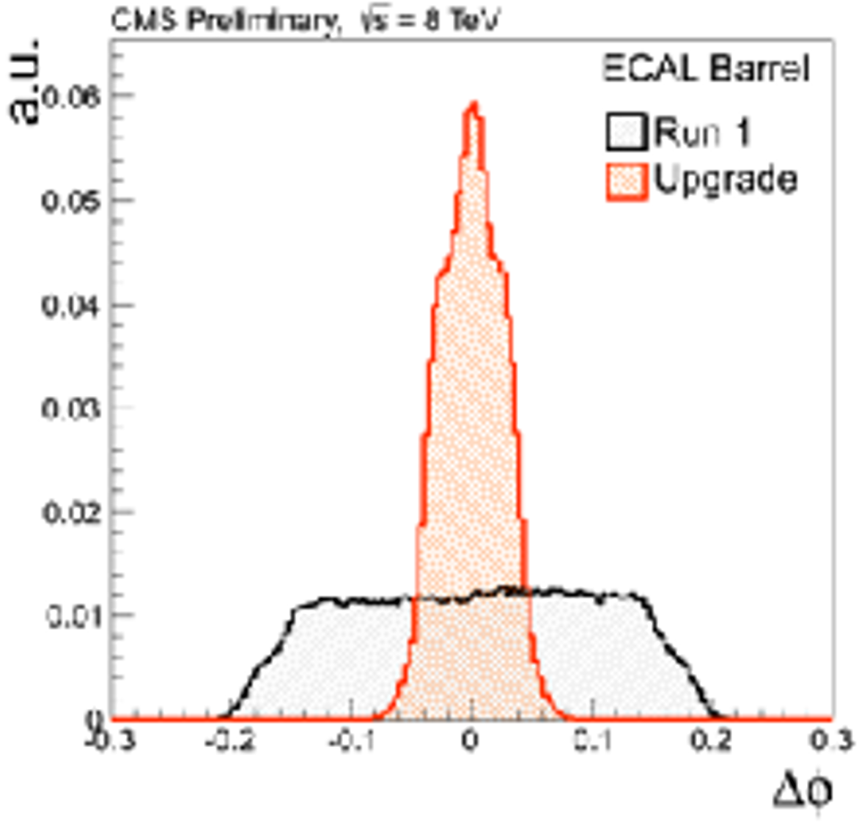
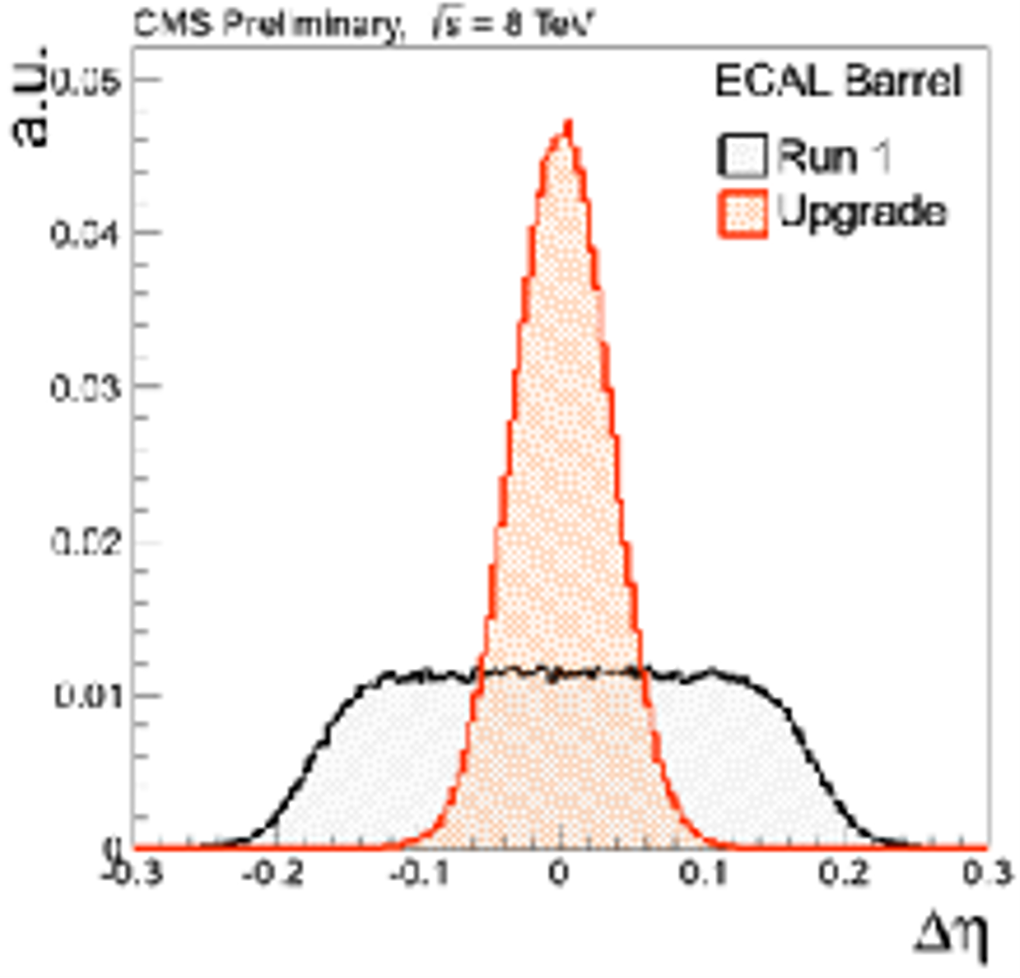
Is this really the case?
Run 0
Run 1
18 of 1 type
9 of 1 type

Slide 41

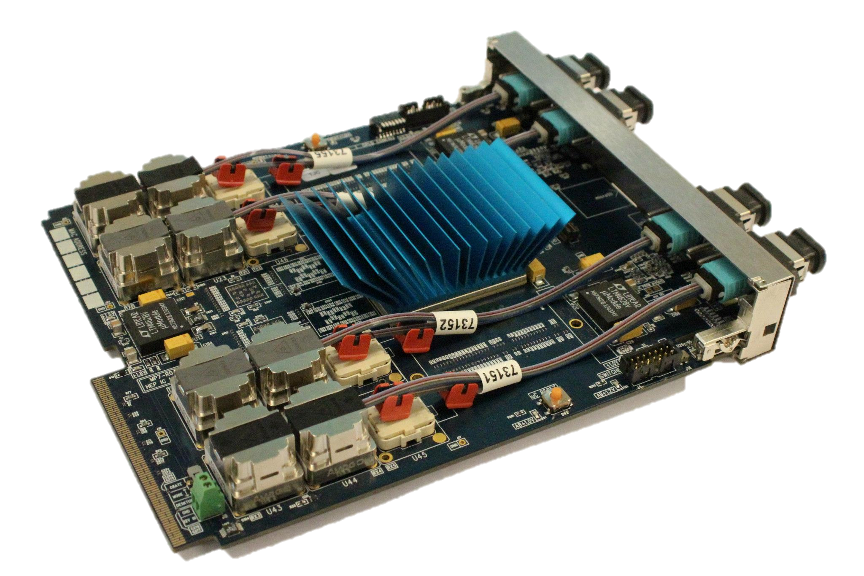
: A generic optical stream processor
950Gb/s in and 950Gb/s out
700,000 logic blocks @400MHz
Designed by G. Iles, J. Jones, A. Rose & S. Greenwood at IC
And it is laid out rationally and looks pretty

Slide 42
A divergence of the CMS and Atlas triggers?
In CMS, time-multiplexing has allowed, and become synonymous with, generic hardware
  Possibly because of my own (extreme) philosophical stance toward simplifying and rationalising which drove me to evangelize/push both time-multiplexing and generic hardware upon CMS.
So much so that, for phase-II, UKCMS has a “common hardware” work-package to meet the needs of all its subsystems
In contrast to Atlas Phase-1 where the push has been towards very specialist boards
  eFEX, jFEX, gFEX, etc.

Slide 43
Three neat time-multiplexing tricks

Slide 44
Three neat time-multiplexing tricks
Within a TM node, can daisy-chain physical boards/FPGAs with enormous bandwidth

Slide 45
Three neat time-multiplexing tricks
Same daisy-chaining technique applies equally when combining multiple systems with the same time-multiplexing period

Slide 46

Three neat time-multiplexing tricks
Imagine a system with N nodes
We lose a node due to hardware failure
  In a conventional trigger losing a board means degrading (or losing!) every event!
  With TM, we lose 1 BX in N – a (inadvertent) trigger prescale!
But we have a final card up our sleeve!
For an additional 1/Nth of the cost we can have a spare node which we can switch in at run-time
  Efficiency restored!

Slide 47
Phase-II

Slide 48
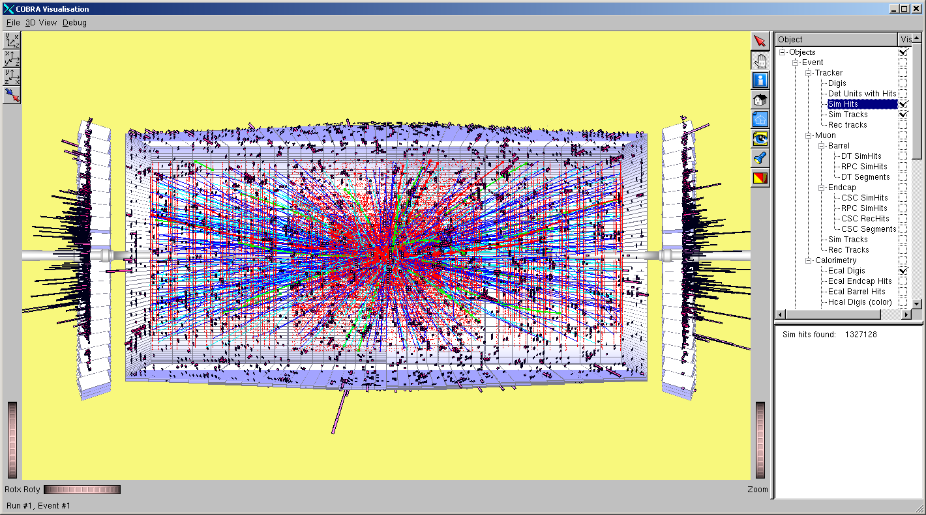
Phase-II
| 10³⁵ cm⁻²s⁻¹ | average 200 events/BX |

Slide 49
The CMS Detector after Phase-II
Upgrades relevant to triggering
Full granularity Ecal included in trigger
New CSC electronics
New GEM layers
New pixel layers
Tracking included in trigger
Complete replacement of endcap Ecal & Hcal
30ps timing resolution
Replace HPD with SiPM in Barrel HCAL
Depth info into trigger
MIP timing layer
30ps timing resolution
New Beampipe
Modified Magnet Yolk
…

Slide 50
The CMS Detector after Phase-II
Upgrades relevant to triggering
Full granularity Ecal included in trigger
New CSC electronics
New GEM layers
New pixel layers
Tracking included in trigger
Complete replacement of endcap Ecal & Hcal
30ps timing resolution
Does anything remain?
Replace HPD with SiPM in Barrel HCAL
Depth info into trigger
MIP timing layer
30ps timing resolution
New Beampipe
Modified Magnet Yolk
…

Slide 51
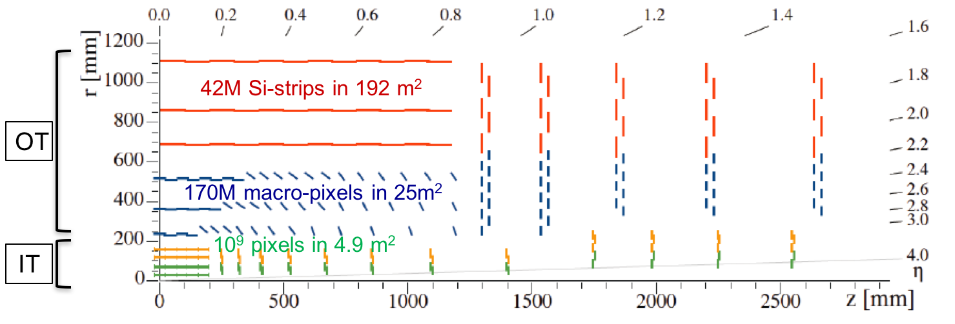
Tracker
Inner Tracker (pixel) design to extend coverage to η ≃ 3.8

Slide 52
Tracker
Inner Tracker (pixel) design to extend coverage to η ≃ 3.8
OT Si-sensors ≃ 200µm thick - 90/100µm pitch - 2.5/5cm strips
OT Si-sensors ≃ 200µm thick - 90/100µm pitch - 1.5 mm macro-pixels
IT Si-silicon sensors ≤ 150µm thickness - 50x50 to 25x100µm²

Slide 53
Tracker
Inner Tracker (pixel) design to extend coverage to η ≃ 3.8
Outer Tracker design driven by ability to provide tracks at 40 MHz to L1-trigger
-

Slide 54
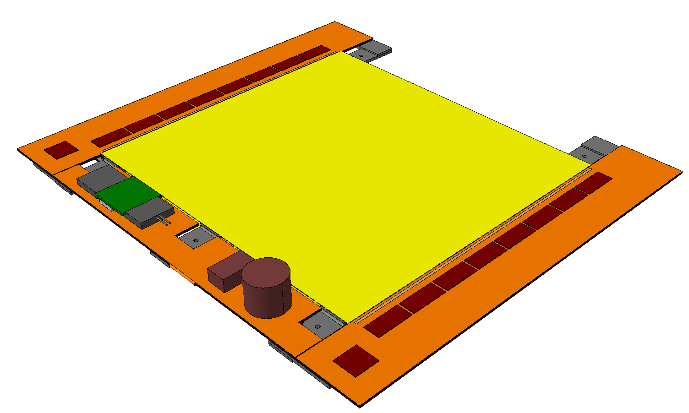
Outer tracker 2S modules
Silicon sensors
CBC
Flex PCB Hybrid
Outer
½ Module
Front End
Hybrid
Inner
Bridge
CF Stiffener
500µm CF Support
Double-Layer
Si Strip Detectors
2S Modules: Two-strip double-layers
~10k modules
42M channels
LP-GBT &
Optical VTRx
10 cm
Each 2S Module:
Sensor Area ~100 cm²
16 CBCs, each reading 254 strips
(127 from top & bottom sensors)
4064 Channels in total
Readout both L1 triggered data & Primitive trigger data
5 cm
127 Strips/CBC
8 CBCs per side
DC-DC
Converter
IC & RAL
CIC
1 per side
Service Hybrid

Slide 55
Tracking Trigger
1 Pb/s
4 ZB/yr
Tracking Trigger
1 Tb/s
4 EB/yr
1 Gb/s
4 PB/yr
~5,000 modules @ 10Gb/s + ~10,000 modules @ 5Gb/s = 100Tb/s = 394 EB/yr
1 Mb/s
4 TB/yr

Slide 56
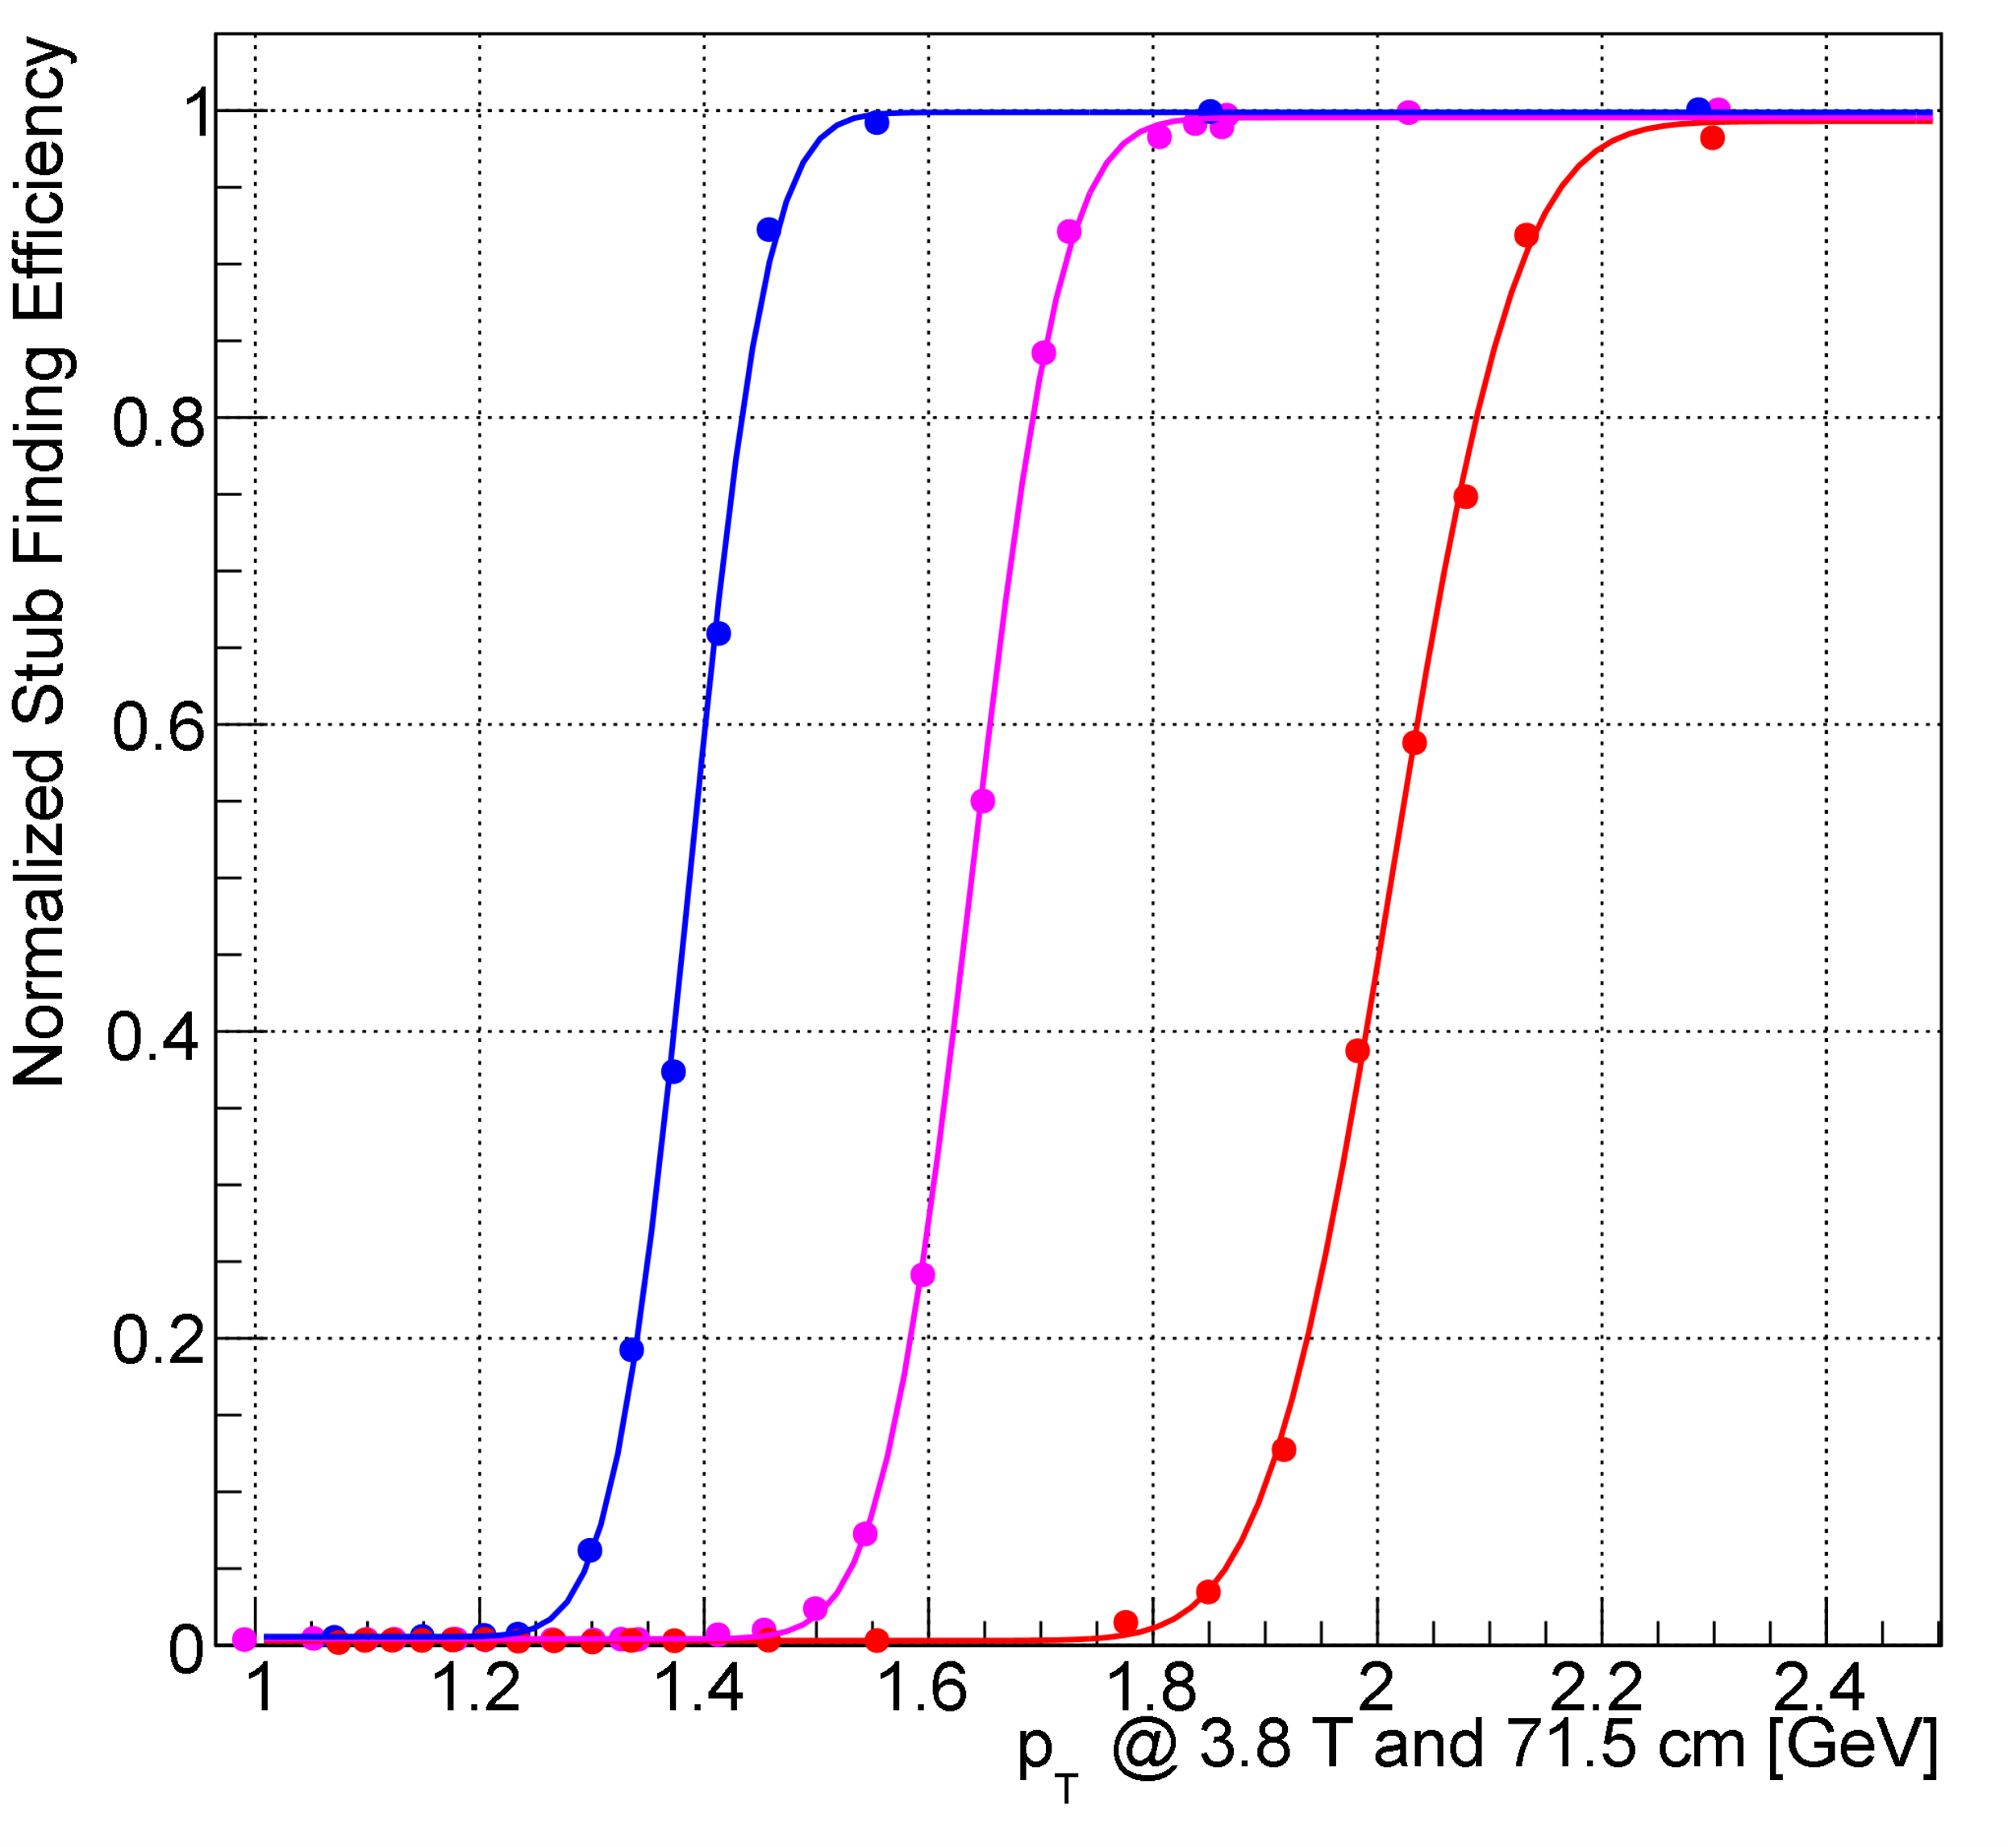
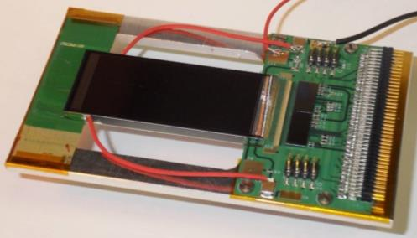
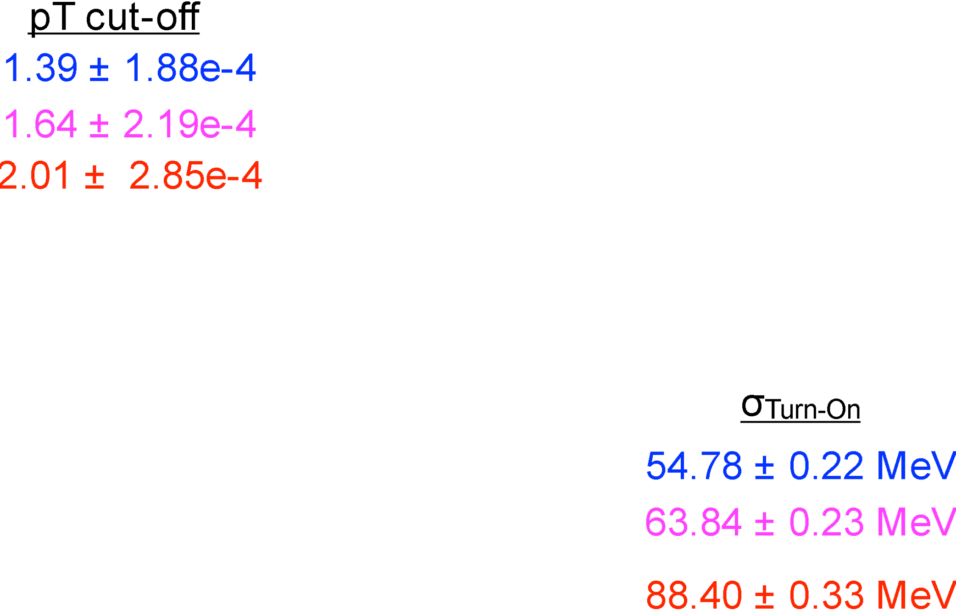
Outer tracker 2S modules: Do they work?
Stub turn-on curve for 2CBC mini-module at FNAL test-beam
Upper Sensor
2× CBC2
Lower Sensor

Slide 57
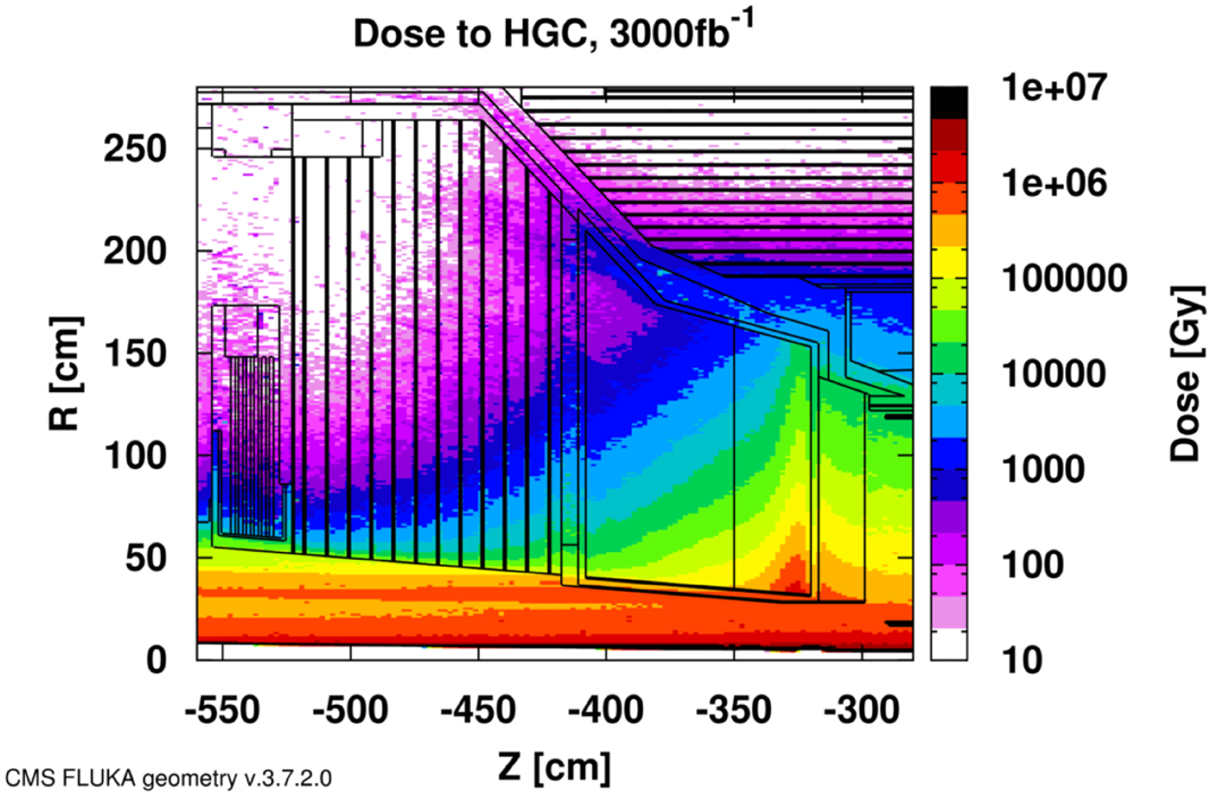

Calorimeter Endcap design
3D shower topology and time resolution of ~30ps
Electromagnetic Endcap (EE)
  28 layers of Silicon sensors in W/Pb absorber (25 X₀, 1.7λ)
Hadronic Endcap (EH)
  24 layers: 8 silicon + 16 silicon/scint. tiles at high/low η in stainless steel absorber (9λ)
253 tonnes
Total power at end of life = 160-180 kW @-30C
520m² Scint. Tiles
2x2 and 5x5 cm² + SiPM
~400k channels
Facing a MegaGray Dose
10¹⁶ cm⁻² 1MeV Neutron equivalent fluence
600 m², 25000 modules , of hexagonal 8” sensors
~6M channels of area 0.5 and 1 cm²

Slide 58
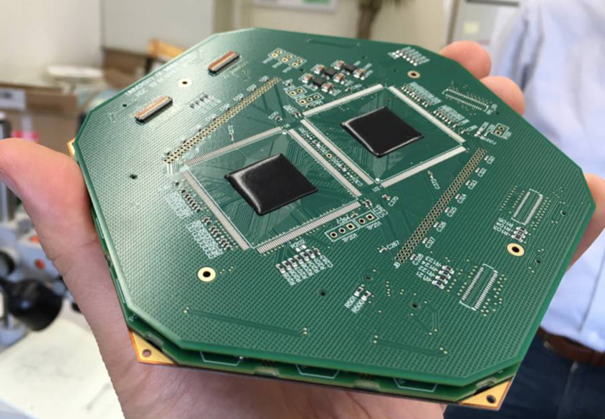
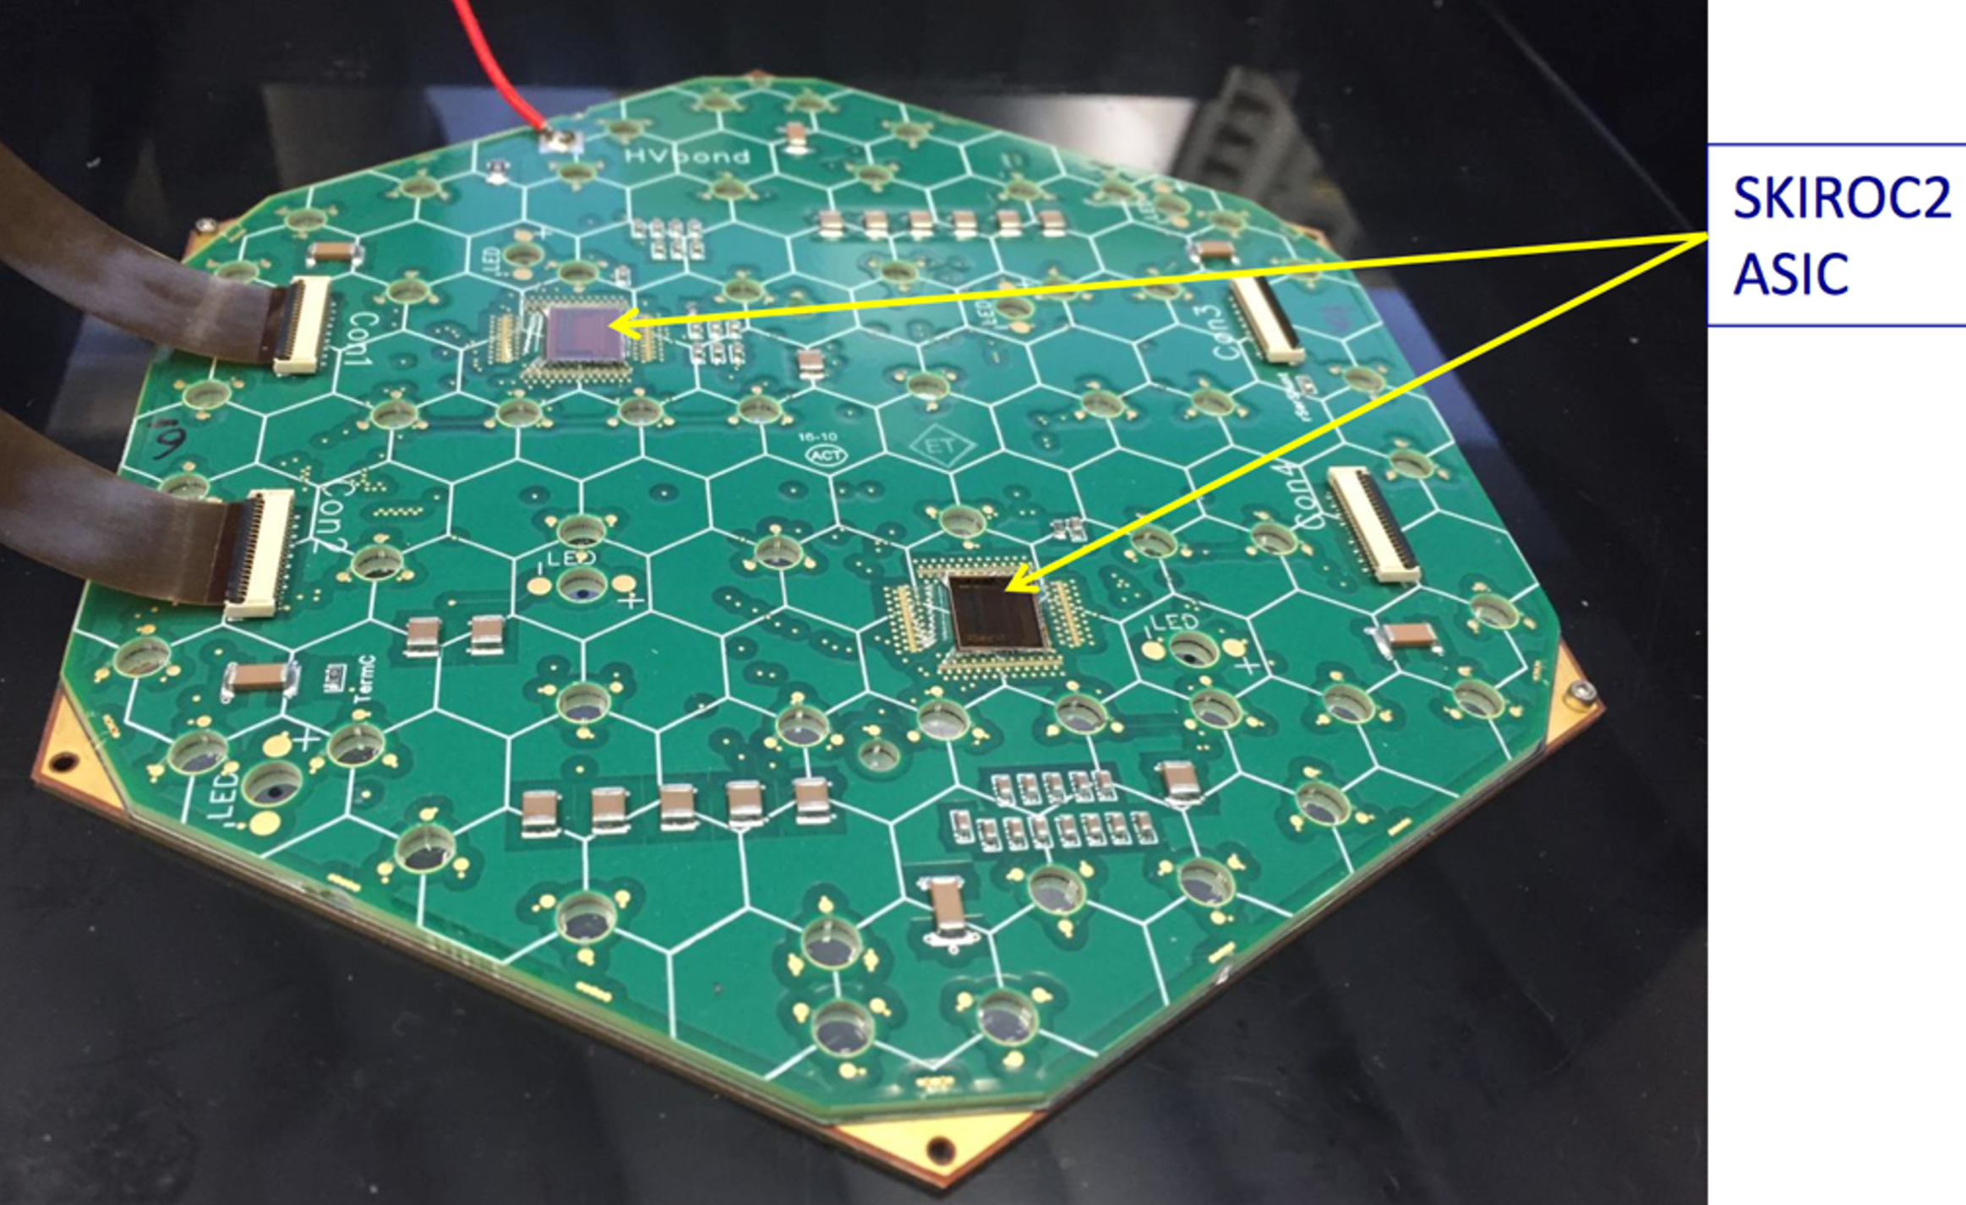
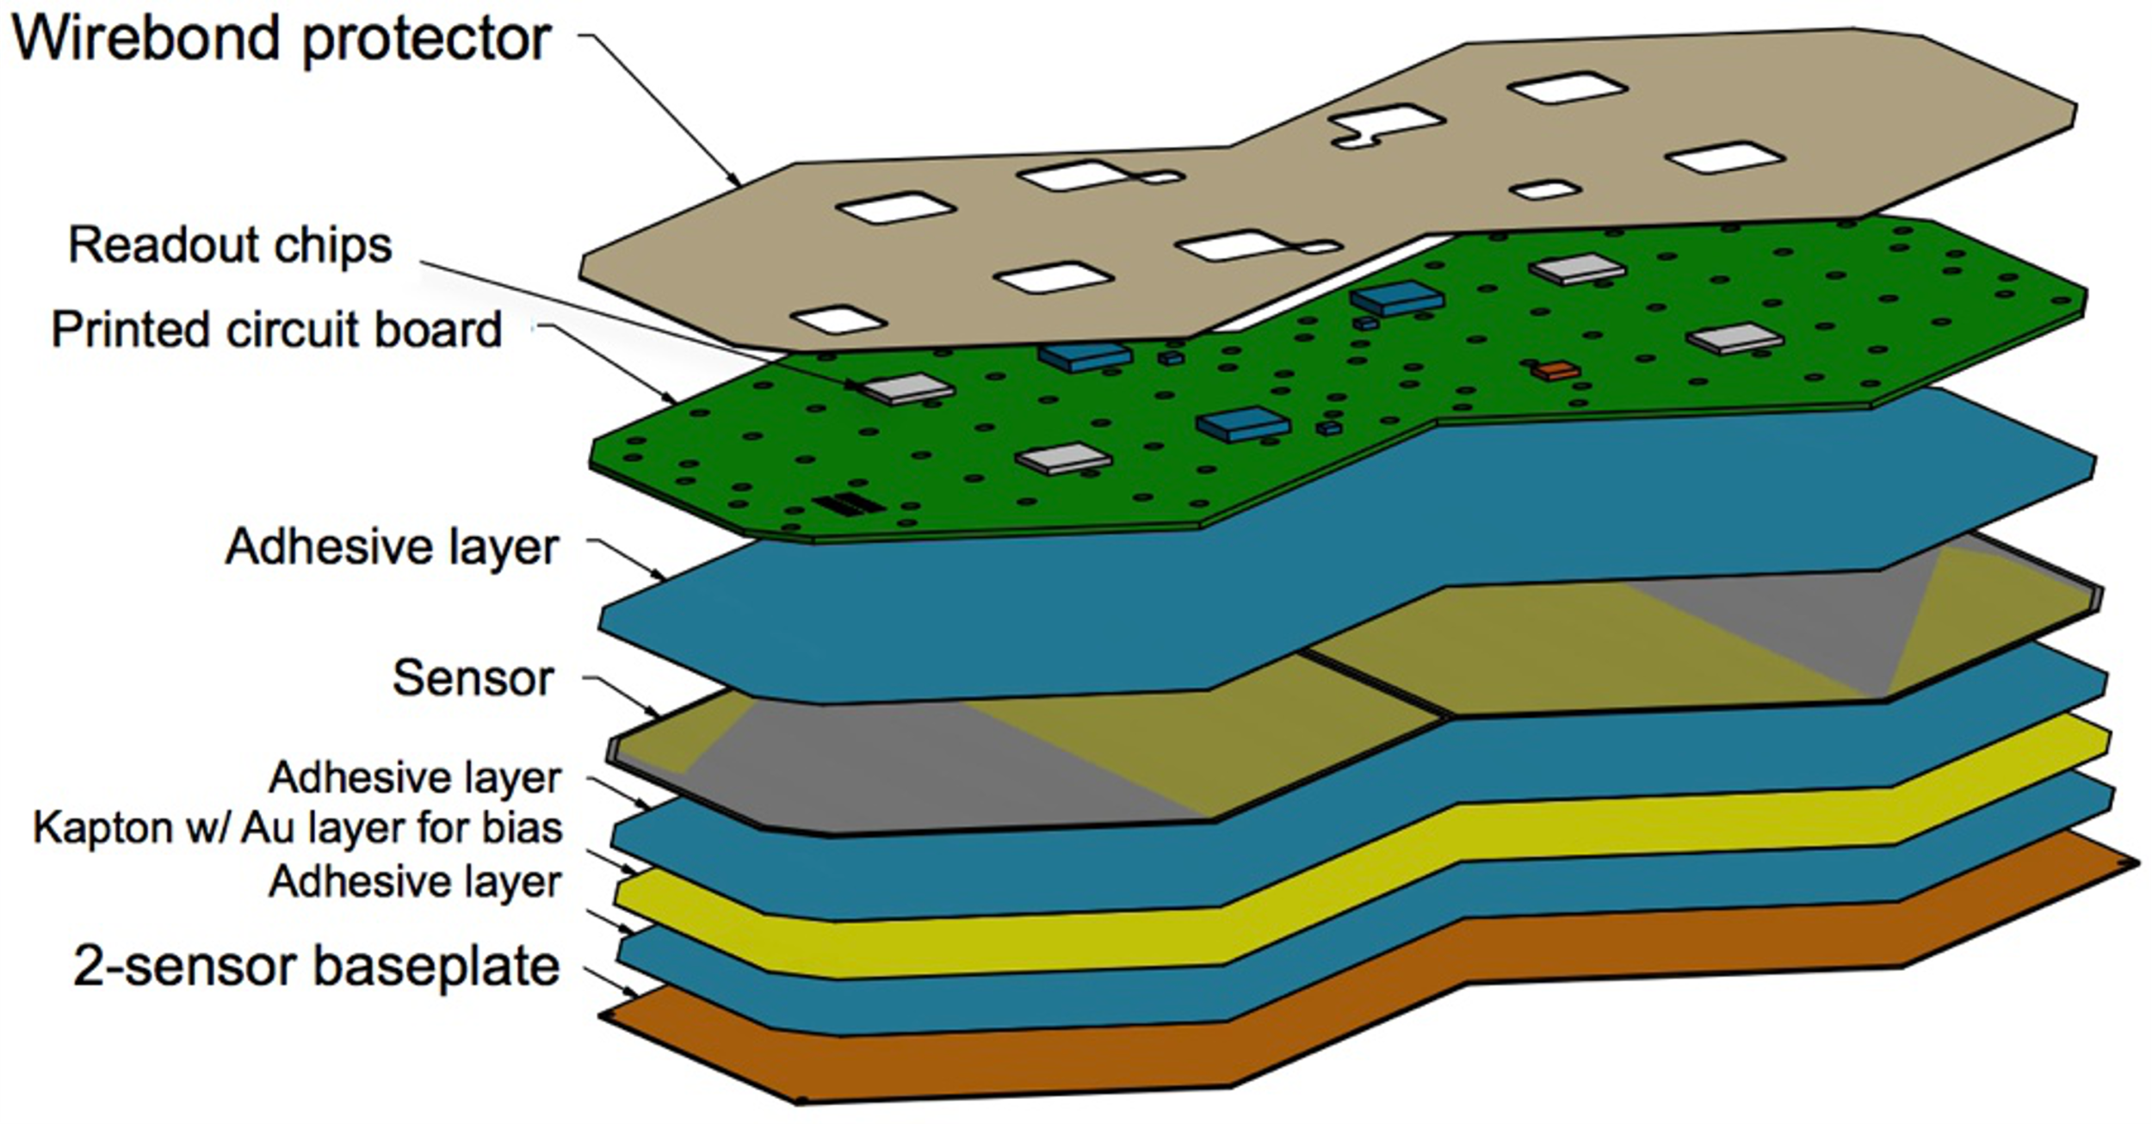
Calorimeter Endcap modules
593 m2 of silicon
6M ch, 0.5 or 1 cm2 cell-size
21,660 modules (8” or 2x6” sensors)
92,000 front-end ASICS

Slide 59
High-Granularity Endcap Calorimeters
1 Pb/s
4 ZB/yr
HGcal
1 Tb/s
4 EB/yr
1 Gb/s
4 PB/yr
7,500 modules @ 10Gb/s = 75Tb/s ≈ 300 EB/yr
(Trigger data only, L1 accepted data on separate fibres)
1 Mb/s
4 TB/yr

Slide 60
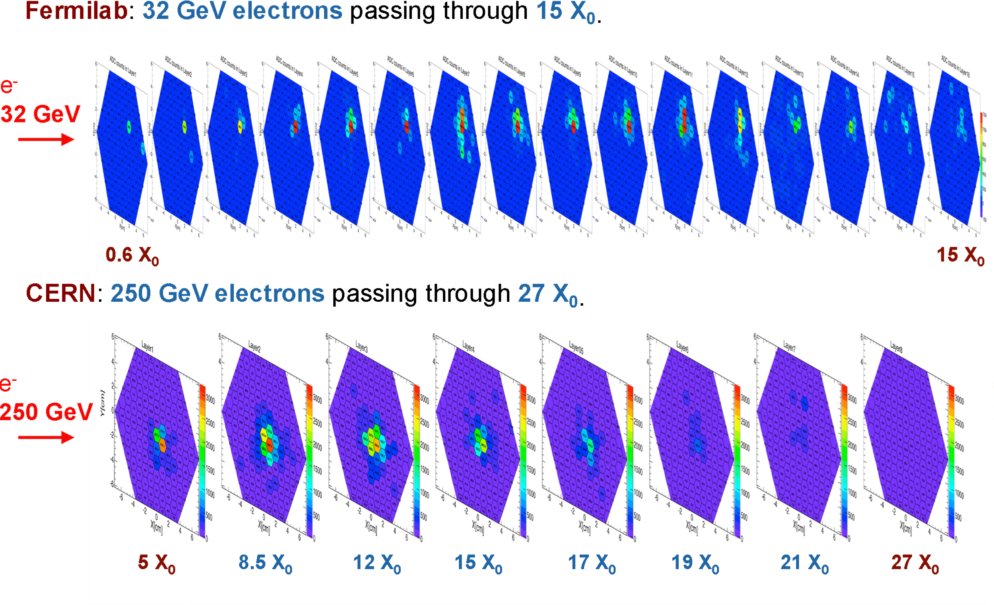
Calorimeter Endcap modules: Do they work?

Slide 61
What are the firmware challenges at Phase-II?
You mean, apart from the small matter of 300Tb/s of data?
So much data it has to be zero-suppressed
  No (or, at least, limited) geometric timing which can be utilized
  Variable data-volume
    Do you handle the worst case? Very inefficient
    Do you handle the average? How do you handle overflows?
We did such a good job at Phase-I, people have very high expectations…

Slide 62
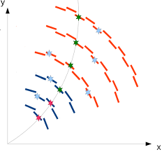
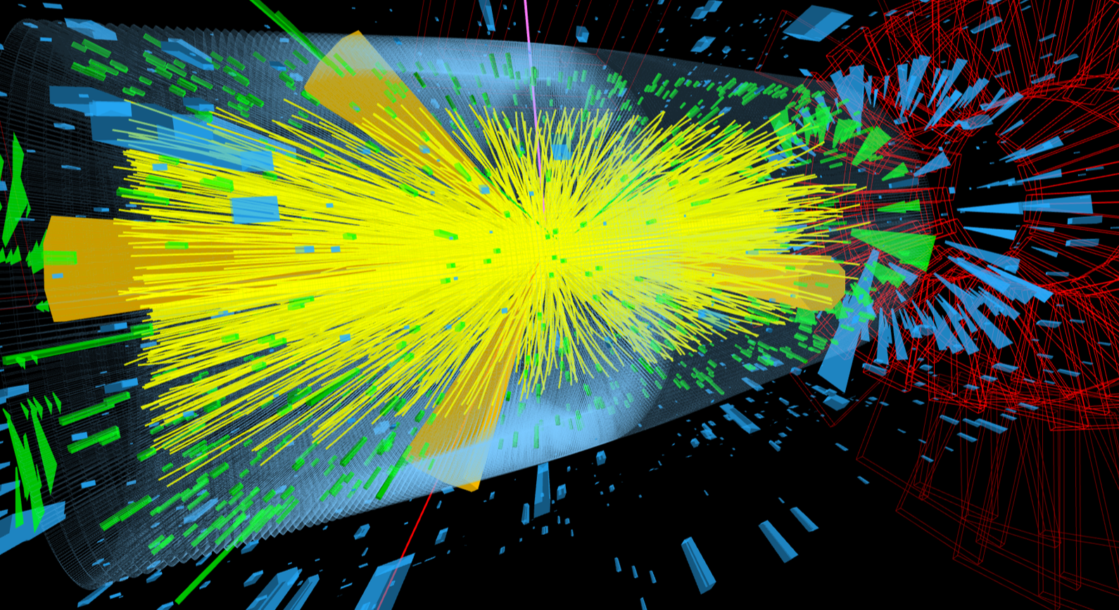
What are the firmware challenges at Phase-II?
Real-time track-finding and fitting

Slide 63
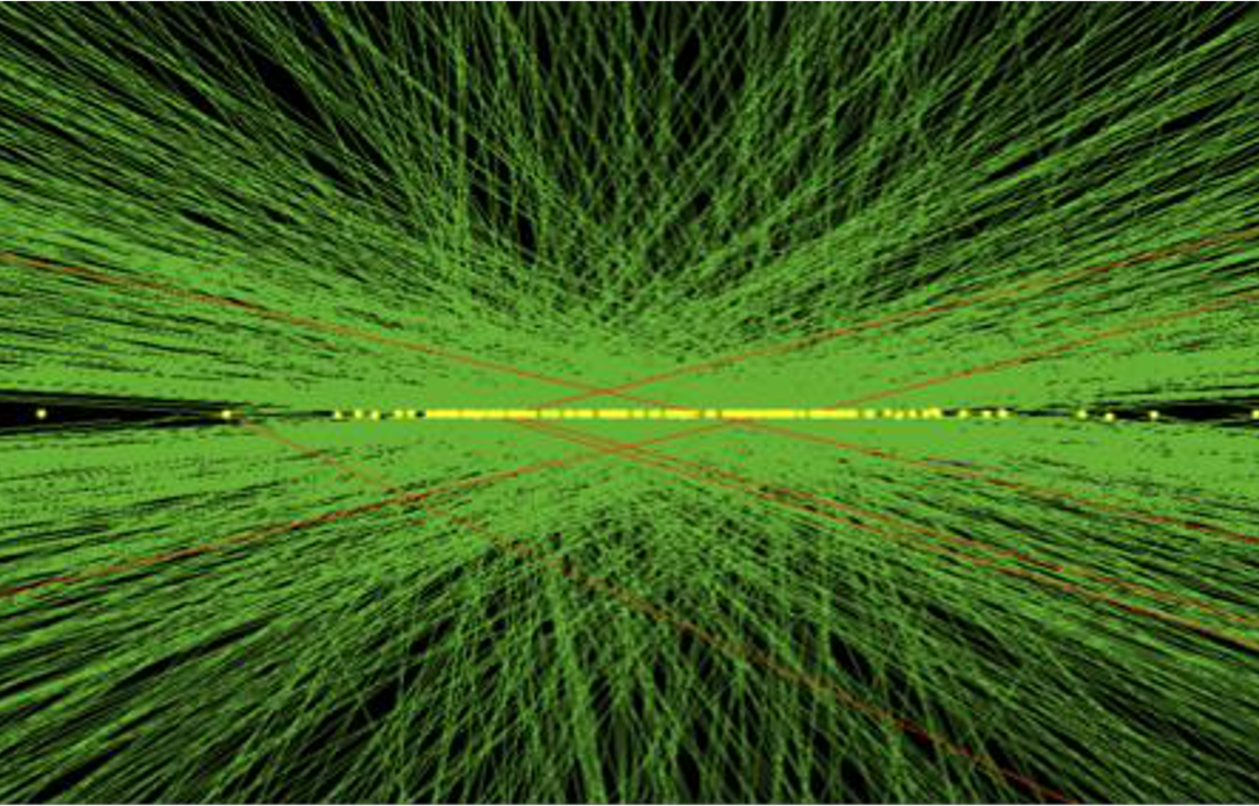
What are the firmware challenges at Phase-II?
Real-time track-finding and fitting
Real-time vertex-finding

Slide 64
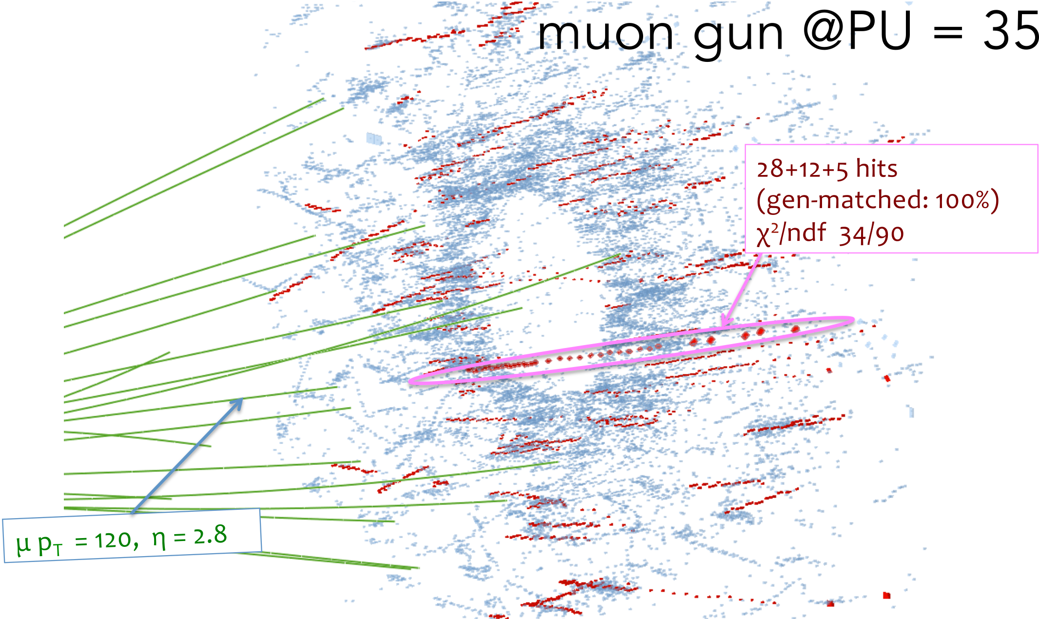
What are the firmware challenges at Phase-II?
Real-time track-finding and fitting
Real-time vertex-finding
3D cluster-finding in endcap

Slide 65
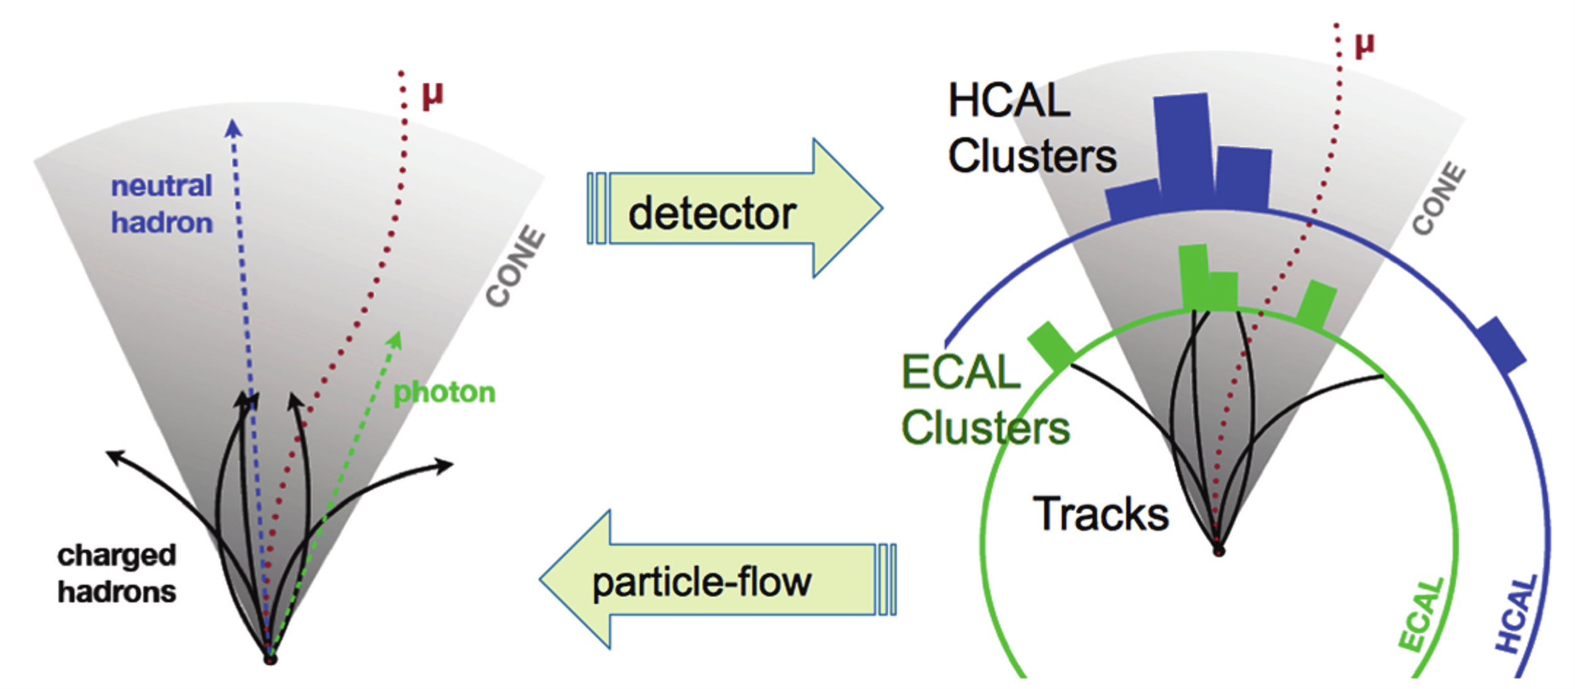
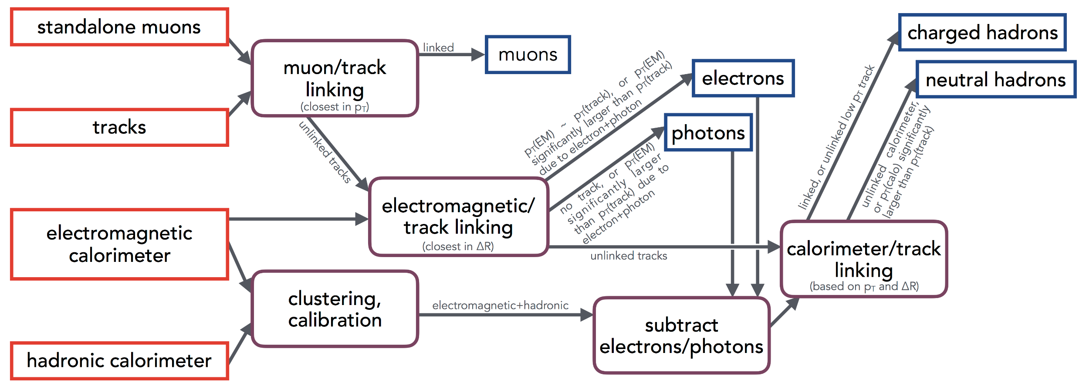
What are the firmware challenges at Phase-II?
Real-time track-finding and fitting
Real-time vertex-finding
3D cluster-finding in endcap
Particle-flow

Slide 66
What are the firmware challenges at Phase-II?
Real-time track-finding and fitting
Real-time vertex-finding
3D cluster-finding in endcap
Particle-flow
So, basically, they want event reconstruction

Slide 67
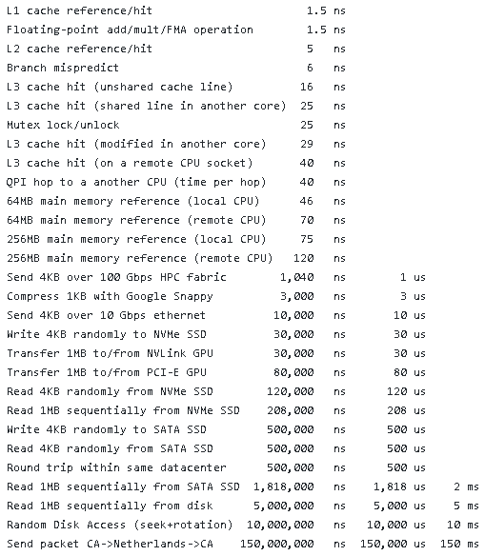
What are the firmware challenges at Phase-II?
Real-time track-finding and fitting
Real-time vertex-finding
3D cluster-finding in endcap
Particle-flow
So, basically, they want event reconstruction
  in under 10μs

Slide 68
And we have stepped up to the plate!
I used to give the following firmware advice to my students on preserving their sanity:
  Avoid iterative algorithms
  Avoid combinatorics
  Make the data-flow deterministic
  Division is hard, resource hungry and latency intensive
  Floating-point is hard, resource hungry and latency intensive

Slide 69
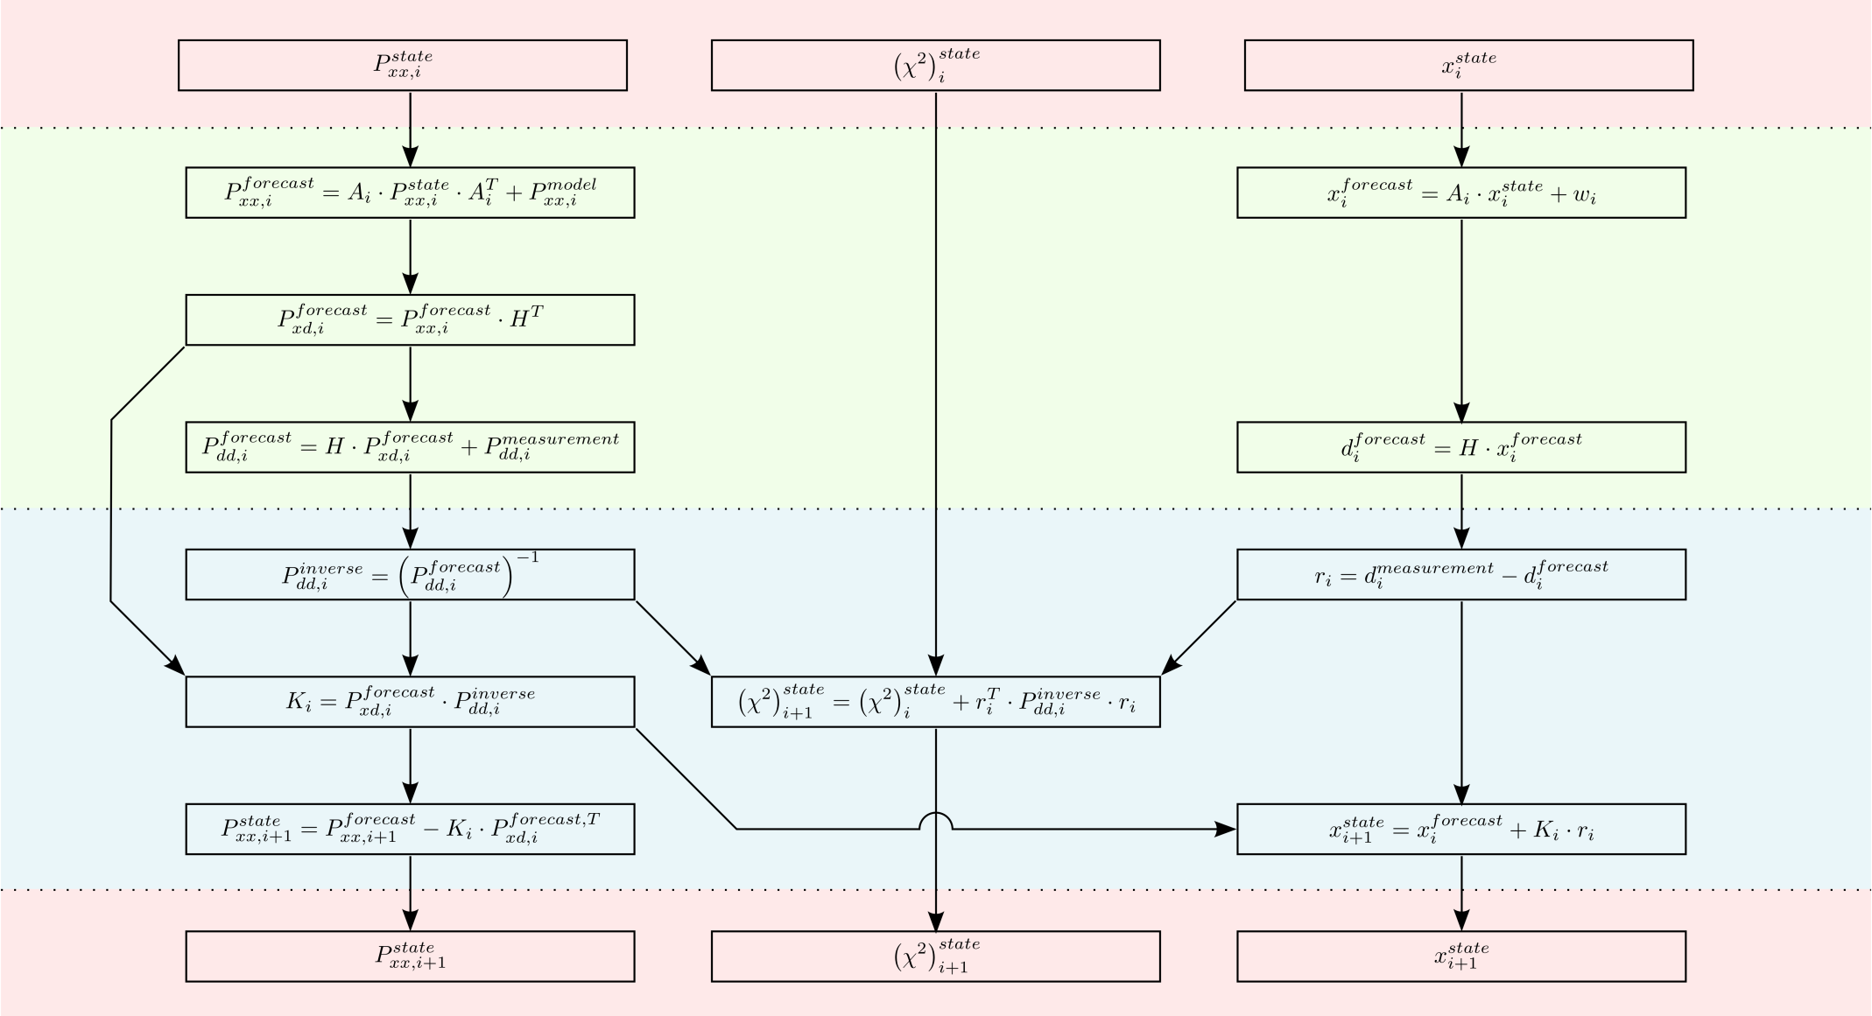
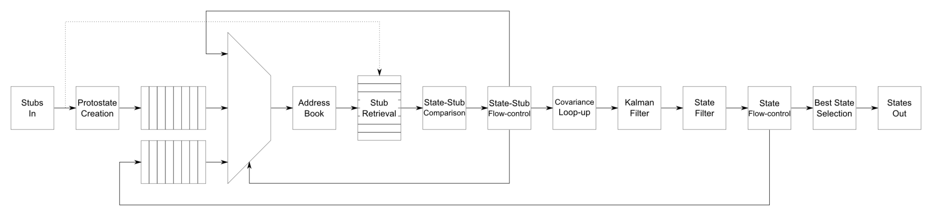
And we have stepped up to the plate!
In
For track fitter we wrote a full Kalman Filter
  Which is iterative
  Results in combinatorics
  Is data-dependent (pseudo-deterministic)
  Requires a division
  We also played with floating-point but dropped it in the final version
Forecast
Update
Out

Slide 70
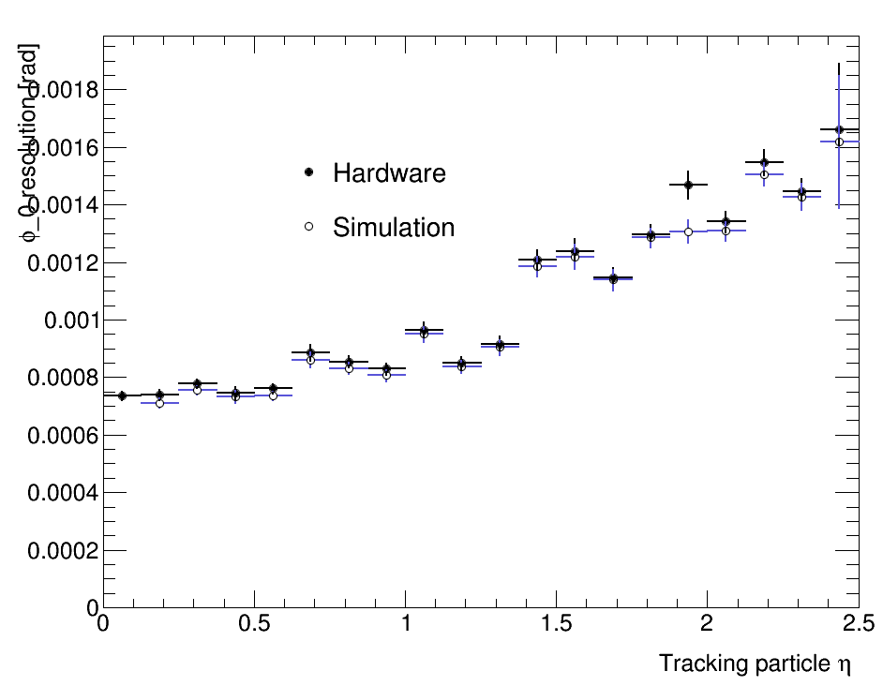
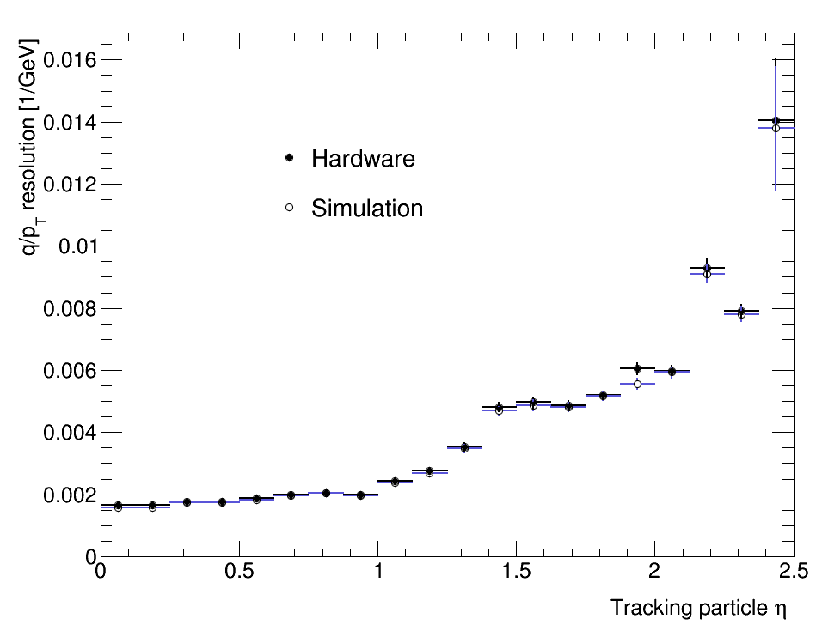

And we have stepped up to the plate!
Fits a 4-point track in 1.5μs
Matches offline floating-point resolution
200 events of TTbar+200PU
OPEN BLUE: floating-point CMSSW
CLOSED BLACK: Hardware capture

Slide 71

UK Common hardware: Serenity
ATCA Development Platform
Next-generation generic optical-stream processor
Carrier Card provides the board services
Daughter Cards host data-processing FPGAs

Slide 72

UK Common hardware: Serenity
CPU
36+36 firefly
36+36 firefly
North
Standard configuration. Provision for:
  2 × 72+72 links @ 25Gbps optical link
    3.6 + 3.6 Tbps
  64 links @ 25Gbps between DCs
    1.6 Tbps
Optional optical expansion:
  2 × 96+96 links @ 25Gbps optical link
    4.8 + 4.8 Tbps
  16 links @ 25Gbps between DCs
    0.4 Tbps
QSFP
64 pairs, direction unspecified
24+24 “spare”
24+24 “spare”
36+36 firefly
36+36 firefly
South

Slide 73
UK Common hardware: Serenity
CPU
36+36 firefly
36+36 firefly
North
Freedom to choose your preferred family, package, generation, (vendor?)
Freedom to choose your balance of optical and electrical connectivity
Reduces financial risk since carrier (bulk of potential failure-modes) qualified before FPGAs (bulk of the cost) are fitted!
QSFP
64 pairs, direction unspecified
24+24 “spare”
24+24 “spare”
36+36 firefly
36+36 firefly
South

Slide 74
Conclusion
Time-multiplexing reduces or eliminates the boundary-handling problems which plague conventional trigger architectures
CMS has successfully used time-multiplexing in the phase-1 upgrade of the calorimeter trigger
Time-multiplexing allows (or even encourages) the use of generic optical-stream processors

Slide 75
Conclusion
The phase-2 upgrades and environment pose significant challenges to the hardware trigger
  Both intrinsic and expectational
UK stepping up to face the challenges!
Time-multiplexing and generic hardware playing a prominent role in phase-2 upgrades

Slide 76
Bring on the future!
Thanks for listening!
Any questions?

Slide 77

The CMS detector

