Slide 1
Trigger Happy 2
The ongoing evolution of the CMS Detector and its L1-Trigger
Andy Rose, Imperial College, London
awr01@imperial.ac.uk
www.hep.ph.ic.ac.uk/~awr01

Slide 2
Introduction
This is a sequel to my 2011 seminar “Trigger Happy: A light-hearted look at the seriously hard business of hardware triggering (and how we are trying to make it easier)”
http://www.hep.ph.ic.ac.uk/~awr01/seminars/triggerhappy/TriggerHappy_v1.1.pptx
That talk:
Honestly (brutally) assessed the shortcomings of the existing CMS trigger
Lay out my glorious vision for the Phase-I upgrade of CMS trigger electronics
Speaker’s prerogative when you gave me a seminar soapbox
Parts of that vision came to pass, some parts didn’t
This talk will assess where CMS stands now, and what it faces after the Phase-II upgrades
And I’ll lay out my new glorious vision
Well… if you are a seminar soapbox again

Slide 3
Where are we with the LHC again?

Slide 4
Where are we with the LHC again?
Run 0
2008-2010
0.05 fb⁻¹

Slide 5
In the beginning…
Run 0
2008-2010
0.05 fb⁻¹

Slide 6
Run 1
Run 0
2008-2010
0.05 fb⁻¹

Slide 7
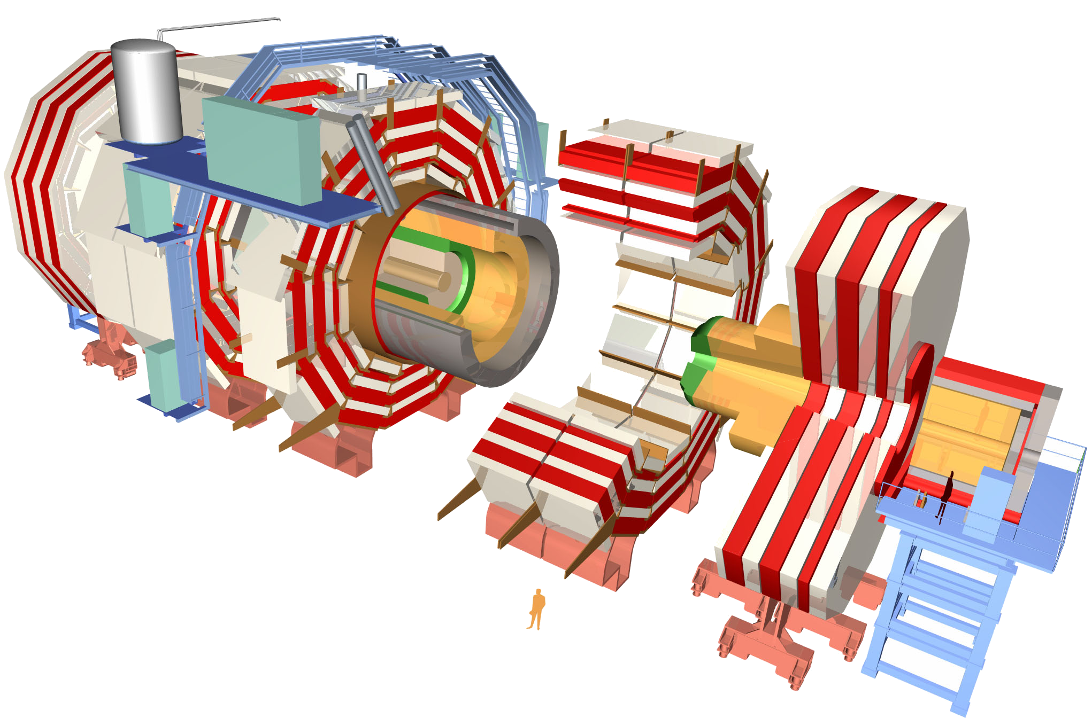
Recap
~80k PbWO₄ Ecal Crystals
~15k channel Brass/Plastic sampling HCAL
~568k RPC/DT/CSC Muon channels
~65M Silicon Pixels
~10M Silicon Strips
~3500 physicists/engineers

Slide 8
Recap
~80k PbWO₄ Ecal Crystals
~15k channel Brass/Plastic sampling HCAL
~568k RPC/DT/CSC Muon channels
× 40,000,000 measurements per second
~65M Silicon Pixels
~10M Silicon Strips
~3500 physicists/engineers

Slide 9
Recap
~80k PbWO₄ Ecal Crystals
≡ 40 TBit per second
~15k channel Brass/Plastic sampling HCAL
≡ 10 TBit per second
~568k RPC/DT/CSC Muon channels
≡ 23 TBit per second
~65M Silicon Pixels
≡ 21 PBit per second
~10M Silicon Strips
≡ 4 PBit per second
~3500 physicists/engineers

Slide 10
CMS: Visualizing the big numbers
1 Eb/s
4 YB/yr
CMS Front-end
1 Pb/s
4 ZB/yr
1 Tb/s
4 EB/yr
1 Gb/s
4 PB/yr
1 Mb/s
4 TB/yr

Slide 11
CMS: Visualizing the big numbers
1 Eb/s
4 YB/yr
CMS Front-end
1 Pb/s
4 ZB/yr
1 Tb/s
4 EB/yr
A man is too apt to forget that in this world he cannot have everything.
A choice is all that is left to him.
Carl W. Buechner
1 Gb/s
4 PB/yr
1 Mb/s
4 TB/yr

Slide 12
CMS: Visualizing the big numbers
1 Eb/s
4 YB/yr
CMS Front-end
1 Pb/s
4 ZB/yr
CMS L1T input
1 Tb/s
4 EB/yr
A man is too apt to forget that in this world he cannot have everything.
A choice is all that is left to him.
Carl W. Buechner
1 Gb/s
4 PB/yr
1 Mb/s
4 TB/yr

Slide 13
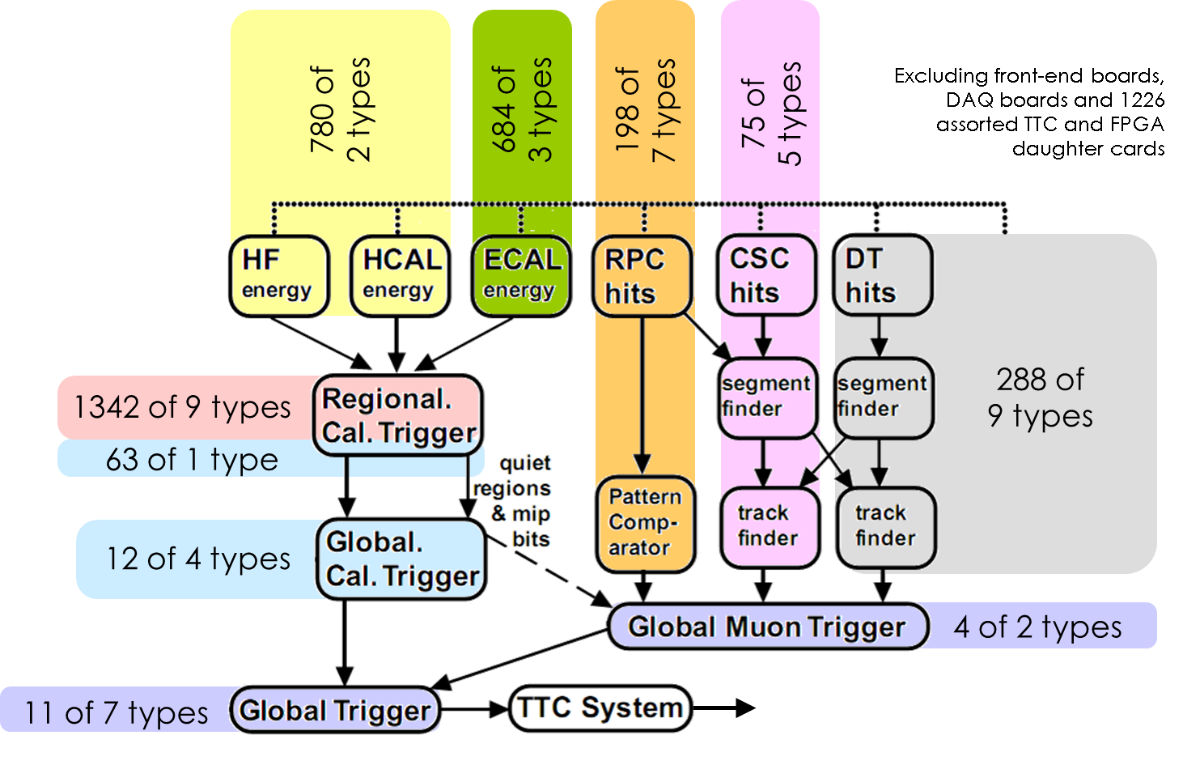
Runs 0 & 1: How we processed data
Many boards of many different types

Slide 14
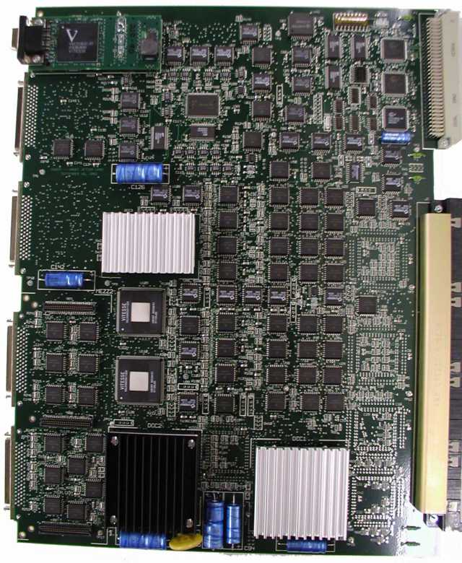
Runs 0 & 1: How we processed data
Most of which looked similar to this…

Slide 15
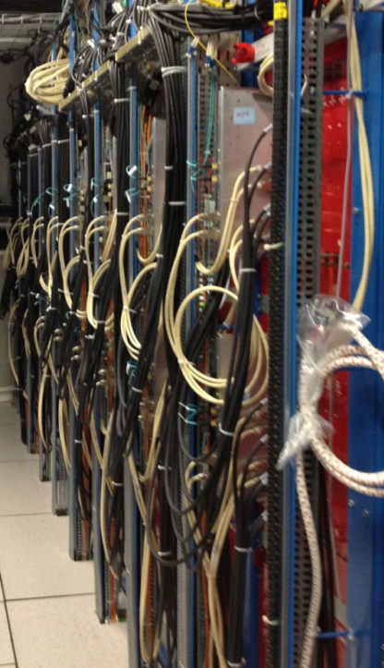
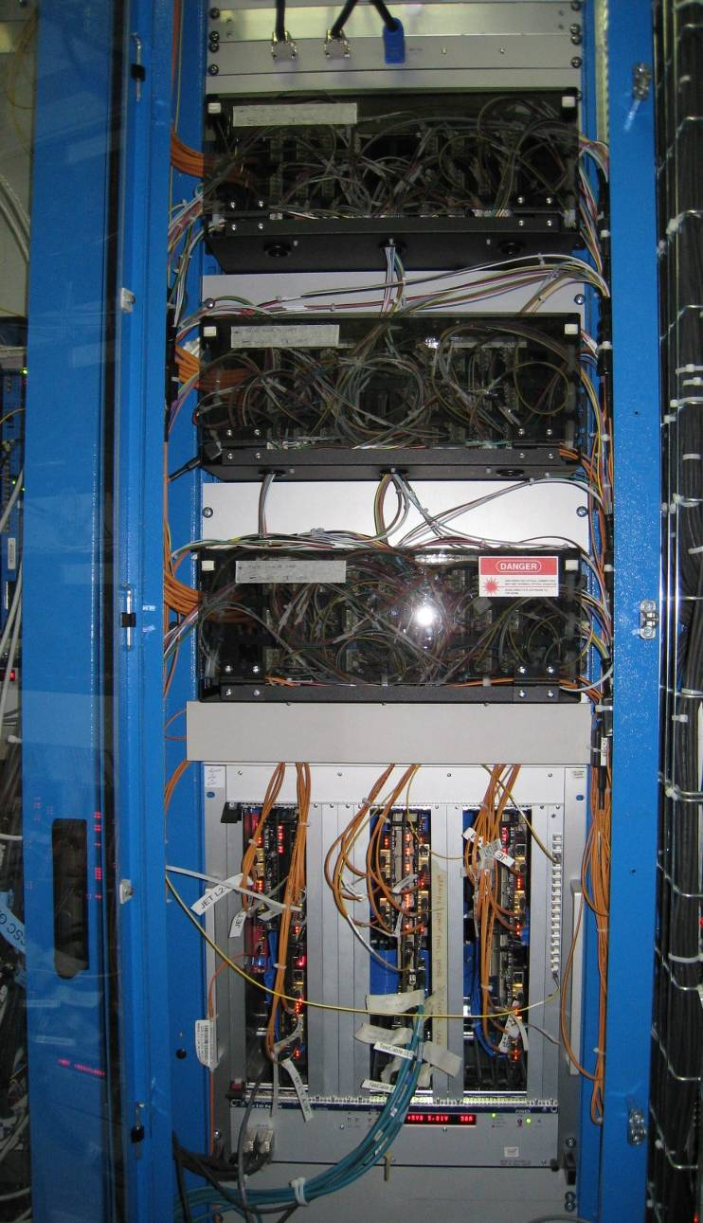
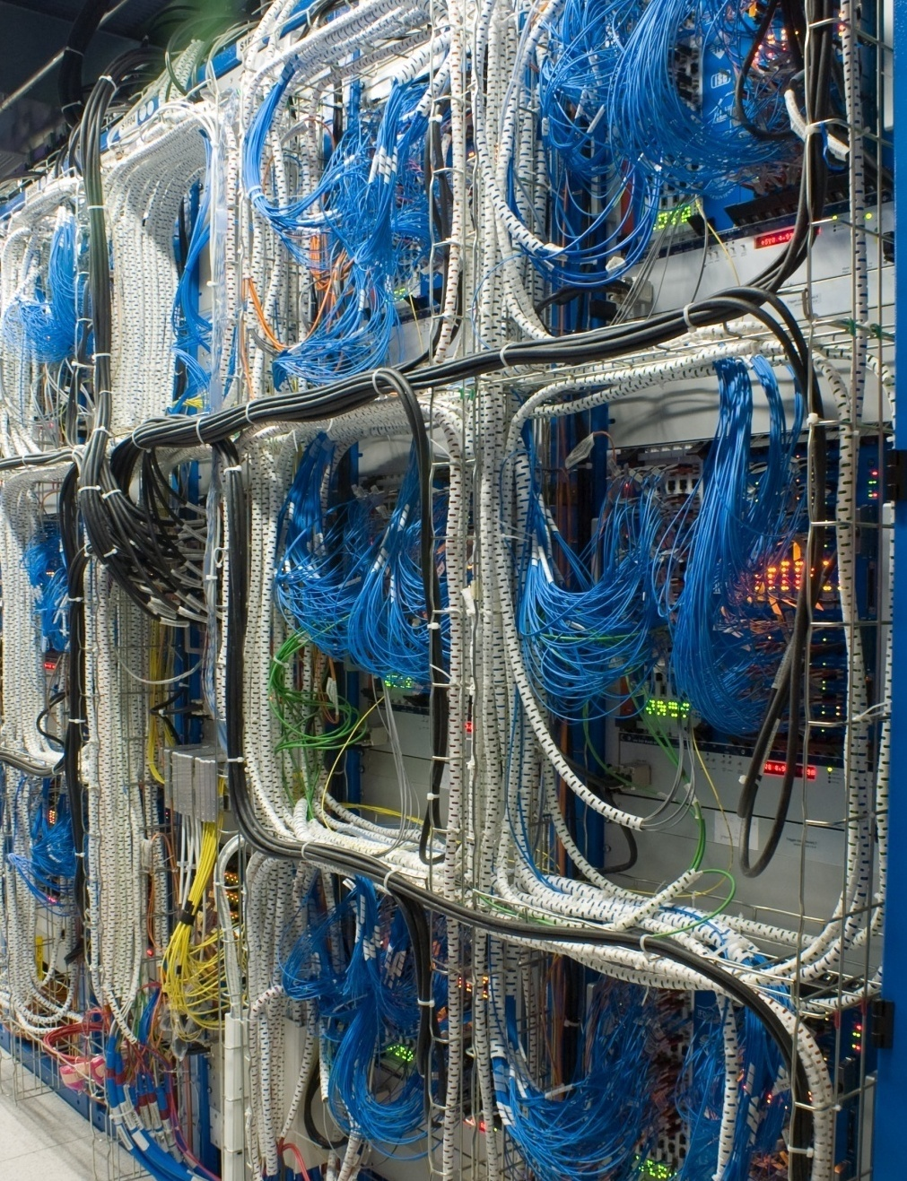
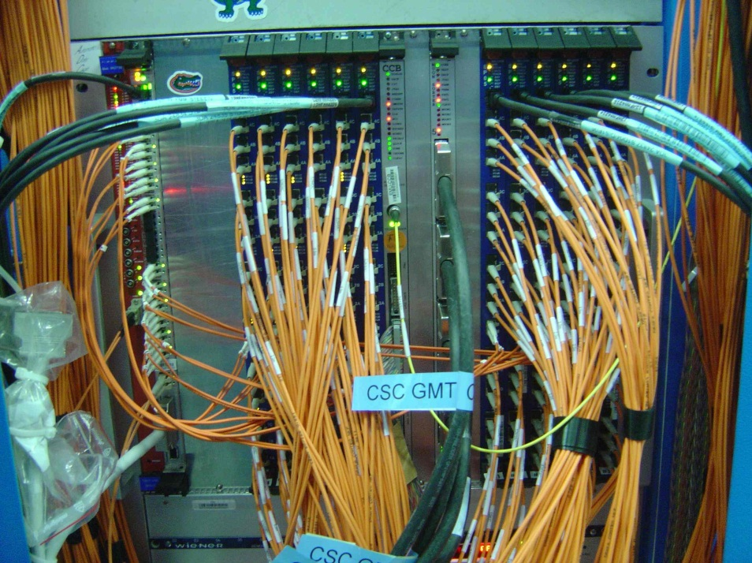
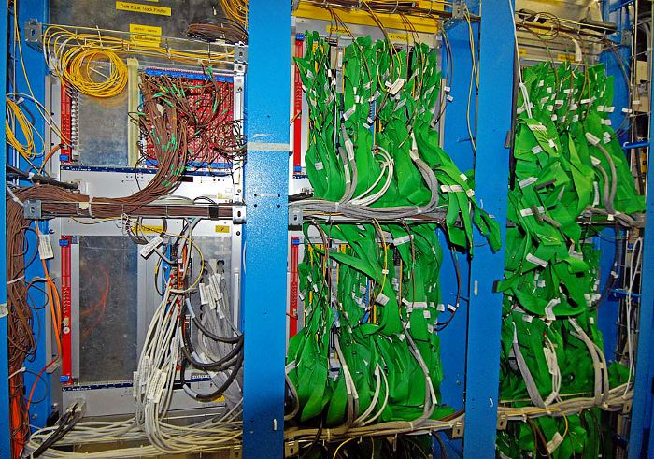
Runs 0 & 1: How we processed data
In systems that looked like this…

Slide 16
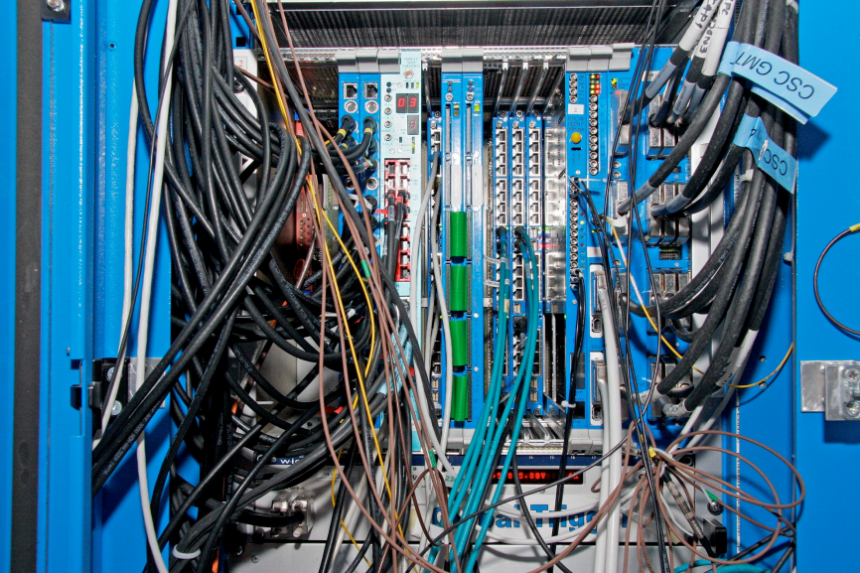
Runs 0 & 1: How we processed data
And like this…

Slide 17
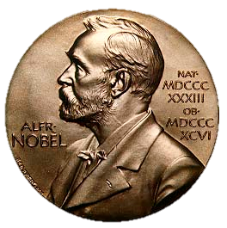
Runs 0 & 1: How we processed data
But sometimes it’s OK to be hideous if it works

Slide 18
Runs 0 & 1: How we processed data
But sometimes it’s OK to be hideous if it works
Who am I kidding? Such an opinion is for Philistines. We should always be aiming to produce something OF BEAUTY

Slide 19
The Prophecy and the Vision

Slide 20
The Prophetic Witticism…
By 2015, every board in the [CMS] trigger will be identical and, after that, they will only get more similar
Andy Rose, 2010

Slide 21
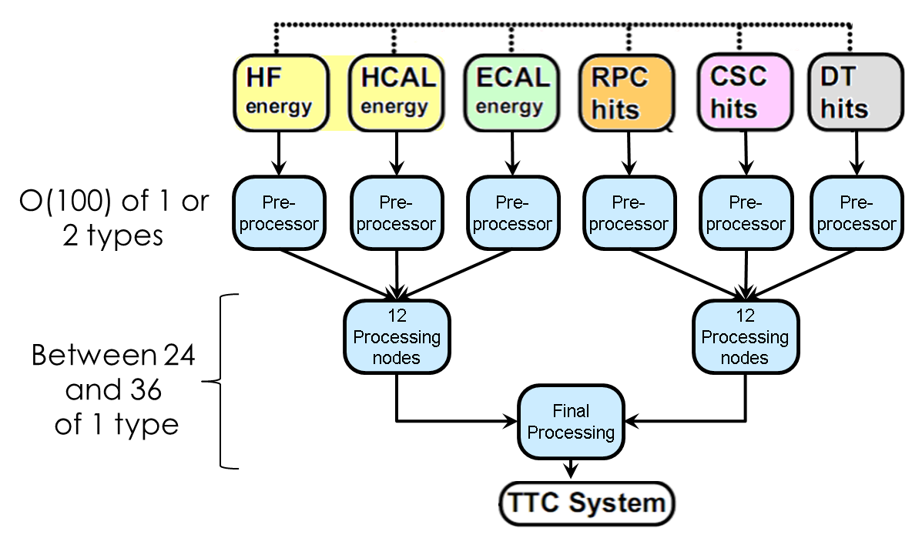
… which accompanied “The Vision”
In 2012, I presented my glorious vision:
Using time-multiplexing to achieve homogeneity by eliminating boundaries
A beautiful, highly homogeneous system
Common hardware
Common link-standards
Common software for controlling everything

Slide 22
The Vision
One board to rule them all, One link-standard to bind them, One control-bus to rule them all, And one software to mind them.

Slide 23
The Vision
One board to rule them all, One link-standard to bind them, One control-bus to rule them all, And one software to mind them.

Slide 24
The Prophetic Witticism
PCB
If you standardize the links and eliminate system-specific boundaries, then all boards
receive parallel streams of data
process parallel streams of data
output parallel streams of data
Multi Gbit TX
Multi Gbit TX
Multi Gbit TX
RAM
RAM
Large FPGA
DAQ and Control interface
Powering,
etc.
Multi Gbit RX
Multi Gbit RX
Multi Gbit RX

Slide 25
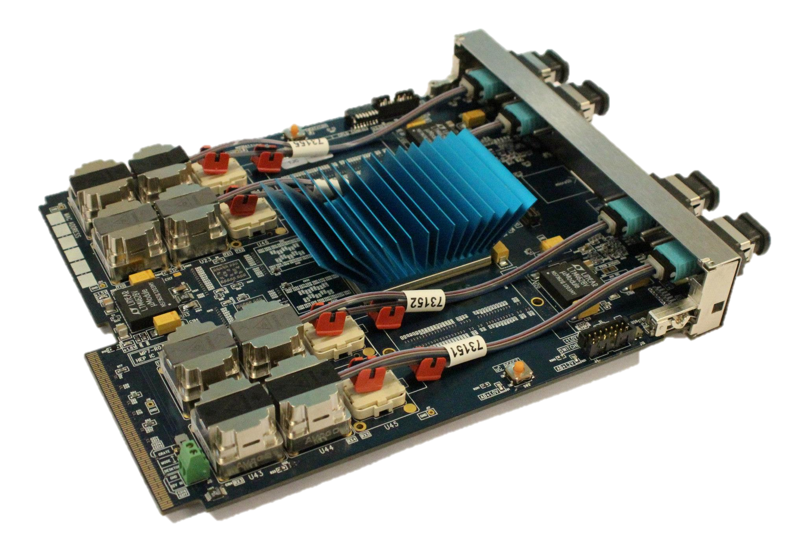
: The original and the best
950Gb/s in and 950Gb/s out
700,000 logic blocks @400MHz
Designed by G. Iles, J. Jones, A. Rose & S. Greenwood at IC

Slide 26
: The original and the best
950Gb/s in and 950Gb/s out
700,000 logic blocks @400MHz
Designed by G. Iles, J. Jones, A. Rose & S. Greenwood at IC
And it is laid out rationally and looks pretty

Slide 27
The Prophetic Witticism
Couple the limited variation in the tasks with the fact that:
The reign of ASICs was over: Long live the FPGA
The number of vendors making sufficiently powerful FPGAs was limited
The number of vendors making sufficiently fast optics was also limited
And the logic behind the prophecy becomes obvious
PCB
Multi Gbit TX
Multi Gbit TX
Multi Gbit TX
RAM
RAM
Large FPGA
DAQ and Control interface
Powering,
etc.
Multi Gbit RX
Multi Gbit RX
Multi Gbit RX

Slide 28
The Prophetic Witticism
Couple the limited variation in the tasks with the fact that:
The reign of ASICs was over: Long live the FPGA
The number of vendors making sufficiently powerful FPGAs was limited
The number of vendors making sufficiently fast optics was also limited
And the logic behind the prophecy becomes obvious, and so the prophecy came to pass…
PCB
Multi Gbit TX
Multi Gbit TX
Multi Gbit TX
RAM
RAM
Large FPGA
DAQ and Control interface
Powering,
etc.
Multi Gbit RX
Multi Gbit RX
Multi Gbit RX

Slide 29
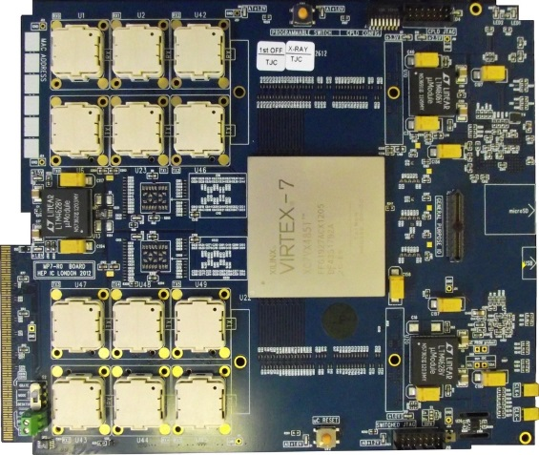
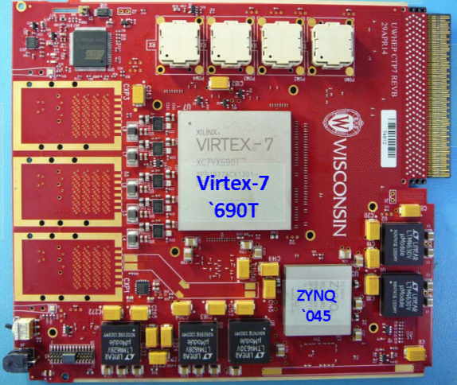
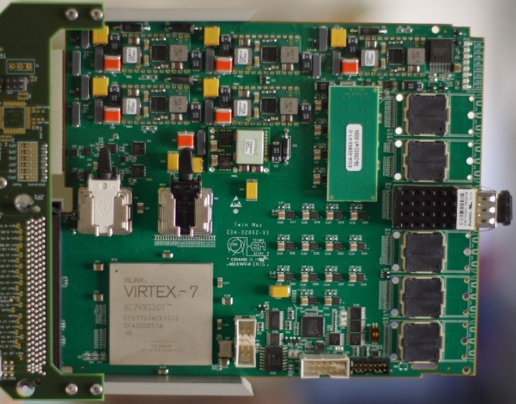
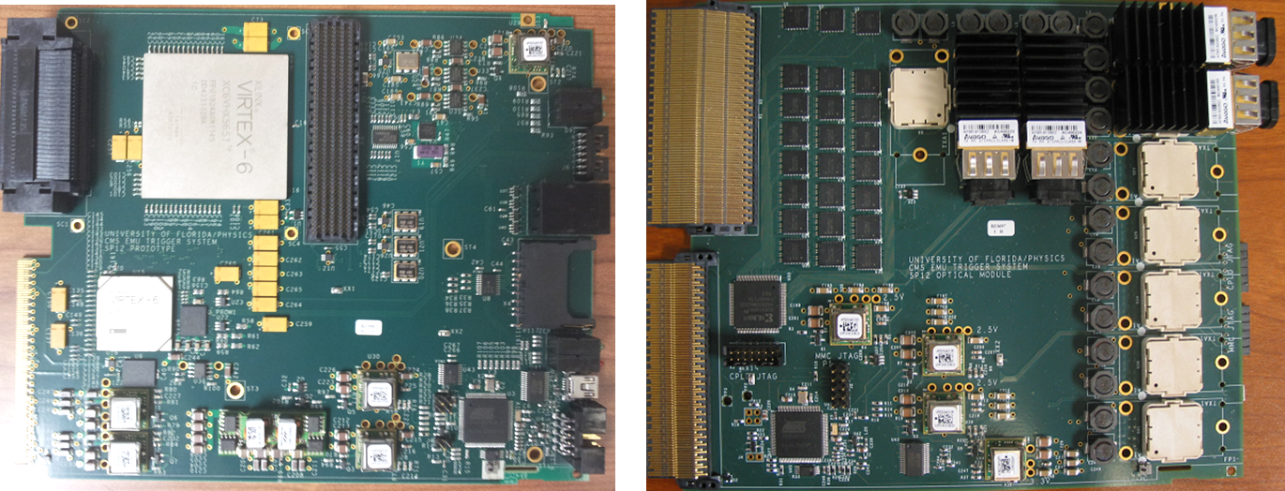
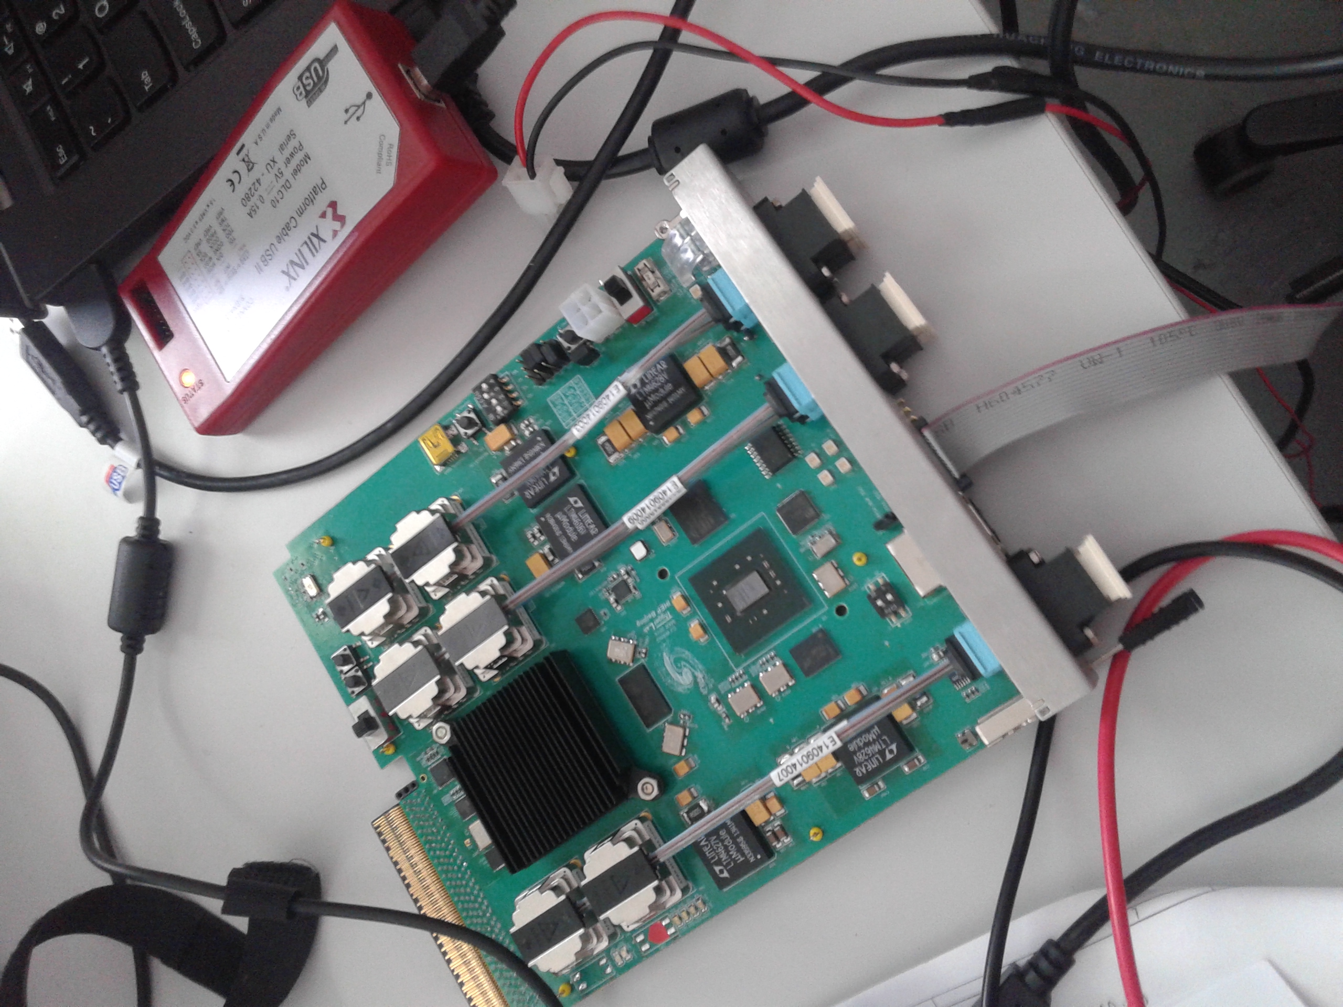
The Prophetic Witticism
Avago Optics
Avago Optics
Avago Optics
Virtex-7 690T
Avago Optics
Avago Optics
Virtex-7 690T
CTP7
TwinMux
Avago Optics
Virtex-7 690T
Avago Optics
Virtex-7 690T
Avago Optics
MTF7
CPPF
(MTF6 shown)

Slide 30
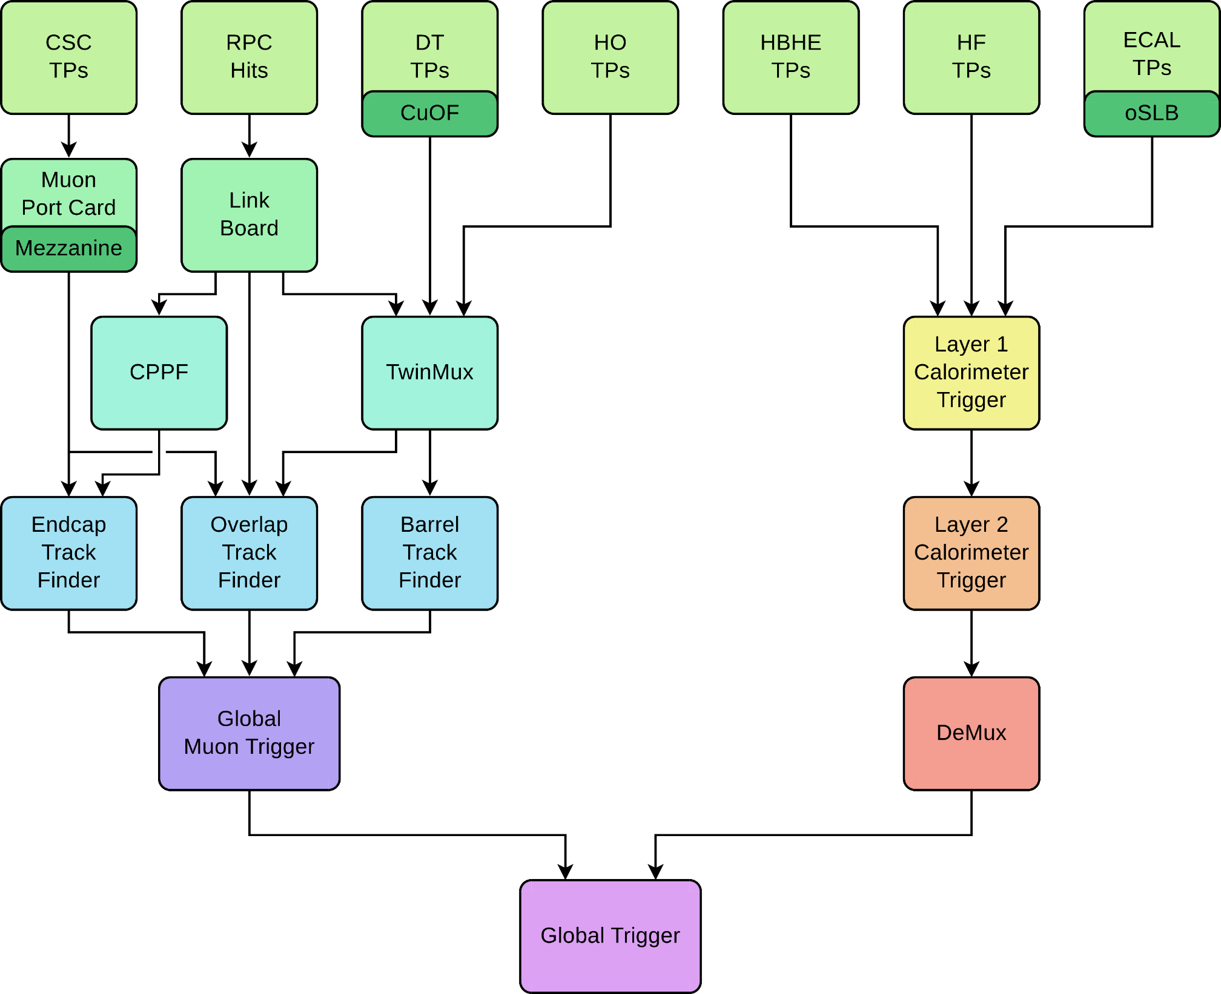
The Vision vs. Reality
Runs 0 & 1
Run 2
Conventional
Time-multiplexed
18 of 1 type
9 of 1 type

Slide 31
The Vision vs. Reality
Runs 0 & 1
Run 2
Conventional
Conventional

Slide 32
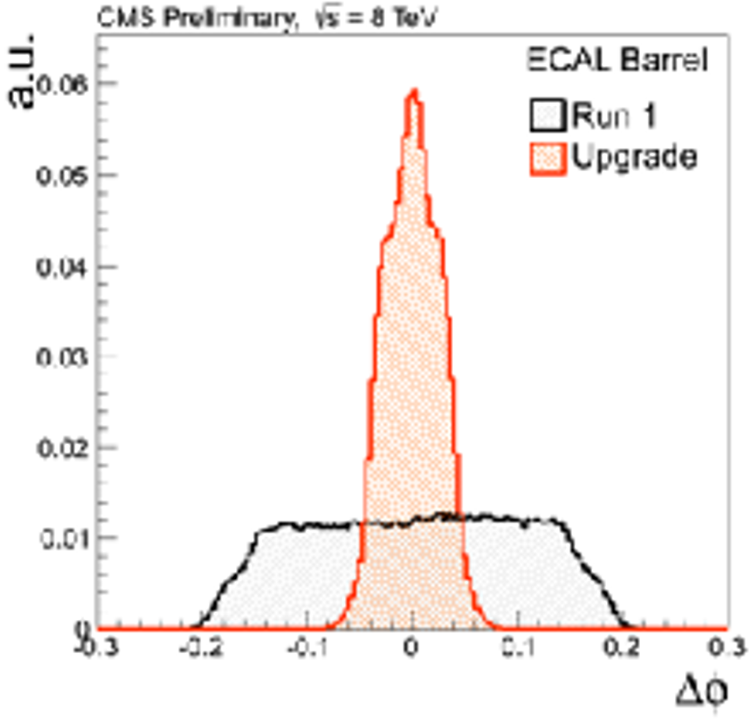
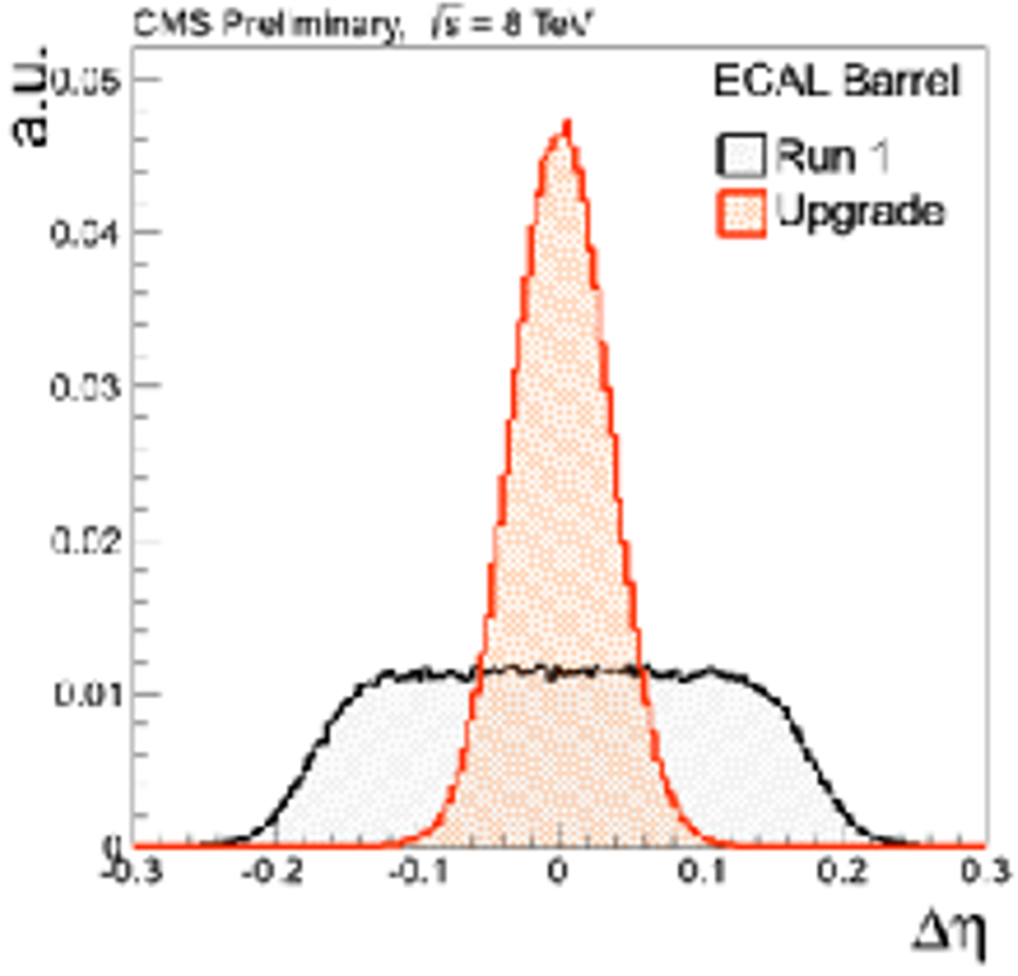
The Vision vs. Reality
Runs 0 & 1
Run 2
18 of 1 type
9 of 1 type

Slide 33
The Vision vs. Reality: Definitely better
“That is simple, my friend. It is because politics is more difficult than physics.”
Albert Einstein 1946

Slide 34
An aside: The Firmware Operating System
MP7 achieved this by
Separating the payload from the infrastructure
Standardizing the interfaces
Producing a build-tool to allow anyone to build their design in “unfamiliar hardware”
A victory for standardization!
SerDes & Buffers
Control
Payload
DAQ
SerDes & Buffers

Slide 35
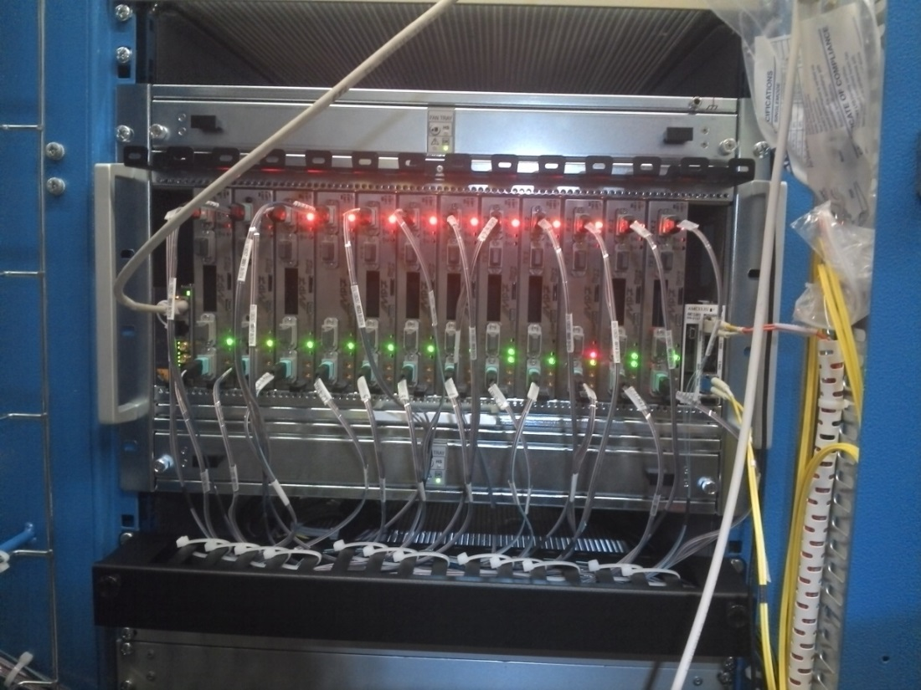
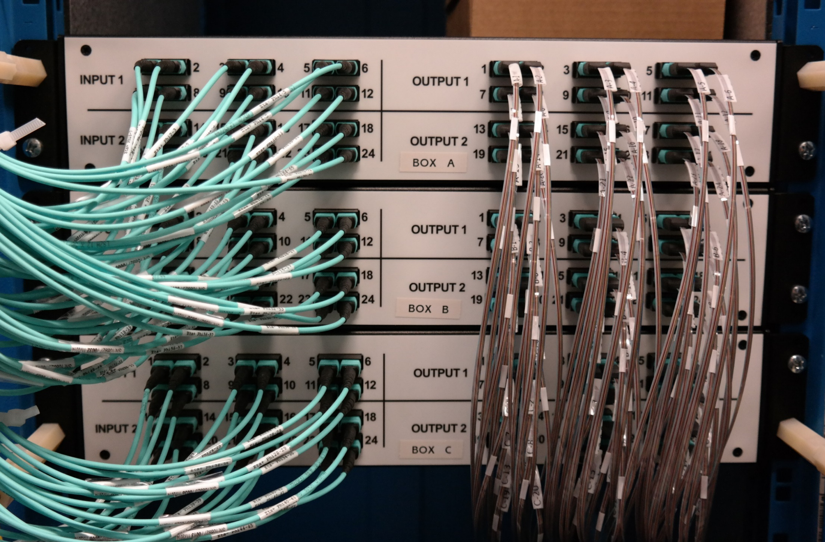
The Vision vs. Reality: Much, much better!

Slide 36
The Vision vs. Reality: Ever so nearly perfect!
IPbus designed out the US
Picked up at IC and bugs fixed
V2 produced at IC/RAL/Bristol
Adopted as standard across CMS
Then in the LHC accelerator group, ATLAS, LHCb, Alice, XFEL, SoLid, ProtoDune…
uHAL software library written at IC
Goes hand-in-hand with IPbus
Hurrah! A major victory for standardization!

Slide 37
Phase 1: Conclusion
Time-multiplexing works
Has been shown to offers all the benefits we said it would!
Now well established in the CMS mindset
The prophecy that all off-detector electronics would be “identical” in 2015 came to pass
The run-2 trigger was certainly more elegant and robust than runs 0 & 1
Many UK-originated ideas gained traction outside the UK:
Common hardware
Firmware operating system
Standardization of link protocols and control infrastructure

Slide 38
Phase 2: A Brave New World

Slide 39
Brave New World
Run 0
2008-2010
0.05 fb⁻¹

Slide 40
The CMS Detector after Phase-II
Upgrades relevant to triggering
Full granularity Ecal included in trigger
New CSC electronics
New RPC/GEM layers
New pixel layers
Tracking included in trigger
Complete replacement of endcap Ecal & Hcal
30ps timing resolution
Replace HPD with SiPM in Barrel HCAL
Depth info into trigger
MIP timing layer
30ps timing resolution
New Beampipe
Modified Magnet Yolk
…

Slide 41
What’s the UK doing?
UK has led, and continues to lead, the development of the Stacked-tracker concept and the tracking-trigger
UK delivering outer-tracker trigger and readout ASIC
UK delivering outer-tracker readout-electronics and developing track-finding algorithms

Slide 42
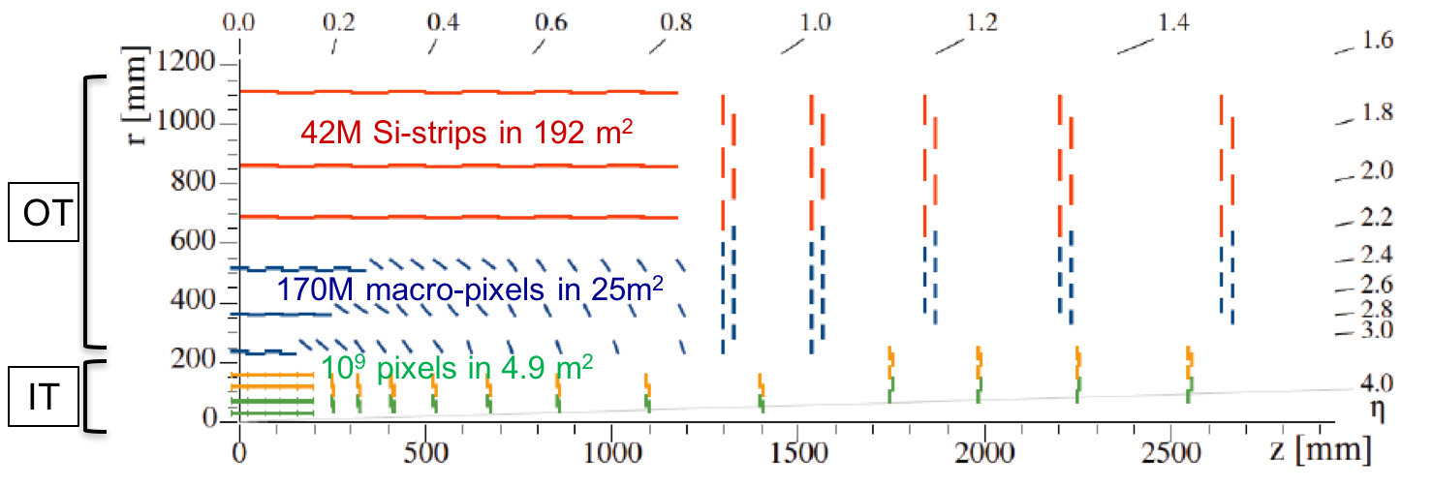
Tracker
Inner Tracker (pixel) design to extend coverage to η ≃ 3.8

Slide 43
Tracker
Inner Tracker (pixel) design to extend coverage to η ≃ 3.8
OT Si-sensors ≃ 200µm thick - 90/100µm pitch - 2.5/5cm strips
OT Si-sensors ≃ 200µm thick - 90/100µm pitch - 1.5 mm macro-pixels
IT Si-silicon sensors ≤ 150µm thickness - 50x50 to 25x100µm²

Slide 44
Tracker
Inner Tracker (pixel) design to extend coverage to η ≃ 3.8
Outer Tracker design driven by ability to provide tracks at 40 MHz to L1-trigger
-

Slide 45
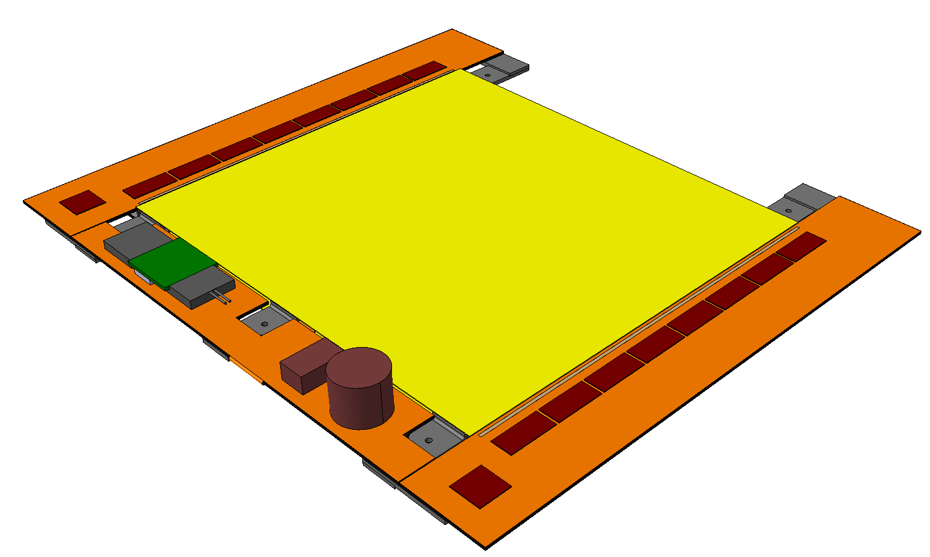
Outer tracker 2S modules
Silicon sensors
CBC
Flex PCB Hybrid
Outer
½ Module
Front End
Hybrid
Inner
Bridge
CF Stiffener
500µm CF Support
Double-Layer
Si Strip Detectors
2S Modules: Two-strip double-layers
~10k modules
42M channels
LP-GBT &
Optical VTRx
10 cm
Each 2S Module:
Sensor Area ~100 cm²
16 CBCs, each reading 254 strips
(127 from top & bottom sensors)
4064 Channels in total
Readout both L1 triggered data & Primitive trigger data
5 cm
127 Strips/CBC
8 CBCs per side
DC-DC
Converter
IC & RAL
CIC
1 per side
Service Hybrid

Slide 46
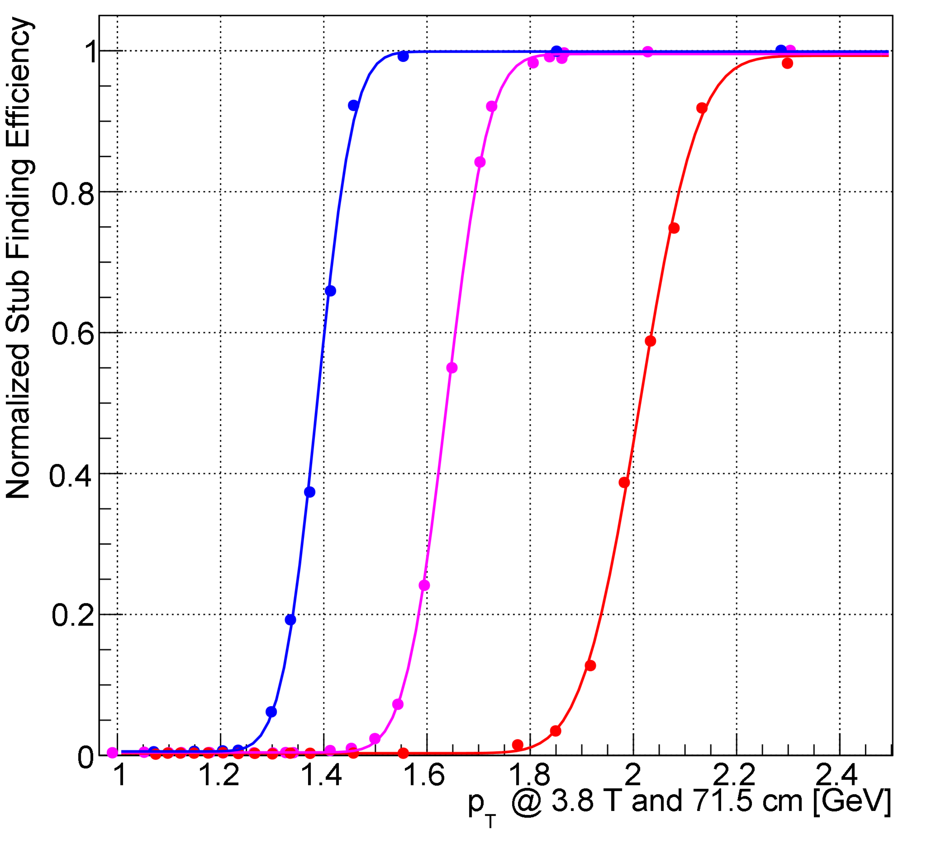
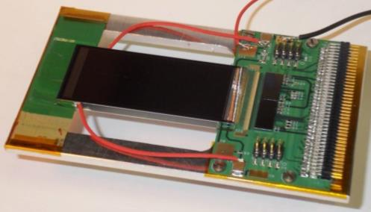
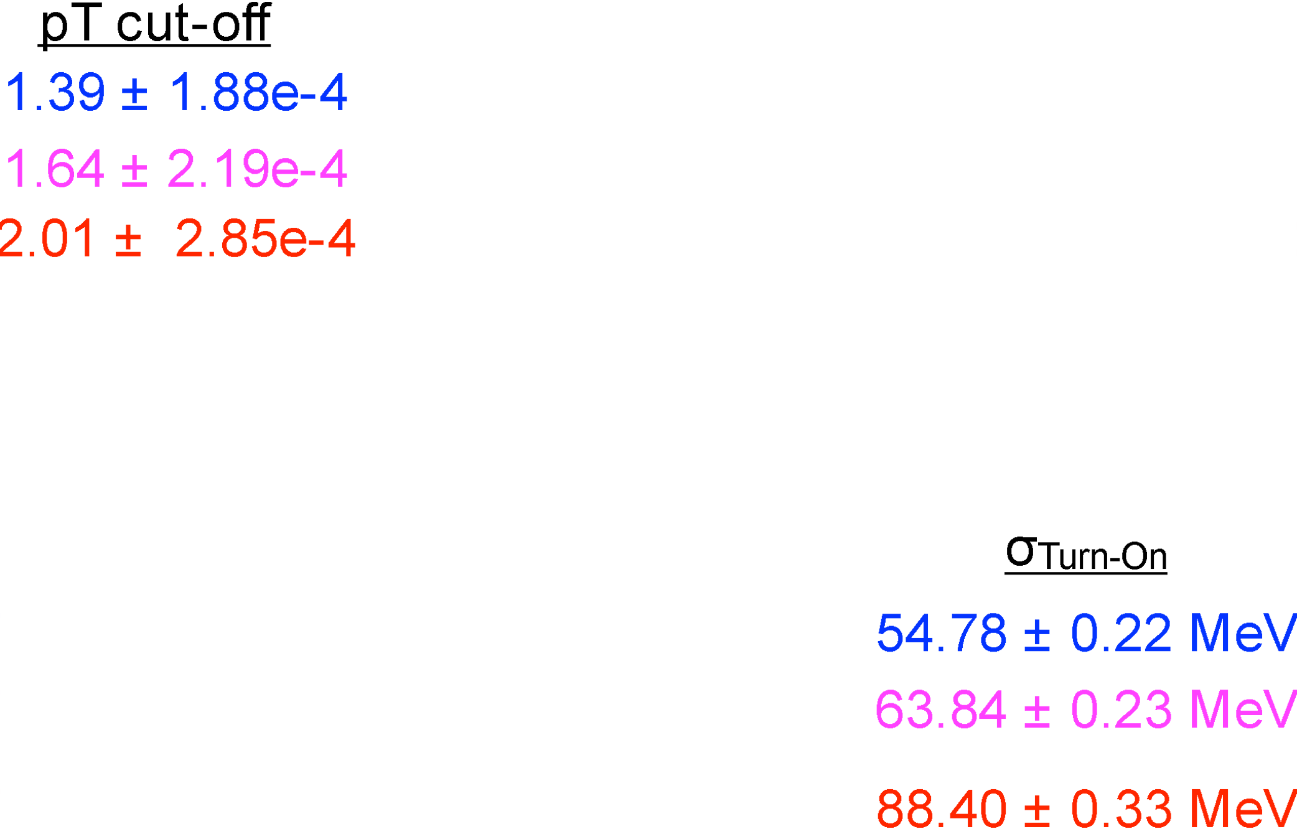
Outer tracker 2S modules: Do they work?
Stub turn-on curve for 2CBC mini-module at FNAL test-beam
Upper Sensor
2× CBC2
Lower Sensor

Slide 47
What’s the UK doing?
UK has led, and continues to lead, the development of the Stacked-tracker concept and the tracking-trigger
UK delivering outer-tracker trigger and readout ASIC
UK delivering outer-tracker readout-electronics and developing track-finding algorithms
UK has led, and continues to lead, the development of the HGC concept
Off-detector electronics and algorithms primarily a UK responsibility

Slide 48
Calorimeter Endcap design
3D shower topology and time resolution of ~30ps
Electromagnetic Endcap (EE)
28 layers of Silicon sensors in W/Pb absorber (25 X₀, 1.7λ)
Hadronic Endcap (EH)
24 layers: 8 silicon + 16 silicon/scint. tiles at high/low η in stainless steel absorber (9λ)
253 tonnes Total power at end of life = 160-180 kW @-30C
520m² Scint. Tiles 2x2 and 5x5 cm² + SiPM ~400k channels
600 m², 25000 modules , of hexagonal 8” sensors ~6M channels of area 0.5 and 1 cm²

Slide 49
Calorimeter Endcap design
3D shower topology and time resolution of ~30ps
Electromagnetic Endcap (EE)
28 layers of Silicon sensors in W/Pb absorber (25 X₀, 1.7λ)
Hadronic Endcap (EH)
24 layers: 8 silicon + 16 silicon/scint. tiles at high/low η in stainless steel absorber (9λ)
253 tonnes Total power at end of life = 160-180 kW @-30C
520m² Scint. Tiles 2x2 and 5x5 cm² + SiPM ~400k channels
Facing a MegaGray Dose
10¹⁶ cm⁻² 1MeV Neutron equivalent fluence
600 m², 25000 modules , of hexagonal 8” sensors ~6M channels of area 0.5 and 1 cm²

Slide 50
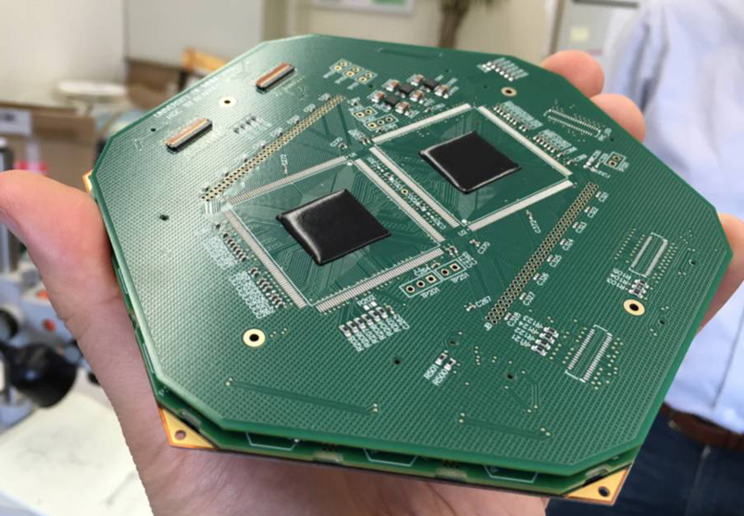
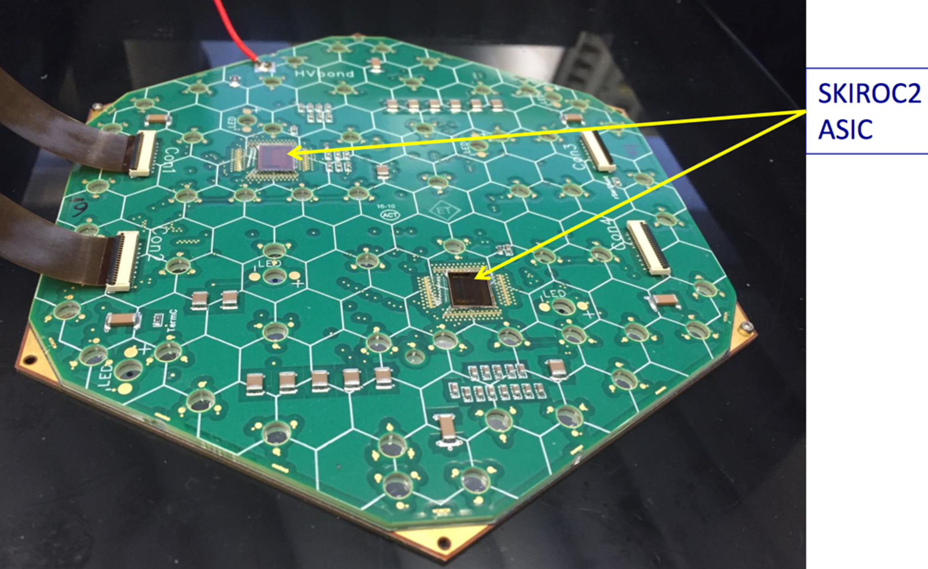
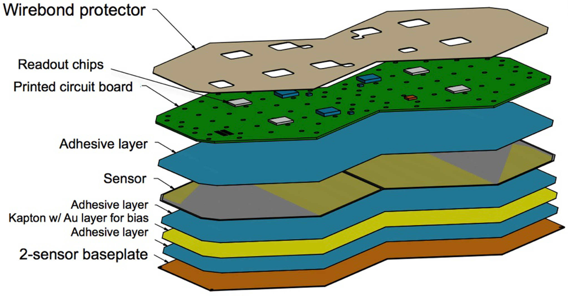
Calorimeter Endcap modules
593 m2 of silicon
6M ch, 0.5 or 1 cm2 cell-size
21,660 modules (8” or 2x6” sensors)
92,000 front-end ASICS

Slide 51
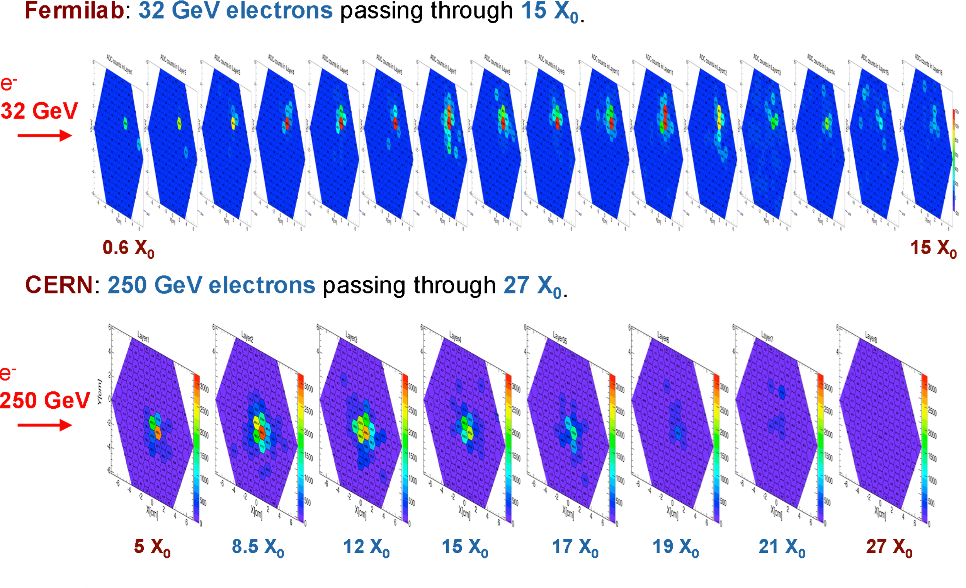
Calorimeter Endcap modules: Do they work?

Slide 52
What’s the UK doing?
UK has led, and continues to lead, the development of the Stacked-tracker concept and the tracking-trigger
UK delivering outer-tracker trigger and readout ASIC
UK delivering outer-tracker readout-electronics and developing track-finding algorithms
UK has led, and continues to lead, the development of the HGC concept
Off-detector electronics and algorithms primarily a UK responsibility
UK has played leading role in the trigger electronics and algos, would like to continue to do so
Barrel-Muon trigger currently using UK hardware and keen to continue doing so in future
Global trigger currently using UK hardware (future TBD)
Good relationship with those responsible for designing the MTD back-end, they are proposing to use UK hardware

Slide 53
What’s the UK doing?
UK has led, and continues to lead, the development of the Stacked-tracker concept and the tracking-trigger
UK delivering outer-tracker trigger and readout ASIC
UK delivering outer-tracker readout-electronics and developing track-finding algorithms
UK has led, and continues to lead, the development of the HGC concept
Off-detector electronics and algorithms primarily a UK responsibility
UK has played leading role in the trigger, electronics and algos would like to continue to do so
Barrel-Muon trigger currently using UK hardware and keen to continue doing so in future
Global trigger currently using UK hardware (future TBD)
Good relationship with those responsible for designing the MTD back-end, they are proposing to use UK hardware
So… looking like UK has major hardware role to play in every system except
Barrel Calorimeter
Endcap Muons
Pixels

Slide 54
What’s the UK doing?
UK has led, and continues to lead, the development of the Stacked-tracker concept and the tracking-trigger
UK delivering outer-tracker trigger and readout ASIC
UK delivering outer-tracker readout-electronics and developing track-finding algorithms
UK has led, and continues to lead, the development of the HGC concept
Off-detector electronics and algorithms primarily a UK responsibility
UK has played leading role in the trigger electronics and algos, would like to continue to do so
Barrel-Muon trigger currently using UK hardware and keen to continue doing so in future
Global trigger currently using UK hardware (future TBD)
Good relationship with those responsible for designing the MTD back-end, they are proposing to use UK hardware
So… looking like UK has major hardware role to play in every system except
Barrel Calorimeter
Endcap Muons
Pixels
Not bad going for a collaboration of only 4 institutes

Slide 55
What’s the UK doing?
UK has led, and continues to lead, the development of the Stacked-tracker concept and the tracking-trigger
UK delivering outer-tracker trigger and readout ASIC
UK delivering outer-tracker readout-electronics and developing track-finding algorithms
UK has led, and continues to lead, the development of the HGC concept
Off-detector electronics and algorithms primarily a UK responsibility
UK has played leading role in the trigger electronics and algos, would like to continue to do so
Barrel-Muon trigger currently using UK hardware and keen to continue doing so in future
Global trigger currently using UK hardware (future TBD)
Good relationship with those responsible for designing the MTD back-end, they are proposing to use UK hardware

Slide 56
So who is stupid enough to take on the task of designing hardware for so many disparate systems?

Slide 57
So who is stupid enough to take on the task of designing hardware for so many disparate systems?

Slide 58
Serenity
ATCA Development Platform
Next generation optical stream processor
Carrier Card provides the board services
Daughter Cards host data-processing FPGAs

Slide 59
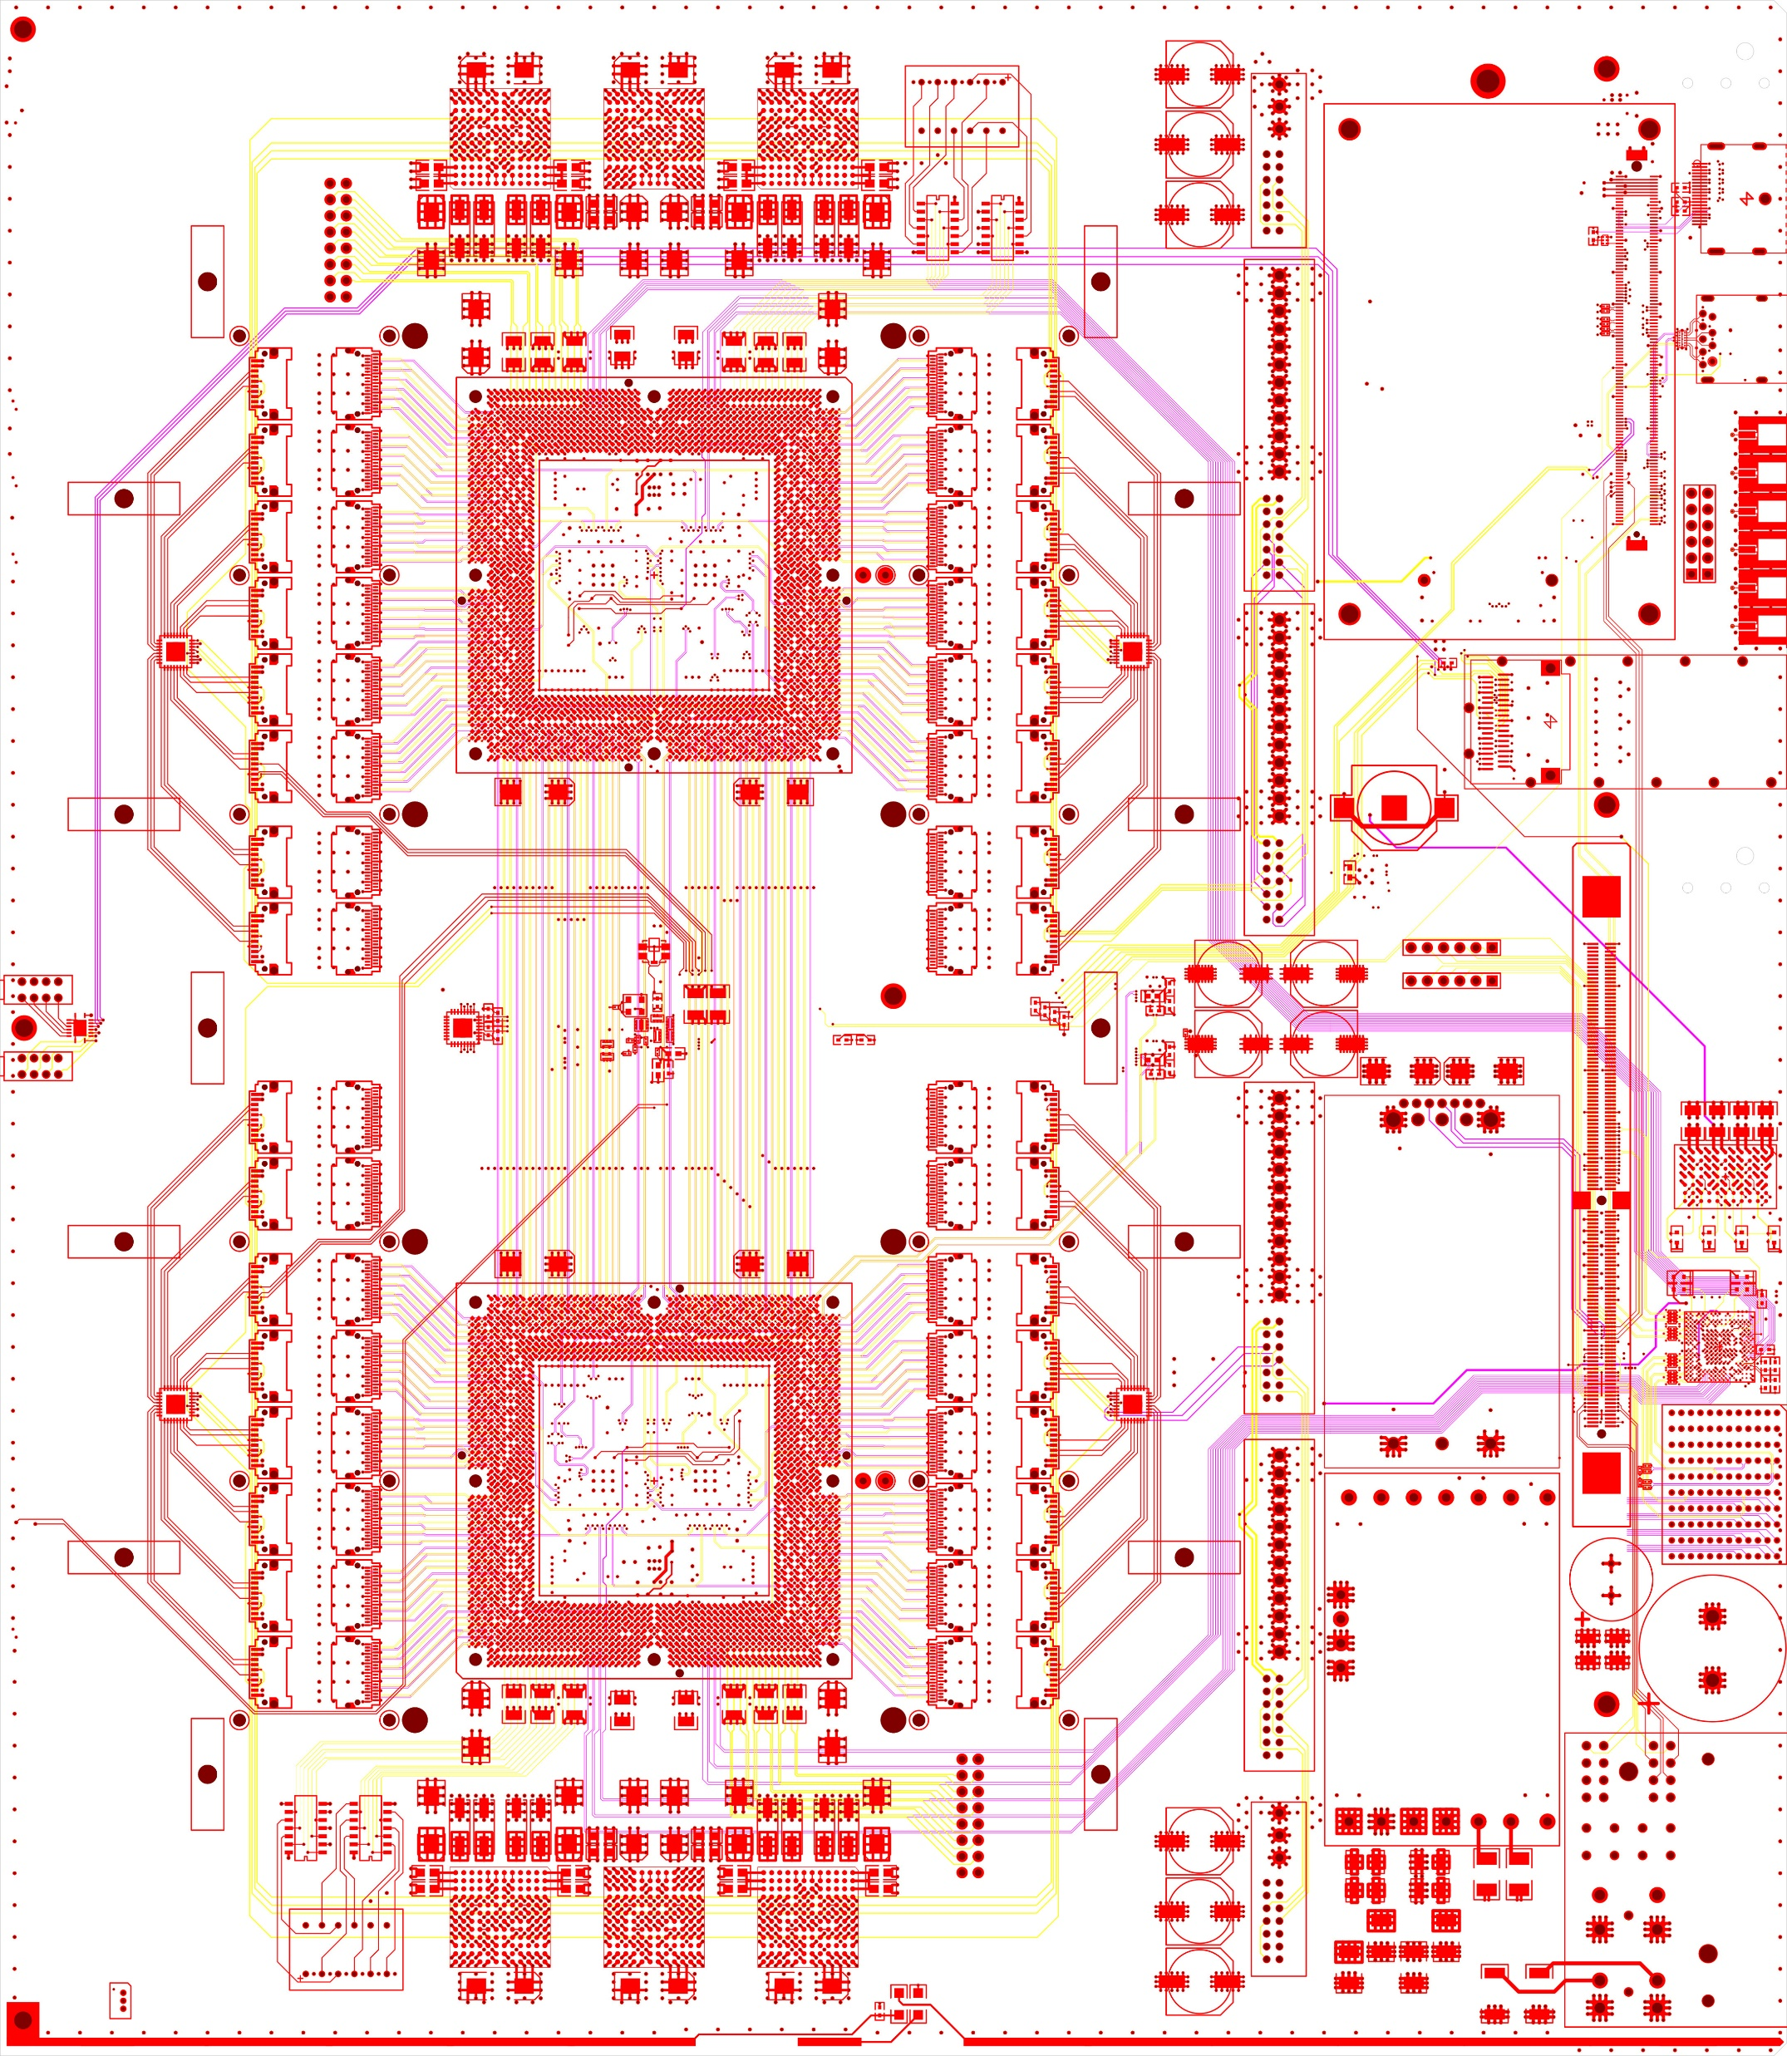
Serenity
CPU
36+36 firefly
36+36 firefly
Standard configuration. Provision for:
2 × 72+72 links @ 25Gbps optical link
3.6 + 3.6 Tbps
64 links @ 25Gbps between DCs
1.6 Tbps
Optional optical expansion:
2 × 96+96 links @ 25Gbps optical link
4.8 + 4.8 Tbps
16 links @ 25Gbps between DCs
0.4 Tbps
North
QSFP
64 pairs, direction unspecified
24+24 “spare”
24+24 “spare”
36+36 firefly
36+36 firefly
South

Slide 60
Serenity
CPU
36+36 firefly
36+36 firefly
Freedom to choose your preferred family, package, generation, (vendor?)
Freedom to choose your balance of optical and electrical connectivity
Reduces financial risk since carrier (bulk of potential failure-modes) qualified before FPGAs (bulk of the cost) are fitted!
North
QSFP
64 pairs, direction unspecified
24+24 “spare”
24+24 “spare”
36+36 firefly
36+36 firefly
South

Slide 61
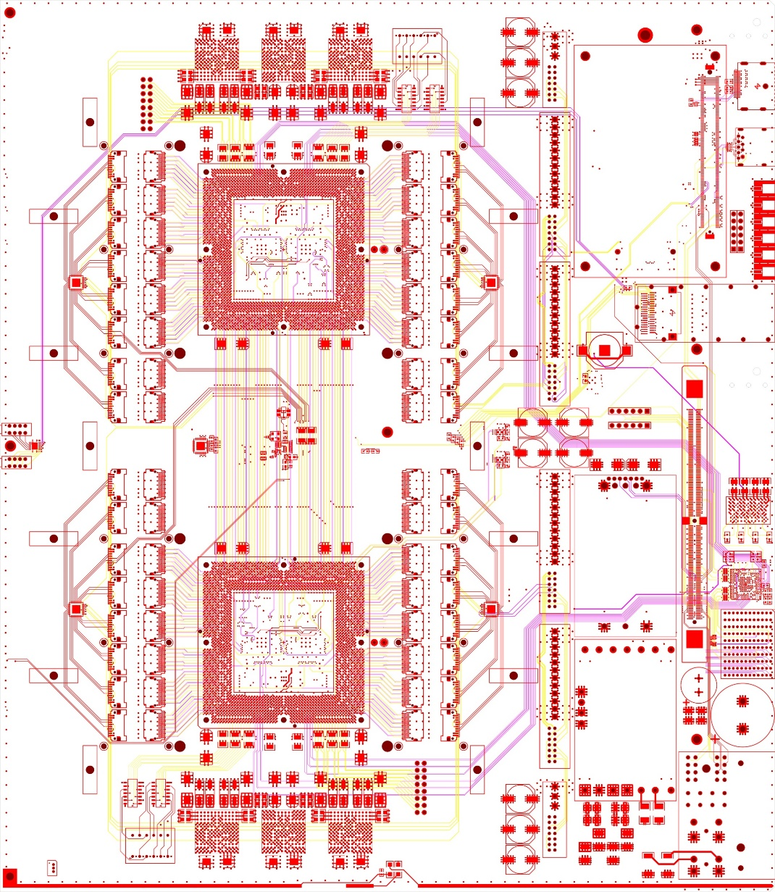
Serenity: One board to rule them all?
48
48
48
48
HGC Trigger v1 (now disfavoured)

Slide 62
Serenity: One board to rule them all?
48
48
36
36
48
48
36
36
36
36
36
36
HGC Trigger v1 (now disfavoured)
HGC DAQ
HGC Trigger v2
Barrel Muon Processor?

Slide 63
Serenity: One board to rule them all?
48
48
36
36
36
24
48
48
36
36
36
24
13
13
36
36
36
24
36
36
36
24
HGC Trigger v1 (now disfavoured)
HGC DAQ
HGC Trigger v2
Barrel Muon Processor?
Outer Tracker DTC
MTD DTC?
The Pixel DTC we are not building for political reasons

Slide 64
Serenity: One board to rule them all?
48
48
36
36
36
24
48
48
36
36
36
24
36
36
13
13
60
36
36
36
24
36
36
36
36
36
24
HGC Trigger v1 (now disfavoured)
HGC DAQ
HGC Trigger v2
Barrel Muon Processor?
Outer Tracker DTC
MTD DTC?
The Pixel DTC we are not building for political reasons
The track-finder processor we are not building for political reasons. Ooops.

Slide 65
Serenity: One board to rule them all?
I would show how it fulfils the role of the trigger correlator
If anyone could tell me what they require of the trigger correlator
I’ll be darned if they can come up with a scenario it can’t handle
?
?
?
?
?
?
?
?
?
?

Slide 66
So is the prophecy coming true?
U.S. Tracker groups
U.S. Barrel Muons
Institutes using the APx “family of boards” (Whatever that will end up meaning)

Slide 67
So is the prophecy coming true?
Not the U.S.:
Serenity

Slide 68
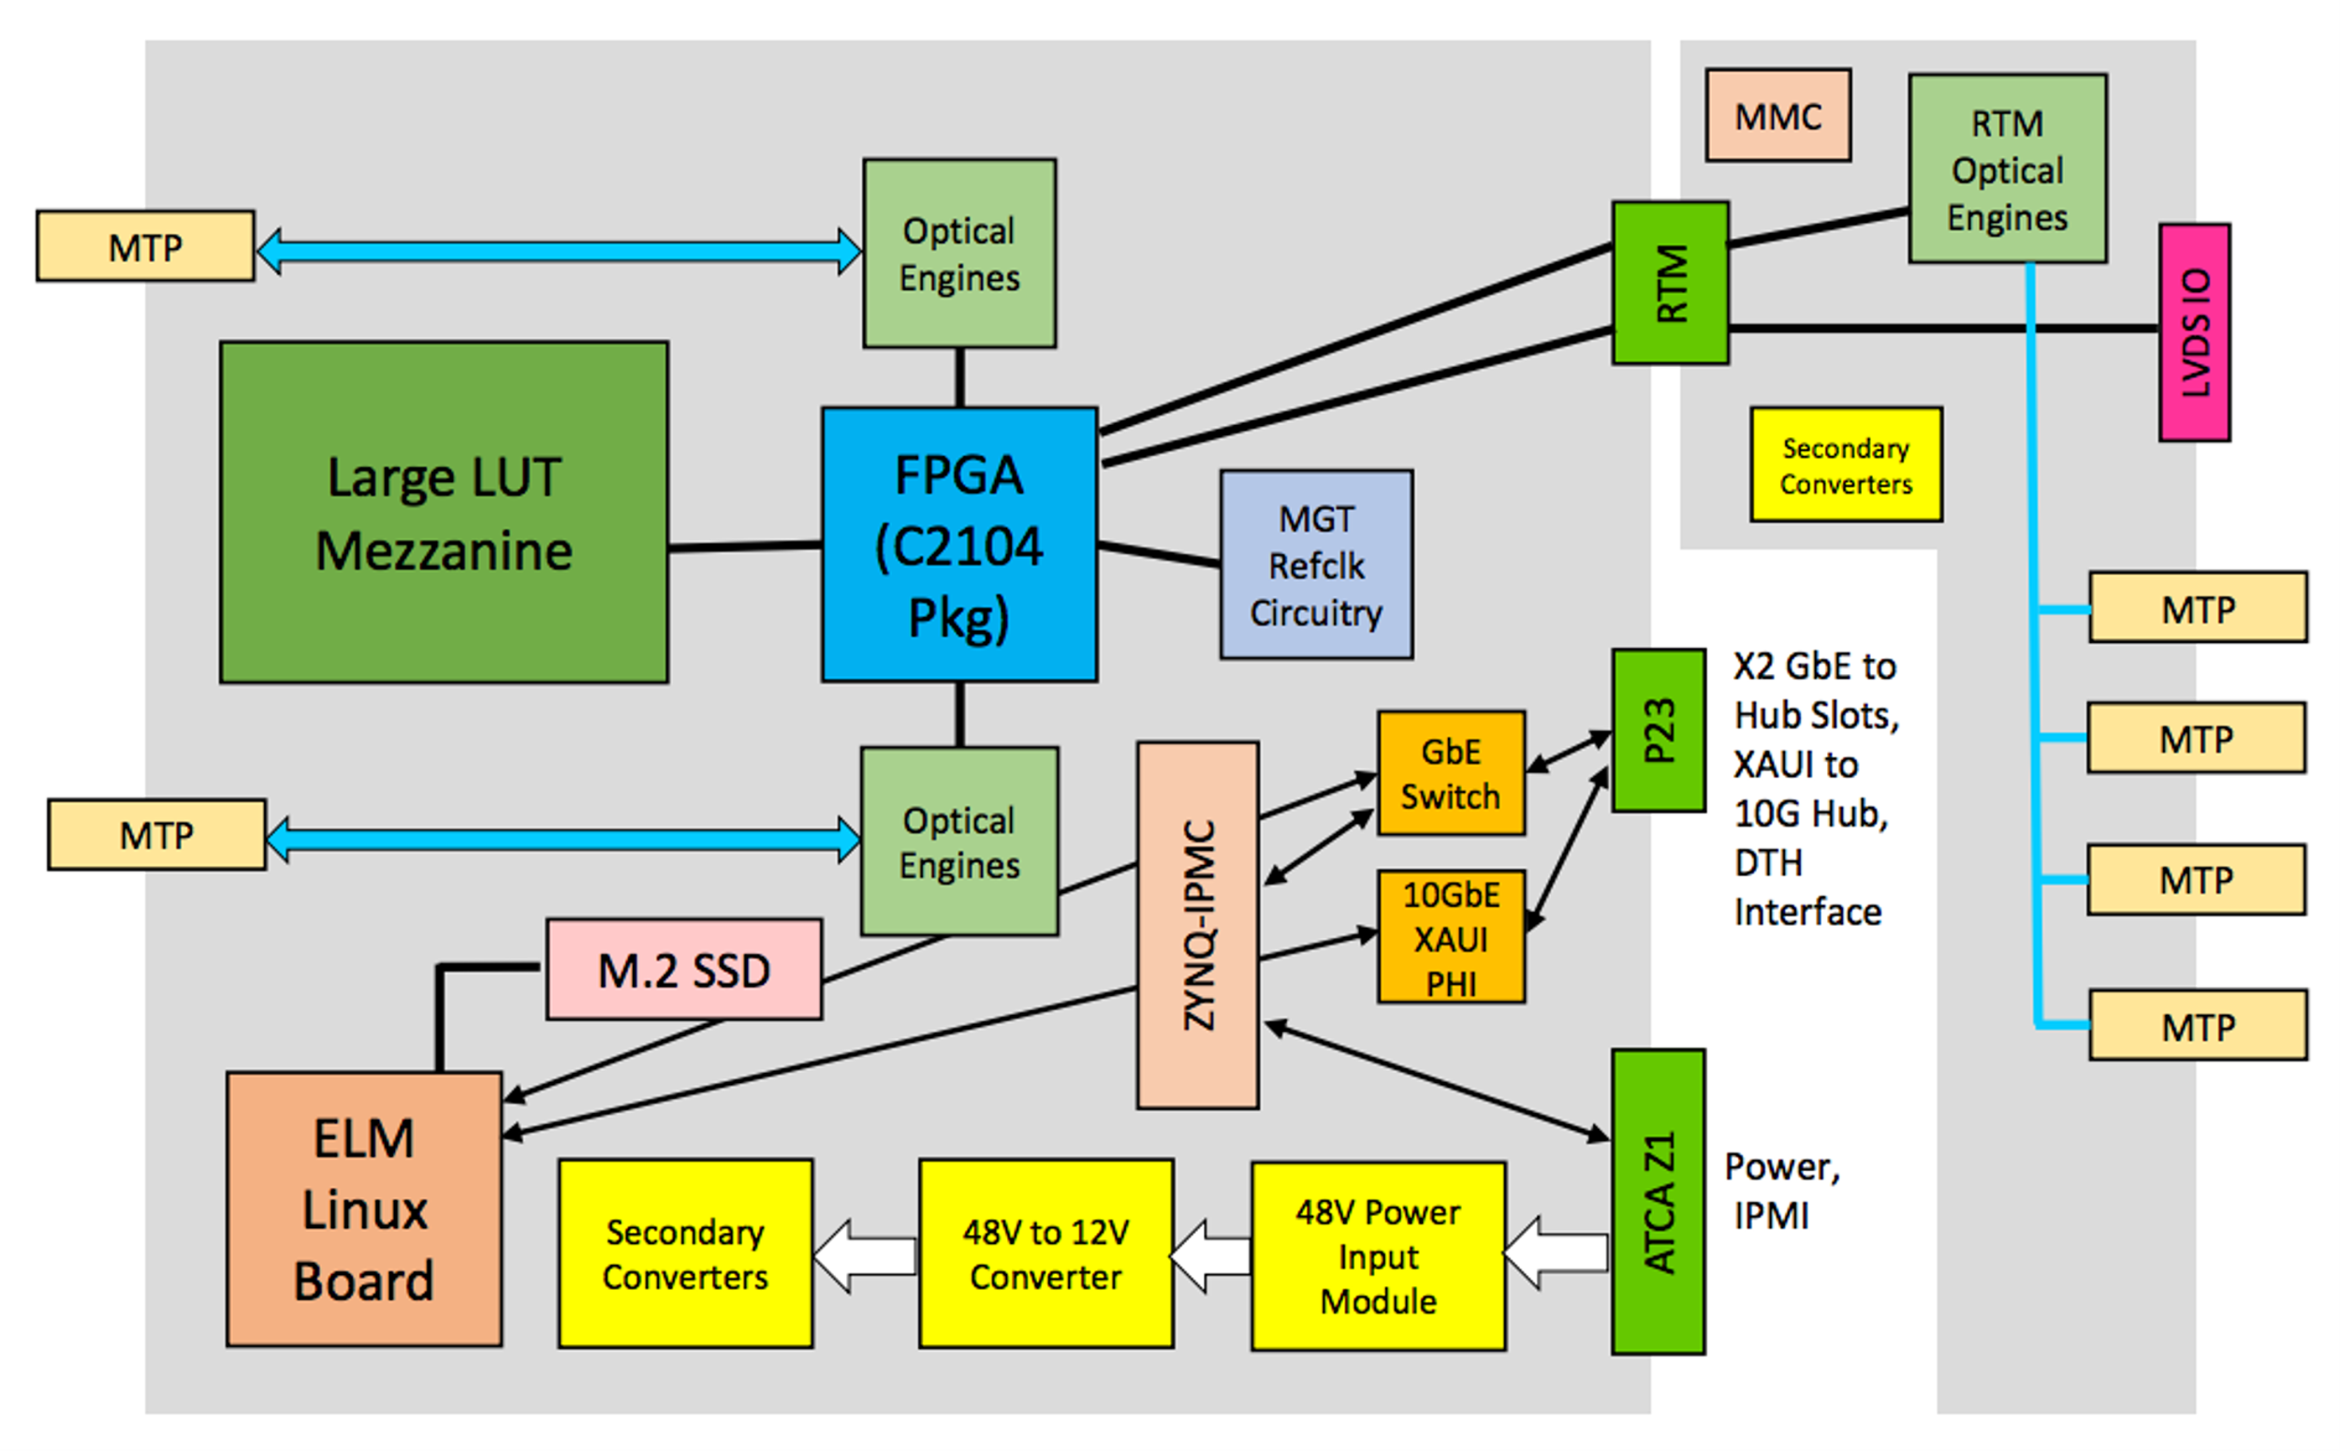
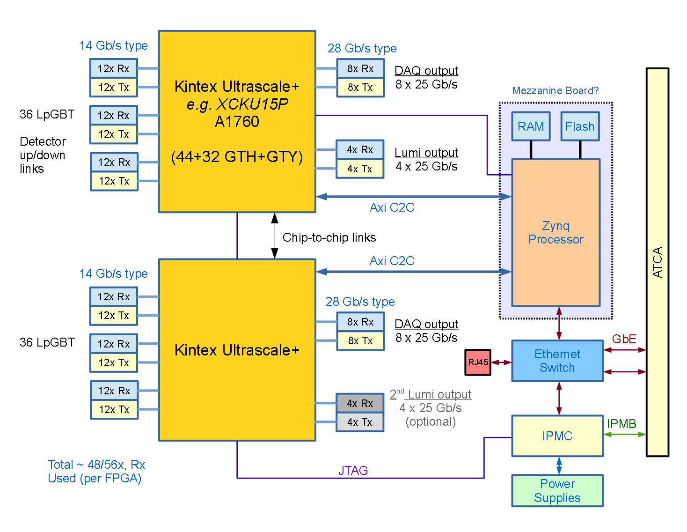
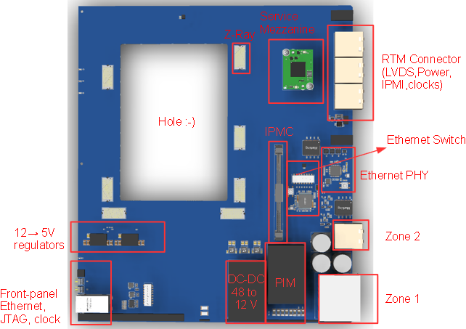
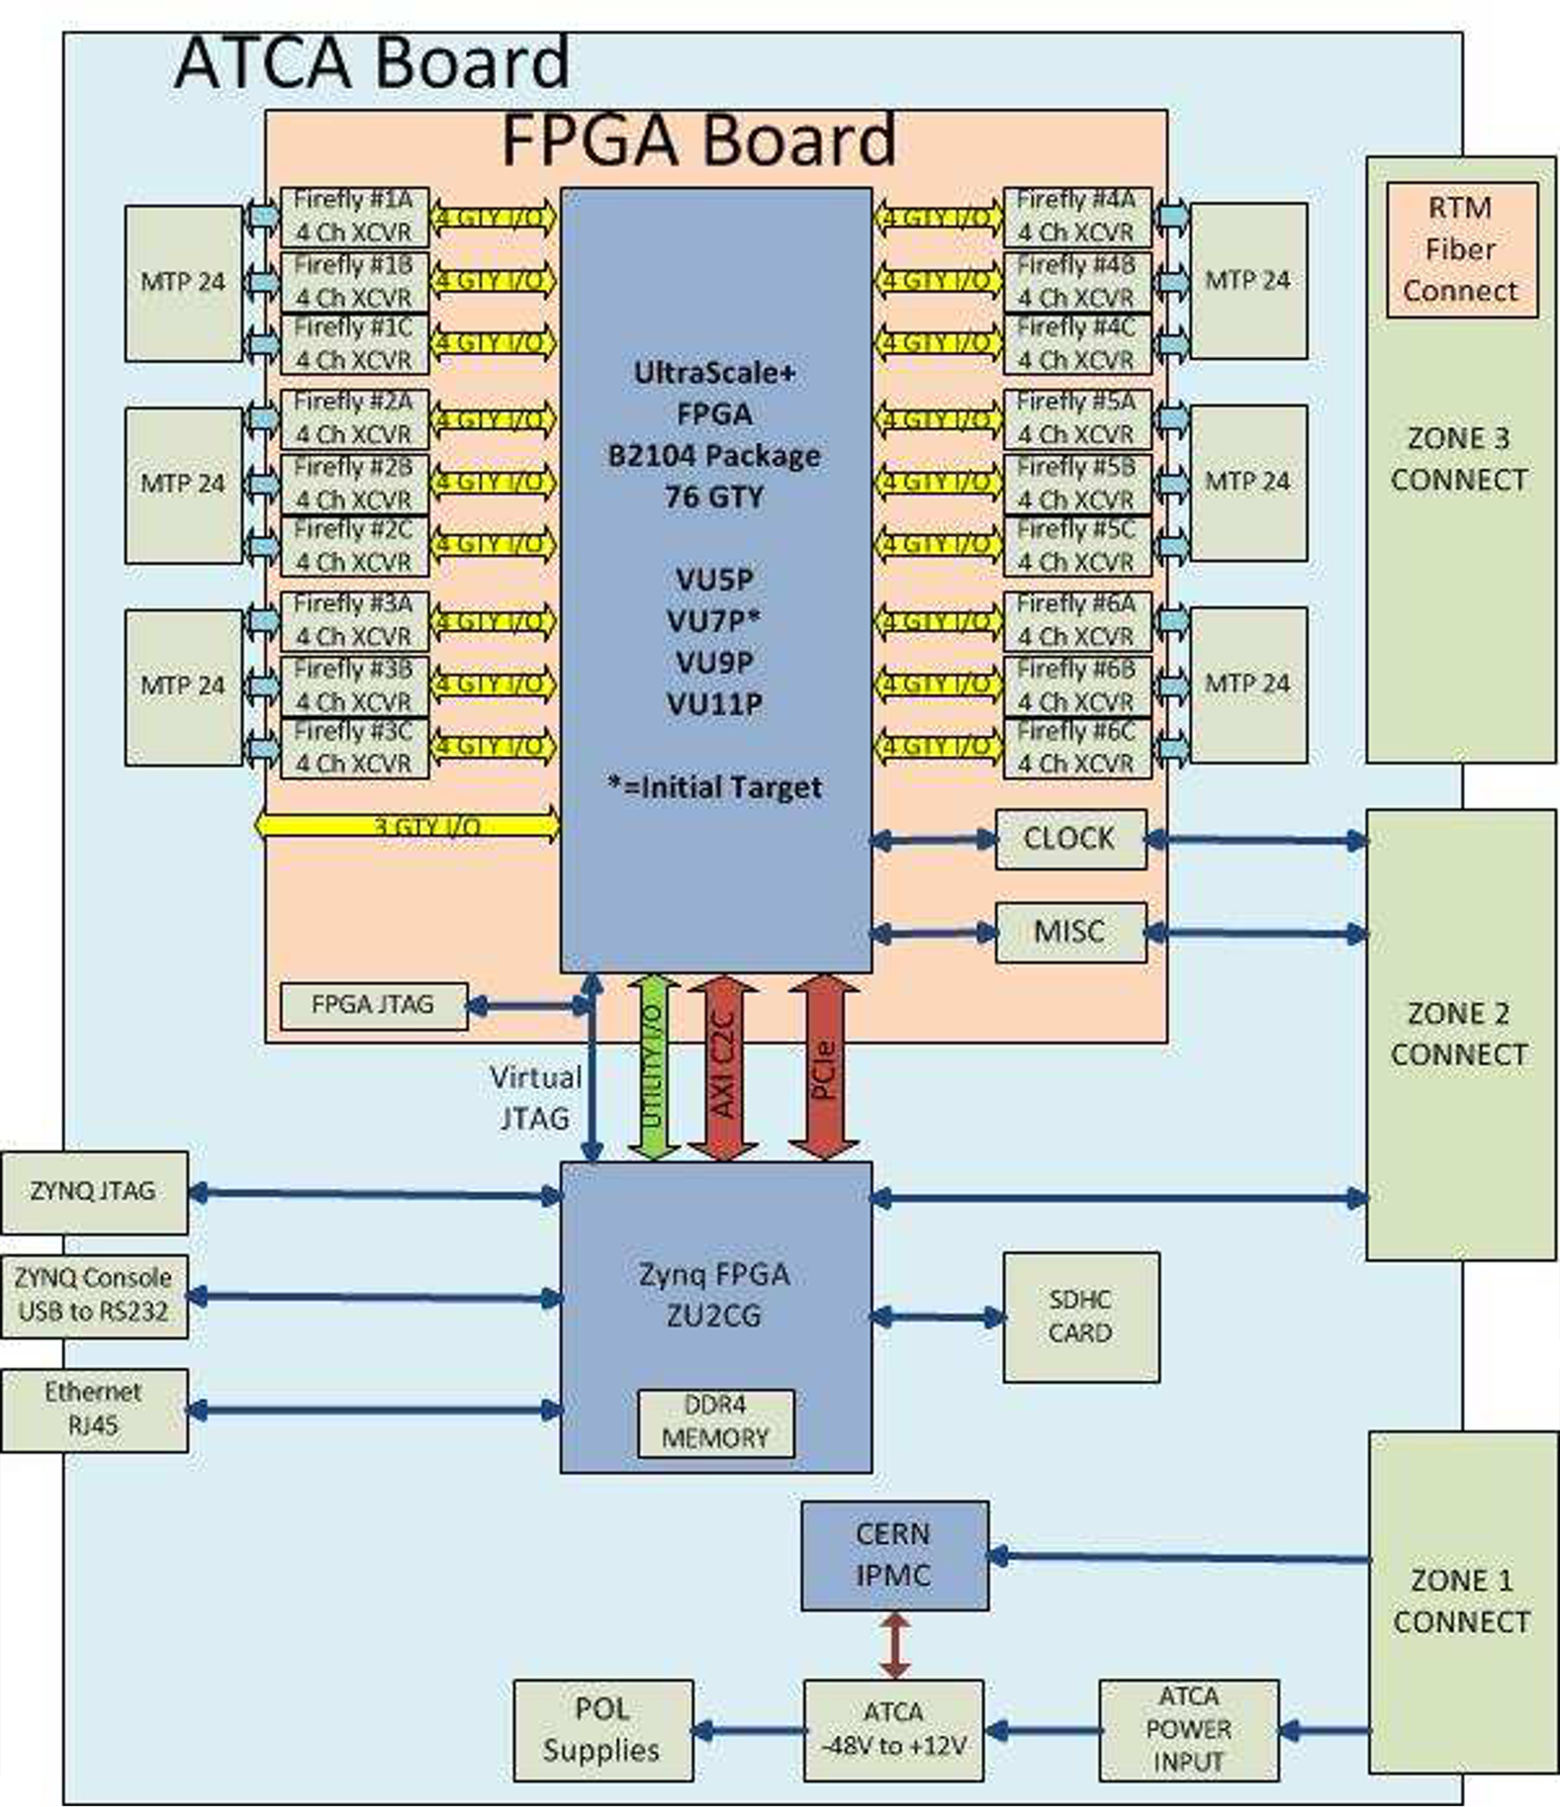
So is the prophecy coming true?
Or: How many boards does the US actually need?
APX
BCP
Merging?
Pixel DTC
Barrel Muons
Track-finder

Slide 69
And have you settled the architecture question yet?
Endcap Calorimeter
Track-trigger
Barrel Muons
Forward Hadron Calorimeter
Endcap Muons
Barrel Calorimeter
TPG
TPG
TPG
TPG
TPG
Correlator
Global Trigger

Slide 70
And have you settled the architecture question yet? Most likely architecture
Endcap Calorimeter
Track-trigger
Barrel Muons
Forward Hadron Calorimeter
Endcap Muons
Barrel Calorimeter
Time-multiplexed
Conventional
TPG
TPG
TPG
TPG
TPG
Correlator
Global Trigger

Slide 71
And have you settled the architecture question yet? Most likely architecture
Endcap Calorimeter
Track-trigger
Barrel Muons
Forward Hadron Calorimeter
Endcap Muons
Barrel Calorimeter
Time-multiplexed
Conventional
TPG
TPG
TPG
TPG
TPG
Regression, not progress ☹
Requiring ugly, specialized boards
Correlator
Global Trigger

Slide 72
And have you settled the architecture question yet? Is this starting to look familiar?
Endcap Calorimeter
Track-trigger
Barrel Muons
Forward Hadron Calorimeter
Endcap Muons
Barrel Calorimeter
TPG
TPG
TPG
TPG
TPG
Correlator
Global Trigger

Slide 73
Anyway…
Enough of the politics
Back to the interesting stuff!

Slide 74
What are the firmware challenges at Phase-II?

Slide 75
What are the firmware challenges at Phase-II?
You mean, apart from the small matter of 300Tb/s of data?

Slide 76
What are the firmware challenges at Phase-II?
You mean, apart from the small matter of 300Tb/s of data?
So much data it has to be zero-suppressed
No (or, at least, limited) geometric timing which can be utilized
Variable data-volume
Do you handle the worst case? Very inefficient
Do you handle the average? How do you handle overflows?

Slide 77
What are the firmware challenges at Phase-II?
You mean, apart from the small matter of 300Tb/s of data?
So much data it has to be zero-suppressed
No (or, at least, limited) geometric timing which can be utilized
Variable data-volume
Do you handle the worst case? Very inefficient
Do you handle the average? How do you handle overflows?
We did such a good job at Phase-I, people have very high expectations…

Slide 78
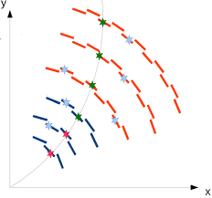
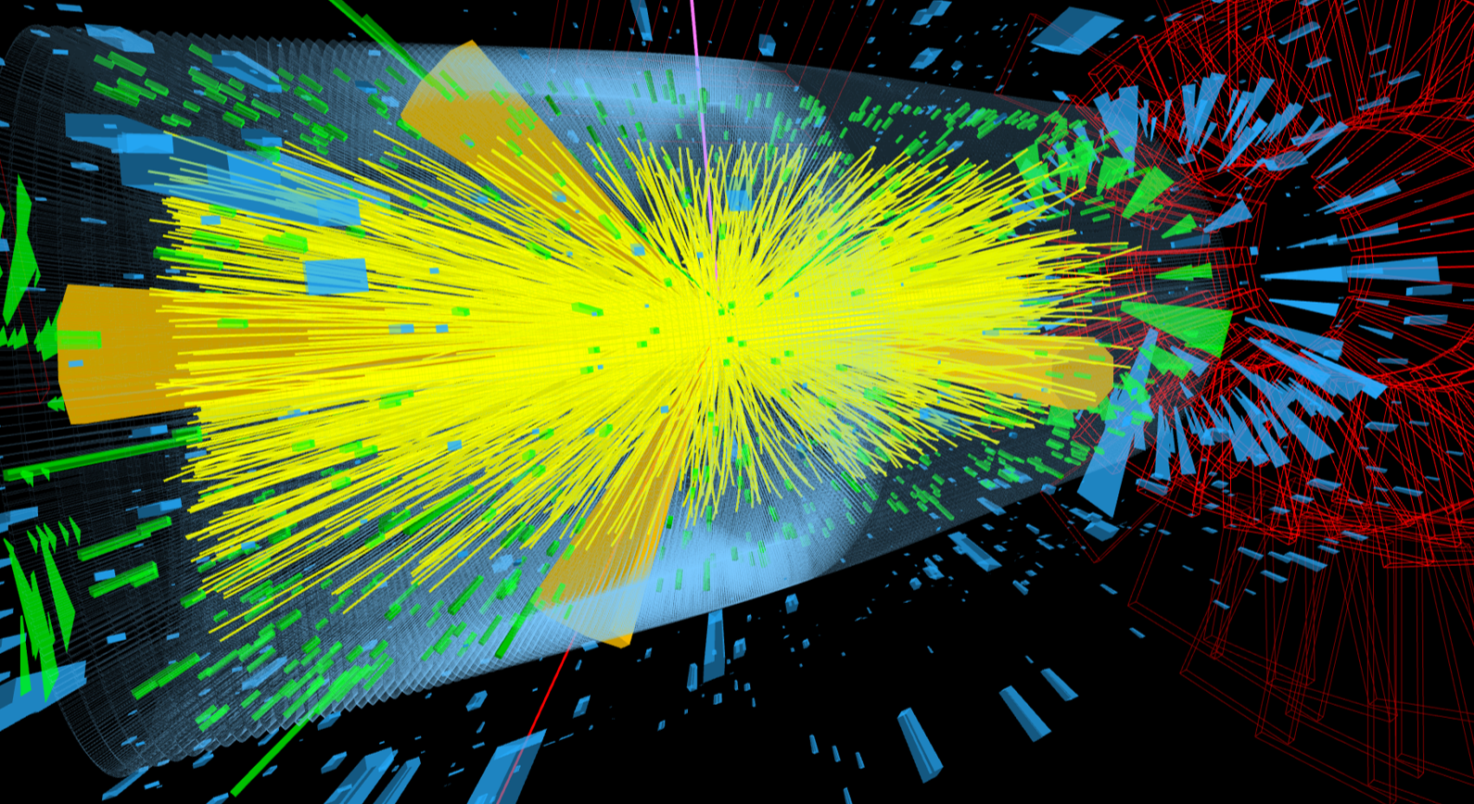
What are the firmware challenges at Phase-II?
Real-time track-finding and fitting

Slide 79
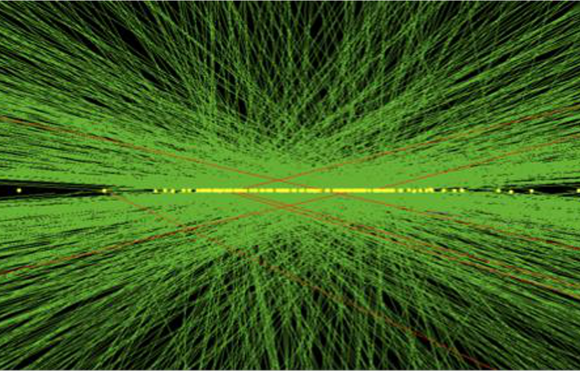
What are the firmware challenges at Phase-II?
Real-time track-finding and fitting
Real-time vertex-finding

Slide 80
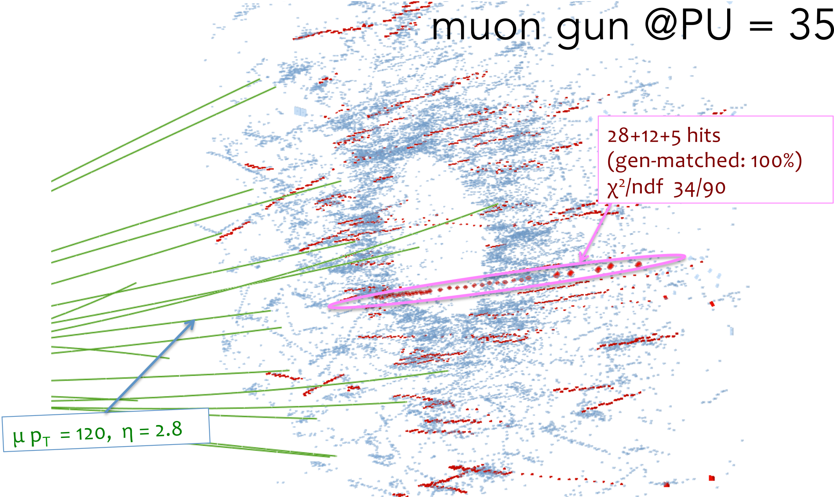
What are the firmware challenges at Phase-II?
Real-time track-finding and fitting
Real-time vertex-finding
3D cluster-finding in endcap

Slide 81
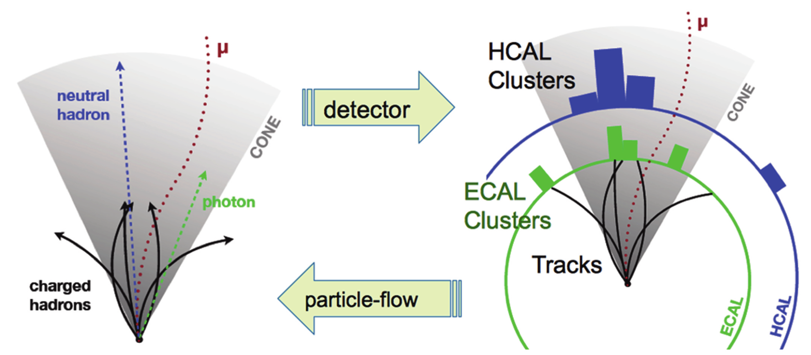
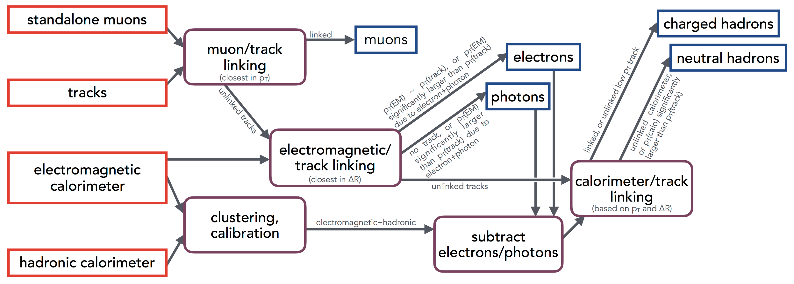
What are the firmware challenges at Phase-II?
Real-time track-finding and fitting
Real-time vertex-finding
3D cluster-finding in endcap
Particle-flow

Slide 82
What are the firmware challenges at Phase-II?
Real-time track-finding and fitting
Real-time vertex-finding
3D cluster-finding in endcap
Particle-flow
So, basically, they want event reconstruction

Slide 83
What are the firmware challenges at Phase-II?
Real-time track-finding and fitting
Real-time vertex-finding
3D cluster-finding in endcap
Particle-flow
So, basically, they want event reconstruction
in under 10μs

Slide 84
What are the firmware challenges at Phase-II?
I used to give the following firmware advice to the students on preserving your sanity:
Avoid iterative algorithms
Avoid combinatorics
Make the data-flow deterministic
Division is hard, resource hungry and latency intensive
Floating-point is hard, resource hungry and latency intensive

Slide 85
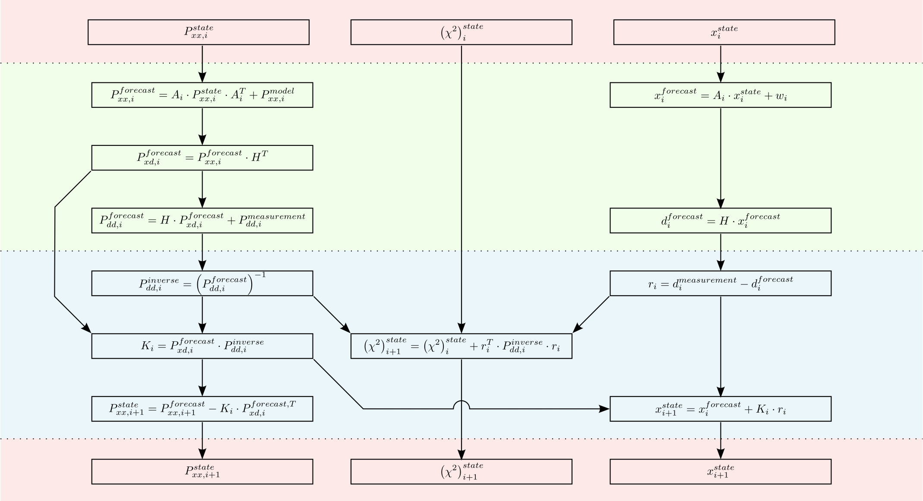
And we have stepped up to the plate!
In
For track fitter we wrote a full Kalman Filter
Which is iterative
Results in combinatorics
Is data-dependent (pseudo-deterministic)
Requires a division
We also played with floating-point but dropped it in the final version
Forecast
Update
Out

Slide 86
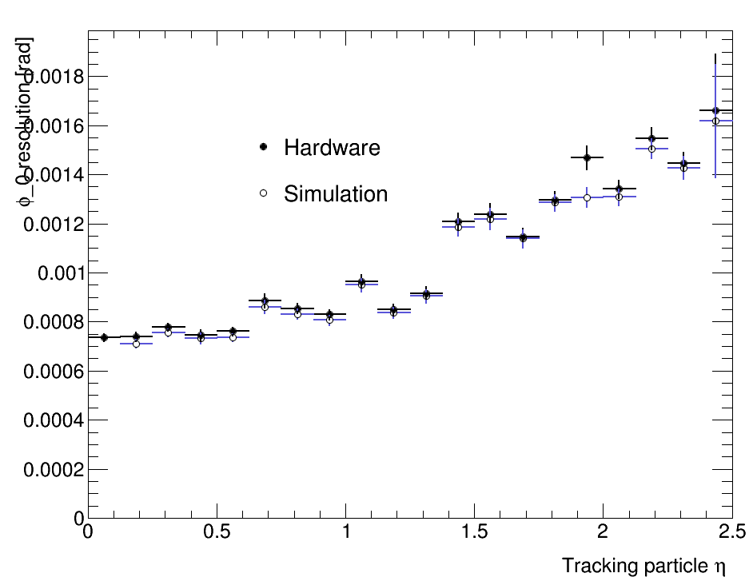
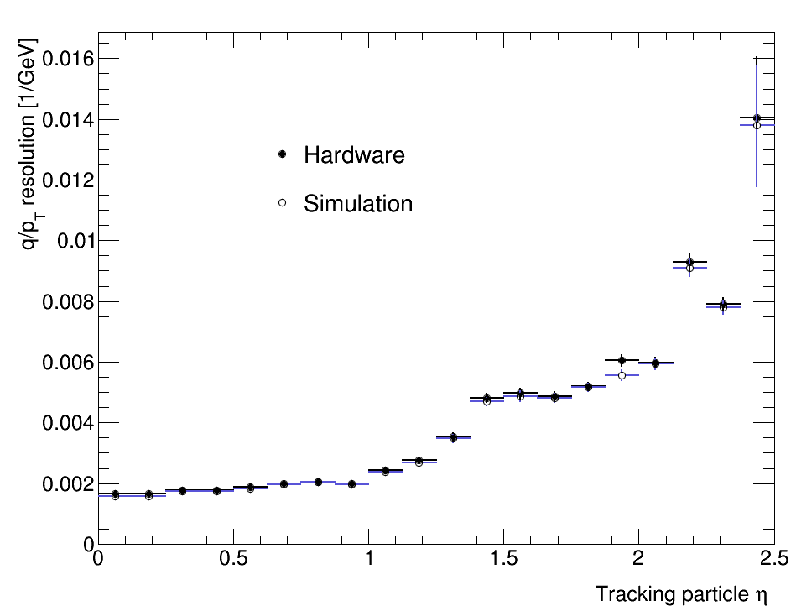
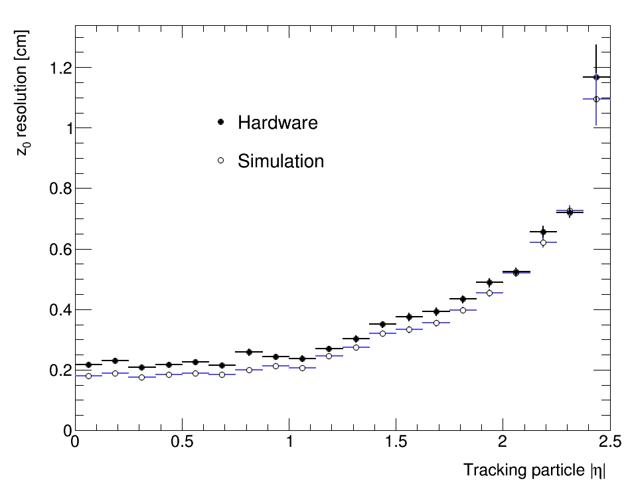
And we have stepped up to the plate!
Fits a 4-point track in 1.5μs
Matches offline floating-point resolution
200 events of TTbar+200PU
OPEN BLUE: floating-point CMSSW
CLOSED BLACK: Hardware capture

Slide 87
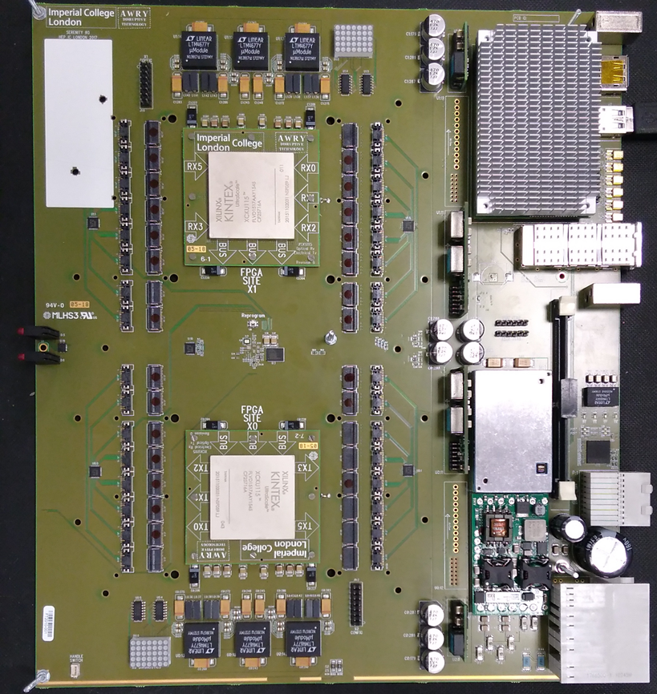
STOP PRESS!
UK claims crown for 1st Phase-2 algorithm in Phase-2 hardware
Real-time vertex-finding
4% LUTS, ~2% RAM & DSPs in KU115 FPGA
240MHZ clock
TM-period + 20clk latency
Running in Serenity hardware

Slide 88
Conclusion
UK has been very dominant in the phase-1 changes to the CMS off-detector electronics
Hardware, System Architecture, Firmware & Control Software
More elegant systems which are more robust, more performant and easier to maintain
UK-originated ideas gaining traction for phase 2
Time-multiplexing
Common hardware
Infrastructure firmware
Phase-2 upgrades introduce a whole new set of detector and trigger challenges
UK stepping up with state-of-the-art hardware and firmware solutions

Slide 89
Bring on the future! Thanks for listening!
Any questions?

