Slide 1
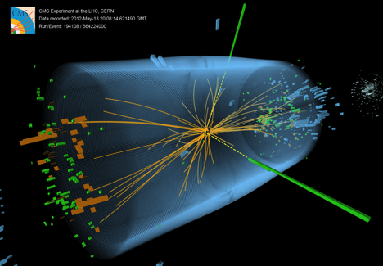
Introduction to CMS
Geoff Hall
24 October 2014
University of Bristol
Brunel University
Imperial College London
Rutherford Appleton Laboratory

Slide 2
Content
I know that few in the audience are physicists
so I plan to give only an elementary introduction to the experiment
Main objectives and experimental requirements
illustrations of some of the items built
Brief history of development and construction
Focus on objects which have been constructed and purchased
hope to provide some insight into opportunities for business
To be supplemented later by a few more details on electronic procurements
in a separate session

Slide 3
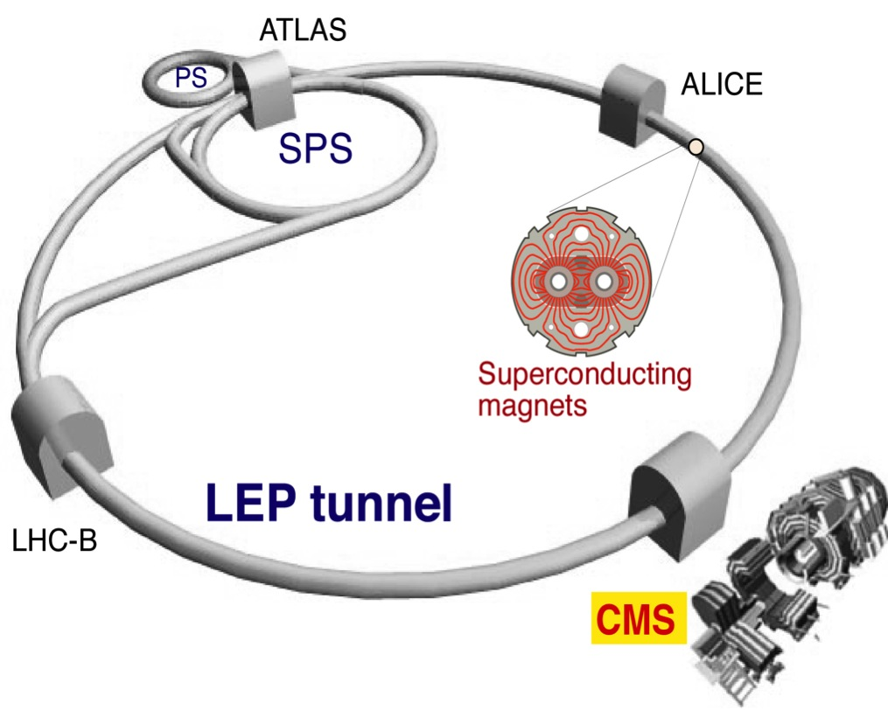
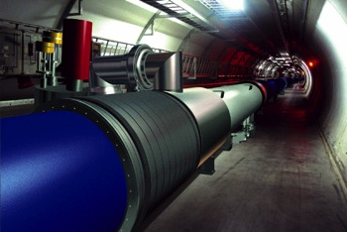
What is the Large Hadron Collider?
Latest CERN accelerator started operation 2010
very high intensity
10¹⁵ collisions per year
very high rate
beams cross @ 40MHz
few “interesting” events
~100 Higgs decays per year
Beams (from 2015)
6.5 TeV protons
=> 13 TeV energy
also ions, eg Pb
LHC

Slide 4
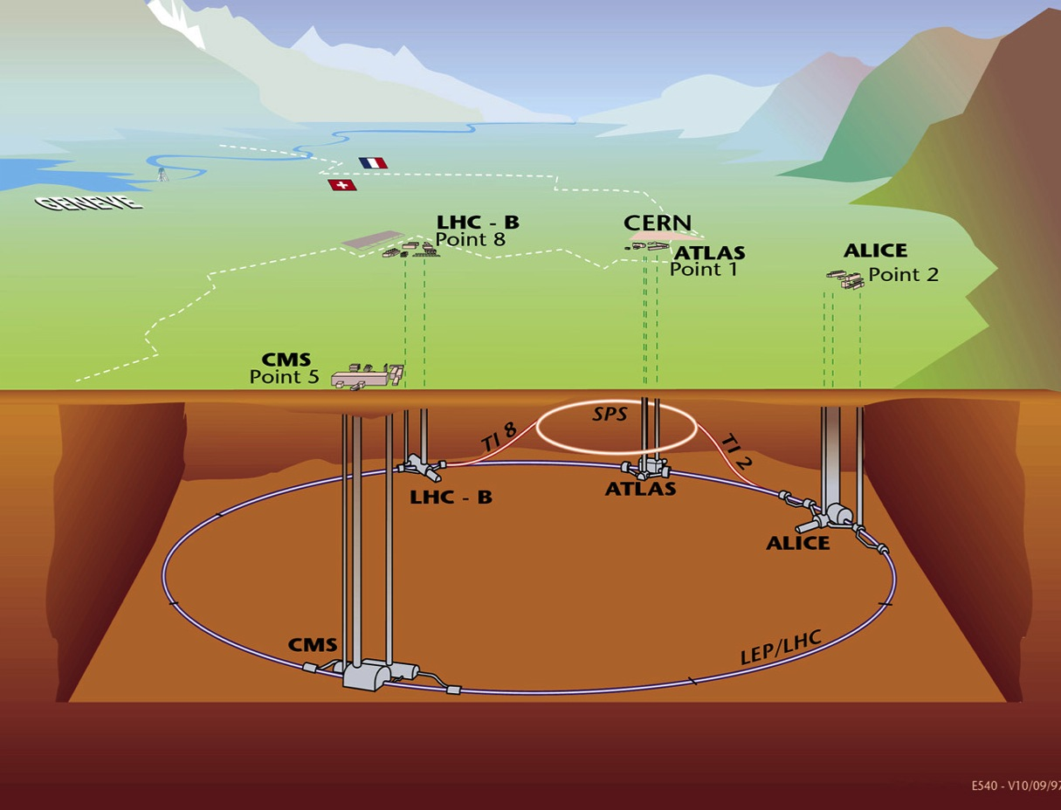
Where is the LHC?
Alps
Jura
~100m

Slide 5
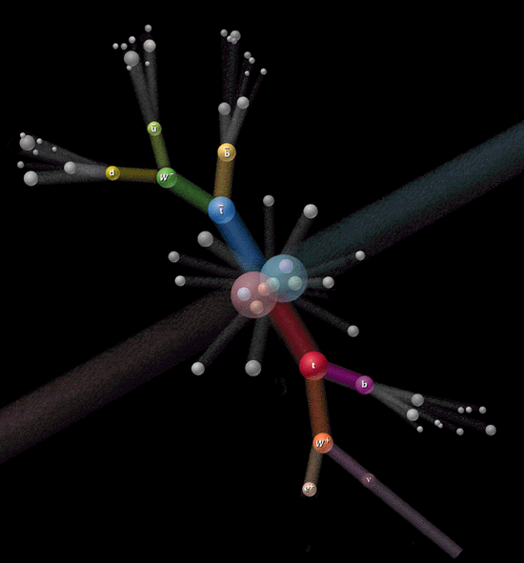
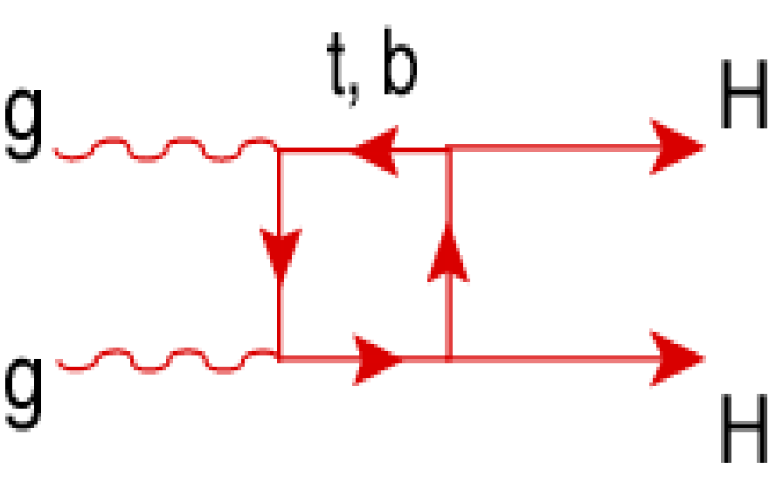
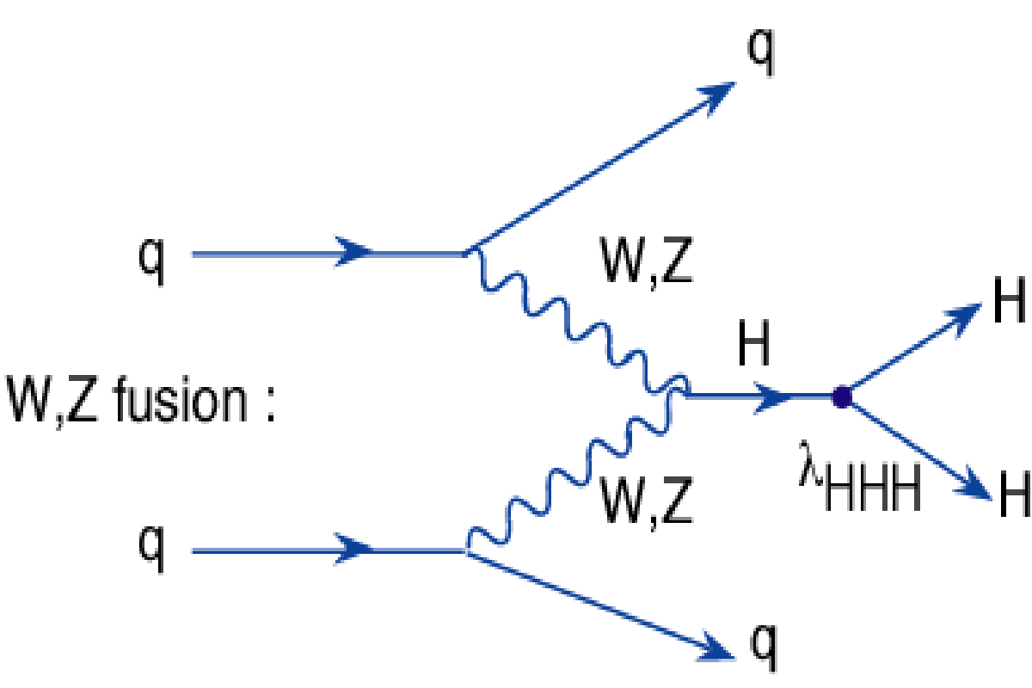
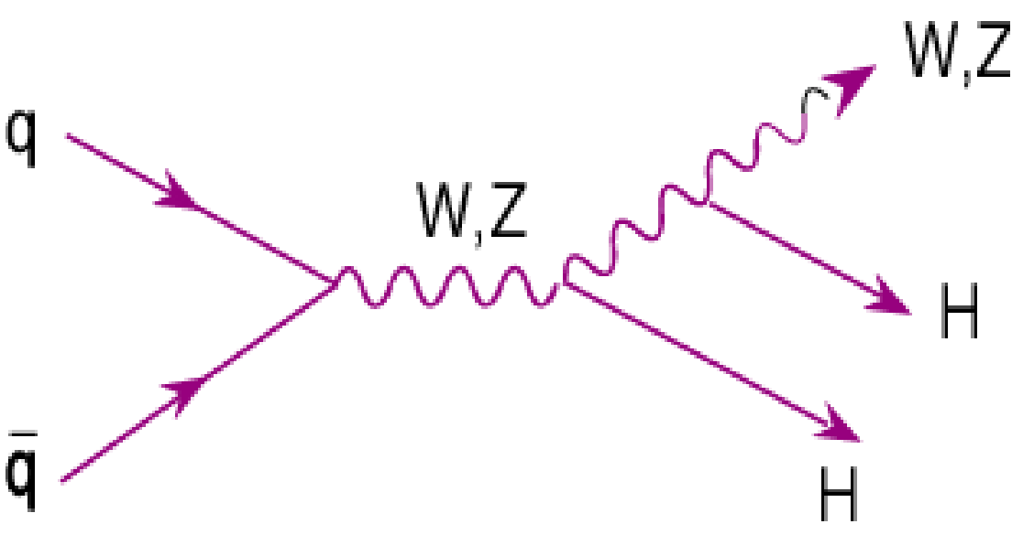
What are we doing at the LHC?
(No more physics after this slide!)
Colliding beams of protons
to maximise the energy available to create new particles
proton
d
d
proton
u
u
u
u
proton collisions are actually between their constituent parts…
λ ~ 1/p ≈ 1/E
gluons
quarks (≈ real and virtual)
and the particles they exchange (Z, W,…)

Slide 6
The Compact Muon Solenoid experiment
a general purpose detector for studying the full range of physics at the CERN Large Hadron Collider
designed to operate (nominally) for 10 years
high radiation levels throughout the experiment
they originate with flux of particles originating from the p-p collisions
so highest in centre and endcap regions
also operate with heavy ions: ~ 1 month annually
R [cm] | Fast hadron fluence [cm⁻²] | Dose [kGy] | Dose [Mrad]
4.3 | 246 10¹³ | 830 | 83
22 | 16 10¹³ | 67 | 6.7
115 | 2 10¹³ | 2 | 0.2
Suffice to say, these are very high and comparable with nuclear reactor interiors

Slide 7
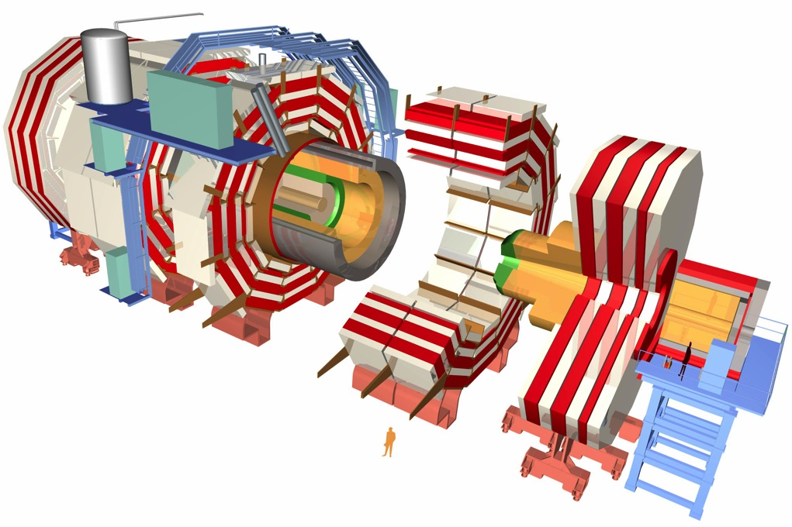
CMS: Compact Muon Solenoid
HCAL
Muon chambers
Tracker
ECAL
4T solenoid
Total weight: 12,500 t
Overall diameter: 15 m
Overall length 21.6 m
Magnetic field 4 T
constructed as a series of layered sub-detectors, each with a specific purpose

Slide 8
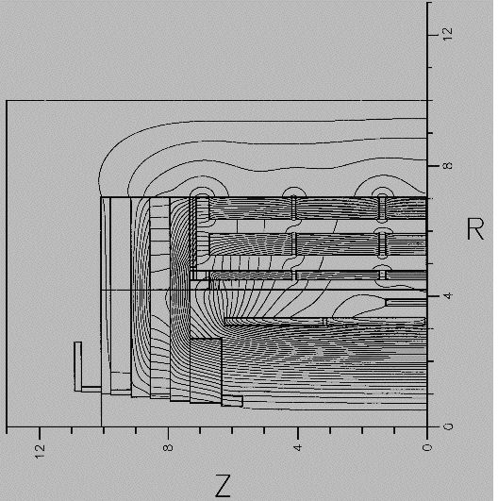
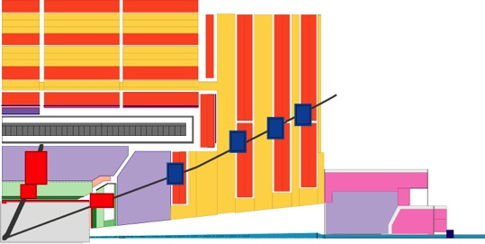
Design philosophy
Large solenoidal (4T) magnet
iron yoke - returns B field, absorbs particles
Muon detection - penetration
the only particles we can measure which traverse the whole detector
Calorimeters – absorb Energy
electromagnetic – electrons and gammas
hadronic – all other types of particle
Tracking system – bend in B field
momentum measurements of charged particles
complex, multi-particle events
complement muon & ECAL measurements

Slide 9
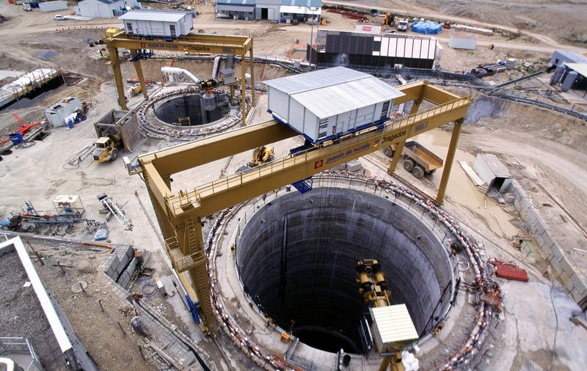
From a hole in the ground

Slide 10
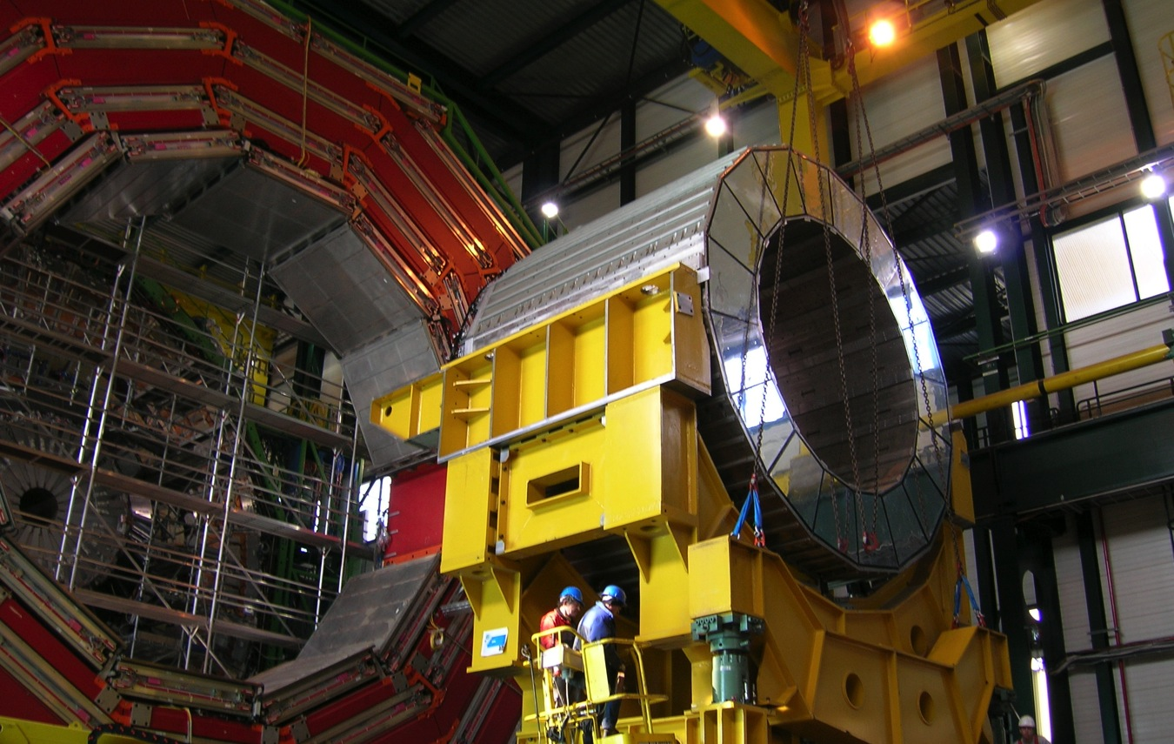
Assembly on the surface

Slide 11
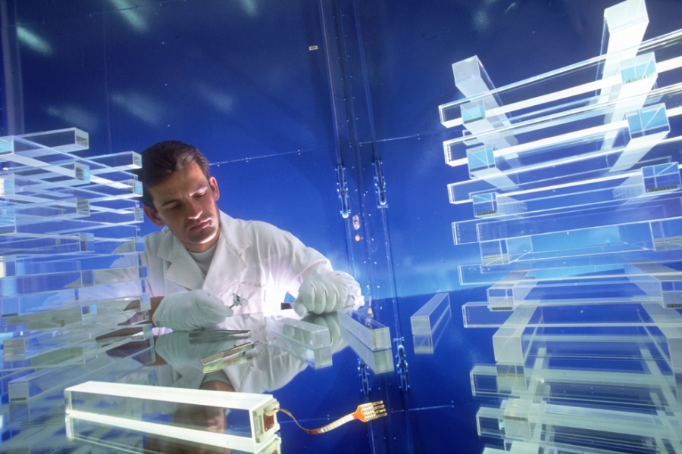
ECAL crystal scintillators

Slide 12
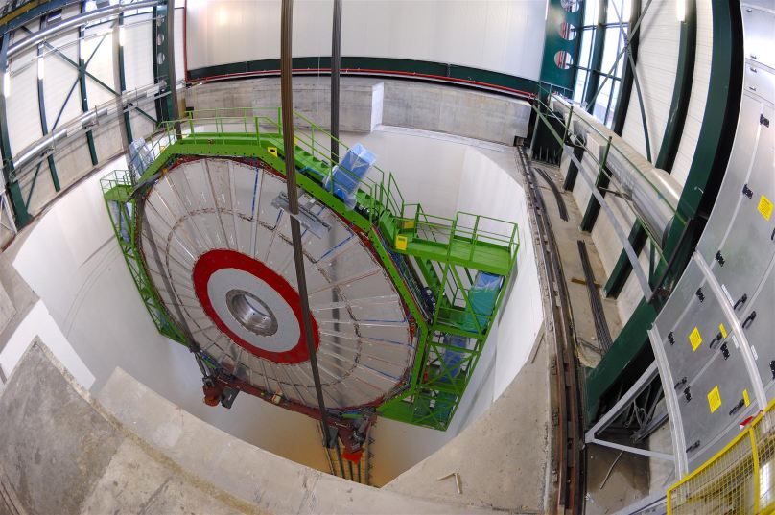
Lowering endcap YE+3 Nov 2006

Slide 13
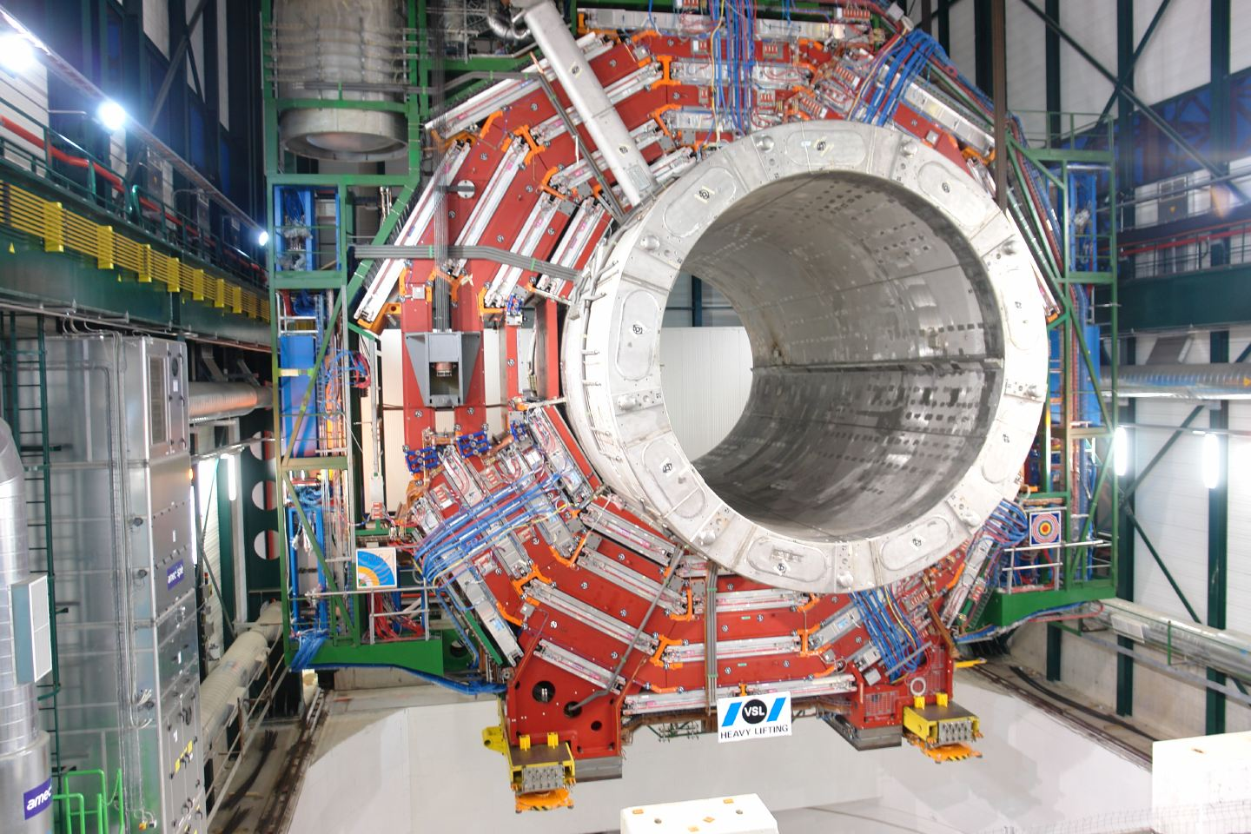
Lowering magnet and central YB0 Feb 2007

Slide 14
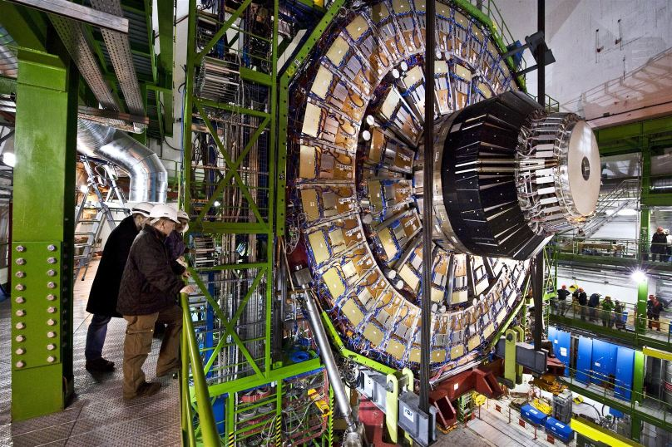
Endcap muon/forward calorimetry YE-1 Jan 2008

Slide 15
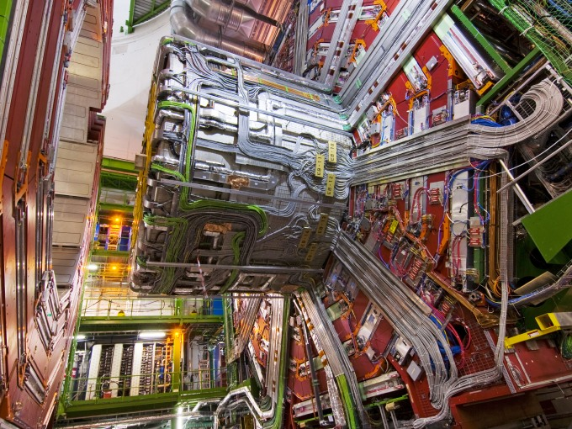
Vacuum tank December 2007
Services =
gas, optical fibres, power and signal cables, liquids for cooling, etc

Slide 16
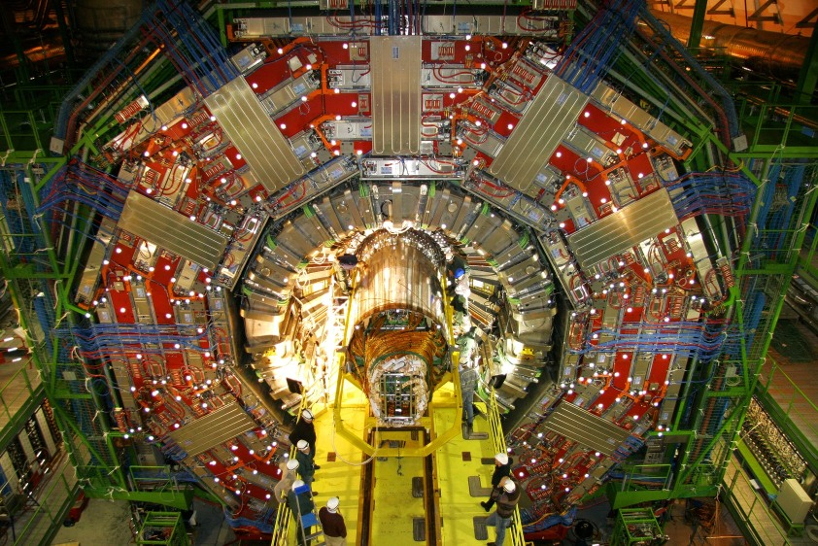
Tracker installation Dec 2007
One of the final detector insertions

Slide 17
The detectors
Would not exist without commercial procurements
For illustration, I have chosen a couple of examples where there has been a strong UK involvement. Our detector activities have included
Custom integrated circuit electronics
Board-based digital electronics
Silicon sensors
Vacuum photodiodes
Scintillating crystals
Semi-custom optical links
Mechanical assemblies – some very large
Data acquisition and software development
…
In most cases in close collaboration with scientists and engineers from other countries

Slide 18
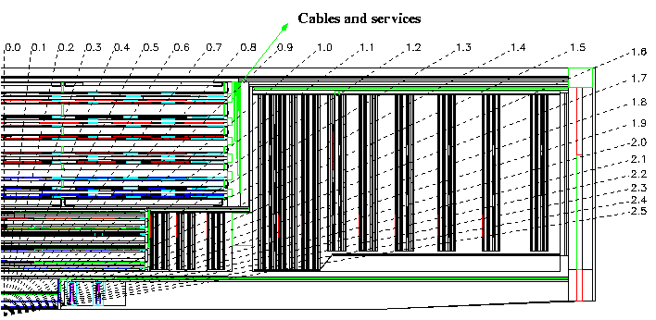
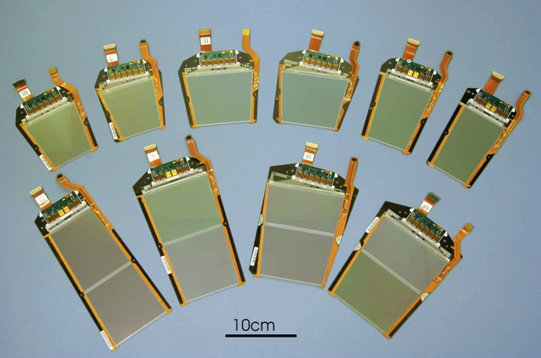
CMS Tracker and its sub-systems
Two main sub-systems: Silicon Strip Tracker and Pixels
pixels quickly removable for beam-pipe bake-out or replacement
SST not replaceable in reasonable time
Microstrip tracker | Pixels
~210 m² of silicon, 9.3M channels | ~1 m² of silicon, 66M channels
73k APV25s, 38k optical links, 440 FEDs | 16k ROCs, 2k olinks, 40 FEDs
27 module types | 8 module types
~34kW | ~3.6kW (post-rad)
TOB
TOB
TEC
TEC
TIB
TIB
TID
TID
PD
PD

Slide 19
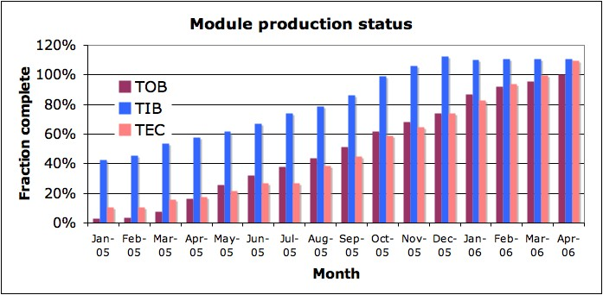
Some milestones of a long project
~Jan 1990 R&D projects
Apr 1992 CMS Letter of Intent
Dec 1994 Technical Proposal
Apr 1998 Tracker Technical Design Report
Oct 1999 Front End Readout ASIC in 0.25µm CMOS
Dec 1999 Decision to construct All Silicon Tracker
Feb 2000 Tracker Technical Design Report Addendum
Apr 2006 Module production completed
Nov 2006 Tracker integration complete
Dec 2007 Tracker inserted in CMS
Mar 2008 Tracker connections completed
Sep 2008 small interlude
Nov 2009 Tracker ON with LHC beam
Mar 2010 Data taking at 7 TeV
R&D phase

Slide 20
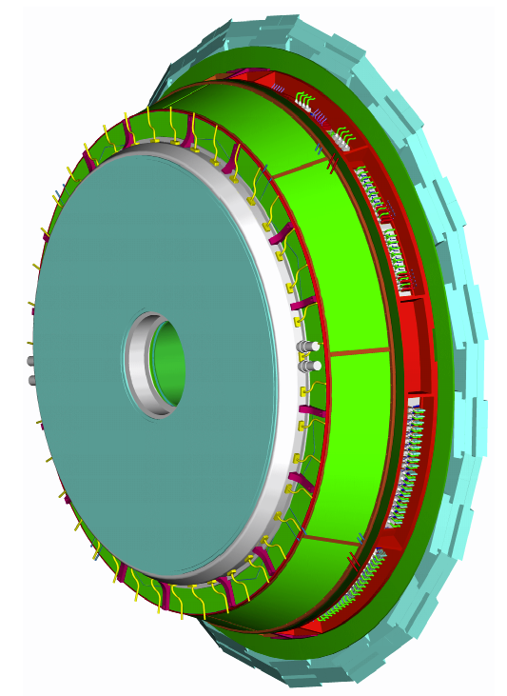
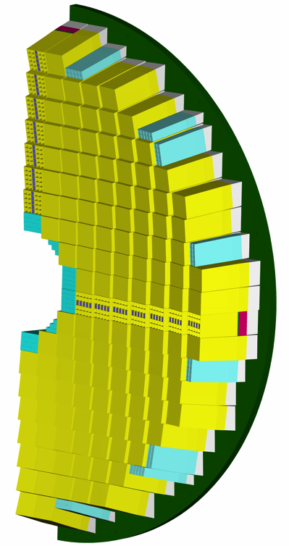
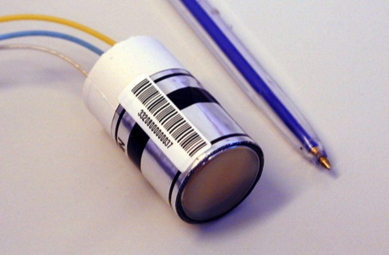
Electromagnetic Calorimeter
Measures electron and photon locations and energies
~80,000 PbWO₄ scintillator crystals
Sensors
APD (barrel)
VPT (end cap)
Endcap assembly
25.4 mm
Heavy mechanical engineering
Innovative crystals and photosensors
Demanding modern electronics
Off-detector electronics and services

Slide 21
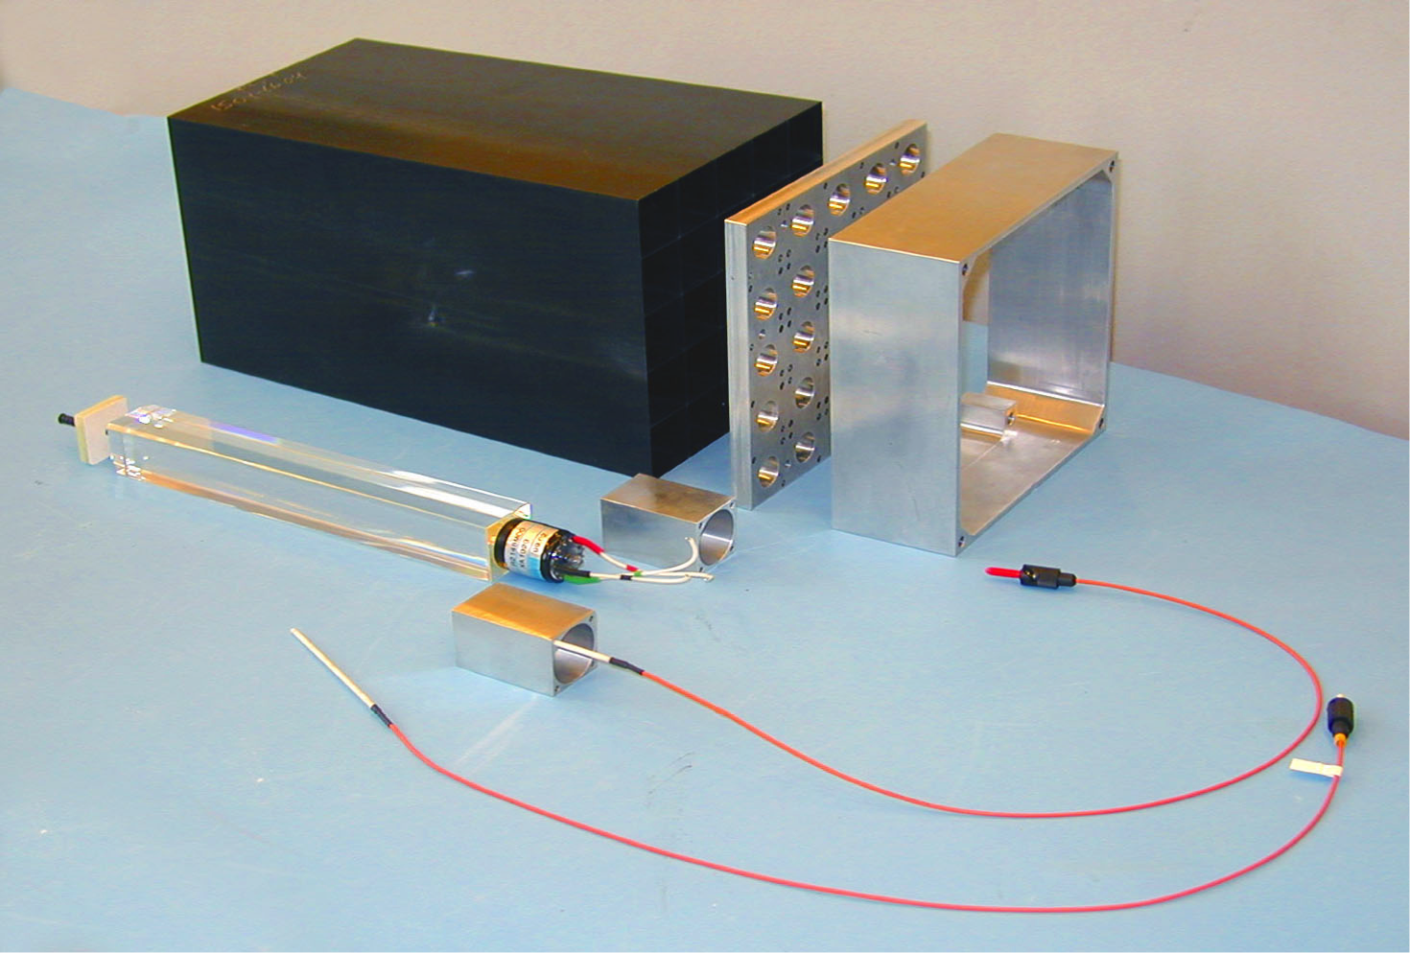
ECAL modules
Main challenges – as well as radiation tolerance
CMS ECAL designed for very high energy resolution
physics advantages for several specific discoveries
very dense crystal material, with demanding specifications
precise mechanical assembly and tolerances
final object very heavy
electronics crucial
large signal dynamic range
(~16bits) & high precision requirement
low noise
linearity
stability
information vital to trigger
selects data for readout
Single endcap
crystal with VPT

Slide 22
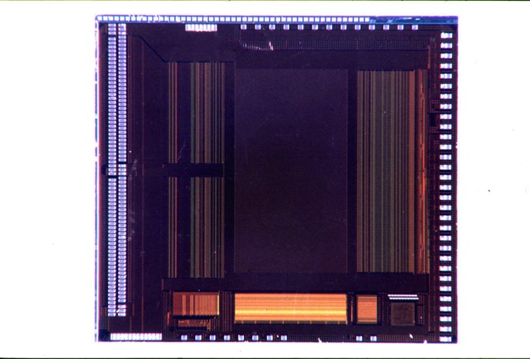
Tracker: APV25 custom integrated circuit
Main features (many innovative, at the time)
Commercial 0.25µm CMOS
128 programmable readout channels
amplifiers, memory, controls,…
Designed and delivered by Imperial College and Rutherford Appleton Lab
manufacture via CERN contract
pipeline
128x192
128 x preamp/shaper
APSP + 128:1 MUX
7.1mm
bias gen.
control
logic
FIFO
CAL
pipe logic
8.1 mm
Peak
Decon.
APV O/P Frame
digital header
128 analogue samples

Slide 23
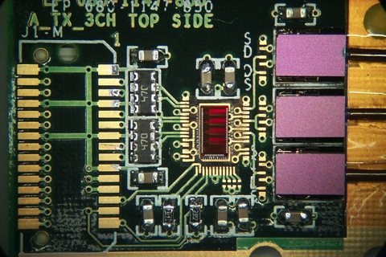
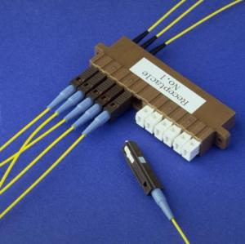
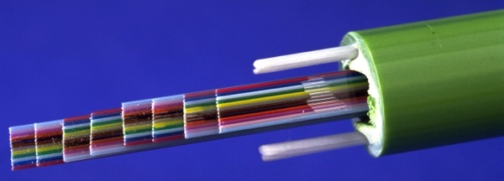
Optical links
System developed for CMS Tracker mainly by CERN with industrial partners – later used for calorimeter, and other detectors
1.3µm single mode FP laser transmitters, III-V semiconductor Tx & Rx
good linearity over wide range, good radiation & B-field tolerance

Slide 24
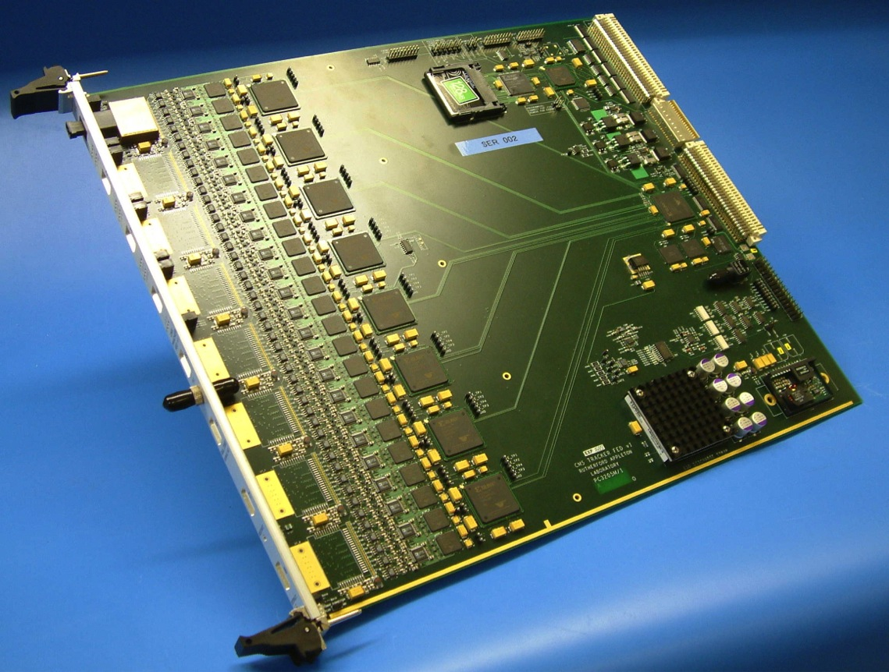
Tracker - Front End Driver
Monolithic assembly (density/cost)
~ year 2005
in UK with high yield
opto-electric conversion
data processing
data transfer
VME control and slow readout
typical of many other CMS modules
JTAG
OptoRx
VME64x
9U board
CFlash
34 x
FPGAs
96 channels
Memories
Analogue
TTC
Power
FE Unit
“Primary” Side

Slide 25
Tracker Construction by worldwide effort Austria, Belgium, Finland, France, Germany, Italy, CERN, Switzerland, UK, USA –62 institutes much movement of components and assemblies Sensors, ASICs, hybrids procured and tested some parts commercially: e.g. hybrids Modules constructed in our dedicated centres, using automated assembly methods…

Slide 26
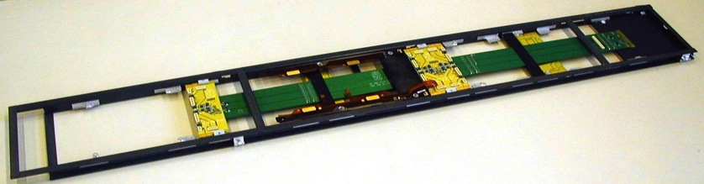
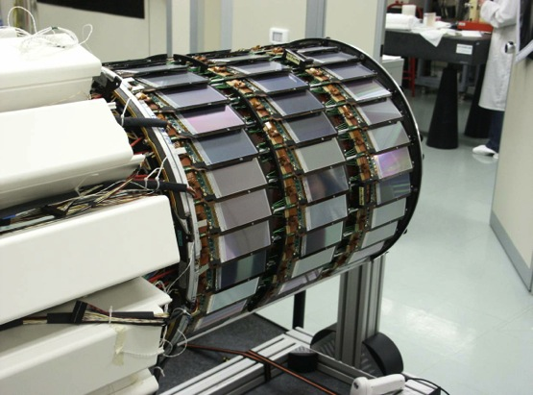
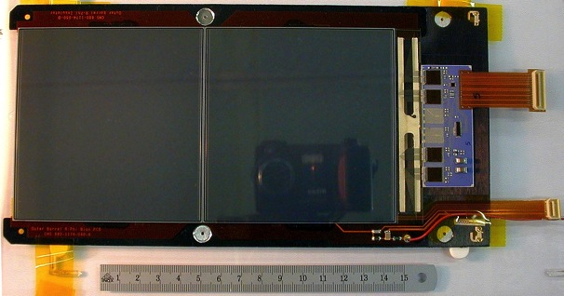
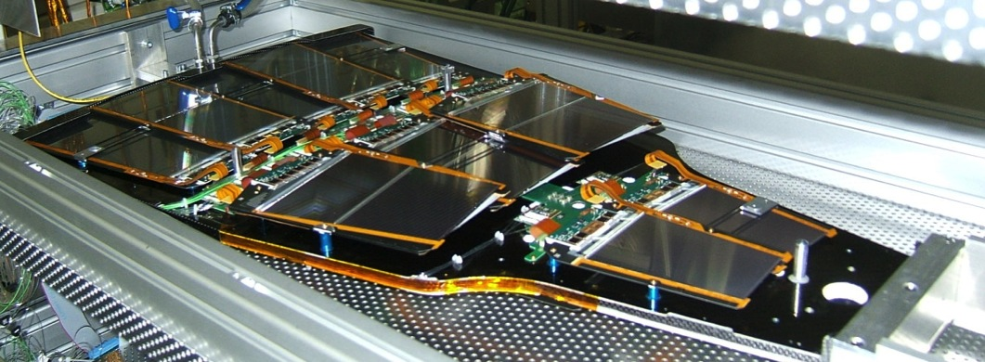
Modules and sub-system assembly
Inner barrel shells (Italy)
TOB modules and Rods
(US, CERN)
Hybrids (industry)
Endcap petals
(Au, Ge, Be, Fr)

Slide 27
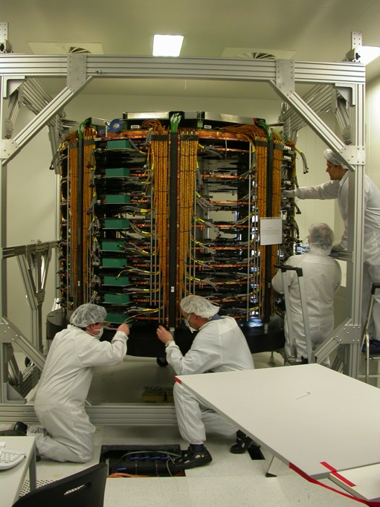
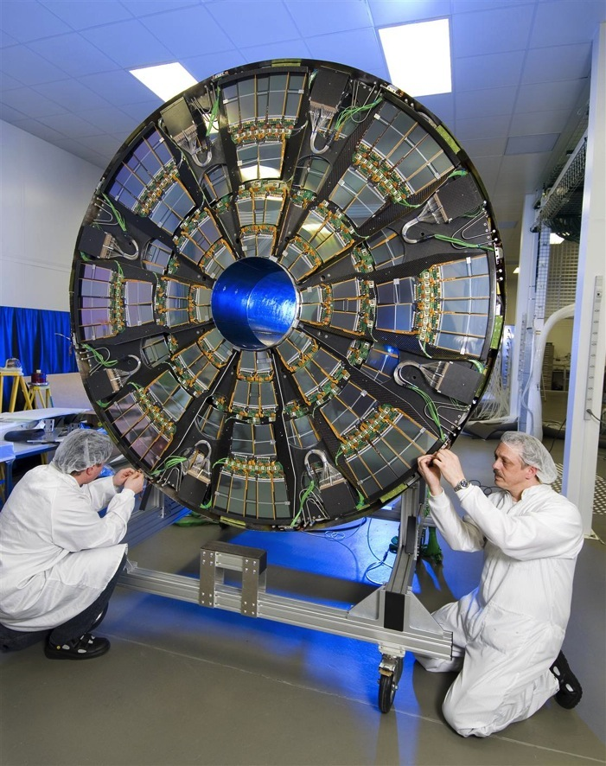
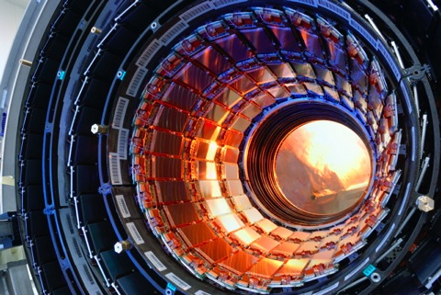
Sub-system integration

Slide 28
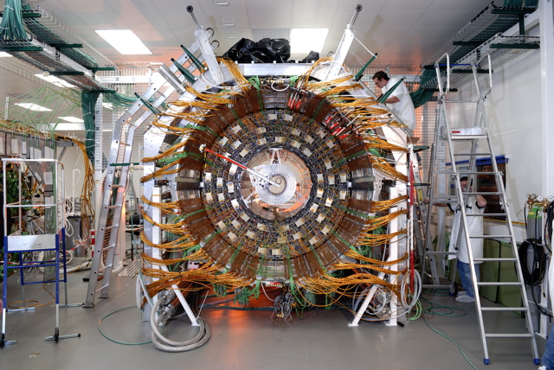
Integration at Tracker Integration Facility
Dedicated clean room laboratory in CERN
assembled sub-systems, then added external cables, cooling, …

Slide 29
Some of the challenges overcome
Sensors: two major contracts with very different production quality
Hybrids: flexible kapton-metal layer structure
subtle problems in through-via manufacture identified at late stage
ASIC yield: variations after initial very good beginning
worked with company to understand and solve
Cooling plant performance: manufacture weakness
failures in plant and components
Many, many other issues
early attention to minor details is crucial to avoiding costly delays
most items are highly specialised with few, or no, second sources

Slide 30
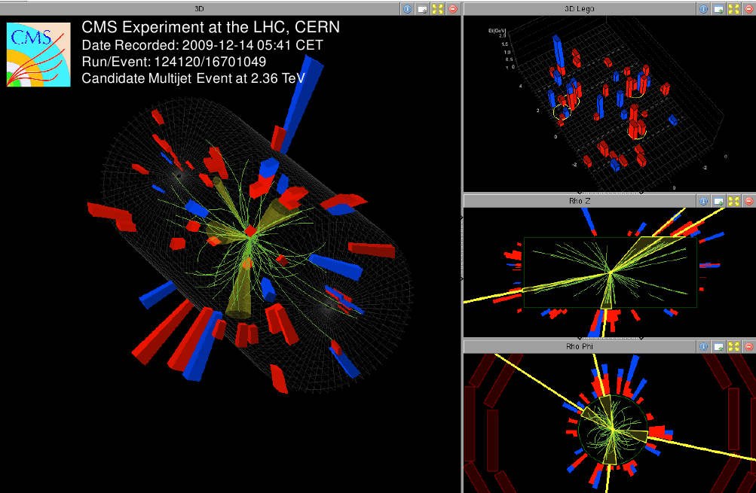
Collision tracks: December 2009
Candidate multi-jet event at 2.36 TeV 4 particle-flow jets with ET > 7 GeV tracks displayed with pT > 0.4 GeV

Slide 33
Discovery!

Slide 34
The future
The experiments were demanding to design and build
the accelerator too…
but we succeeded in overcoming unprecedented challenges
a huge effort by many people and institutes, over many years
Now we have set ourselves an even more difficult problem
upgrade the experiments to take data for a further 10-15 years
under even more demanding conditions
radiation tolerance, data volumes, reliability,..
while maintaining, or even improving, performance
Replacing several major sub-detectors
and many other improvements
currently at R&D stage, prototyping, then construction from 2018?

