Slide 1
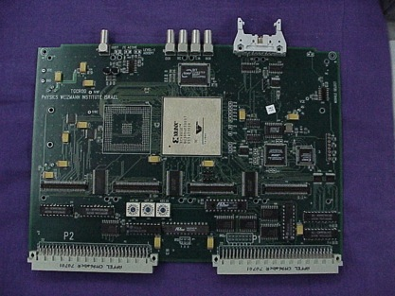
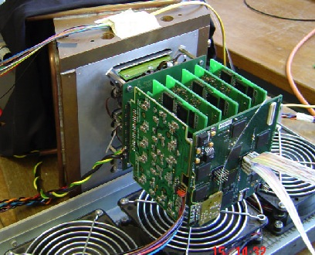
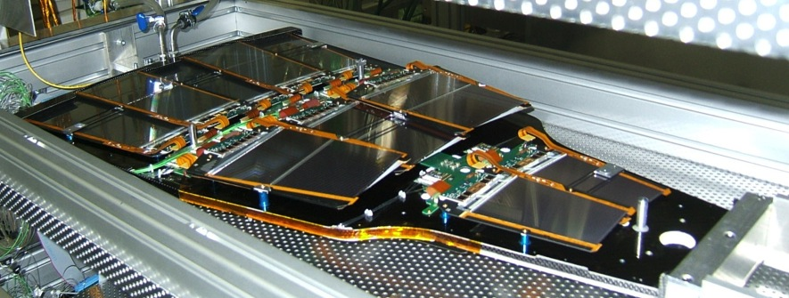
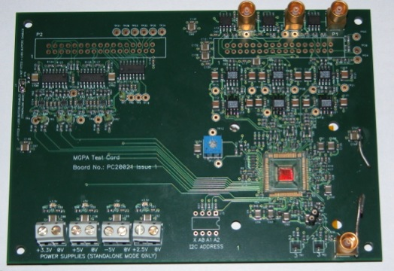
Electronics procurements
Geoff Hall
24 October 2014

Slide 2
Procurements from CERN
There are a wide range of electronics items procured by CERN
  but we are familiar with only some of them
Probably two main categories:
  for experiments: mainly, but not only, LHC where users and CERN staff are building their experiments
    mostly customised items, specific to the project
    but also less customised parts, such as power supplies, controls, crates, optical links
  for accelerators:
    we are less familiar with their requirements, and may be even larger than experiments
    some of it does resemble experiment procurements, i.e. customised, often located in radiation zones
    other parts are probably more standard, such as PS, controls, etc

Slide 3
Experiment requirements
Use examples from CMS – only time for a few illustrations
Several types of electronics purchases, including:
  custom integrated circuits (ASICs) – radiation zone
    sometimes packaged, or custom assemblies
  multi-layer hybrids (electromechanical support for ASICs) to attach to sensors – radiation zone
  board-based (VME/µTCA/ATCA/…) off-detector digital electronics
    heavy use of FPGAs, processing and control functions
  data transmission via high speed optical links, and electrical assembly
We are by no means responsible for all of them!
  but hopefully can provide some insight, or links to contacts
  several technical experts present today

Slide 4
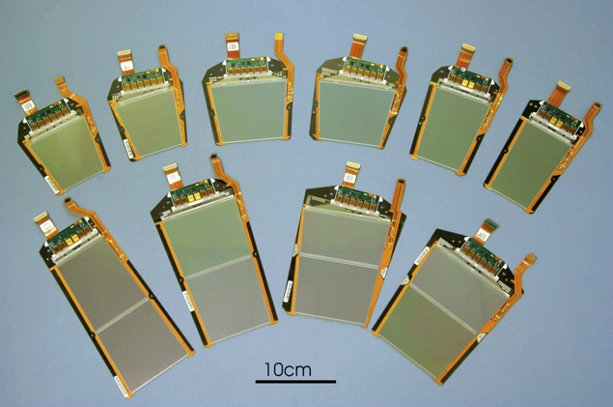
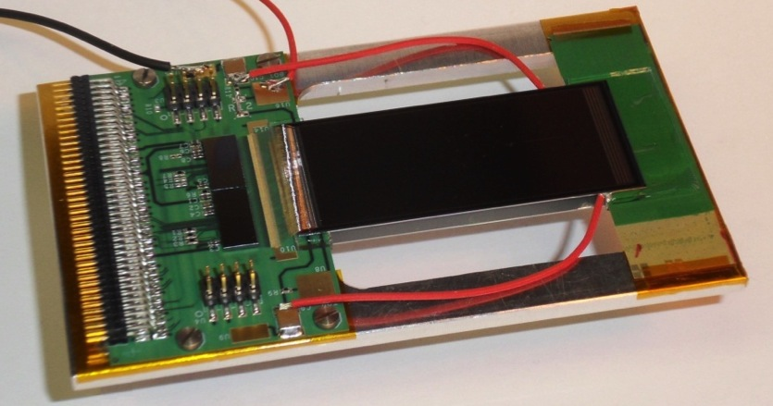
Silicon tracker detectors
Very large systems in CMS, ATLAS and also LHCb and ALICE
p-n diode arrays, finely segmented into microstrips (pitch ~100µm)
assembled into modules with ASICs

Slide 5
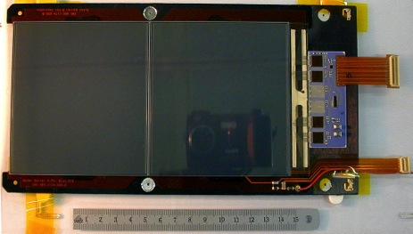
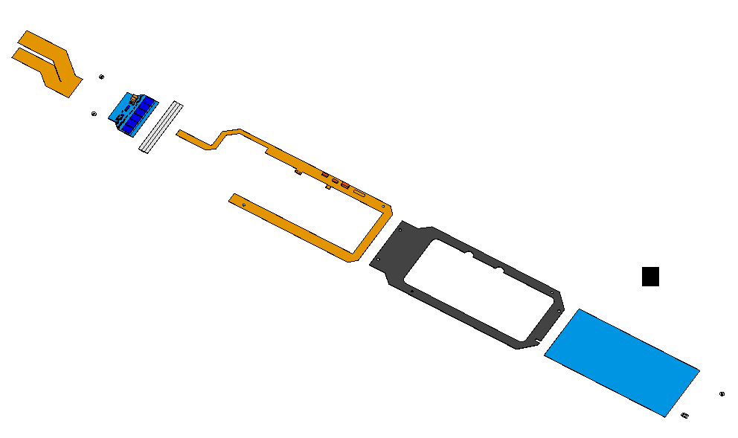
Typical module components
Pins
Front-End Hybrid
APV and control chips
Kapton cable
Now incorporated
with the hybrid.
Pitch Adapter
Kapton Bias Circuit
Carbon Fiber/Graphite Frame
Silicon Sensors

Slide 6
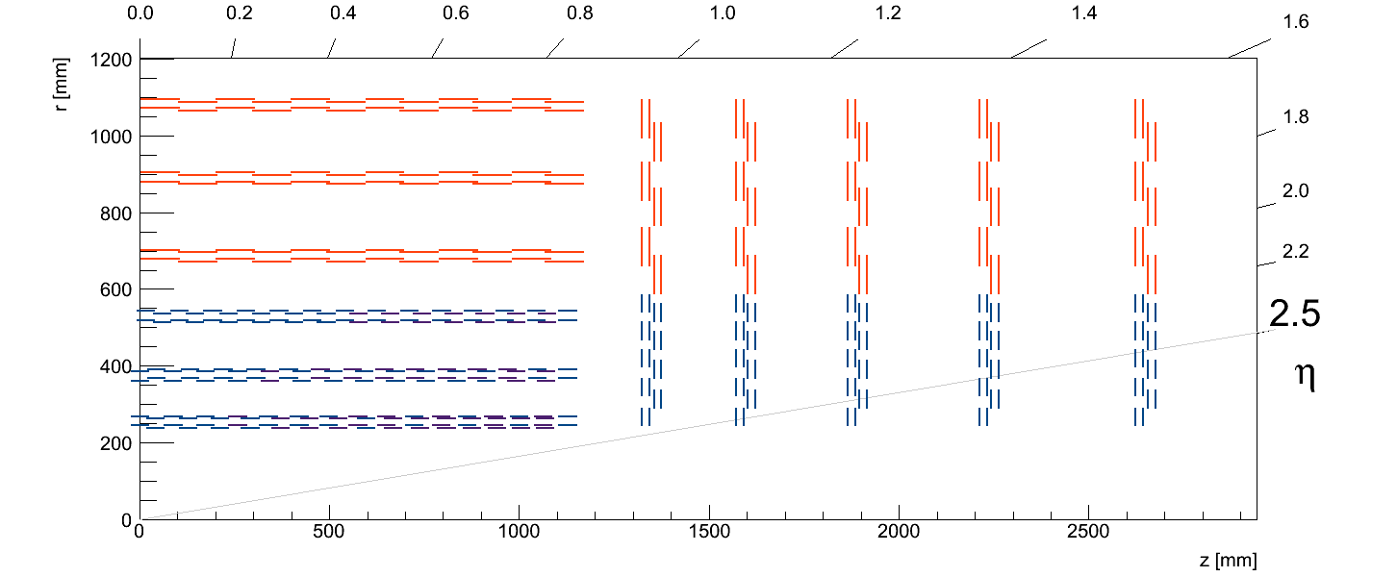
New types of module under development
~15000 modules transmitting
  p_{T}-stubs to L1 trigger @ 40 MHz
  full hit data to HLT @ 0.5-1 MHz
~7100 PS-modules
~8400 2S-modules

Slide 7
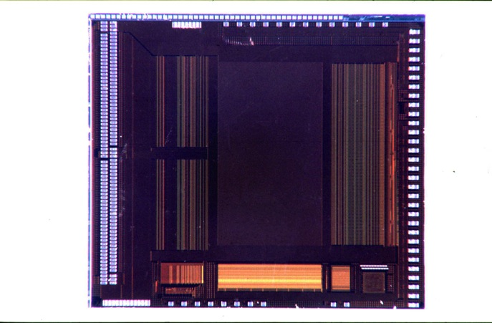
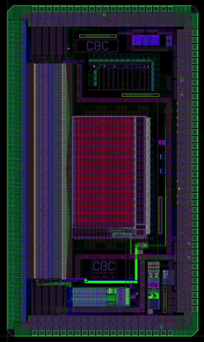
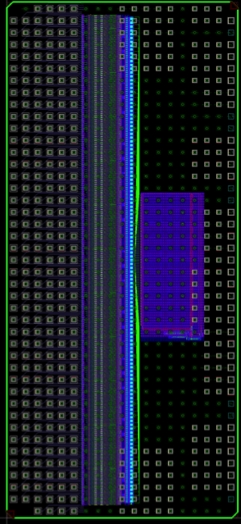
CMS Tracker ASIC evolution
1999: APV25 0.25µm 2011: CBC 0.13µm 2013: CBC2 0.13µm
  7 mm x 8mm (128 chan) 7mm x 4mm (128 chan) 11mm x 5mm (254 chan)
pipeline
128x192
128 x preamp/shaper
APSP + 128:1 MUX
bias gen.
control
logic
FIFO
CAL
pipe logic
  programmable settings (now standard)
  analogue data
  ~4 µs latency
  wire-bondable
  pulse-shaping choice
  binary data,
  6.4 µs latency
  wire-bondable
  bump-bondable,
  cluster & correlation logic

Slide 8
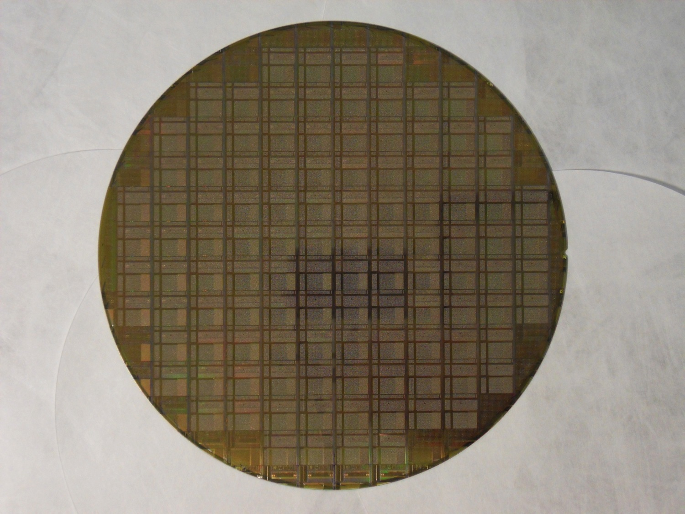
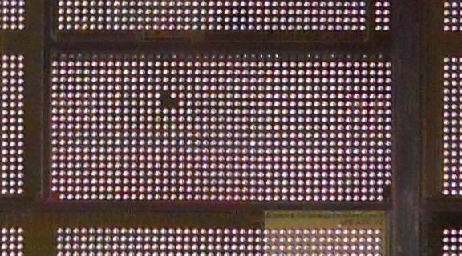
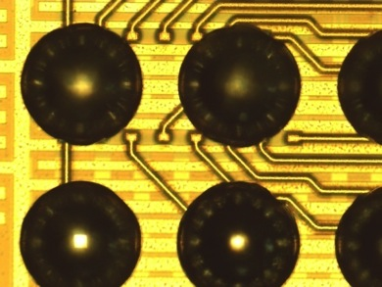
CBC2 C4 wafers
delivered on wafers, and tested in-house
CBC2
reticle
notch
wafer name:
A4PNFAH

Slide 9
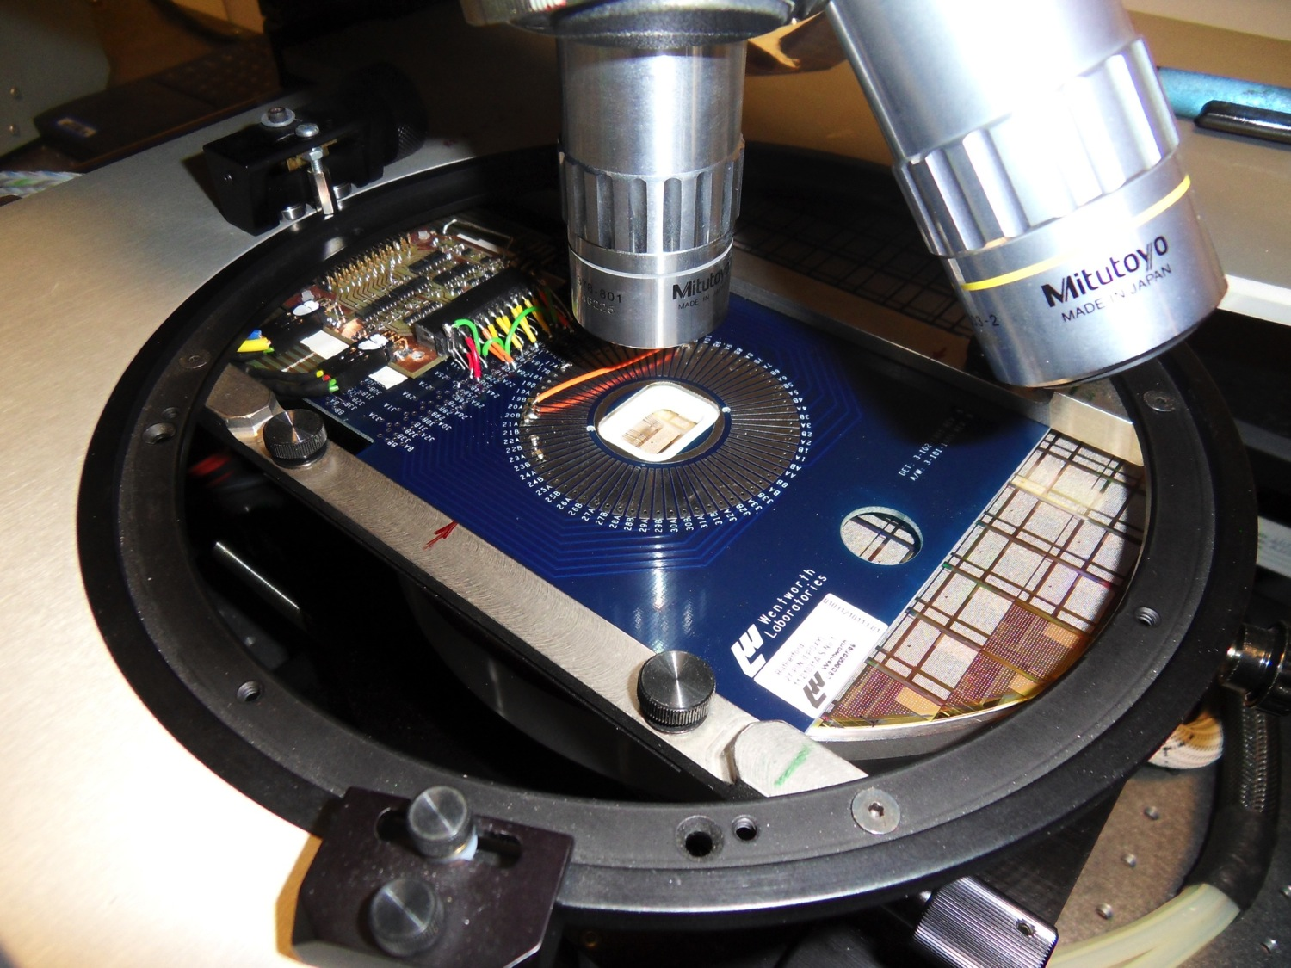
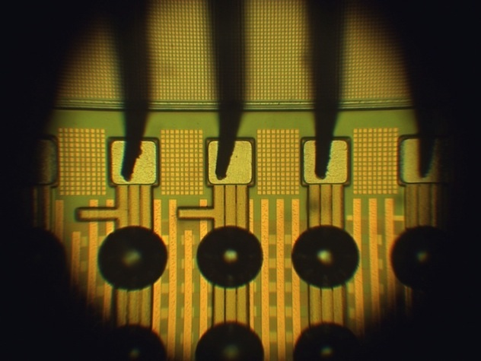
first wafer probed manually

Slide 10
More advanced hybrids

Slide 11
Some requirements
Fine pitch
dense layout
multi-layers
impedance control
…

Slide 12
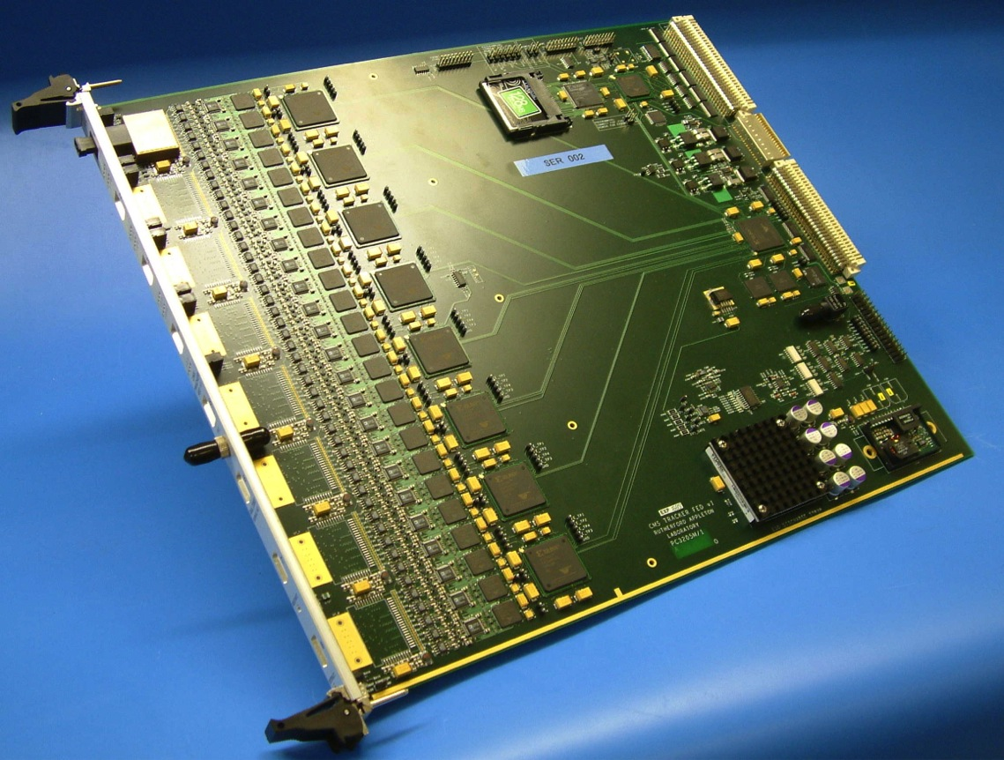
Supplemented by off-detector digital boards…
typical of many other CMS modules
JTAG
OptoRx
VME64x
9U board
CFlash
34 x
FPGAs
96 channels
Memories
Analogue
TTC
Power
FE Unit
“Primary” Side

Slide 13
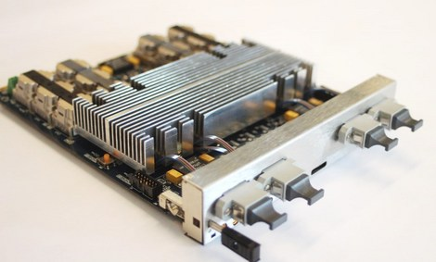
Today’s hardware
MP7 (Virtex-7 XC7VX690T)
future generations will improve, but don’t yet know precisely how
purpose-built µTCA card for CMS upgraded L1 calorimeter trigger
TM performance & calo algorithms demonstrated in recent integration tests
- 72 input/72 output optical links
-all links operate at 12.5 Gbps
(10 Gbps in CMS)
- total bandwidth > 0.9 Tbps
tested, currently in production
NB good cooling required!

Slide 14
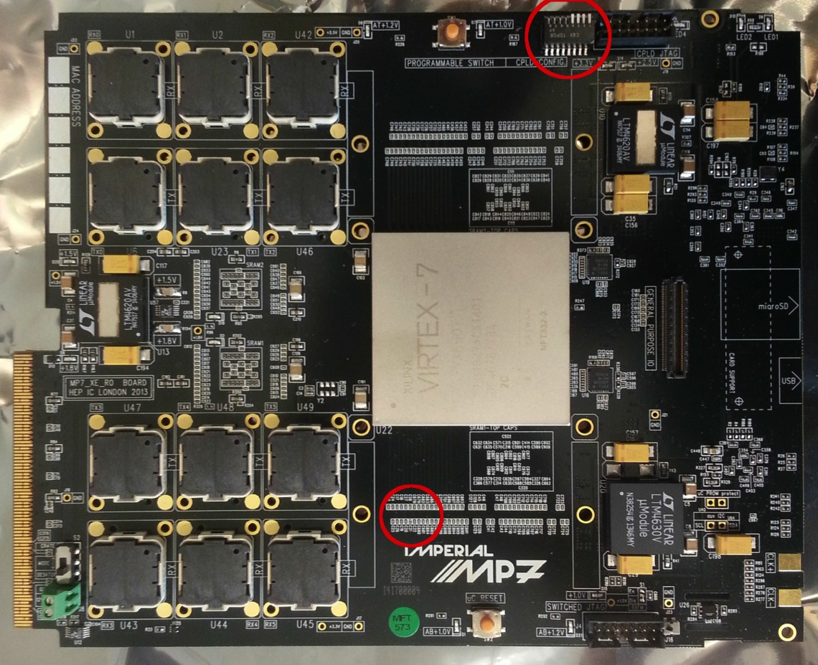
MP7 2013
G Iles et al
  IN
  72 x 12.5 Gbps = 0.9 Tbps
  OUT
  72 x 12.5 Gbps = 0.9 Tbps
  flexible processing
  NB smaller form factor than 9U FED
  Power similar

Slide 15
Not always problem-free
Sensors: two major contracts with very different production quality
Hybrids: flexible kapton-metal layer structure
  subtle problems in through-via manufacture identified at late stage
ASIC yield: variations after initial very good beginning
  worked with company to understand and solve
Cooling plant performance: manufacture weakness
  failures in plant and components which could have had major repercussions
QA issues – picked up by monitoring, in time
  early attention to minor details is crucial to avoiding costly delays
  all highly specialised items with few, or no, second sources

Slide 16
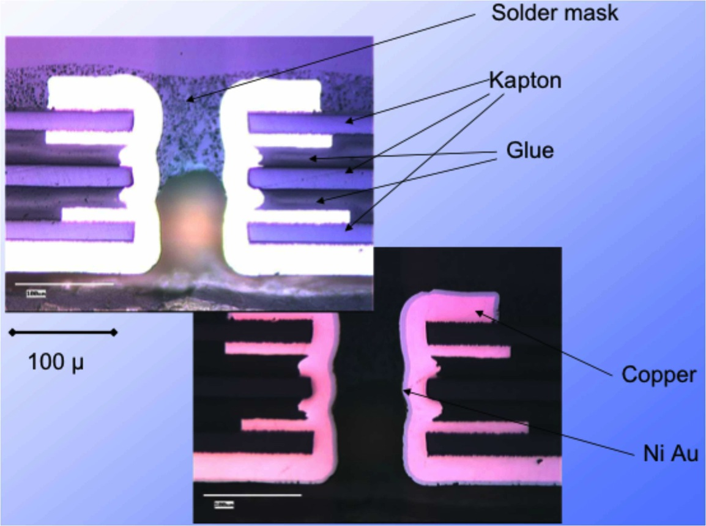
Hybrid cross-section – after actions
late 2004
Recent cross-sections from company, confirmed by CMS
Extra kapton layer, reduces glue
100µm vias -> 120µm
New metal process

Slide 17
FC7: design motivations (II)
principally designed with two CMS users in mind
  the Trigger Control & Distribution System (TCDS) –
    distribution of LHC clock, fast (e.g. trigger) and slow commands, reception of synchronous detector status,…
  the Pixel Front End Driver (pixFED)
    – replacement front end board to acquire data from the upgrade pixel detector, to be installed in 2017;
- compatibility with uTCA for CMS (AMC13)
- low jitter clock distribution & deterministic latency
capability to run 10Gbps SERDES links

Slide 18
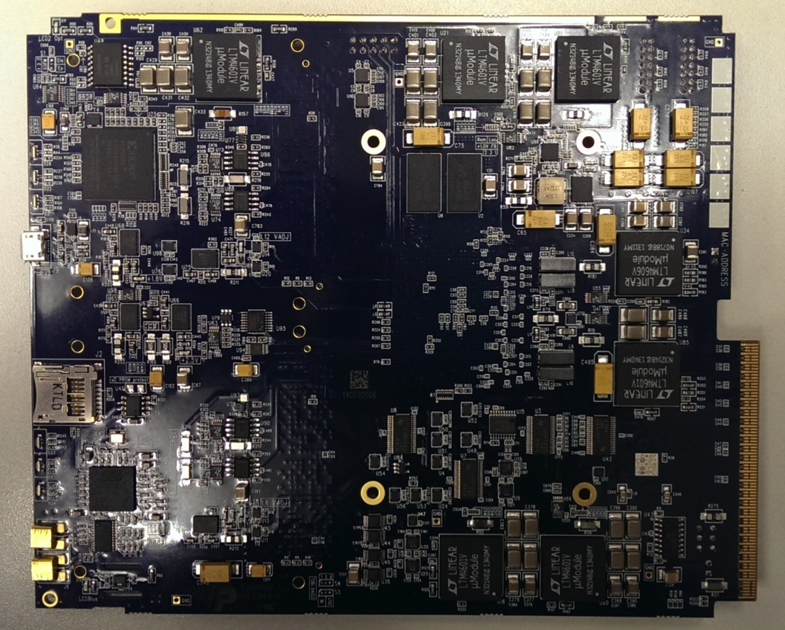
FC7
  16 layer PCB
  Nelco N4000 13-EPSI
  - low loss tangent for HF
  - low dielectric constant
  misaligned with PCB weave
  strict constraint on thickness

Slide 19
manufacturing experiences
submitted prototype and pre-production series runs with two different manufacturers
  one well known to CERN/UK, one with no prior experience of
  experimented with two PCB materials compatible with the impedances & high speed signal integrity required
large fraction of development period dedicated to tracking down & resolving manufacturing issues
  two manufacturers extremely useful to identify manufacturing vs. design faults (whether due to designer error or board complexity)
  have learnt the importance of good, two-way communication with your supplier

Slide 20
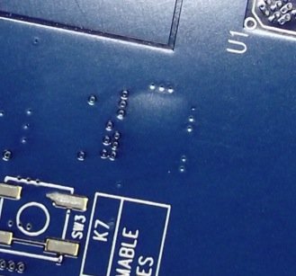
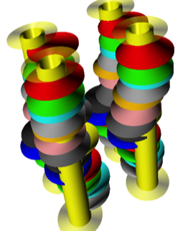
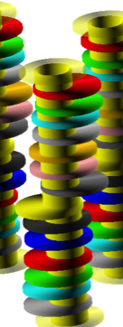
example 1: PCB issues
for 10Gbps we can’t use simple FR4…
Nelco N4000 laminate (Park) has very good high frequency characteristics but now known to be susceptible to delamination & registration defects
  also expensive material, low yield
  requires careful handling during manufacture & assembly;
TU-872 SLK laminate (TUC) trialled successfully but also tends to suffer similar registration defects –
key is building communicative relationship with supplier
real x-ray representations

Slide 21
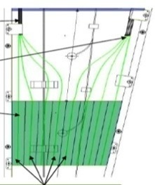
Endcap Calorimeters
Other projects
Two approaches
  Maintain tower geometry - develop rad-tolerant solutions for 3000 fb⁻¹
    EE towers e.g. in Shashlik design (crystal scintillator: LYSO, CeF)
    Te build HE with more fibers, and rad-tolerant scintillator
  Alternative geometry/concepts
    Potentially improved performance and/or lower cost
      Dual fiber read-out: scintillation & Cerenkov (DROC) – alla DREAM/RD52
      Particle Flow Calorimeter (PFCAL) – following work of CALICE
21
Notes:
Dual fiber read-out: scintillation & Cerenkov (DROC) – following work of DREAM/RD52
using doped/crystal fibers - allows e/h correction for improved resolution
Particle Flow Calorimeter (PFCAL) – following work of CALICE
using GEM/Micromegas – fine transverse & longitudinal segmentation to measure shower topology

Slide 22
Upgrade project status
R&D underway, especially in UK, for at least 5 years
  prototyping ASICs, board based electronics, detector modules, trigger and readout systems
    NB includes much FPGA firmware and online software, as well as simulations of future detectors and their physics performance
New detectors should be installed and be operational in 2023
  several years of procurement, construction, assembly, qualification, commissioning tests are needed before installation
    followed by commissioning in the experiment, then operation
  approval of construction funding is still at an early stage
    although under discussion for some years
    Technical Design Reports, for final approval, expected 2016-2017
R&D funds in place in many agencies
  expect this to grow further in the coming years

