Slide 1
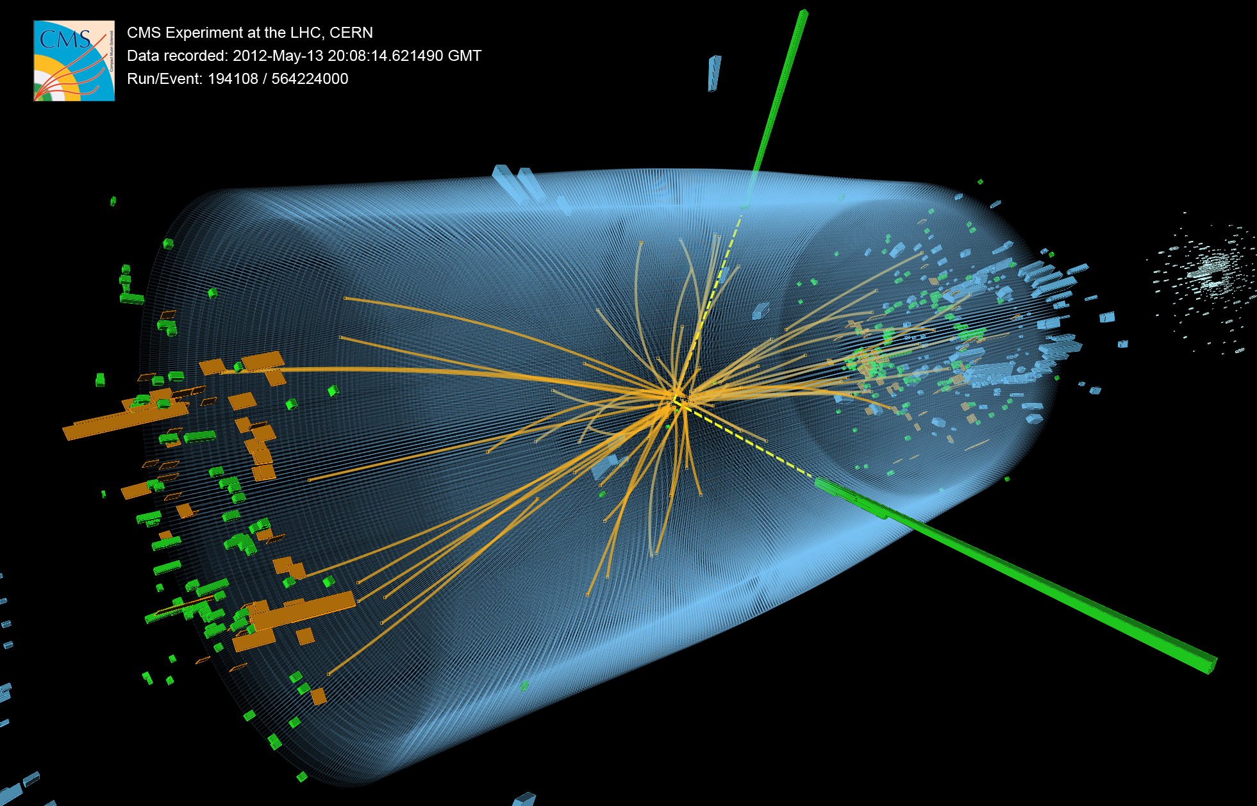
UK CMS Upgrades to Tracker and Trigger systems
Geoff Hall
20 September 2012
University of Bristol
Brunel University
Imperial College London
Rutherford Appleton Laboratory

Slide 2
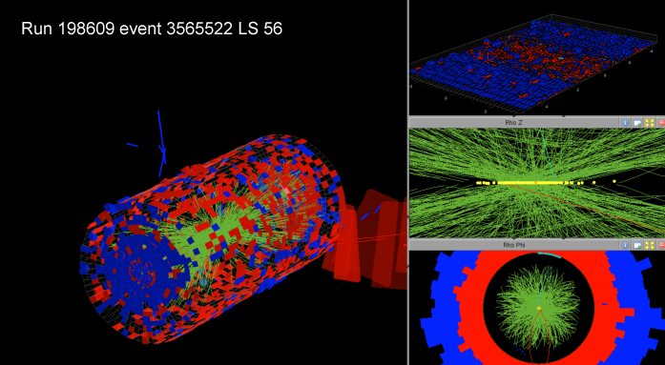
Overview
CMS status
LHC status and future plans
Motivation for upgrade
R&D background and status
WP objectives
Vision for future
Summary of Request
78 events pileup!

Slide 3
CMS status

Slide 4
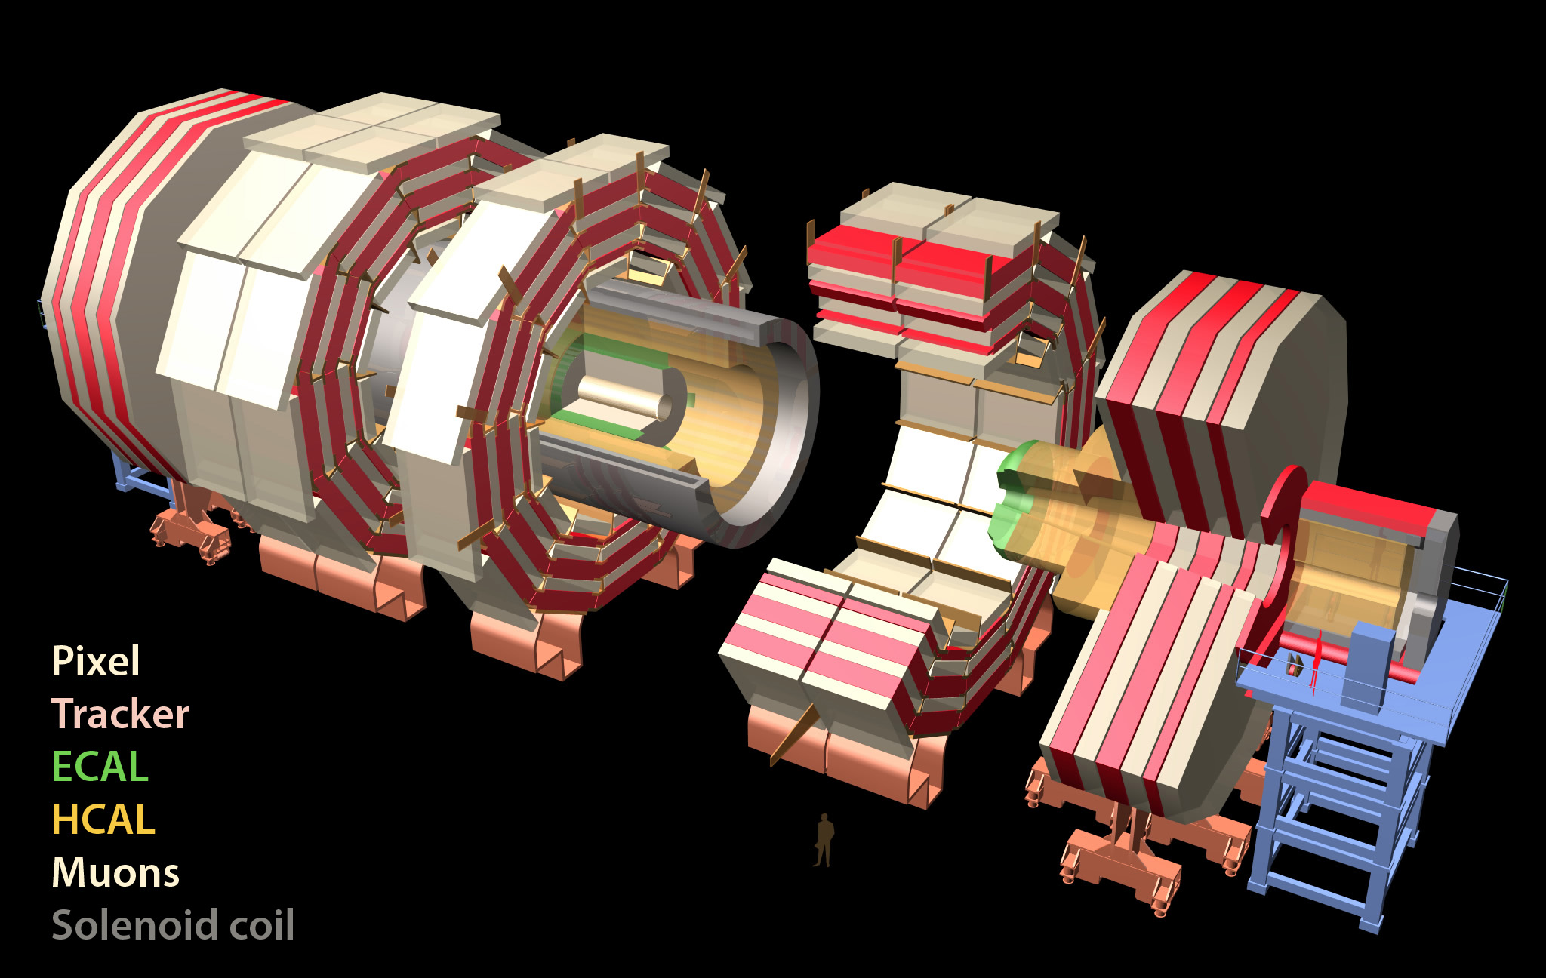
CMS
Total weight 14000 t
Overall diameter 15 m
Overall length 28.7 m
ECAL
76k scintillating
PbWO₄ crystals
MUON ENDCAPS
HCAL
Scintillator/brass
Interleaved ~7k ch
473 Cathode Strip Chambers (CSC)
432 Resistive Plate Chambers (RPC)
3.8T Solenoid
IRON YOKE
Preshower
Si Strips ~16 m²
~137k ch
YE1-3
YBO
Foward Cal
Steel + quartz Fibers ²~k ch
YB1-2
Pixels & Tracker
Pixels (100x150 μm²)
~ 1 m² ~66M ch
Si Strips (80-180 μm)
~200 m² ~9.6M ch
MUON BARREL
250 Drift Tubes (DT) and
480 Resistive Plate Chambers (RPC)
Notes:
Largest and most powerful SC Solenoid 3.8T
Houses All Silicon tracker 66 M channels
Crystal Calorimeter 76k

Slide 5
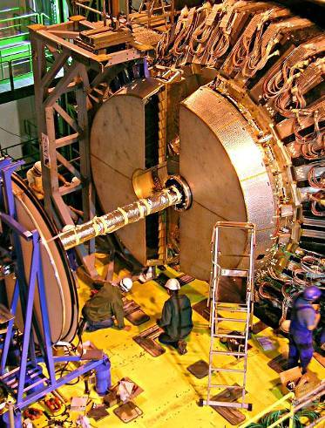
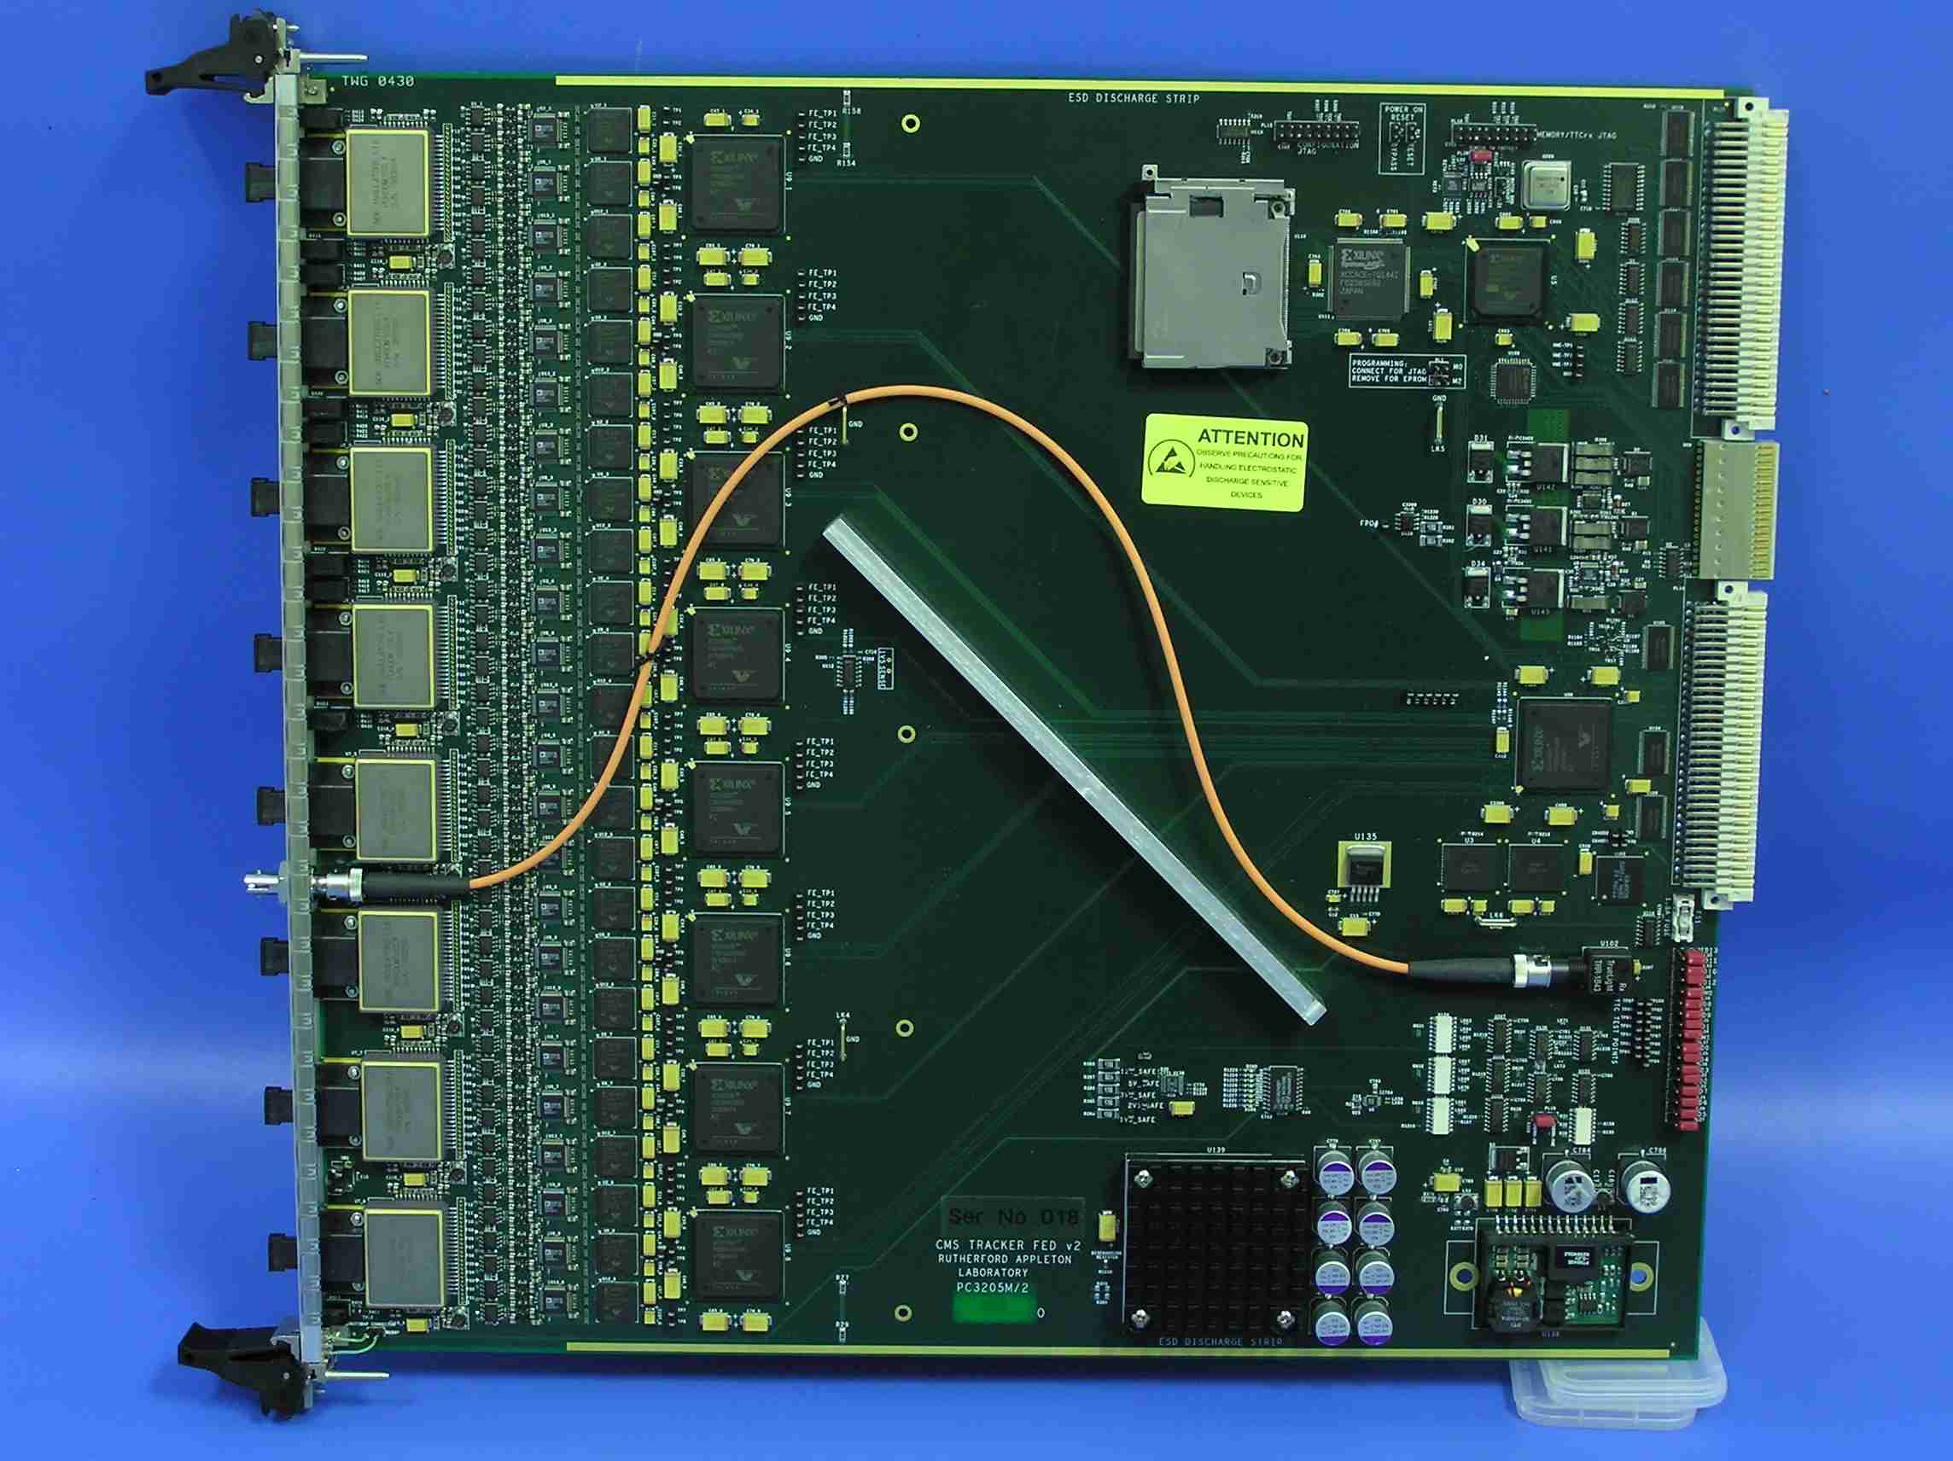
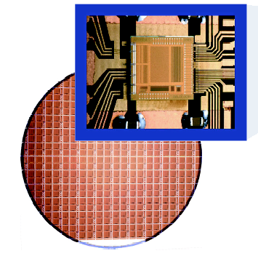
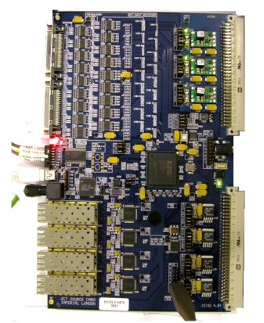
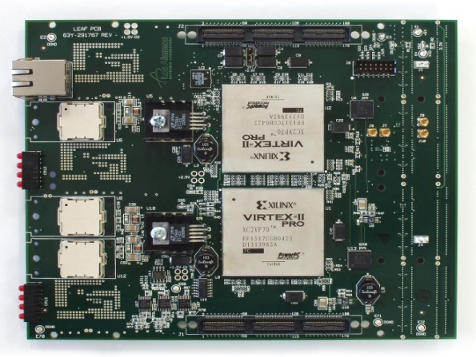
Some UK contributions to CMS
Delivery of systems critical to success of CMS
  functioning very well to date
Endcap ECAL – 14648 PbWO4 crystals & VPTs
Tracker readout system – largest CMS DAQ system
  ASICs and VME FPGA hardware
Global Calorimeter Trigger – heart of trigger
  FPGA boards, with high speed links
Computing, offline, physics…

Slide 6
Current Operational Status*
Pixel Tracker | Strip Tracker | Preshower | ECAL Barrel | ECAL Endcaps | HCAL Barrel | HCAL Endcaps | HCAL Forward | HCAL Outer | Muon DT | Muon CSC | Muon RPC
97.1% | 97.75% | 97.1% | 99.16% | 98.54% | 99.92% | 99.96% | 99.88% | 96.88% | 99.1% | 97.67% | 98.2%
*As of June 15 2012

Slide 7
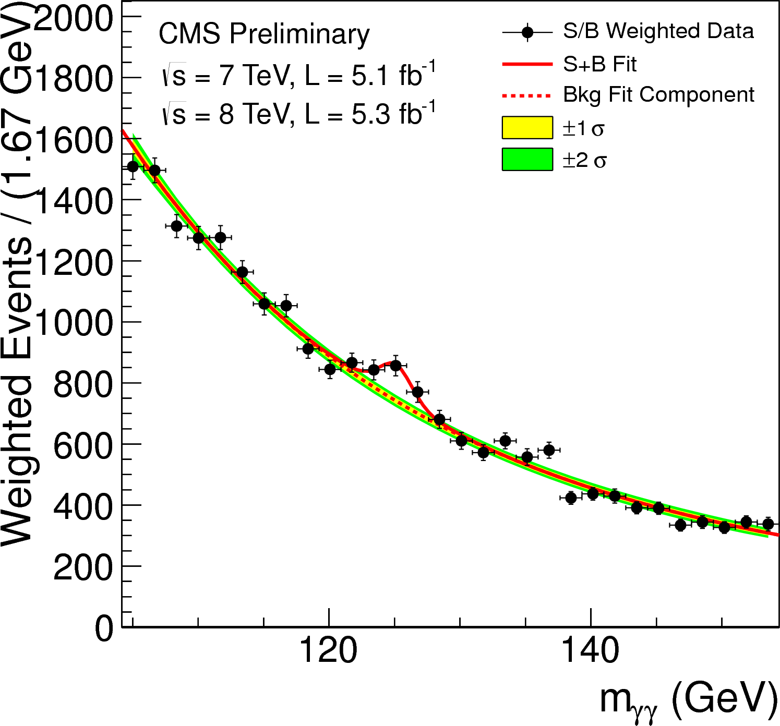
4 July 2012
half design energy,
one third of integrated luminosity
five times higher pileup
than originally expected

Slide 8
New physics
CMS has already made one major discovery
  still to prove it is a Higgs boson by measuring all its properties and couplings
  it was expected to require much more data
CMS has excluded large areas of phase space for the simplest SUSY models and new heavy vector bosons
  moving on to more complex models where mass of putative Higgs may give hints (“natural” SUSY)
  many other physics papers published…
Further investigations require much more data
  eg 2012 data insufficient to prove if 125 GeV boson spin 0 or 2
  searching for rare phenomena: ~2B events will be stored in 2012

Slide 9
CMS SUSY Searches
Impressive amount of SUSY
Topology Searches
UK CMS a key player.
No sign of SUSY (yet).
Searches continue to be updated, so far to 5 fb⁻¹
Observed limits from several CMS SUSY searches plotted in the CMSSM (m₀,m_{1/2}) plane

Slide 10
Heavy vector boson searches
Z’ e⁺e⁻
Masses (Z’_{SSM}) < 2.59 TeV excluded
Another UK flagship effort

Slide 11
lhc status

Slide 12
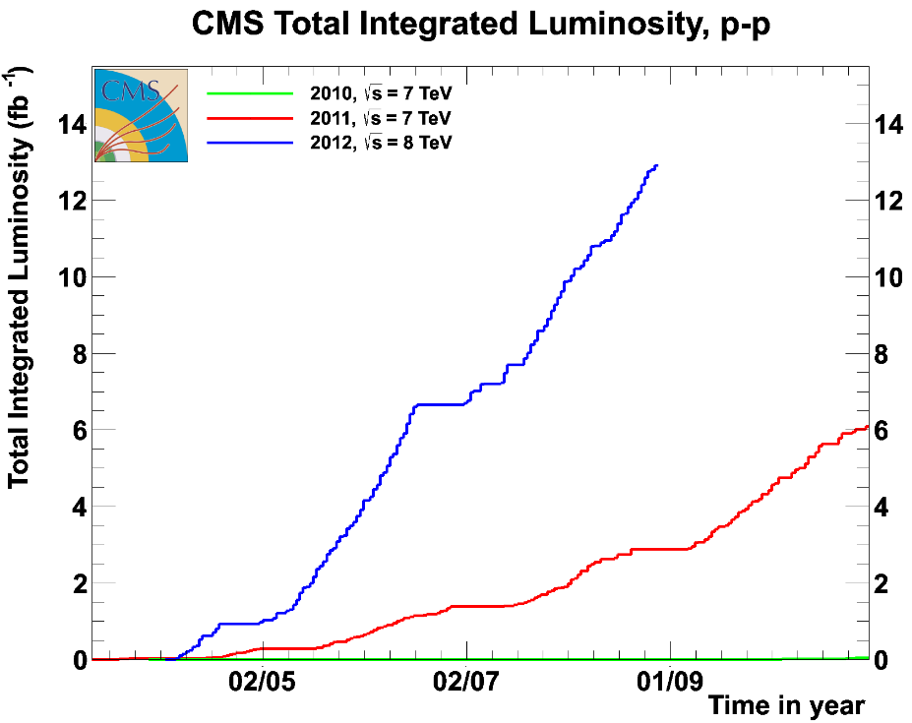
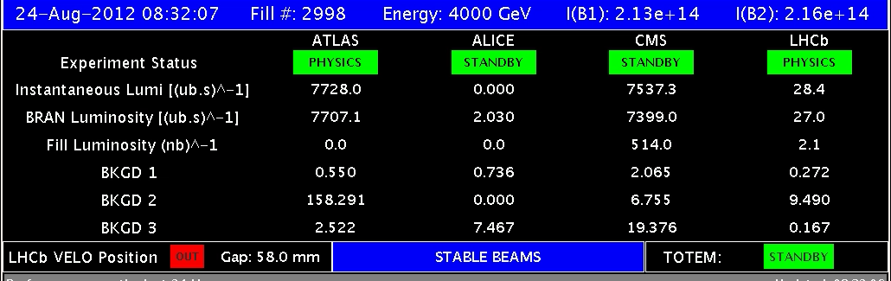
Comparison 2010 – 2011 - 2012
2010: 0.04 fb⁻¹
  Machine commissioning
2011: 6.1 fb⁻¹
  Production
2012: 13 fb⁻¹ so far
  Higher energy
  Smaller beta*
  Increased bunch current
12

Slide 13
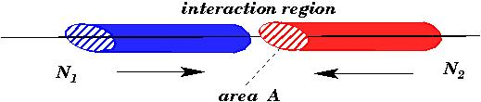
Luminosity
Nearly all the parameters are variable (and not independent)
  Number of bunches per beam k_{b}
  Number of particles per bunch Ν
  Normalised emittance ε_{n}
  Relativistic factor (E/m₀) γ
  Beta function at the IP β *
  Crossing angle factor F
    Full crossing angle θ_{c}
    Bunch length σ_{z}
    Transverse beam size at the IP σ*
Total Intensity
Beam Brightness
Energy
Interaction Region
θ_{c}
Presently F ≈ 0.8

Slide 14
Comparison with nominal & pile-up
pile-up ≈ number of events per bunch crossing
  ie µ = Nσ
  Tracker also sees particles looping in B field
For same L, 2x bunch spacing -> 2x pile-up
CMS designed for 14 TeV, L = 10³⁴ cm⁻²s⁻¹ and 25 ns
Parameter | 2010 | 2011 | 2012 | Nominal
N ( 10¹¹ p/bunch) | 1.2 | 1.5 | 1.6 | 1.15
k (no. bunches) | 368 | 1380 | 1380 | 2808
Bunch spacing (ns) | 150 | 75 / 50 | 50 | 25
ε_{n} (µm rad) | 2.4-4 | 1.9-2.4 | 2.2-2.5 | 3.75
β* (m) | 3.5 | 1.5 → 1 | 0.6 | 0.55
L (cm⁻²s⁻¹) | 2×10³² | 4.0×10³³ | 7.6×10³³ | 10³⁴
μ | 3 | 19 | 35 | 23
14

Slide 15
Motivation for Upgrade

Slide 16
The need for upgrades
CMS and the LHC are working so well, with outstanding results, so why is an upgrade needed?
  maintain physics performance in high pile-up conditions
    trigger must maintain low p_{T}/E thresholds and 100 kHz rate
    inner detector will be damaged by radiation
    pixel tracker loses data at high rate
Why is it needed now? (+ time needed to build the systems)
  luminosity much higher than expected, and much sooner
  pile-up has dramatic impact on trigger
  tracking degrades significantly
  original designs were limited by technology of the time
Eventually (~2022) a brand new tracker is required
  must be ready for large scale production by 2017

Slide 17
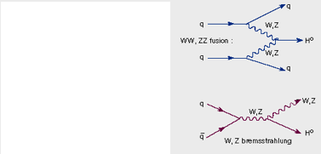
Examples of physics impact
Tracker degradation gives overall loss of data/quality
  and, e.g., significant losses of b quark jets
Potential losses at trigger level
  WH associated production
  trigger on W (single e/µ) to measure H properties without bias
    p_{T} thresholds will rise significantly before LS2 (next slide)
  For Higgs couplings measurements
  may only be possible using VBF production topology
  trigger on correlations between jets, especially forward jets
  pile-up is extreme.

Slide 18
Sample trigger menu from current L1 trigger
Algorithm | 8 TeV 7E33 ~25 PU |  | 14 TeV 2E34 50 PU
 | Thresh (GeV) | Rate (kHz) | Thresh (GeV) | Rate (kHz)
Single EG | 22 | 10 | 46 | 10
Single IsoEG | 18 | 9 | 31 | 9
DoubleEG | 13, 7 | 9 | 22, 12 | 9
Single Muon | 16 | 9 | 50 | 9
Dble Muon | 10, open | 5 | 35, open | 5
EG+Mu | 12, 3.5 | 3 | 21, 6 | 3
Mu+EG | 12, 7 | 2 | 25, 15 | 2
SingleJet | 128 | 2 | 188 | 2
DoubleJet | 56 | 10 | 132 | 10
QuadJet | 36 | 2 | 96 | 10
Double Tau | 44 | 2 | 56 | 2
MET | 36 | 7 | 84 | 7
HTT | 150 | 2 | 511 | 2
Example 14 TeV trigger menu
Using current bandwidth allocation
Based on MC - still needs to be fully validated & finalised
Single lepton thresholds are very high
Combined rate of current single lepton triggers only
~ 140 kHz at 14 TeV 2E34
Cannot maintain current thresholds with current L1 trigger at 14 TeV 2E34
Multi-jet trigger thresholds affected by both √s and PU

Slide 19
LHC future plans
LHC operational conditions in 2012
  8 TeV, 50ns bunch spacing, L_{inst}~8 x 10³³ cm⁻²s⁻¹
    target ~25 fb⁻¹
Long term plan: Long Shutdowns (later dates may change)
  LS1: March 2013-2015 - upgrade to full energy
    14 TeV, 25 (50?) ns bunch spacing, L_{inst}< 2.5 x 10³⁴ cm⁻²s⁻¹
  LS2: 2018 - improve collimation and other machine elements
    14 TeV, L_{inst}< 4(?) x 10³⁴ cm⁻²s⁻¹
  LS3: 2022 - upgrade for very high luminosity
    14 TeV, L_{inst}~5 x 10³⁴ cm⁻²s⁻¹ (levelled)
LHC machine consistently outperforming expectations
  no scope for relaxation if physics reach to be maximised

Slide 20
Long Shutdown 1
End March 2013 – November 2014
Consolidation for 6.5 – 7.0 TeV operation
  Measure all splices and repair defective ones
  Repair of magnet interconnects after 2008 event with new design (clamp, shunt)
  Finish installation of pressure release valves
  Exchange of weak cryo-magnets and DFBAs
  Relocation of equipment to reduce radiation effects on electronics
  Installation of collimators with integration beam position measurement, injection absorbers refurbishment
  Injection kickers reduction of heating
  Experiments consolidation and upgrades
Plus a lot of other work ongoing
  Cryogenics, Quench Protection, electrical infrastructure, cooling & ventilation, Radio Frequency, beam dump absorber & magnet, change of dump switches (radiation), electron cloud mitigations …
20

Slide 21
IMPACT on cms

Slide 22
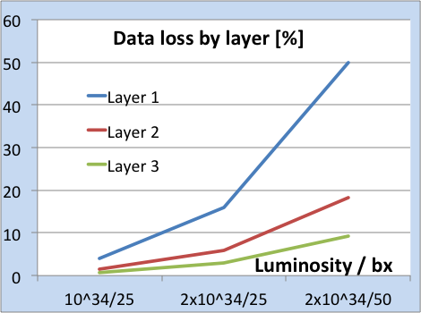
Tracking at high pileup
Tracking efficiency is reduced – affects everything
Fake track rates are increased
Primary vertices merge
Resolution worsens, due to wrong hits
Increased CPU and memory use
Inner pixel layers: dynamic data loss affects track seeding

Slide 23
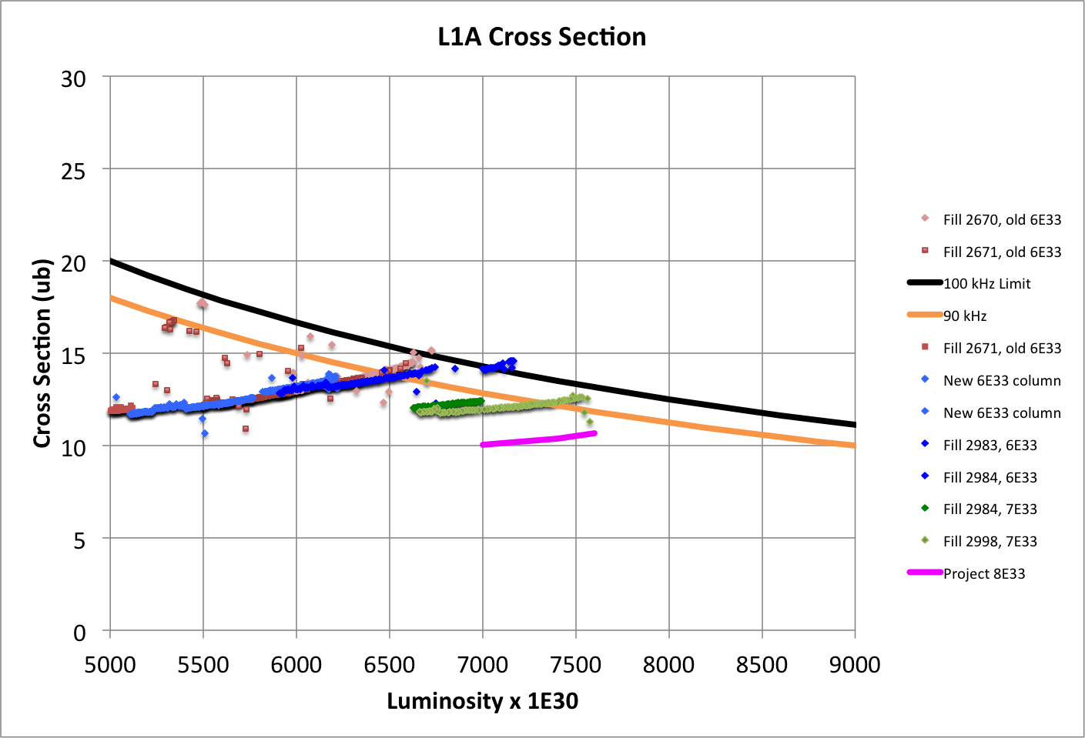
L1 Total Cross Section vs. Luminosity (Limits of Prescale Columns)
“6E33” column to
6.7E33
“7E33” column to 7.7E33
100 kHz^{(*)}
“8E33” column to ~8.4E33
90 kHz
(*) Deadtime limits to 90 kHz

Slide 24
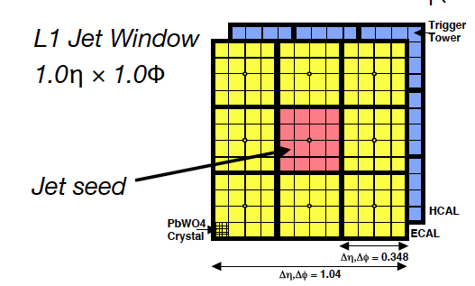
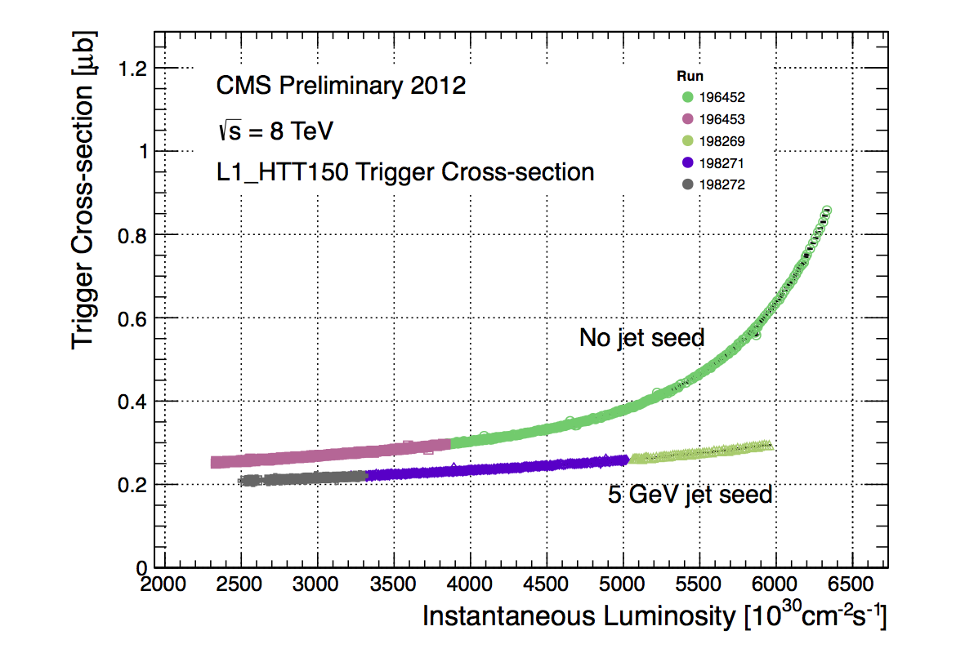
Improved Pile-up Handling in L1 Jets
Increased jet seed threshold to 5 GeV in Global Calorimeter Trigger since June Technical Stop
Significantly reduces
exponential rise in xsec
GCT team

Slide 25
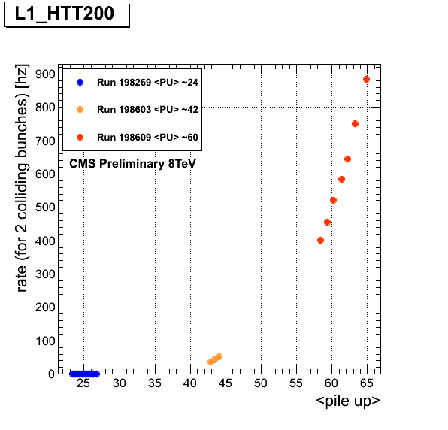
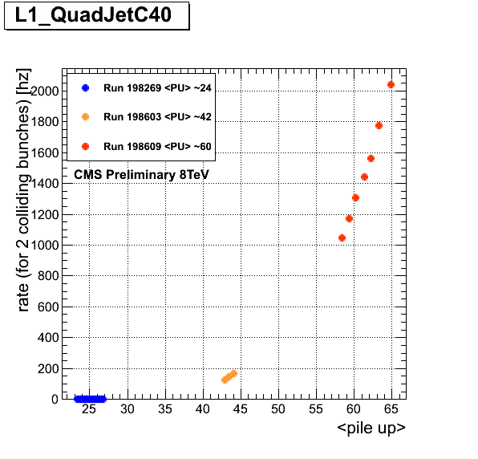
But… Problem is only Postponed…
Blow-up seen to return at higher pile-up (special fills)
  Can further increase the seed threshold and jet threshold in HT
  But better yet is an upgraded L1 trigger !
0.5 MHz @ 50 ns !
C.Battilana
Lumi @ 50ns: 1E34 1.4E34

Slide 26
UK R&D since 2009

Slide 27
UK CMS upgrade R&D achievements
WP1 – software and simulations
  IPbus (µTCA control) (10/11) adopted as common CMS-wide standard (02/12)
  simulation studies for trigger and tracker upgrades in TDRs (09/12)
WP2 – Outer microstrip tracker readout
  CBC 128 channel ASIC (03/11) developed in single design iteration & evaluated
  CBC2 256 channel ASIC submitted (07/12), with trigger data, due (10/12)
  DAQ & FED studies, with CBC module beam tests (09/11)
WP3 – L1 calorimeter trigger system
  Mini-T5 (02/10) & MP7 (07/12) processor boards delivered and working
  CMS review recommended UK hardware for future baseline (12/11)
  original new trigger architecture proposed (02/11) and demonstrated (03/12)
WP4 – pixel DAQ
  Long experience in Tracker DAQ and DQM
  UK proposal to design and deliver new pixel FED accepted (11/11)
    modified trigger hardware, IPbus and pixel ROC test beam experience (7/12)

Slide 28
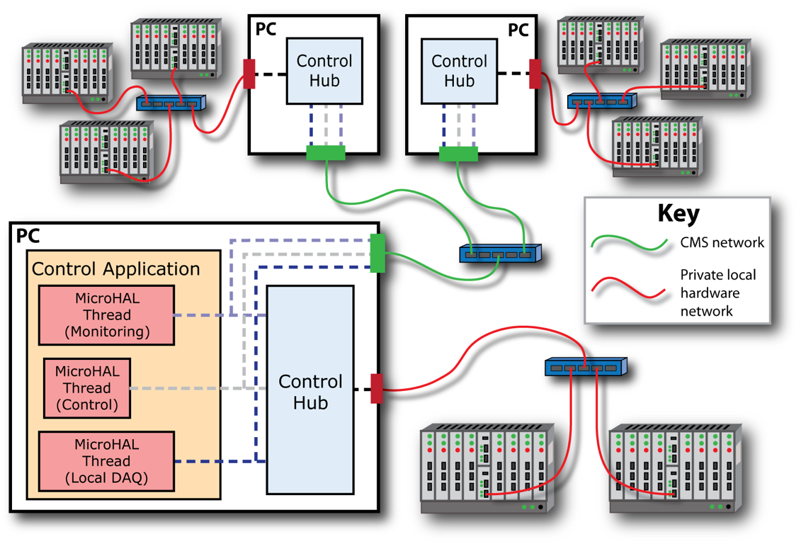
Online Control System
IPbus: scalable, hierarchical software/firmware system

Slide 29
Track reconstruction code optimisation
Example of ongoing efforts to improve high pile-up performance
  also relevant to current operation
New search method to reduce time spent in the two [pixel] triplet seed generators based on k-D trees
  Using k-D tree code in both generators gives significant decrease in CPU time
  negligible reduction in tracking efficiency
 | Standard | Large Tip k-D tree | LargeTip and HLT k-D tree
LargeTIPGenerator | 3.94% (28s) | 0.83% (6s) | 0.84% (6s)
HLTGenerator | 1.37% (10s) | 1.38% (10s) | 0.74% (5s)
CombinedHitGenerator | 5.31% (38s) | 2.20% (16s) | 1.58% (11s)

Slide 30
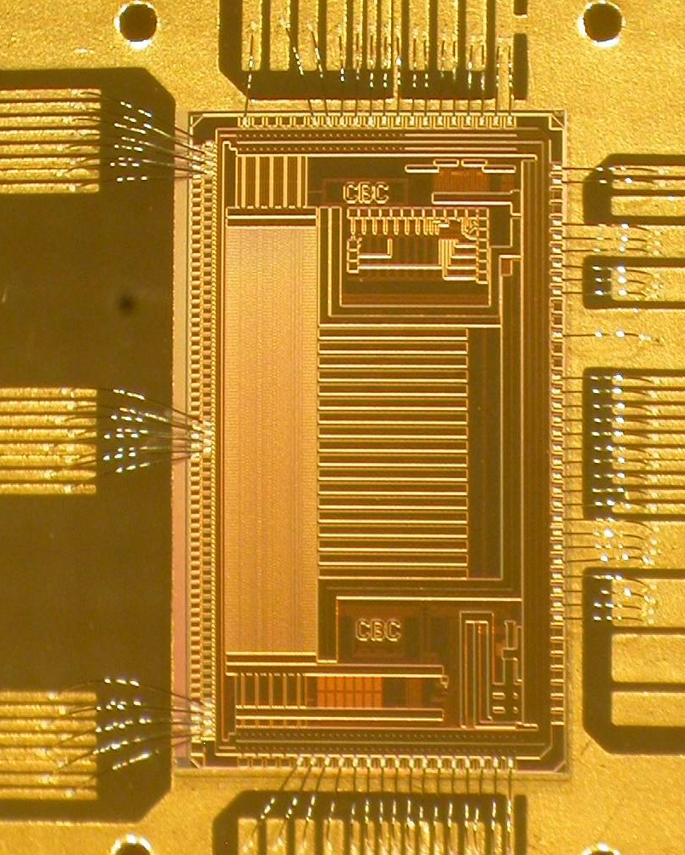
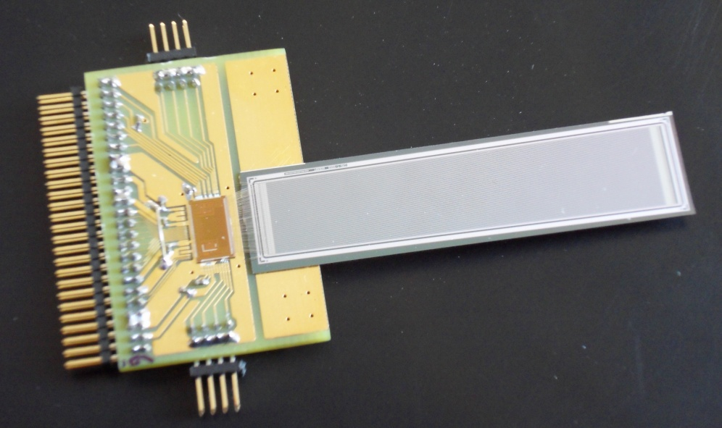
WP2: Phase II Outer Tracker readout
beam profile
CMS Binary Chip: 130nm CMOS
  128 channel binary ASIC, non-zero suppressed
  Amplifier, pipeline, memory, logic, control
  many new features, excellent performance
  tested in beam with 5cm µstrips
APV plane
CBC sensor
5 mV / division
p-on-n
150 mm pitch
320 µm thick
5 cm

Slide 31
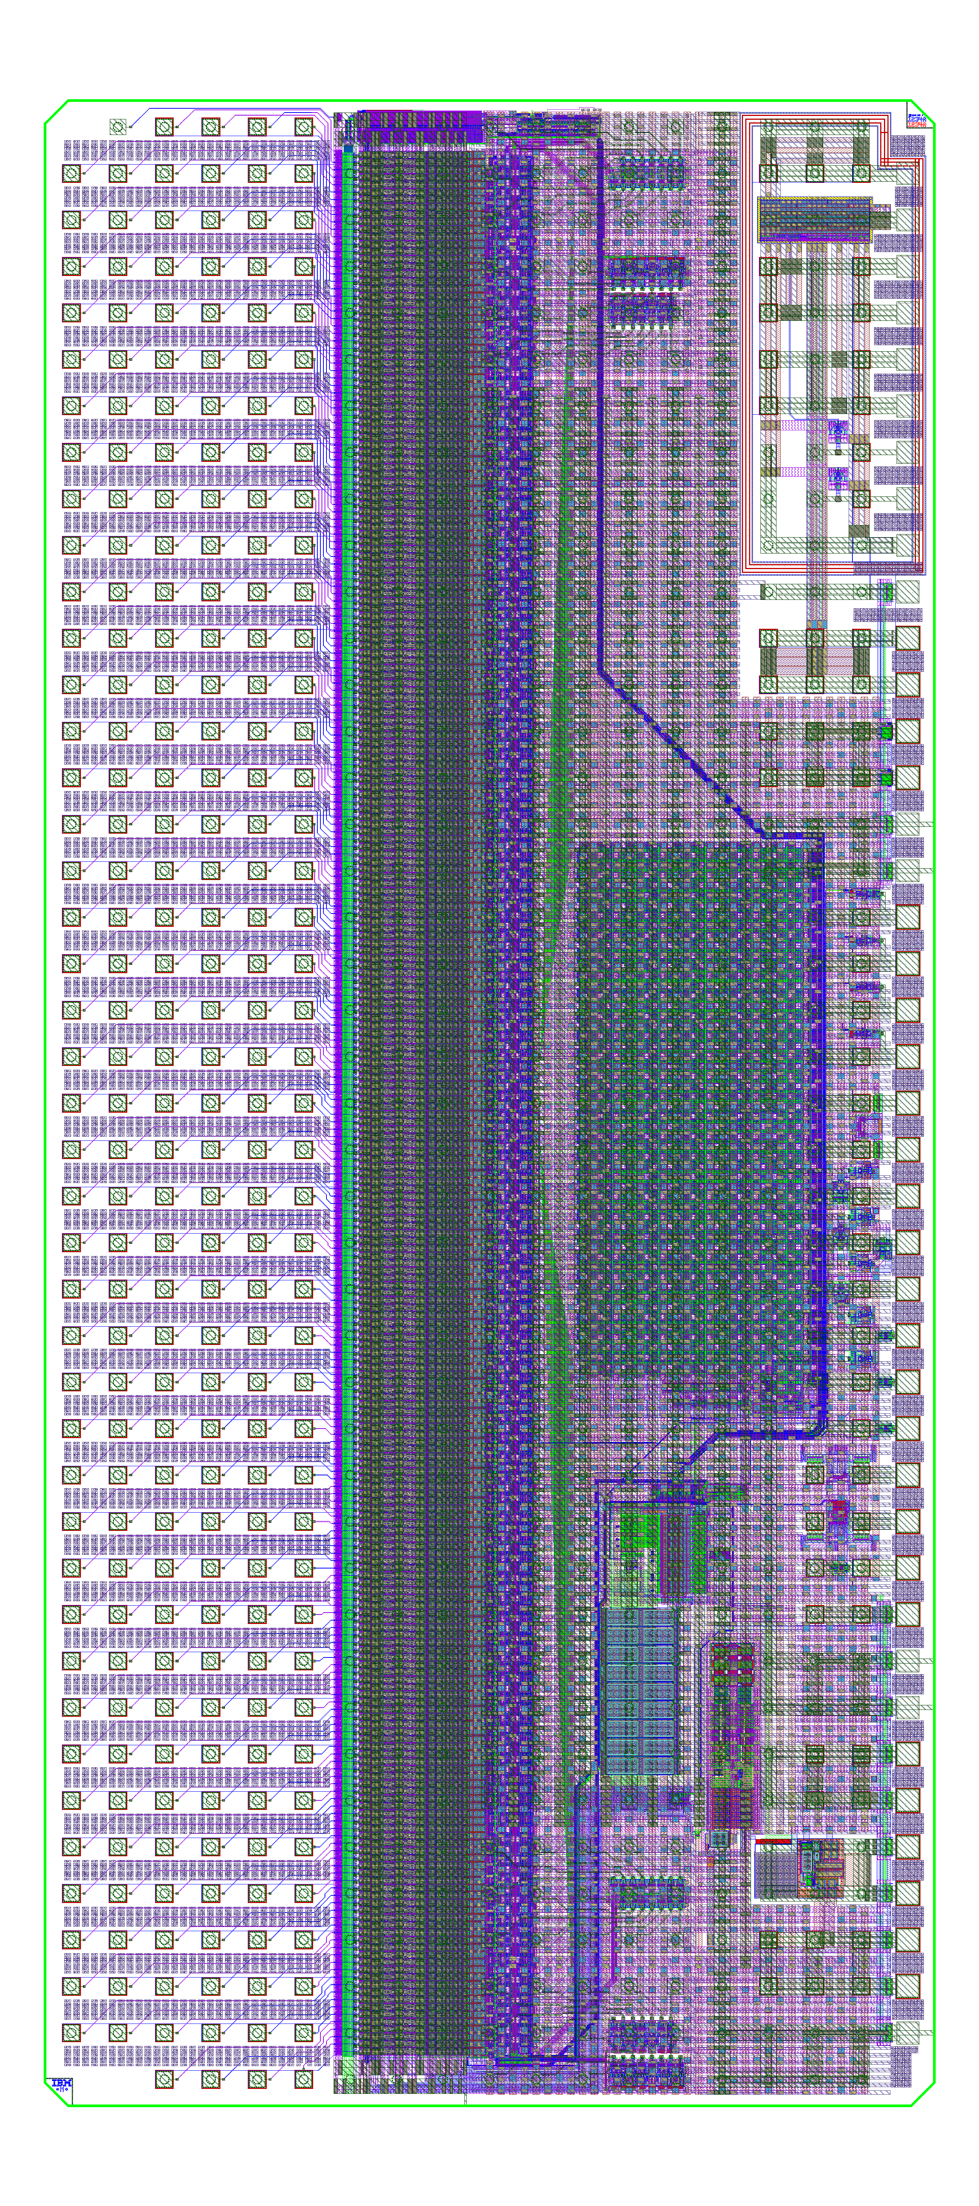
CBC2 design
250 µm pitch C4 layout
  back edge wire-bond pads for wafer probe
254 channels
  allows correlation between 127 top & 127 bottom strips
architecture based on CBC prototype
  front end, pipeline, readout architecture, powering features, …..
submitted July 2012
  wafers expected ~ October
tested, functional CBC2 is final deliverable of current Upgrade programme
11 mm
5 mm

Slide 32
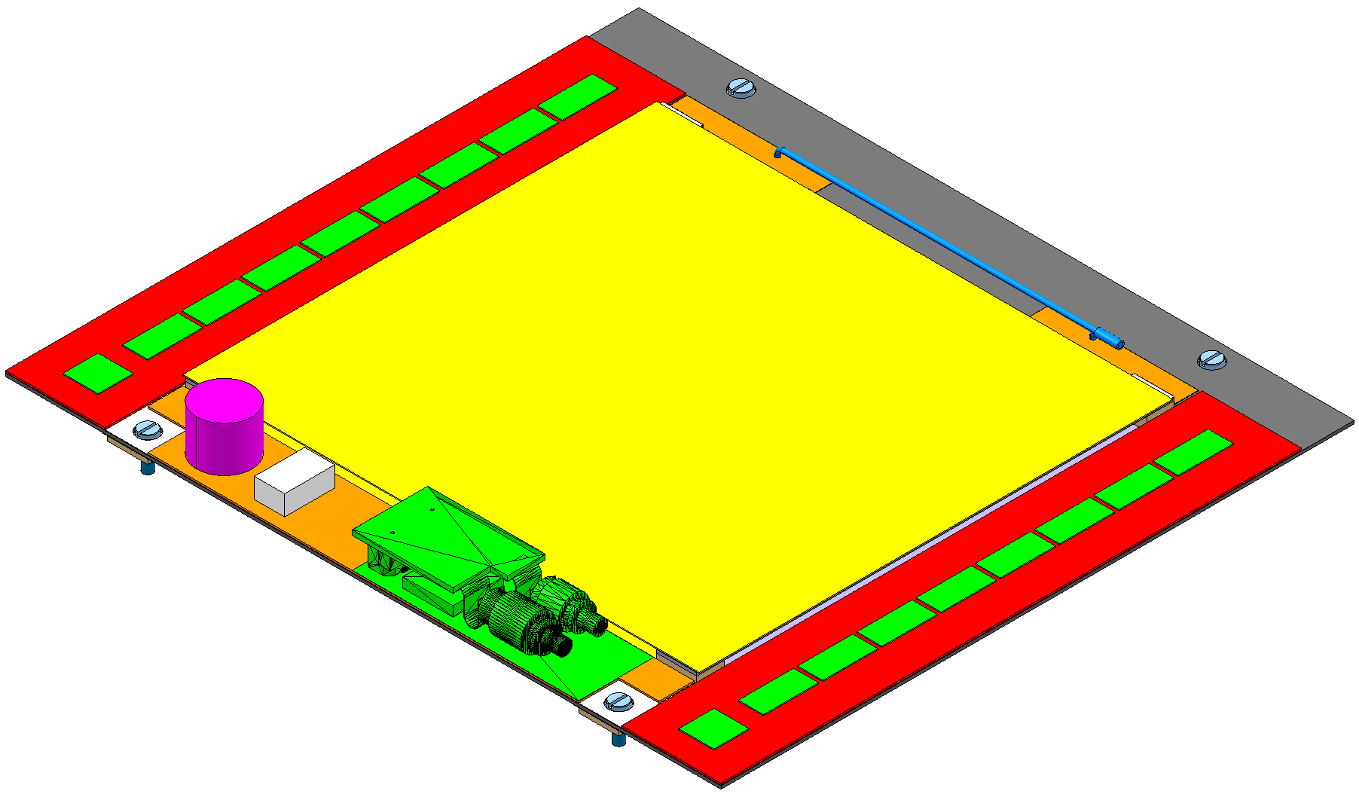
2S PT-module with CBC2
Track & trigger module under development with CERN, Lyon, ..
  CBC2 logic correlates hits on two sensors to reject those from low p_{T} tracks
    many issues to construct such a module
two layers of sensors
chips on top surface only
signals from lower sensor
via’d through substrate
8 x 254 channel chips
bump-bonded to hybrid
concentrator
&
controller
~5 cm
~5 cm
90 µm pitch strips
sensors wire-bonded
above and below
8 x 254 channel chips
bump-bonded to hybrid
32

Slide 33
WP3: calorimeter trigger
Brand new architecture proposed (but hardware is agnostic)
  possible because of technology progress (FPGAs & links)
  TMT = boundary-less calorimeter processing
Demonstrator using mini-T5 (Virtex-5 FPGA)
  emulates ¼ of present CMS calorimeter trigger
  TMT versions of present algorithms (much faster)
  HL-LHC algorithms already in firmware
  latency (potential concern) measured
MP7: final board delivered August 2012 (Virtex 7 FPGA)
  already producing impressive results in very early tests

Slide 34
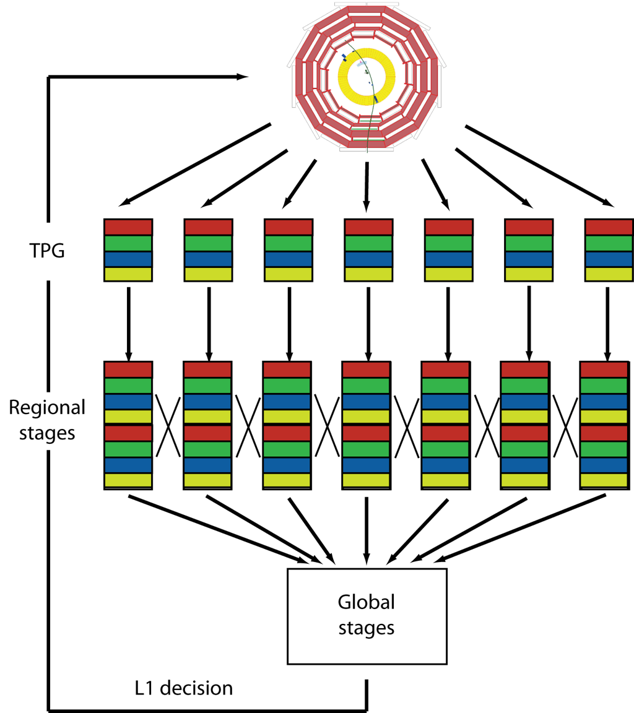
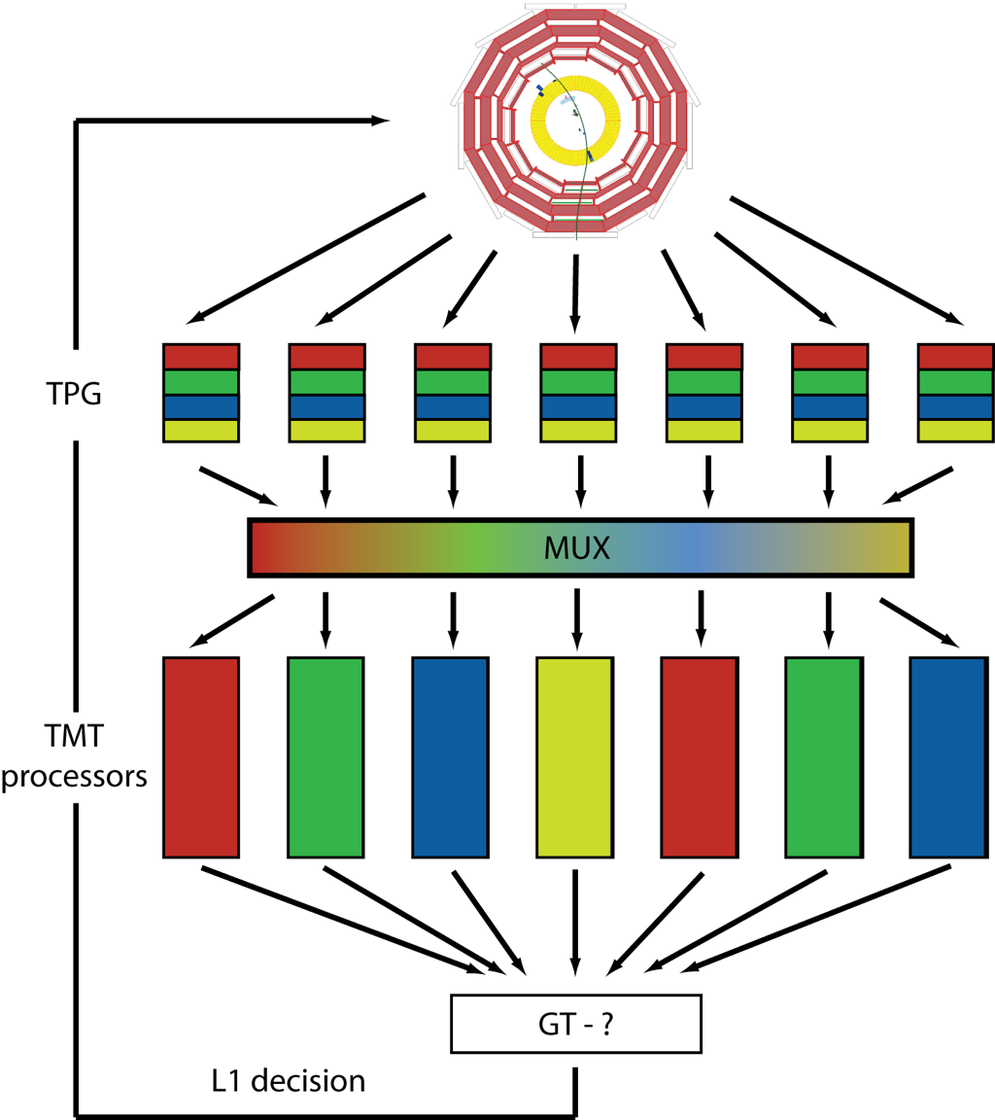
Trigger Architecture
Options: Conventional Trigger vs Time Multiplexed Trigger
  TMT: all calorimeter data to single processor
  Allows more flexibility in trigger design & avoids boundaries and data sharing
CT
TMT

Slide 35
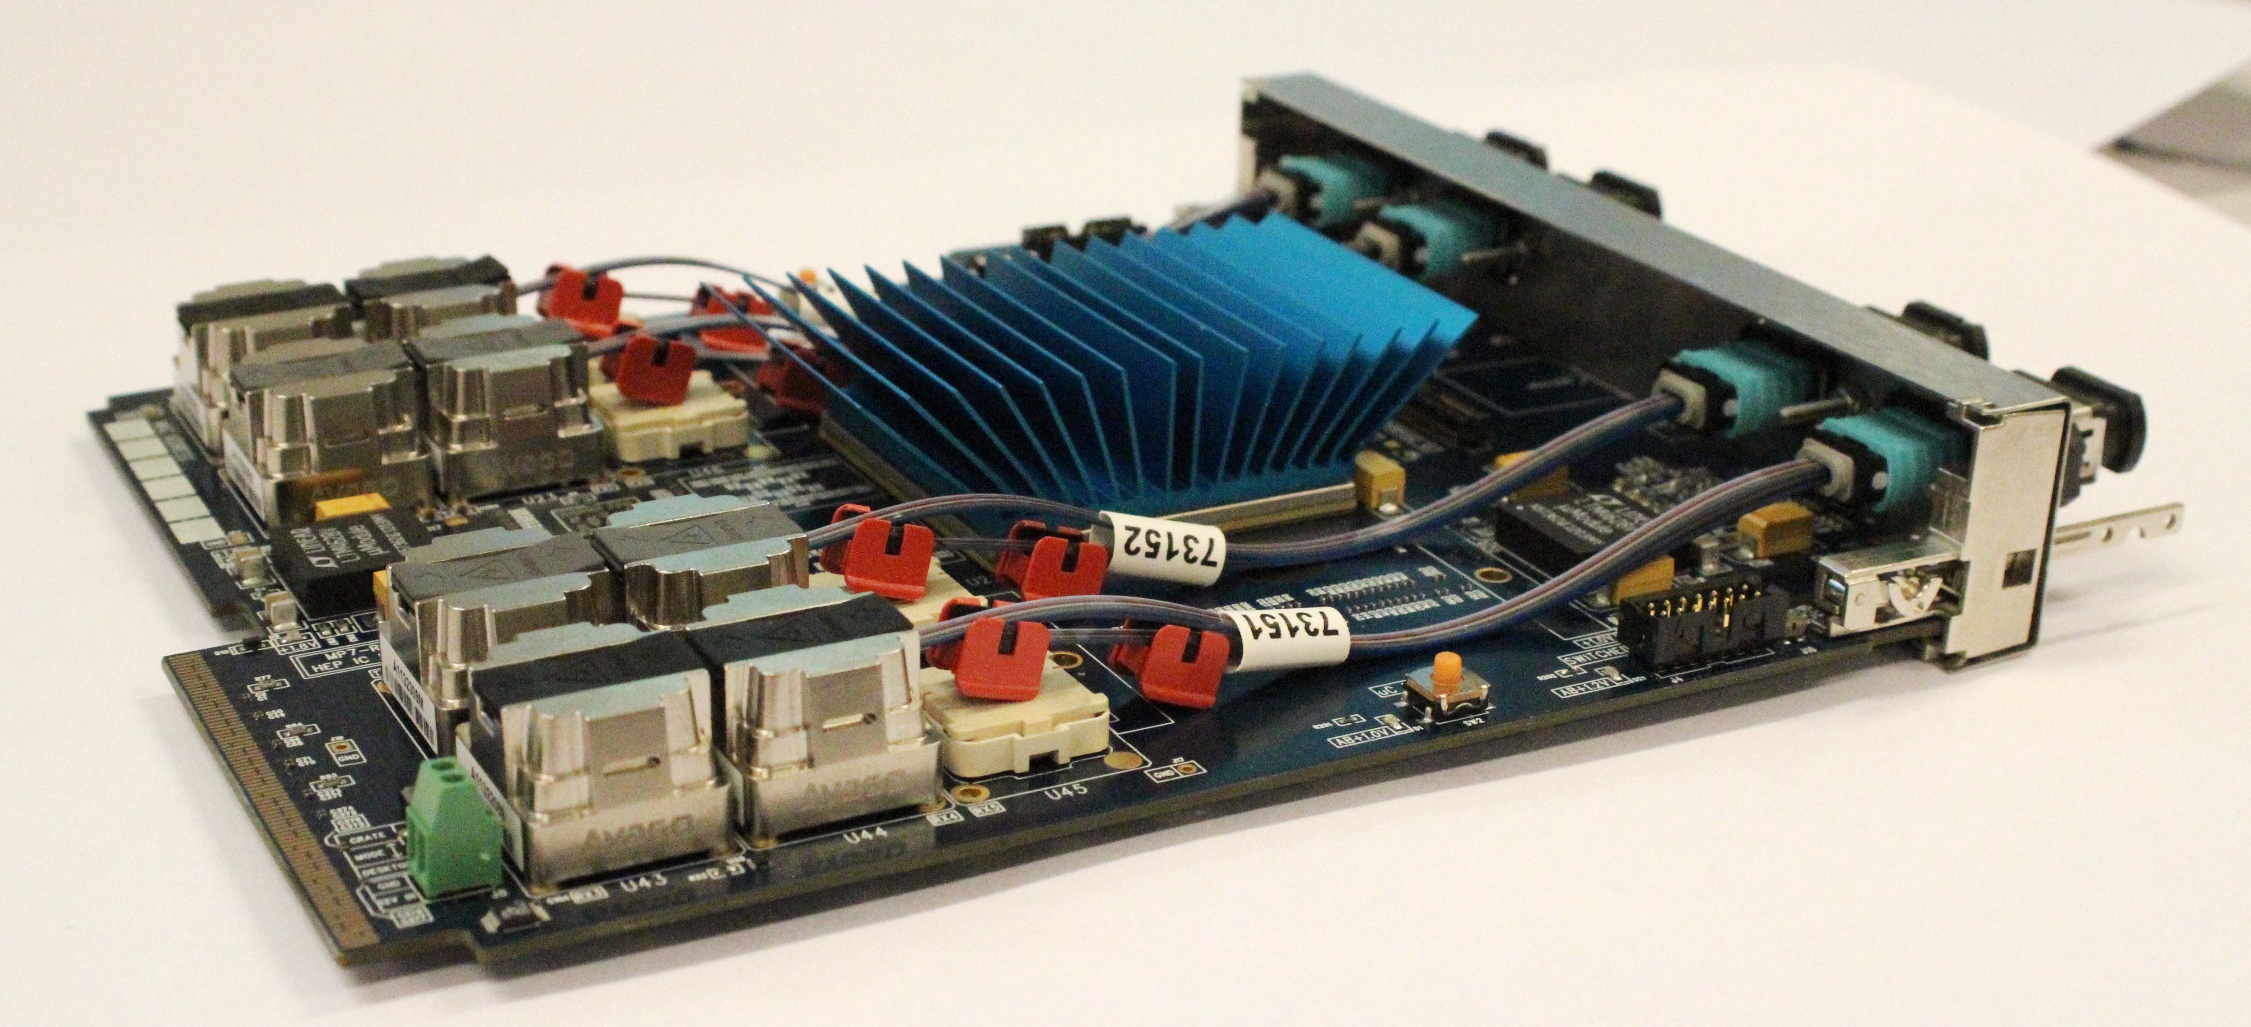
MP7 Prototype
Preliminary Results
1Tb/s - All 96 optical links operating at 10Gb/s simultaneously
  x4 bandwidth of any previous card in CMS
  1.0 - 1.4 Tb/s of optical I/O (Tracker FED ~ 25 Gbps)
All peripherals operating (RAM, CPLD, MMC, etc)
Cooling will be improved
  verify contributions to power consumption when diagnostics available

Slide 36
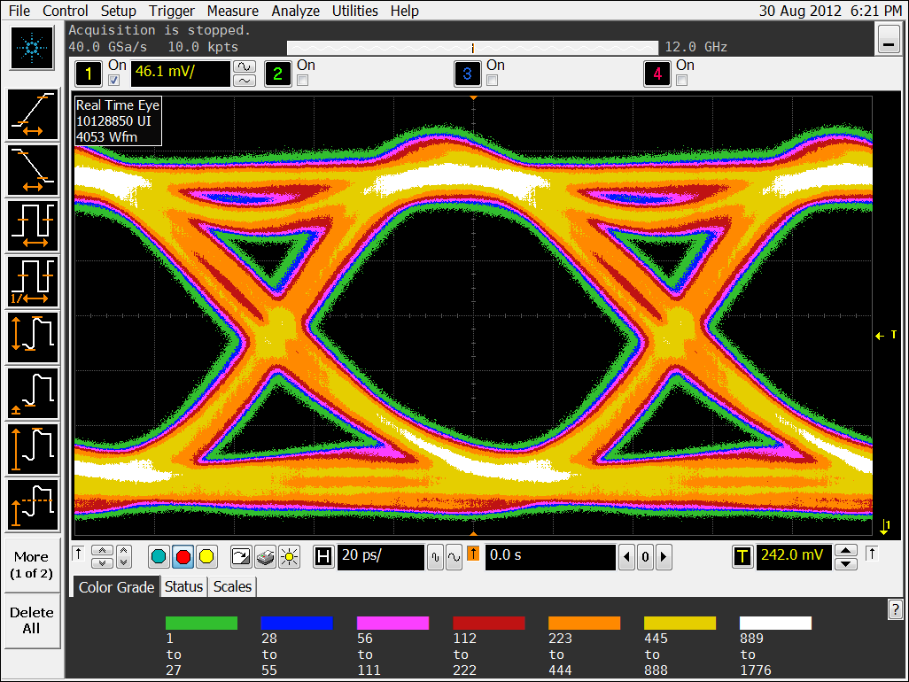
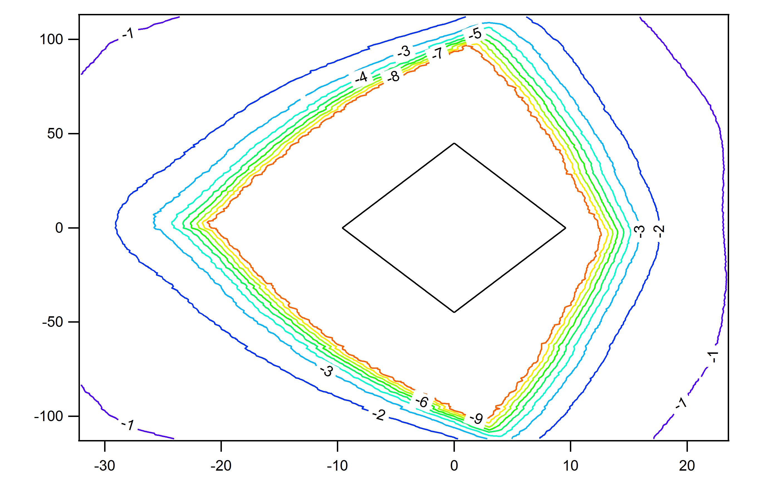
MP7 - Preliminary results
Clean optical eye (left) and electrical received eye (right).
  pre-emphasis in the optical receiver, should improve the eye even more.
PCB manufacturing improvements are possible should we need them.

Slide 37
Demonstrator
ECAL & HCAL Trigger Primitive Data would enter here
MINI-T5 (6x PreProcessors)
PP0
PP1
PP2
PP3
PP4
PP5
PP0
PP0
x 24 Pre-Processors
  1/4 CMS at 24 bit/tower resolution for every 6th BX
Patch Panel
MINI-T5
(Main Processor)
MINI-T5
(Main Processor)
x 2 Main-Processors
MINI-T5
(Global Trigger)
MCH
Standard Services
AMC13
Custom Services

Slide 38
WP4: pixel DAQ
Pixel detector will be replaced at end of 2016
  improved performance for high pile-up environment
UK proposed to build pixel FED & take DAQ responsibility
  builds on UK expertise in Tracker DAQ
  draws on R&D to date from all existing WPs, with sharing by all UK groups
  WP1: IPbus & simulations
  WP2: SFED development
  WP3: mini-T5/MP7 hardware & firmware
Very positive response from CMS
  UK is highly regarded, and we gain expertise in strategic area
  strengthens pixel project & matches long term µTCA adoption

Slide 39
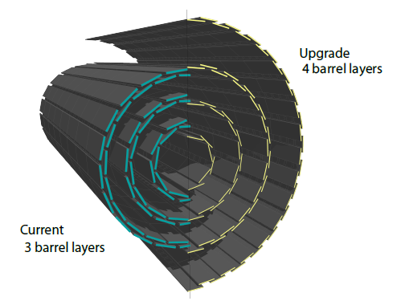
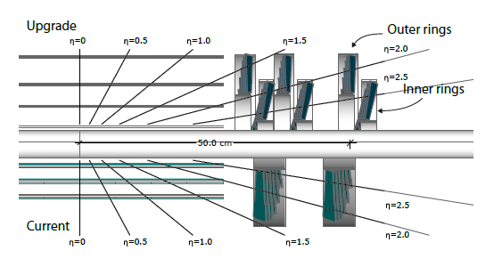
Phase I pixel upgrade
Replacement is a lower mass detector with 4 barrel layers and 3 endcap disks per side
  less material & better layout means less conversions & interactions
  better IP resolution and b-tagging efficiency
  improved seeding efficiency & lower fake rates from extra tracking layer
  4th layer provides better track projection to the strip tracker
  higher readout efficiency and less deadtime with new ROC and digital readout chain

Slide 40
Phase I pixel upgrade
Dots – Upgrade
Green – Current
100 PU
Radiation length vs. Eta
  substantially reduced detector mass, despite twice number of channels
    CO₂ cooling, improved mechanics, optimised layout of services
  b-jet efficiency improvement of 30%, for a 1% fake rate at 100 PU

Slide 41
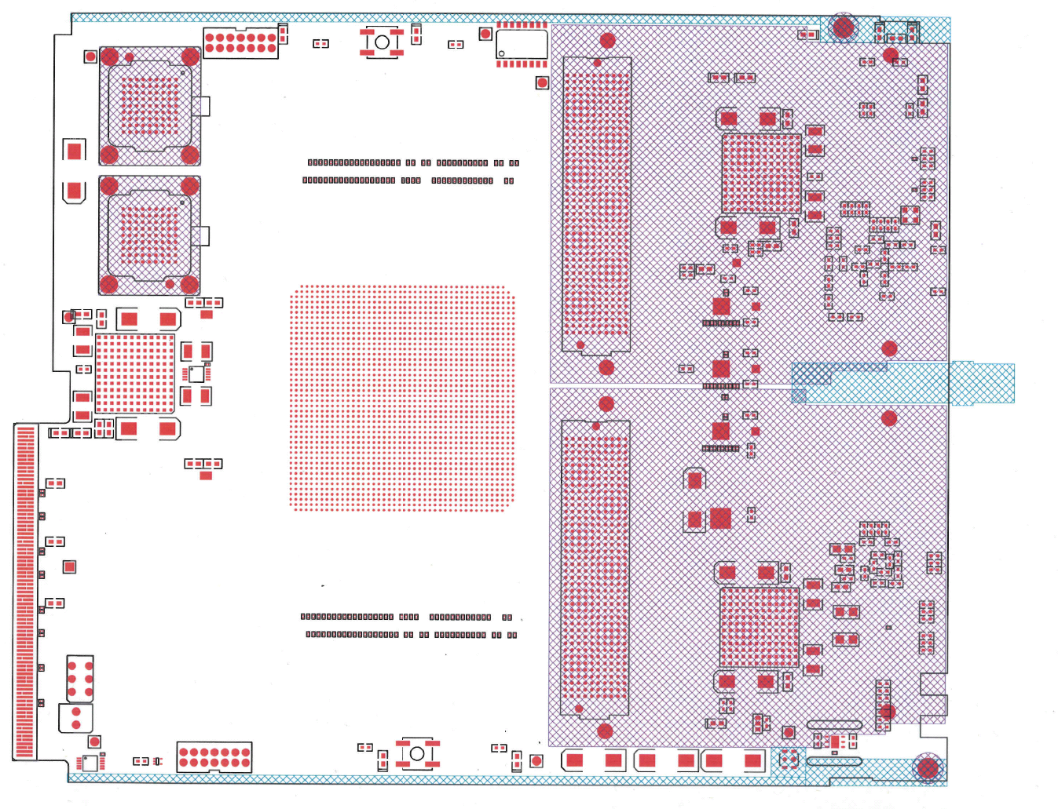
Phase I pixel FED
New DAQ required
  new digital optical links
  more channels so higher data throughput
FED prototype based on MP7
  mezzanine cards for prototyping and maximum flexibility
  reusing MP7 design mitigates risk and benefits from firmware & software investment
FMC1
FMC2

Slide 42
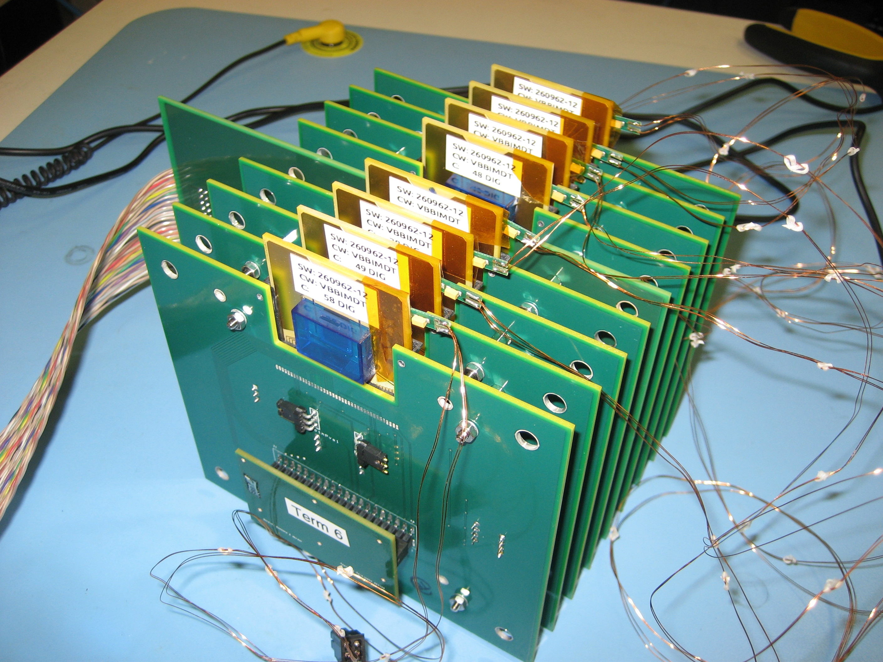
Pixel beam telescope
Modular system
  Variable number of ROCs
  Variable readout system
  Standard ROC carriers
  Easy to replace ROCs
Successfully used in beam test in July 2012

Slide 43
Programme of Work
Builds and continues R&D progress to date
  detailed plans based on (best knowledge of) CMS schedule
WP2: prepare for construction of Phase II tracker
WP3: construct new calorimeter trigger
WP4: deliver pixel FEDs and implement new DAQ

Slide 44
WP2 objectives: next ~ 6 years
complete CBC development for SS-pT module
  bring chip to final state ready for mass production
develop hardware & software for mass production test
  extensive experience from LHC production
major role in definition, construction and evaluation of prototype modules
  in collaboration with groups responsible for other module components
contribute to ancillary chips development and PS-pT (strixel layer) module
contribute to tracker construction
  procurements, integration and commissioning
Geoff Hall
CMS UK OSC Mar 2012
44

Slide 45
WP3 deliverables
No | Month | Deliverable
M3.1 | 9 | Updated algorithms and software for current L1 calo trigger
M3.2 | 15 | CMS L1 Calo trigger ready for post-LS1 running
M3.3 | 24 | Design studies for > 2x 10³⁴ cm⁻²s⁻¹ trigger ready; architectural choices made by CMS; sign-off point on > 2x 10³⁴ cm⁻²s⁻¹hardware production
M3.4 | 40 | Hardware systems ready for > 2x 10³⁴ cm⁻²s⁻¹ trigger
M3.5 | 48 | > 2x 10³⁴ cm⁻²s⁻¹ trigger in operation
M3.6 | 60 | Technical design of post-LS3 trigger complete; sign-off point on LS3 prototype production
M3.7 | 72 | Delivery of track trigger prototype
Geoff Hall
CMS UK OSC Mar 2012
45

Slide 46
WP4 deliverables
No | Month | Deliverable
M4.1 | 6 | prototype FMC-FED hardware available
M4.2 | 18 | standalone prototype FED, multi ROC readout
M4.3 | 18 | standalone prototype FEC, multi-module control
M4.4 | 24 | demonstrator FED & FEC with readout & control of pilot blades
M4.5 | 24 | demonstrator fast link integrated with central DAQ hardware
M4.6 | 33 | final FED hardware ready for production
M4.7 | 39 | final firmware & software for full system ready for deployment
M4.8 | 45 | delivery of full Pixel DAQ
Geoff Hall
CMS UK OSC Mar 2012
46

Slide 47
Long term: HL-LHC challenges
Trigger must evolve from present CMS detector
  but little scope for additional raw data, except from Tracker
  very hard to increase 100kHz L1 rate, so more selectivity needed
  hence studies and developments UK has taken a lead in
  advanced tracker modules + additional digital processing power & links
Tracker faces many challenges
  demonstration of fully functioning tracking + trigger modules
  power consumption and material budget impact
    higher granularity, more channels, more FE chips (electronics related material dominates existing material budget)
  power delivery
    constrained by existing cabling
    bring in at higher voltage – CMS will use DC-DC conversion in tracker volume
Present R&D is not too soon!
Geoff Hall
CMS UK OSC Mar 2012
47

Slide 48
Request
101.2 SY new, project-funded effort
  incl. project students
  incl. 3.7 FTE management and admin support effort
61.0 SY of CG-funded & RAL PPD effort
Equipment and consumables: £2.887M
Travel: £390k
Total cost:
  £11.486M: new funding
  £5.199M: existing via grants and RAL PPD
Grand total: £16.685M

Slide 49
Summary
CMS must upgrade to maintain physics performance in challenging pileup conditions
UK proposes to build on very successful R&D efforts to contribute to crucial areas
  upgraded pixel detector
  new calorimeter trigger
  R&D for track-trigger modules for new tracker in 2022
CMS objective is to share Phase I upgrade cost between agencies in proportion to PhD authors
  and probably in future
The UK investment in R&D was very timely and has placed us in a strong position, for which we are very grateful.

Slide 50
Further information

Slide 52
Pre LS1 date change

Slide 53
Potential Performance after LS1
Determined by the performance of the injector chain
Different collimator scenarios, not detailed here
LHC Injector Upgrade (LIU) fruits after LS2
 | Number of bunches | β* [m] | Half X-angle [μrad] | Ib SPS | Emit SPS [um] | Peak Lumi [cm-²s⁻¹] | ~Pile-up | Int. Lumi [fb⁻¹]
25 ns | 2800 | 0.50 | 190 | 1.2e11 | 2.8 | 1.1e34 | 23 | ~30
50 ns | 1380 | 0.40 | 140 | 1.7e11 | 2.1 | 1.8e34 β* level | 81 β* level | ?
25 ns low emit | 2600 | 0.40 | 150 | 1.15e11 | 1.4 | 2.0e34 | 48 | 52
50 ns low emit | 1200 | 0.40 | 120 | 1.71e11 | 1.5 | 2.2e34 | 113 | ?
Presently at 4 TeV, β* = 0.6 m, half X-angle 145 μrad

Slide 54
IPbus Readout (spec from Dave Newbold)
Off Chip Memory
DDR2/3 QDRII
Data is “pulled” by PC
FPGA
Memory Controller
Handshake
Status
Registers
GbE link
Data
Controls
Memory Interface
Detector Data
Processing
FIFO
Input
“Event Buffer Manager”
State Machine
R/O Buffer(s)
IPbus
R/O Buffer(s)
Data N bits
Clk
Strobe
Tag
S/W
Python
C++
TAG
Buffer
Event MetaData
RAL TD f/w
FE controls

Slide 55
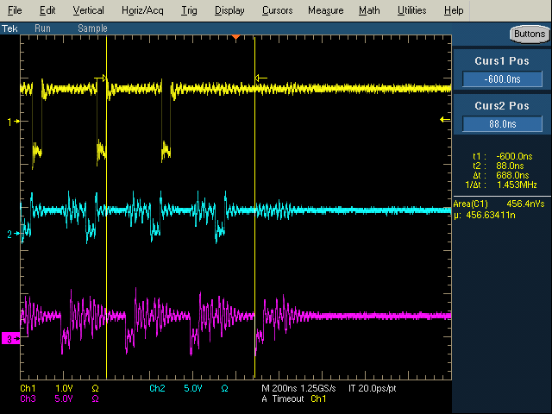
Latency – Time-Multiplexed CMS GCT
PP algo
PP GTX
MP GTX
MP Align
MP Algo
MP GTX
GT GTX
GT Align
Total latency is:
1 Link latency (PP to MP) | 6.5 BX | 161.6ns
1 Algorithm latency | 3.7 BX | 92.8ns
1 Link latency (MP to GT )† | 7.5 BX | 182.4ns
1 Time-Mux period | 10 BX | 250 ns
Total | 27.7 BX | 686.8 ns
PP output valid flag
MP output valid flag
Look at that – the maths works, phew! ☺
GT input valid flag
†Making allowances here for the firmware bug

Slide 56
Latency – Time-Multiplexed CMS GCT
Original GCT timing specification
BX 0 |  |  |  |  |  |  |  |  |  | BX 10 |  |  |  |  |  |  |  |  |  | BX 20 |  |  |  |  |  |  |  |  |  | BX 30
Source card |  | Source to Leaf card link |  |  |  | Leaf card deserialization |  |  |  | Jet Finder Algorithm |  |  |  |  |  |  |  |  |  |  | Wheel card |  |  | Concentrator card |  |  |  | Concentrator to GT link |  |  | GT deserialization
TMT GCT timing using Mini-Ts
BX 0 |  |  |  |  |  |  |  |  |  | BX 10 |  |  |  |  |  |  |  |  |  | BX 20 |  |  |  |  |  |  |  |  |  | BX 30
 |  | PP to MP link, deserialization and alignment |  |  |  |  |  | Jet Finding (1-3) |  |  |  | Sort 1D |  | MP to GT link, deserialization and alignment
 |  |  | PP to MP link, deserialization and alignment |  |  |  |  |  | Jet Finding (4-6) |  |  |  | Sort 1D |  | MP to GT link, deserialization and alignment
 |  |  |  | PP to MP link, deserialization and alignment |  |  |  |  |  | Jet Finding (7-9) |  |  |  | Sort 1D |  | MP to GT link, deserialization and alignment |  |  |  |  |  | Sort in other direction (if necessary)
 |  | Time Muliplexing |  |  | PP to MP link, deserialization and alignment |  |  |  |  |  | Jet Finding (10-12) |  |  |  | Sort 1D |  | MP to GT link, deserialization and alignment
 |  |  |  |  |  | PP to MP link, deserialization and alignment |  |  |  |  |  | Jet Finding (13-15) |  |  |  | Sort 1D |  | MP to GT link, deserialization and alignment
 |  |  |  |  |  |  | PP to MP link, deserialization and alignment |  |  |  |  |  | Jet Finding (16-18) |  |  |  | Sort 1D |  | MP to GT link, deserialization and alignment
Data flow through one Main Processor
Using the 6 data frames needed instead of the 10 used in the demonstrator system
Fixing the GT deserialization bug
Adding the 1D sort
TMT latency, 23 BX

Slide 57
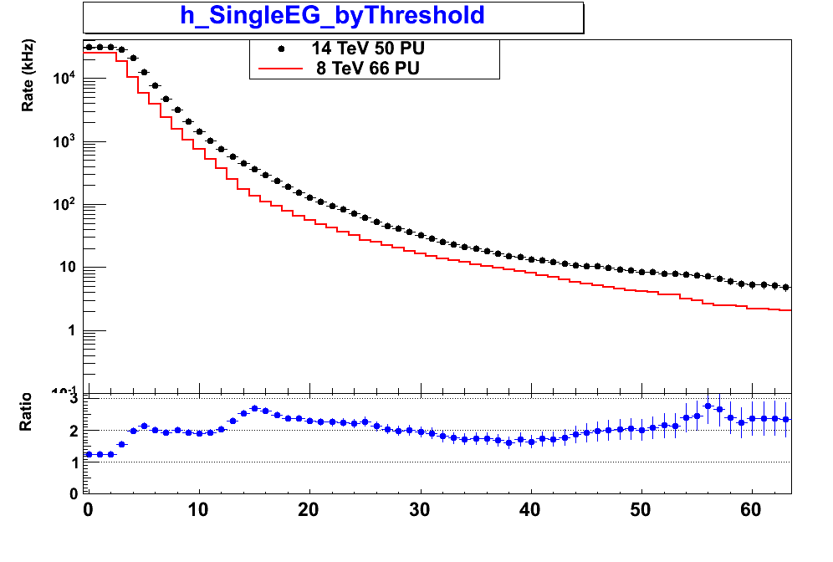
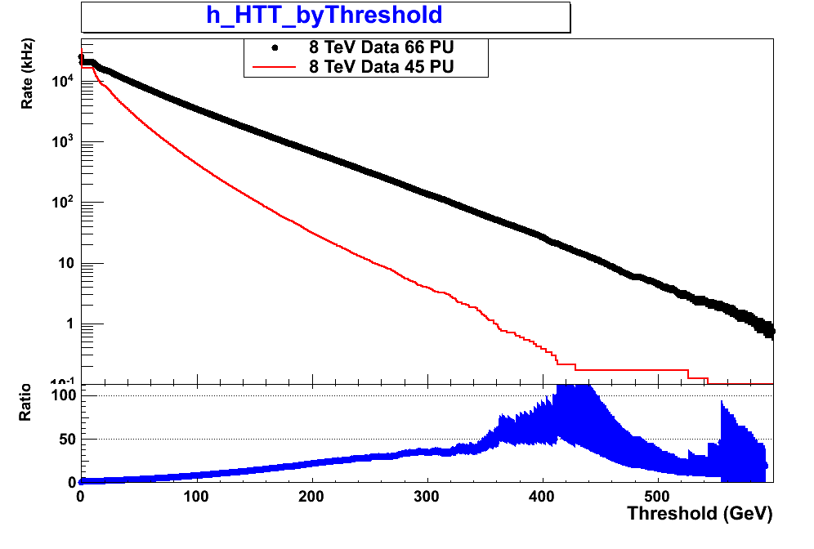
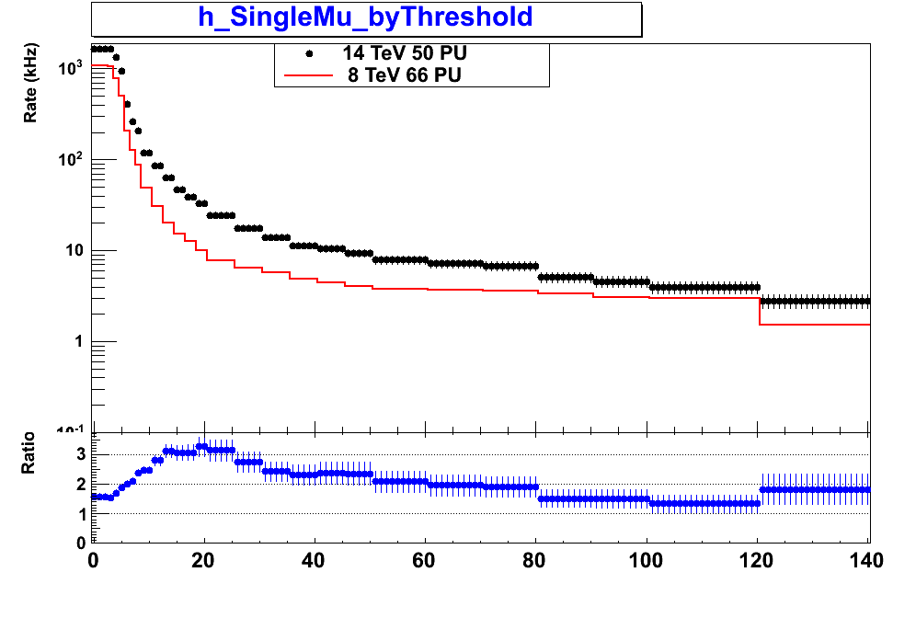
Sample trigger rates from current L1 trigger
Rates shown for Linst=2×10³⁴cm⁻²s⁻¹
Single e/γ trigger
      Black - 14 TeV MC (50 PU)
        Red - 8 TeV data (66 PU)
HT (ET sum of jets)
Black - 8 TeV data (66 PU)
        Red - 8 TeV data (45 PU)
Single muon trigger
Black - 14 TeV MC (50 PU)
        Red - 8 TeV data (66 PU)
Jet trigger rates strongly dependent on PU
Poor control of lepton rates at high thresholds due to poor pT resolution

Slide 58
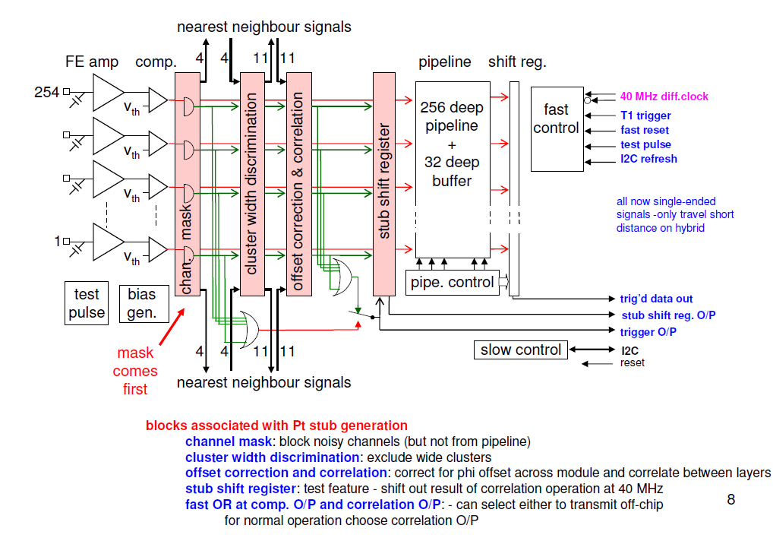
CBC Architecture
Notes:
Could use fastOR and an external Read for readout of coincidence data:
Always @(fastOR posedge)
if (Read==0) write data;
else;
Always @(read posedge) readout data;
Always @(read negedge) reset data;

Slide 59
simplified WP2 Gannt
CBC2
available
here
2013
2014
2015
2016
2017
CBC3 design & production
CBC4 design & production
CBC4 full wafer masks and engineering run
CBC2 test
CBC3 test
CBC4 test
CBC2-based module studies
CBC3-based module studies
CBC3 should be very close to final chip - available late 2014
  includes architecture for formation and high speed transmission of stub information
CBC4 pre-production iteration (2015/16) allows final bug fixes before full-wafer engineering run in 2017
Geoff Hall
CMS UK OSC Mar 2012
59

Slide 60
New ROC and readout chain
New ROC and readout scheme required for efficient operation up to 100 PU
  estimated ~50% data loss at 100 PU (50 ns bunch spacing, 2x10³⁴ cm⁻²s⁻¹ at r = 3.9cm)
  requirement is for < 3% data loss at new 2.9cm reduced radius
160 Mbps digital readout at ROC
data on a module multiplexed and encoded onto twisted fibre with new TBM
token in
160 Mbps data
TBM
OH
optical link to FED
ROC
400 Mbps 4b/5b encoded data
token out
new optical hybrids for high speed digital transmission at 400 Mbps
- increased buffer sizes and improved hit buffering architecture in ROC
- 8 bit ADC to digitise pulse height information within ROC
module
service cylinder

Slide 61
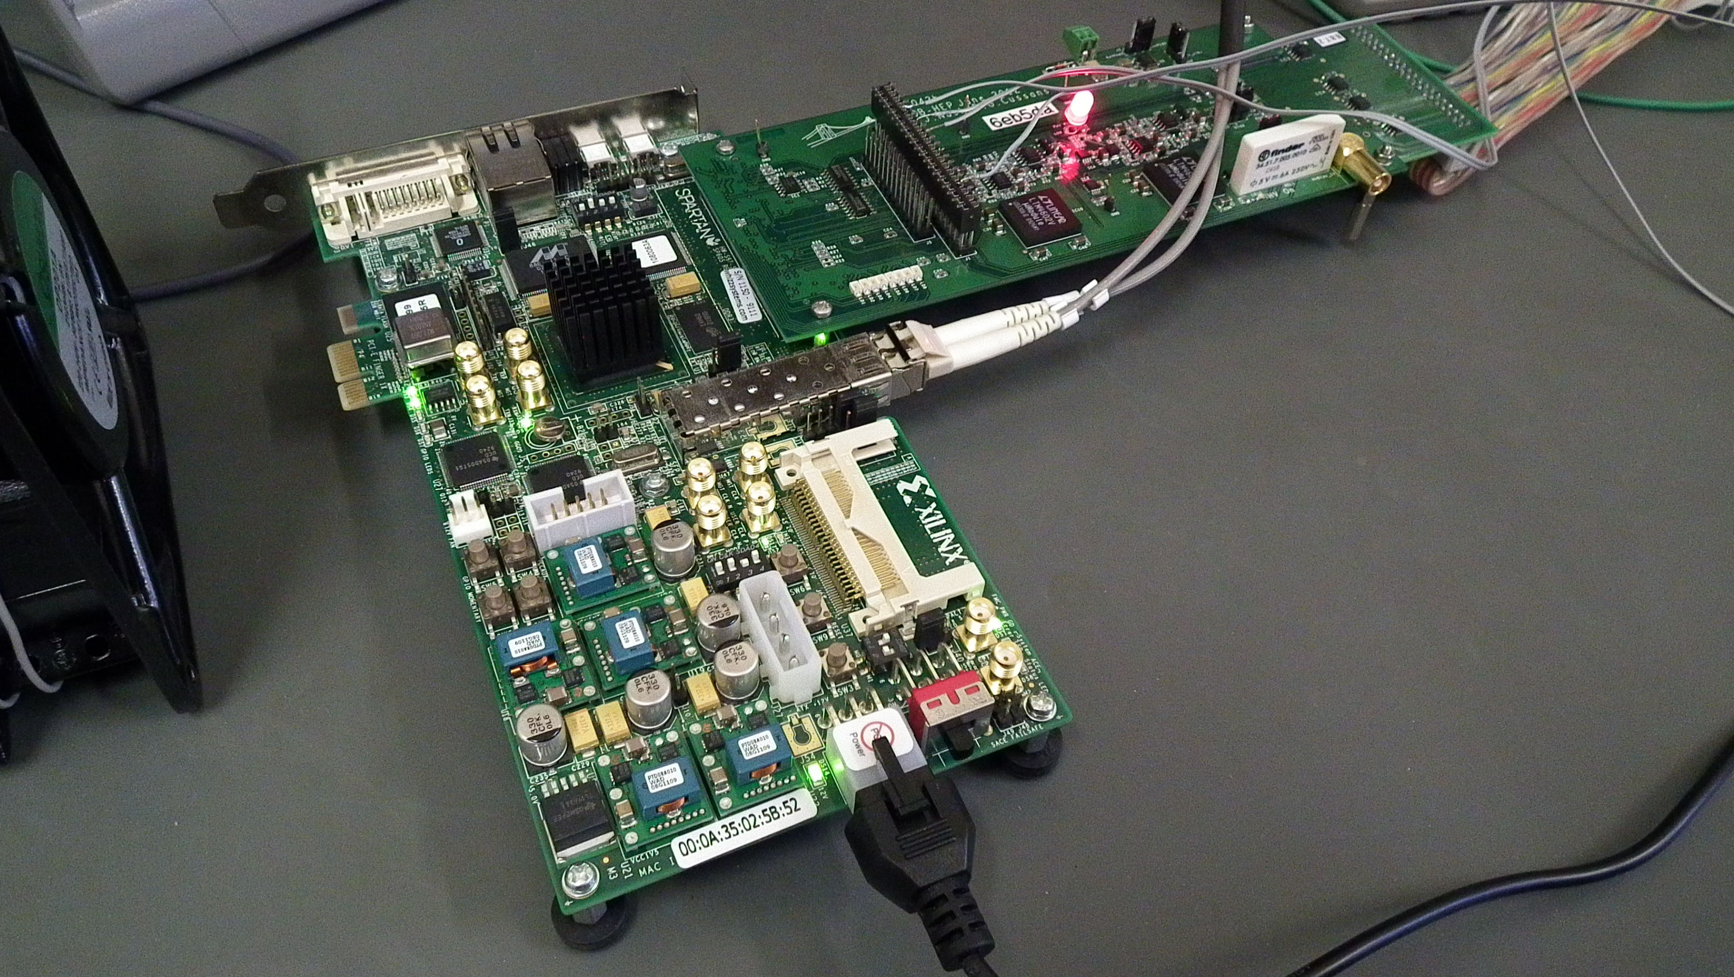
Pixel DAQ board
First FED firmware test bed
  Xilinx evaluation board with custom adapter
First application
  high rate test beam in October

